Slide 1
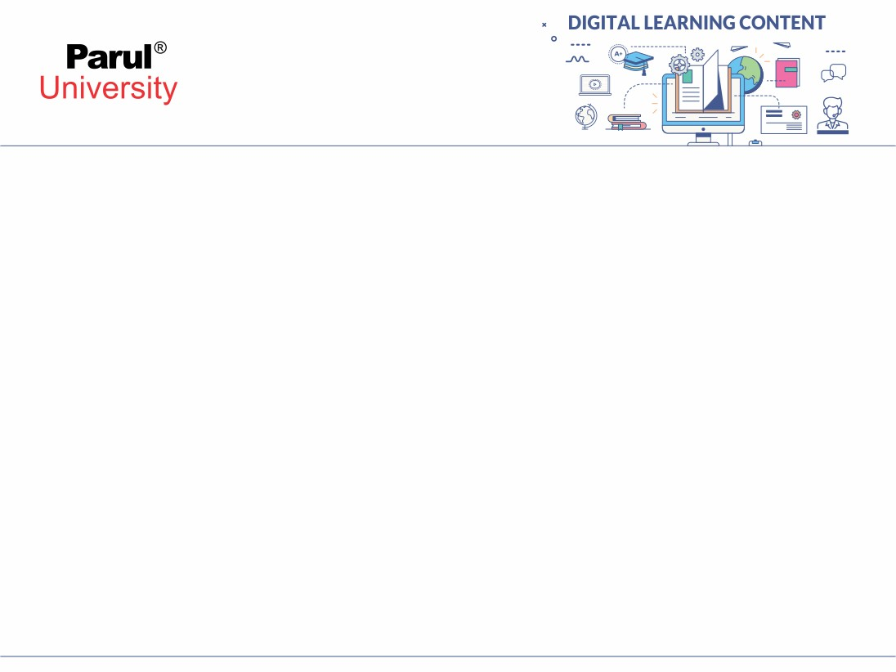

CHAPTER-5
Functions & Recursion

Slide 2

Contents
Functions
Recursion

Slide 3
1. Function :
A function in C is a set of statements that when called perform some specific task.
It is the basic building block of a C program that provides modularity and code reusability. The programming statements of a function are enclosed within { } braces, having certain meanings and performing certain operations.
They are also called subroutines or procedures in other languages.

Slide 4
Syntax of Functions in C
The syntax of function can be divided into 3 aspects:
Function Declaration
Function Definition
Function Calls

Slide 5
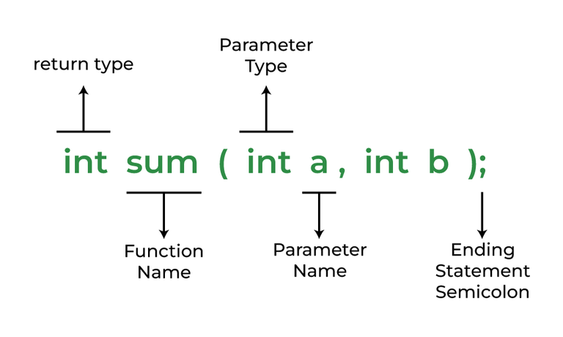
Function Declarations
The parameter name is not mandatory while declaring functions. We can also declare the function without using the name of the data variables.
In a function declaration, we must provide the function name, its return type, and the number and type of its parameters.
A function declaration tells the compiler that there is a function with the given name defined somewhere else in the program.
Syntax:
return_type name_of_the_function (parameter_1, parameter_2);

Slide 6
Function Definition
The function definition consists of actual statements which are executed when the function is called (i.e. when the program control comes to the function).
return_type function_name (para1_type para1_name, para2_type para2_name)
{
// body of the function
}
A C function is generally defined and declared in a single step because the function definition always starts with the function declaration so we do not need to declare it explicitly. The below example serves as both a function definition and a declaration.

Slide 7
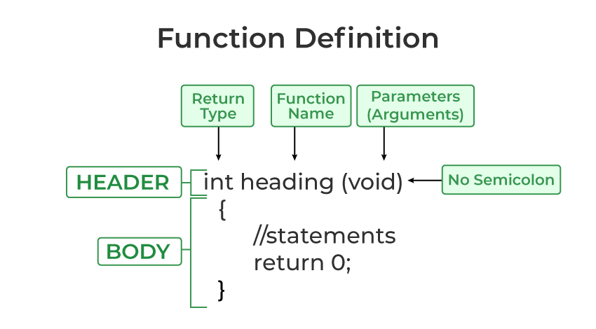
Structure :

Slide 8
Function Call:
A function call is a statement that instructs the compiler to execute the function. We use the function name and parameters in the function call.
In the below example, the first sum function is called and 10,30 are passed to the sum function. After the function call sum of a and b is returned and control is also returned back to the main function of the program.

Slide 9
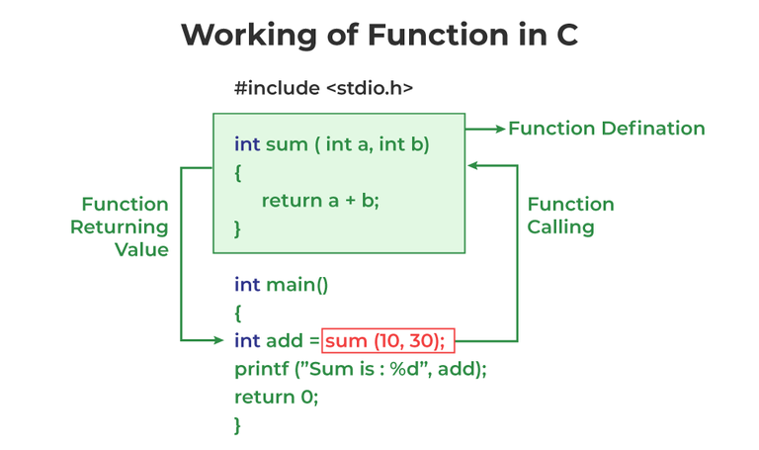
Working concept :
Note: Function call is neccessary to bring the program control to the function definition. If not called, the function statements will not be executed.

Slide 10
Example:
:
// C program to show function
// call and definition
#include <stdio.h>
// Function that takes two parameters
// a and b as inputs and returns
// their sum
int sum(int a, int b)
{
return a + b;
}
// Driver code
int main()
{
// Calling sum function and
// storing its value in add variable
int add = sum(10, 30);
printf("Sum is: %d", add);
return 0;
}

Slide 11
Output
Sum is: 40
As we noticed, we have not used explicit function declaration. We simply defined and called the function.

Slide 12
Function Return Type
Function return type tells what type of value is returned after all function is executed. When we don’t want to return a value, we can use the void data type.
Example:
int func(parameter_1,parameter_2);
The above function will return an integer value after running statements inside the function.
Note: Only one value can be returned from a C function. To return multiple values, we have to use pointers or structures.

Slide 13
Function Arguments:
Function Arguments (also known as Function Parameters) are the data that is passed to a function.
Example:
int function_name(int var1, int var2);
Conditions of Return Types and Arguments
In C programming language, functions can be called either with or without arguments and might return values.
They may or might not return values to the calling functions.
Function with no arguments and no return value
Function with no arguments and with return value
Function with argument and with no return value
Function with arguments and with return value

Slide 14
How Does C Function Work?
Working of the C function can be broken into the following steps as mentioned below:
Declaring a function: Declaring a function is a step where we declare a function. Here we define the return types and parameters of the function.
Defining a function:
Calling the function: Calling the function is a step where we call the function by passing the arguments in the function.
Executing the function: Executing the function is a step where we can run all the statements inside the function to get the final result.
Returning a value: Returning a value is the step where the calculated value after the execution of the function is returned. Exiting the function is the final step where all the allocated memory to the variables, functions, etc is destroyed before giving full control to the main function.

Slide 15
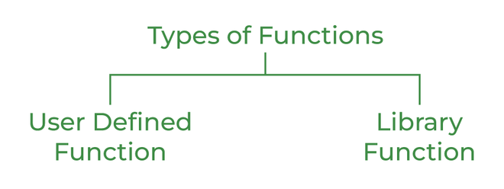
Types of Functions
There are two types of functions in C:
Library Functions
User Defined Functions

Slide 16
1. Library Function
Flowchart of For Loop
A library function is also referred to as a “built-in function”. A compiler package already exists that contains these functions, each of which has a specific meaning and is included in the package. Built-in functions have the advantage of being directly usable without being defined, whereas user-defined functions must be declared and defined before being used.
For Example:
pow(), sqrt(), strcmp(), strcpy() etc.

Slide 17
Example: for loop
Advantages of C library functions
C Library functions are easy to use and optimized for better performance.
C library functions save a lot of time i.e, function development time.
C library functions are convenient as they always work.

Slide 18
Library Function
// C program to implement
// the above approach
#include <math.h>
#include <stdio.h>
// Driver code
int main()
{
double Number;
Number = 49;
// Computing the square root with
// the help of predefined C
// library function
double squareRoot = sqrt(Number);
printf("The Square root of %.2lf = %.2lf",
Number, squareRoot);
return 0;
}
Output
The Square root of 49.00 = 7.00

Slide 19
2. User Defined Function
Functions that the programmer creates are known as User-Defined functions or “tailor-made functions”. User-defined functions can be improved and modified according to the need of the programmer.
Whenever we write a function that is case-specific and is not defined in any header file, we need to declare and define our own functions according to the syntax.
Advantages of User-Defined Functions
Changeable functions can be modified as per need.
The Code of these functions is reusable in other programs.
These functions are easy to understand, debug and maintain.

Slide 20
User Defined Function Example:
// C program to show
// user-defined functions
#include <stdio.h>
int sum(int a, int b)
{
return a + b;
}
// Driver code
int main()
{
int a = 30, b = 40;
// function call
int res = sum(a, b);
printf("Sum is: %d", res);
return 0;
}
Output
Sum is: 70

Slide 21
Passing Parameters to Functions
The data passed when the function is being invoked is known as the Actual parameters.
In the below program, 10 and 30 are known as actual parameters.
Formal Parameters are the variable and the data type as mentioned in the function declaration.
In the below program, a and b are known as formal parameters.

Slide 22
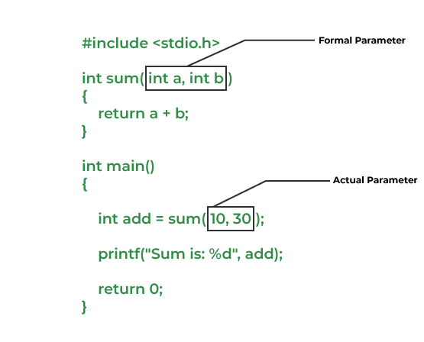
Example:

Slide 23
Advantages of Functions in C
Functions in C is a highly useful feature of C with many advantages as mentioned below:
The function can reduce the repetition of the same statements in the program.
The function makes code readable by providing modularity to our program.
There is no fixed number of calling functions it can be called as many times as you want.
The function reduces the size of the program.
Once the function is declared you can just use it without thinking about the internal working of the function.

Slide 24
Disadvantages of Functions in C
The following are the major disadvantages of functions in C:
Cannot return multiple values.
Memory and time overhead due to stack frame allocation and transfer of program control.

Slide 25
Types of User Defined Functions in C
The following are the major types of User Defined Functions in C:
Function with No Arguments & No Return Type
Function with No Arguments & But Return Type
Function with Arguments & No Return Type
Function with Arguments & Return Type
EXPLAIN ALL OF THEM WITH PROPER EXAMPLE

Slide 26
Recursion:
Recursion is the process of repeating items in a self-similar way. In programming languages, if a program allows you to call a function inside the same function, then it is called a recursive call of the function.
void recursion() {
recursion(); /* function calls itself */
}
int main() {
recursion();
}

Slide 27
The C programming language supports recursion, i.e., a function to call itself. But while using recursion, programmers need to be careful to define an exit condition from the function, otherwise it will go into an infinite loop.
Recursive functions are very useful to solve many mathematical problems, such as calculating the factorial of a number, generating Fibonacci series, etc.
Number Factorial
The following example calculates the factorial of a given number using a recursive function

Slide 28
#include <stdio.h>
unsigned long long int factorial(unsigned int i) {
if(i <= 1) {
return 1;
}
return i * factorial(i - 1);
}
int main() {
int i = 12;
printf("Factorial of %d is %d\n", i, factorial(i));
return 0;
}

Slide 29
Write a program to swap value of two variables using pointer / call by reference
int main()
{
  int num1,num2;
  printf("Enter value of num1 and num2: ");
  scanf("%d %d",&num1, &num2);
//displaying numbers before swapping
  printf("Before Swapping: num1 is: %d, num2 is: %d\n",num1,num2);
//calling the user defined function swap()
  swap(&num1,&num2);
//displaying numbers after swapping
  printf("After Swapping: num1 is: %d, num2 is: %d\n",num1,num2);
return 0; } Enter value of num1 and num2: 5 10
Before Swapping: num1 is: 5, num2 is: 10
After Swapping: num1 is: 10, num2 is: 5
}

