Slide 1
UNIT 2 :HTML Elements & Forms
Weighatage:26M

Slide 2
Course Outcome
Design web forms with different input fields.

Slide 3
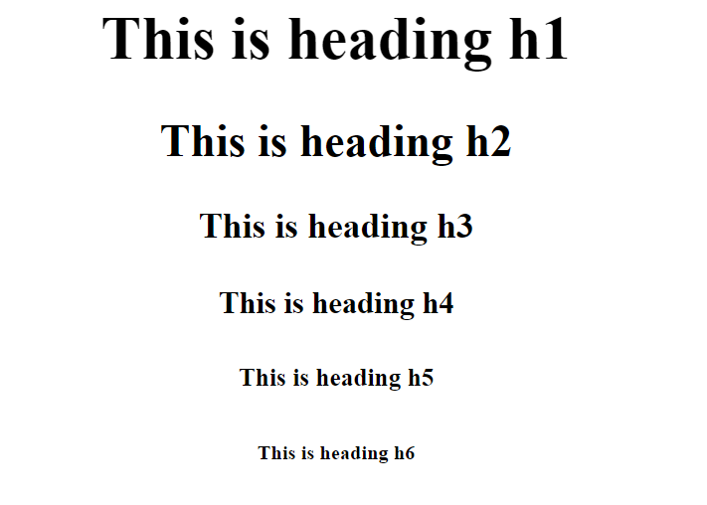
Heading tag
HTML offers six levels of heading tags, each serving a different purpose in structuring your content

Slide 4
<!DOCTYPE html>
<html lang="en">
<head>
<title>HTML</title>
</head>
<body>
<h1>This is a Heading h1</h1>
<h2>This is a Heading h2</h2>
<h3>This is a Heading h3</h3>
<h4>This is a Heading h4</h4>
<h5>This is a Heading h5</h5>
<h6>This is a Heading h6</h6>
</body>
</html>

Slide 5
Paragraphs tag
The HTML <p> element defines a paragraph.
A paragraph always starts on a new line, and browsers automatically add some white space (a margin) before and after a paragraph.
Example:
<p>This is a paragraph.</p>
<p>This is another paragraph.</p>

Slide 6
Unordered, Ordered, and Description Lists in HTML
Lists are used to store data or information in web pages.
Syntax:
<li> content </li>

Slide 7
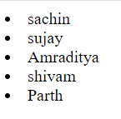
Example:
OUTPUT:
<html >
<head>
<title>inline style attribute</title>
</head>
<body>
<li>sachin</li>
<li>sujay</li>
<li>Amraditya</li>
<li>shivam</li>
<li>Parth</li>
</body>
</html>

Slide 8
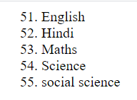
<html >
<head>
<title>inline style attribute</title>
</head>
<body>
<ol>
<li value="51">English</li>
<li>Hindi</li>
<li>Maths</li>
<li>Science</li>
<li>social science</li>
</ol>
</body>
</html>

Slide 9
Ordered list
An ordered list defines a list of items in which the order of the items are matters
Different ways to number the ordered lists using the type attribute:
type="1"- The list items will be numbered with numbers (default)
type="A"- The list items will be numbered with uppercase letters
type="a"- The list items will be numbered with lowercase letters
type="I"- List items will be numbered with uppercase Roman numbers
type="i"- The list items will be numbered with lowercase Roman numbers

Slide 10
Syntax:
<ol> content </ol>
Attributes of an ordered list:
1. reversed: This attribute is used to specify that the order of the list should be reversed.
Syntax:
<ol reversed>

Slide 11
2. start: This attribute is used to specify the start value of the list.
Syntax:
<ol start = "number">

Slide 12
3. type: This attribute is used to specify the type of list item maker. The value of this attribute is decimal(Default)/lower-roman/upper roman/lower-alpha/upper alpha
Syntax:
<ol type = "1|b|A|i|I">

Slide 13
<html>
<head>
<title>ordered list</title>
</head>
<body>
<h1>Example of ordered list whose type = "A"</h1>
<ol type="A">
<li>Sachin</li>
<li>Manoj</li>
</ol>
<h1>Example of reverse ordered list</h1>
<ol reversed>
<li>Parth</li>
<li>sujay</li>
</ol>
<h1>Example of ordered list start from 10</h1>
<ol start = "10">
<li>Pushpa</li>
<li>Purvi</li>
</ol>
</body>
</html>

Slide 14
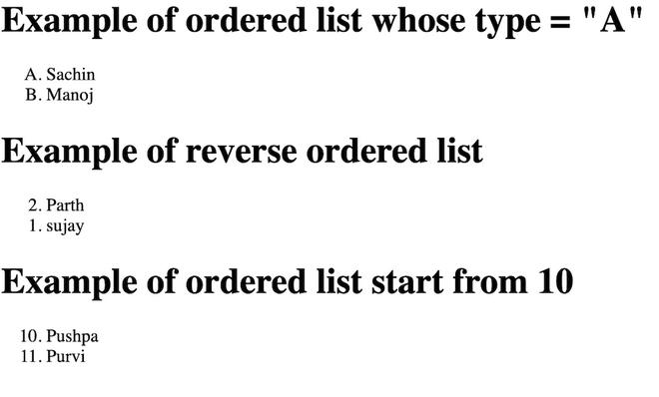
OUTPUT:

Slide 15
Description list
Description list is a list in which each term contains its description. This tag contains <dt> and <dd> tag.
<dt></dt>: This tag is used to define the name or term
<dd><dd>: this tag is used to describe the term.
Syntax:
<dl> content </dl>

Slide 16
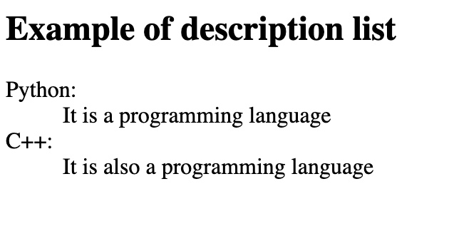
<html>
<head>
<title>Description list</title>
</head>
<body>
<h2>Example of description list</h2>
<dl>
<dt>Python:</dt>
<dd>It is a programming language</dd>
<dt>C++:</dt>
<dd>It is also a programming language</dd>
</dl>
</body>
</html>

Slide 17
Basic HTML Table Structure
An HTML table is created using the <table> tag. Inside the table, we use:
<tr>: Table Row
<th>: Table Header
<td>: Table Data

Slide 18
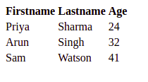
<!-- index.html -->
<!DOCTYPE html>
<html lang="en">
<head>
<meta charset="UTF-8">
<meta name="viewport"
content="width=device-width, initial-scale=1.0">
<title>HTML</title>
</head>
<body>
<table>
<tr>
<th>Firstname</th>
<th>Lastname</th>
<th>Age</th>
</tr>
<tr>
<td>Priya</td>
<td>Sharma</td>
<td>24</td>
</tr>
<tr>
<td>Arun</td>
<td>Singh</td>
<td>32</td>
</tr>
<tr>
<td>Sam</td>
<td>Watson</td>
<td>41</td>
</tr>
</table>
</body>
</html>

Slide 19
The <tfoot> tag is used to group footer content in an HTML table.
HTML <thead> tag is used to group the header content of HTML table.
The <tbody> tag is used to group the body content in an HTML table.

Slide 20
Introduction to Forms
Forms are used to collect user input.
<form> tag encloses input elements.
Common in login, registration, feedback, etc.

Slide 21
Basic Form Structure
<form>
<!-- Input fields go here -->
<button type='submit'>Submit</button>
</form>
Uses <input>, <label>, <button>

Slide 22
Input and Label
<input>: Takes user input.
<label>: Describes input field.
Example:
<label for='username'>Name:</label>
<input type='text' id='username'>

Slide 23
Input Field Types
text → Enter plain text
email → Email validation
password → Hidden characters
number → Numeric input
date → Calendar input

Slide 24
Input Field Types
text → Enter plain text
email → Email validation
password → Hidden characters
number → Numeric input
date → Calendar input

Slide 25
JavaScript Events
onclick → Triggered when button clicked
onchange → Triggered when value changes
onsubmit → Triggered when form is submitted

Slide 26
JavaScript Methods
prompt() → Ask user input
alert() → Show message
confirm() → Ask Yes/No
Example:
let name = prompt('Enter your name:');
alert('Welcome ' + name);

Slide 27
Why Semantic HTML?
Meaningful tags describe content & structure
Improves accessibility (screen readers, landmarks)
Better SEO & indexing
Cleaner code vs. excessive <div> usage (div soup)

Slide 28
About 'container'
'container' is NOT an HTML tag.
It's a common CSS class name used on a <div> to set width/padding.
Example: <div class='container'> ... </div>

Slide 29
Basic Page Layout (Semantic)
<!DOCTYPE html>
<html lang="en">
<head>
<meta charset="UTF-8">
<meta name="viewport" content="width=device-width, initial-scale=1.0">
<title>Semantic Layout</title>
</head>
<body>
<header>
<h1>Site Name</h1>
<nav>
<a href="#home">Home</a> | <a href="#blog">Blog</a> | <a href="#contact">Contact</a>
</nav>
</header>
<main>
<section>
<h2>News</h2>
<article>
<h3>Post Title</h3>
<p>Article content…</p>
</article>
</section>
<aside>Related links…</aside>
</main>
<footer>&copy; 2025 MySite</footer>
</body>
</html>

Slide 30
Multimedia Elements Overview
<img> – Images (inline, no closing tag)
<audio> – Sound/music with controls
<video> – Video playback with controls
Use <source> for multiple formats; <track> for captions

Slide 31
Images: Key Points
Use descriptive alt text: alt="Team photo at summit"
Width/height or CSS for responsive images
Consider <figure> with <figcaption> for labeled media
Modern formats: WebP/AVIF (fallbacks recommended)

Slide 32
<img> Example
<figure>
<img src="banner.webp" alt="Conference banner for JS Summit">
<figcaption>JS Summit 2025</figcaption>
</figure>

Slide 33
<audio> Example
<audio controls>
<source src="theme.mp3" type="audio/mpeg">
<source src="theme.ogg" type="audio/ogg">
Your browser does not support the audio element.
</audio>

Slide 34
<video> Example with Captions
<video controls width="640" poster="thumb.jpg">
<source src="promo.mp4" type="video/mp4">
<source src="promo.webm" type="video/webm">
<track kind="captions" src="promo.en.vtt" srclang="en" label="English">
Sorry, your browser doesn't support embedded videos.
</video>

Slide 35
Accessibility & SEO Tips
Use headings (h1–h6) in order within <section>/<article>
One <main> per page; avoid nesting <main>
Landmark roles are implied (no need for role= when native)
Provide captions (<track>) and transcripts for media

Slide 36
Do vs. Don't
✅ Do: Choose semantic tags that match meaning
✅ Do: Group related content into <section> with a heading
❌ Don't: Use <div> for everything ('div soup')
❌ Don't: Put navigation links outside <nav> without reason

Slide 37
Thank you

