Slide 1

ZUNO
Wear the Mindset.
Our store website: first look
Notes:
ZUNO's new store website, built to match the @zuno.clo Instagram look.

Slide 2
What we built
A simple store for our first drop, styled like our Instagram.
3
3
1
pages
T-shirts
tap to order
Shop, product details and About
Our launch collection, easy to add more
Order button opens an Instagram DM

Slide 3
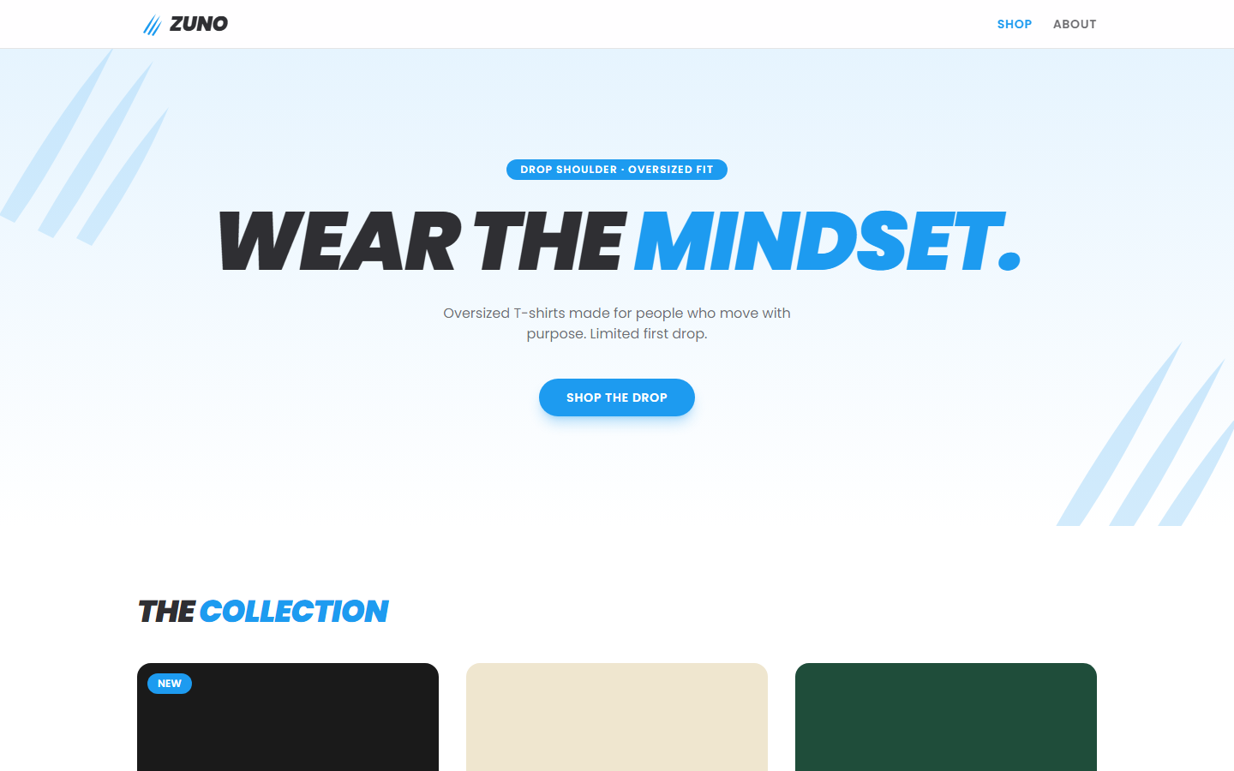
Home page
Brand-first banner
“Wear the Mindset.” in heavy italic type, like our posts
Claw-mark motif
The blue slashes from our logo frame the page
One clear action
Shop the drop jumps straight to the T-shirts

Slide 4
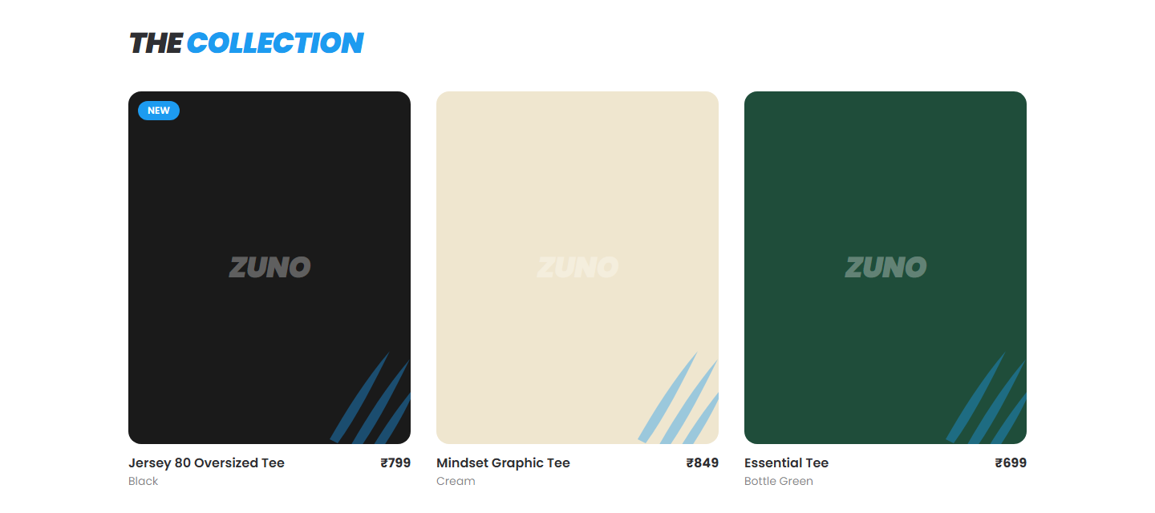
The collection
Coloured blocks are placeholders until we add real product photos.

Slide 5
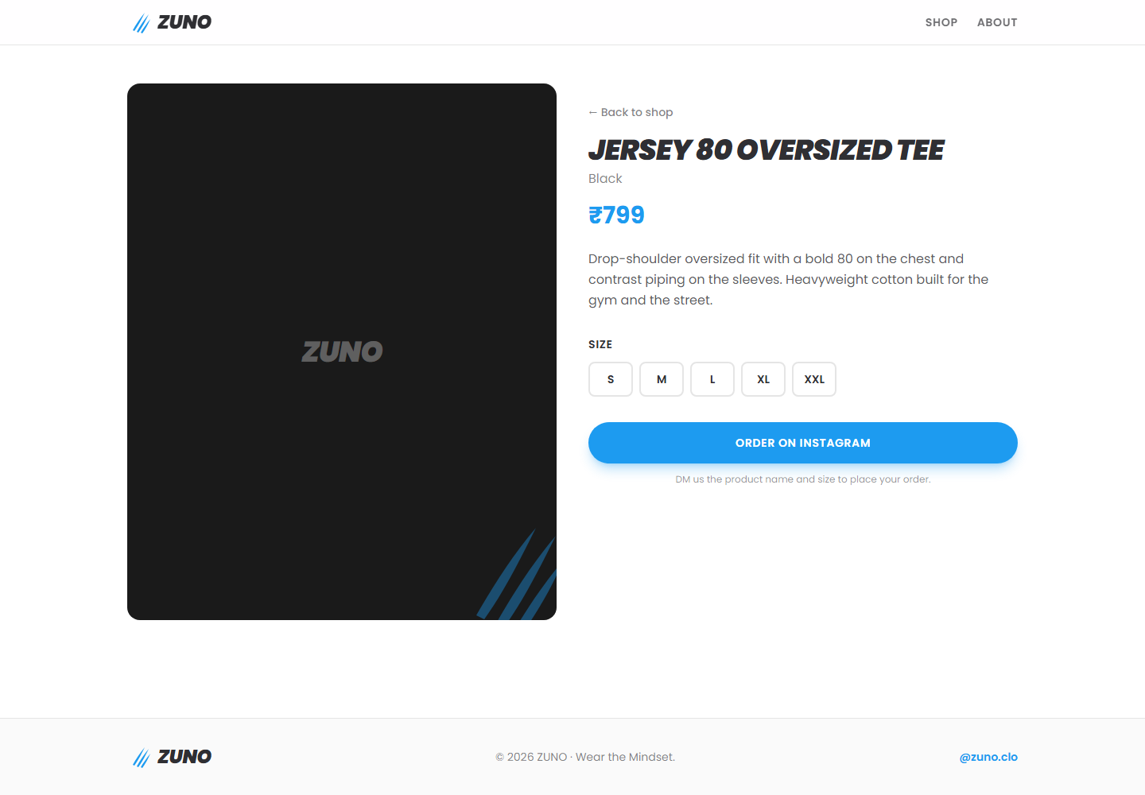
Product page
Price and details
Name, colour, price and a short description
Size picker
S to XXL, selected size shows on the button
Order on Instagram
Opens a DM to @zuno.clo, no checkout needed yet

Slide 6
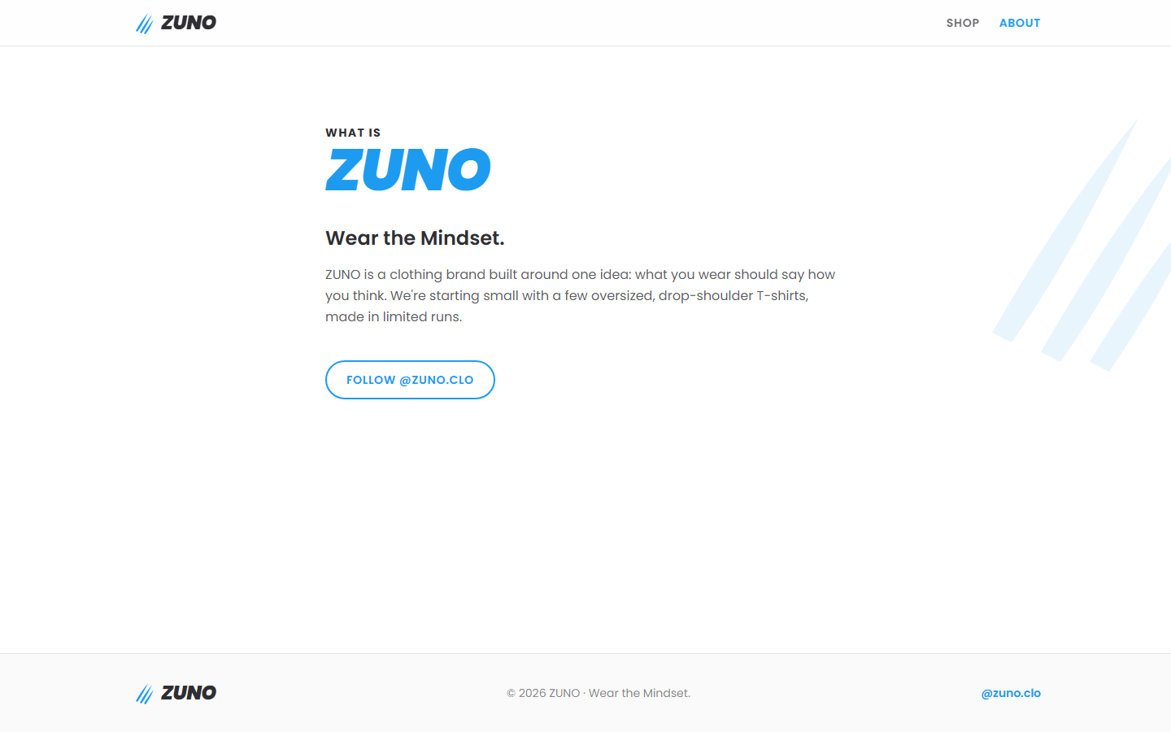
About page
“What you wear should say how you think.”
Tells our story in a few lines and links to @zuno.clo so visitors can follow us.

Slide 7
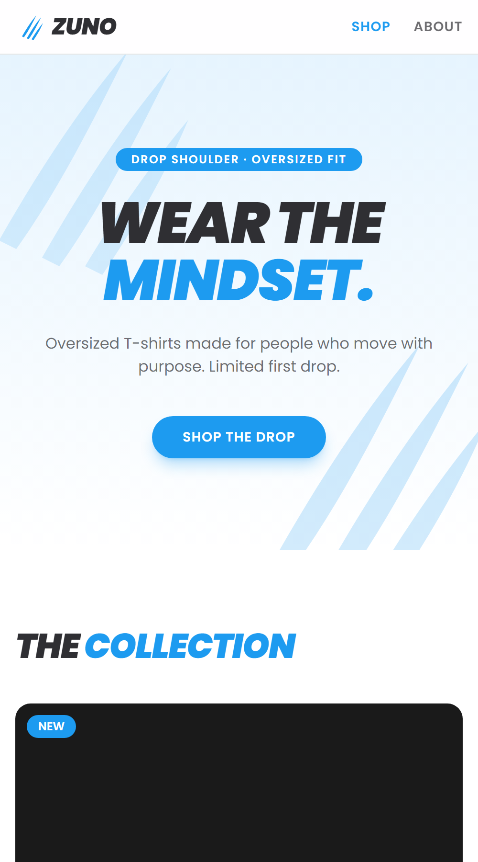
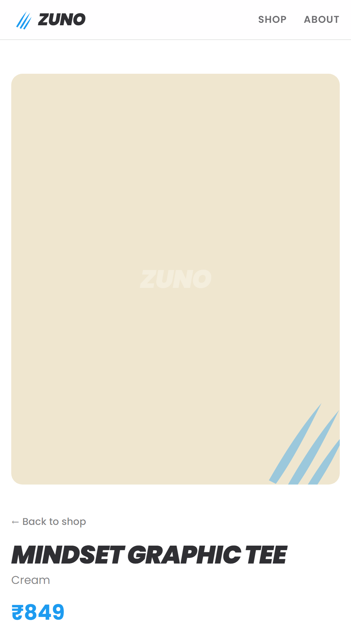
Made for phones
Most visitors come from Instagram
So every page is built to work on a phone first
Same look, any screen
Layout stacks into one column on small screens

Slide 8
How it works
Website
React + Tailwind
What customers see
Server
Express API
Sends the product list
products.json
One simple file
Edit to update the shop
Ordering: pick a size → tap Order on Instagram → DM us → we confirm and ship

Slide 9
Next steps
01
Real photos
Shoot each tee and drop the photos in
02
Final prices & sizes
Confirm names, prices and stock
03
Easier ordering
Add a cart or WhatsApp ordering
04
Go live
Put the site online with our own domain

