Slide 1

IMDb’s top 1000 Movies
by Ramakrishna Nimmathota

Slide 2
What is IMDb?
IMDb is the world's most popular and authoritative source for movie, TV and celebrity content, designed to help fans explore the world of movies and shows and decide what to watch.
IMDb provides information related to cast, production crew crew, fan reviews, ratings and lot more.

Slide 3
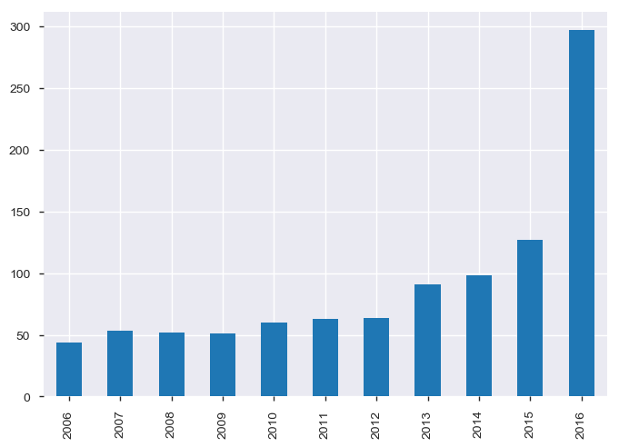
Evolution of movies over years?
The evolution of movies has been quite high over the past years.

Slide 4
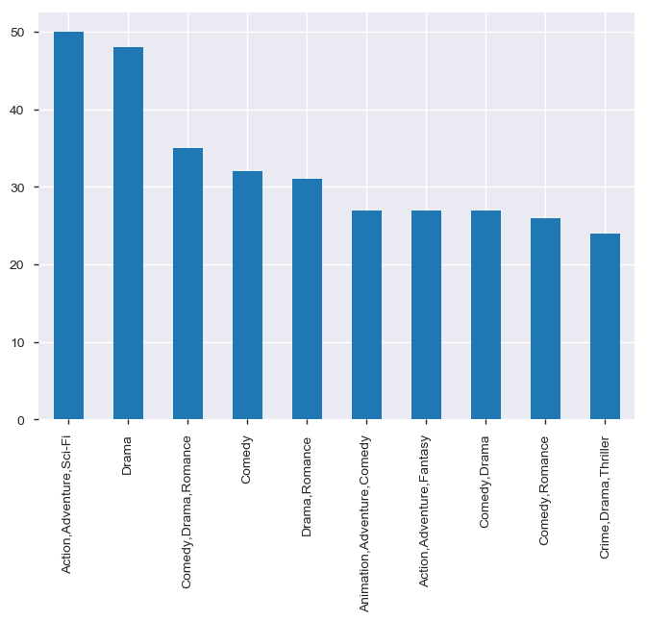
Top 10 movie by genres

Slide 5

Which Movie to choose?
Often users get confused in selecting a movie of their choice from the IMDb’s top list.
To overcome this problem we can validate the movies based on some parameters

Slide 6
Deal with Missing Values and find correlation
Draw the correlation between the available parameters like user reviews, Rating, Runtime, Metascore , Genre and find patterns
Replace missing values with Mean or Median for numerical data

Slide 7
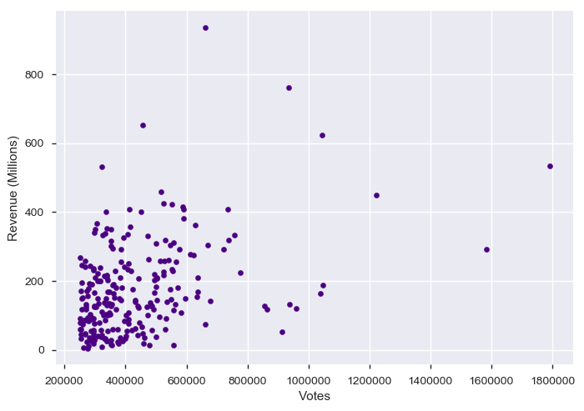
Votes & Revenue
Created using matplotlib on top 1000 Movies list

Slide 8
Observations
Movie should not be picked on basis on Revenue they generated, Rather votes can be taken into consideration
Dark knight received highest votes but its revenue is around 500 millions
whereas Avatar and The Avengers received low votes, but have received highest revenues of 760 and 620 Millions

Slide 9
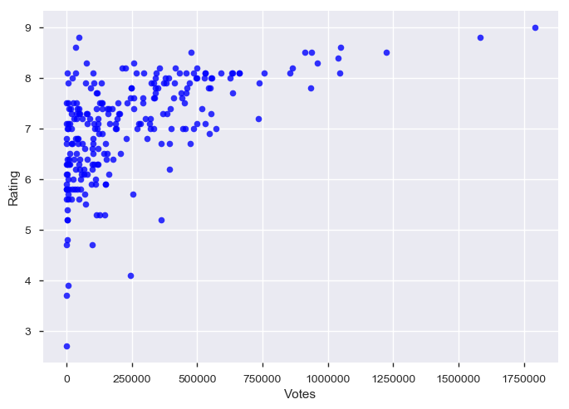
Votes & Rating
Created using matplotlib on top 1000 Movies list

Slide 10
Objectives & Graphs
We can see fairly in this plot that as number of Votes increases the rating increases, which means they are fairly strong, positively linear
Movies with higher votes tends to have the best or top rating
Movies which have more than 0.7 million users have an average of 8.2 Rating

Slide 11
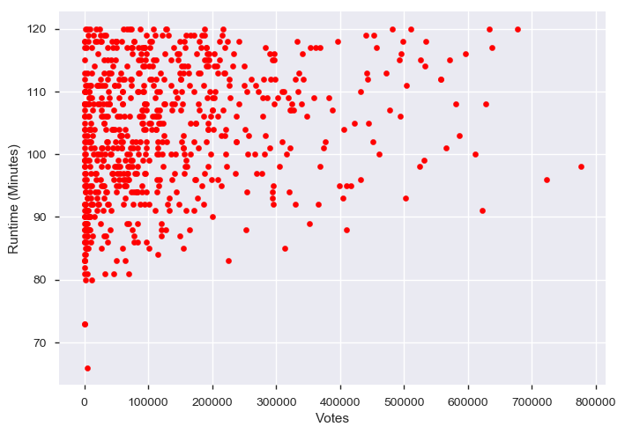
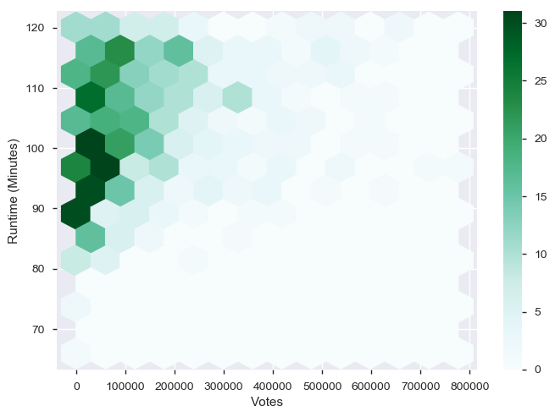
Votes & Runtime
Fig: Behavior of 1000 Movies
Fig: Movies with runtime < 120 Min

Slide 12
Observations
From the above scatter and pair plot we can infer that 70% of the IMDb's top 1000 movies have runtime less than or equal to 120 Minutes
From the scatter plot we can observe a strong positive relationship between the two data points votes and Runtime
Movies which have run time less than 120 minutes tend to have less votes

Slide 13
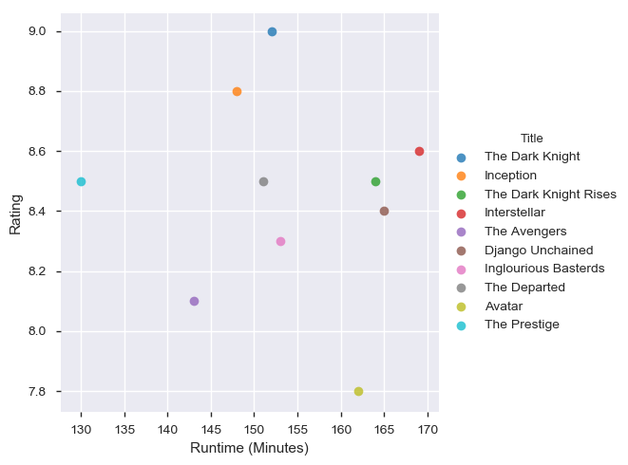
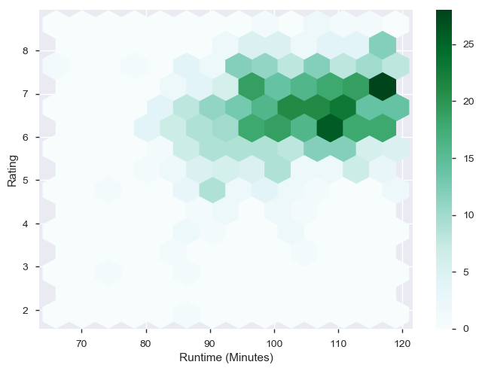
Rating & Runtime

Slide 14
Observations
we can infer that movies which have length of 120 minutes or less have higher chance of getting Rank around 7
Maximum (70%) of the top 1000 list movies lie in below or equal to 120 minutes

Slide 15
Conclusion
Movies should not be picked on basis on revenue they generate, rather votes can be taken into consideration
Runtime of movies greater than 130 min with votes greater than 0.7 million have an average rating of 8.2
Movies with higher votes tends to have the best or top rating

