Slide 1

IMDb’s top 1000 Movies EDA

Slide 2
What is the importance of votes ?
I am interested to see how parameters like revenue, rating and runtime have an impact over the votes received by a movie

Slide 3
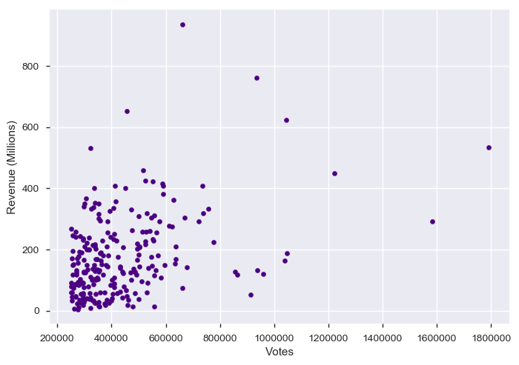
What is the relationship of votes w.r.t the revenue?
Dark knight received highest votes but generated revenue of 500 millions only
On the other hand, Avatar and The Avengers received less votes, but have generated highest revenues of 760 and 620 Millions

Slide 4
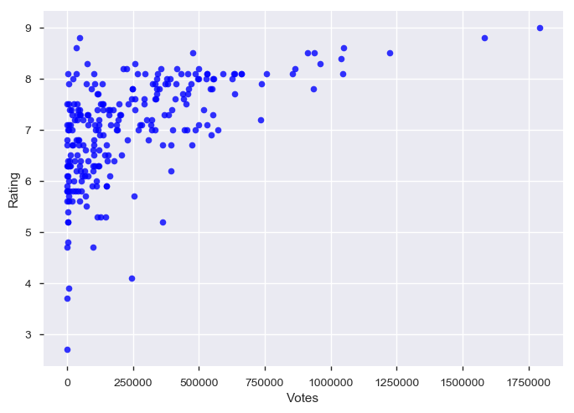
What is the relationship of votes w.r.t the Rating?
We can see fairly in this plot that as number of Votes increases the rating increases, which means they are fairly strong, positively linear
Movies with higher votes tends to have the best or top rating
Movies which have more than 0.7 million users have an average of 8.2 Rating

Slide 5
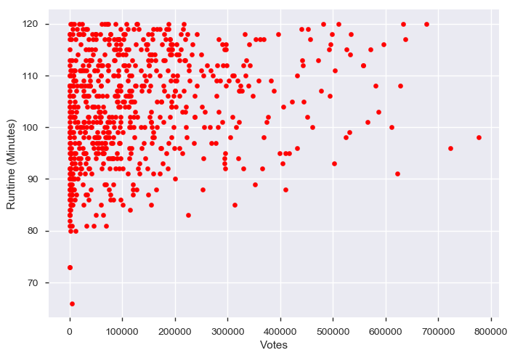
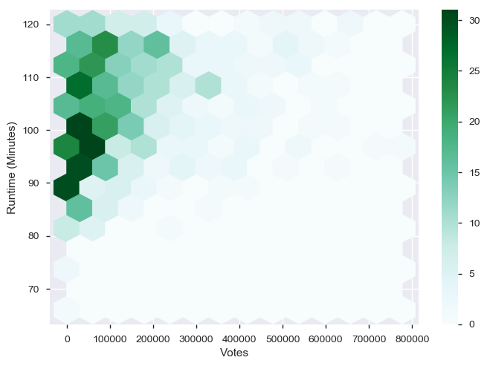
What is the runtime of the movie which has less votes?
Behavior of 1000 Movies with runtime <120 min
Behavior of top 10 movies with runtime > 120 min
Movies which have run time less than 120 minutes tend to have less votes
From the above scatter and pair plot we can infer that 70% of the IMDb's top 1000 movies have runtime less than or equal to 120 Minutes

Slide 6
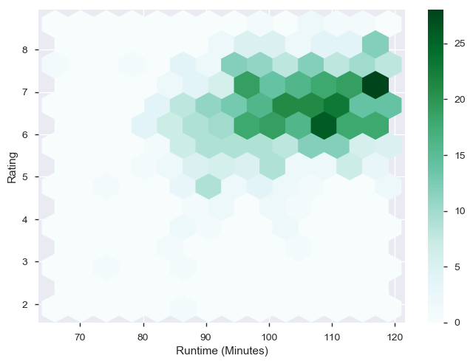
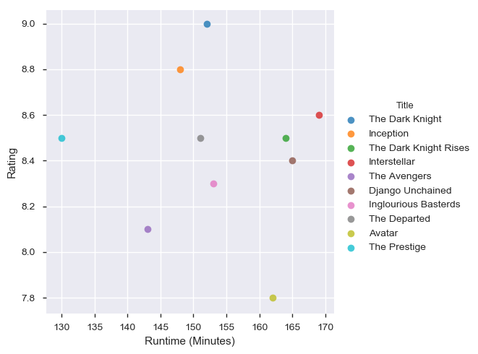
What is the runtime of the movies which has highest rating?
we can infer that movies which have runtime of 120 minutes or less have higher chance of getting Rating around 6 to 7.2
Where as runtime of movies greater than 130 min with votes greater than 0.7 million have an average rating of 8.2.

Slide 7
Insights gained from EDA
The voting of the movie is not based on the revenue they generate.
As the number of votes increases the rating of a movie increases.
Runtime of movies less than 120 minutes tends to have minimum number of votes.
Runtime of movies greater than 120 minutes with votes greater than 0.7 million have an average rating of 8.2.

