Slide 1

IMDb’s top 1000 Movies
by Ramakrishna Nimmathota

Slide 2
What is the importance of votes ?
I am interested to see how factors like rating, revenue and runtime are used to predict the votes a movie receives.
IMDb provides information related to cast, production crew crew, fan reviews, ratings and lot more.

Slide 3
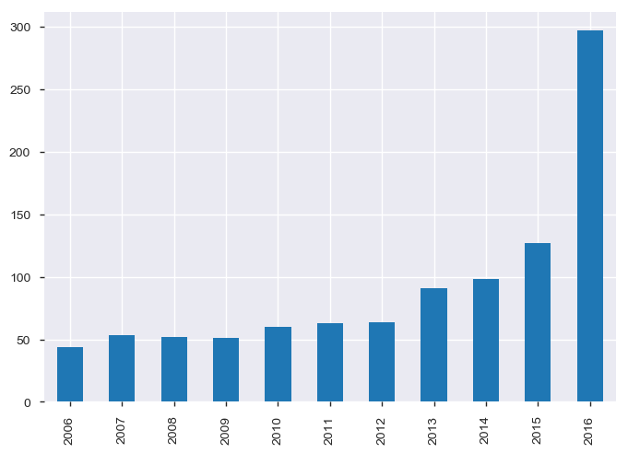
Evolution of movies over years?
The evolution of movies has been quite high over the past years.

Slide 4
Deal with Missing Values and find correlation
Found 128 in Revenue and 64 in Metascore
Replaced missing values with Median in Revenue mean in Metascore
Find the relationship of votes with Rating, Revenue, Runtime

Slide 5
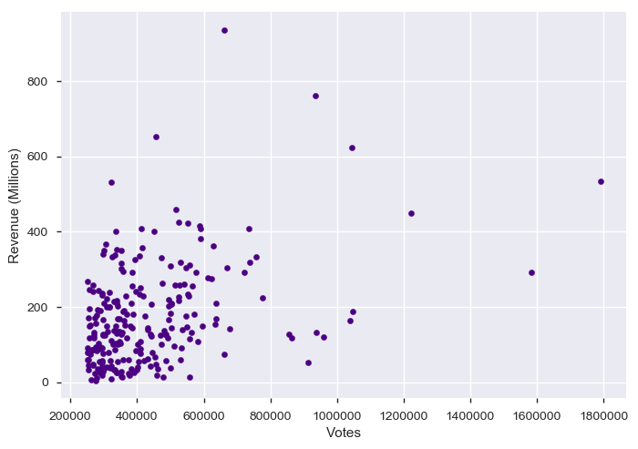
Votes & Revenue
Created using matplotlib on top 1000 Movies list

Slide 6
Observations
Movie should not be picked on basis on Revenue they generated, Rather votes can be taken into consideration
Dark knight received highest votes but its revenue is around 500 millions
whereas Avatar and The Avengers received low votes, but have received highest revenues of 760 and 620 Millions

Slide 7
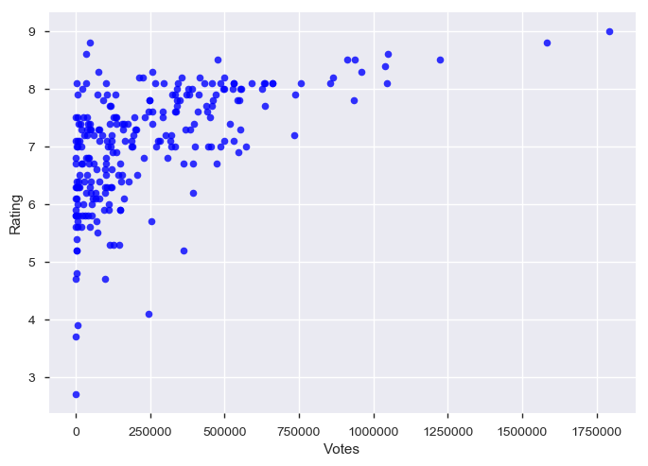
Votes & Rating
Created using matplotlib on top 1000 Movies list

Slide 8
Objectives & Graphs
We can see fairly in this plot that as number of Votes increases the rating increases, which means they are fairly strong, positively linear
Movies with higher votes tends to have the best or top rating
Movies which have more than 0.7 million users have an average of 8.2 Rating

Slide 9
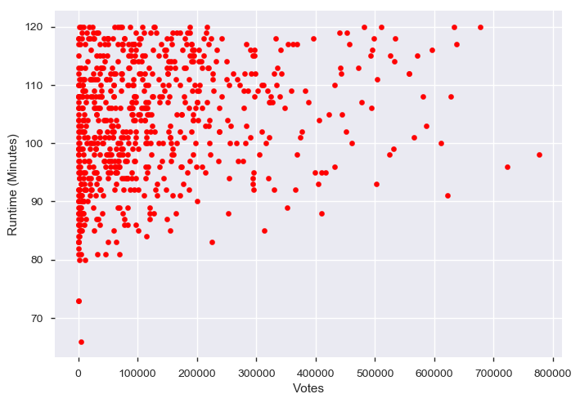
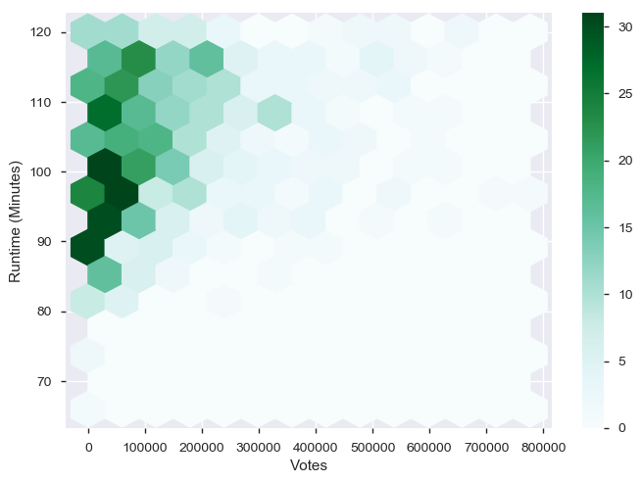
Votes & Runtime
Fig: Behavior of 1000 Movies
Fig: Movies with runtime < 120 Min

Slide 10
Observations
From the above scatter and pair plot we can infer that 70% of the IMDb's top 1000 movies have runtime less than or equal to 120 Minutes
From the scatter plot we can observe a strong positive relationship between the two data points votes and Runtime
Movies which have run time less than 120 minutes tend to have less votes

Slide 11
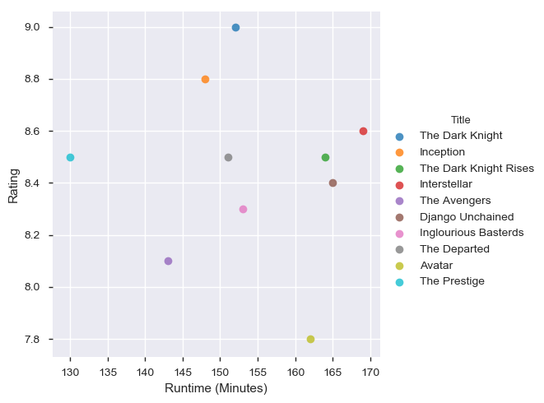
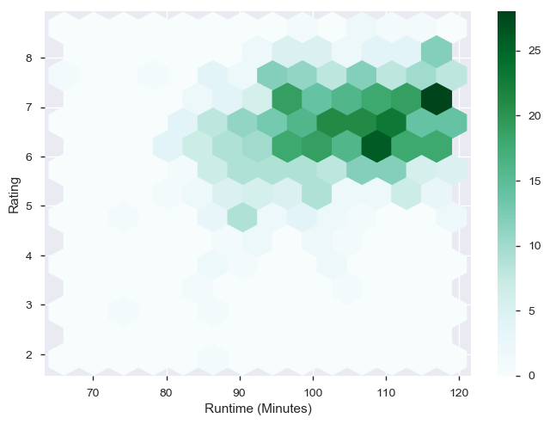
Rating & Runtime

Slide 12
Observations
we can infer that movies which have length of 120 minutes or less have higher chance of getting Rank around 7
Maximum (70%) of the top 1000 list movies lie in below or equal to 120 minutes

Slide 13
Conclusion
Movies should not be picked on basis on revenue they generate, rather votes can be taken into consideration
Movies with higher votes tends to have the best or top rating
Runtime of movies greater than 130 min with votes greater than 0.7 million have an average rating of 8.2.
Therefore, chance of getting high votes is more if rating is more

