Slide 1
Build Tool : Maven
What you are going to learn.
At the end of this module you will be able to:
What is Maven .
Use of Maven.
How Maven can helping us.
What is POM and How a POM Looks Like .
Install Maven on Linux and work with maven lifecycle.
Difference between Maven and Ant.
Maven Life cycle.
Maven Repository.
Satyam Kumar Pandey
DevopsTraining@December2018

Slide 2

Build Tool : Maven
Based on the concept of a project object model (POM)
What is Maven ?
Maven is a build automation tool used primarily for Java projects provides developers a complete build lifecycle framework.
Maven is based on the concept of a Project Object Model (POM)
Maven reads the pom.xml file, then executes the goal.
If you run a command mvn clean compile/package/ maven will read the pom.xml
Maven makes life of developer easy while creating reports, checks, build and testing automation setups.
Pom.xml file contains documentation for all of the
Objects, properties, methods and events.
Satyam Kumar Pandey
DevopsTraining@December2018

Slide 3
Build Tool : Maven
What Maven does ?
It makes a project easy to build
It provides uniform build process (maven project can be shared by all the maven projects)
It provides project information (log document, cross referenced sources, mailing list, dependency list, unit test reports etc.)
It is easy to migrate for new features of Maven
Deployable artifacts can be generated from source code.
Your Source code is compiled, packed, test and distributed
<groupId>com.example</groupId>
<artifactId>makemyplan</artifactId>
<version>0.0.1-SNAPSHOT</version>
<name>makemyplan</name>
<packaging>war</packaging>
<description>Demo project</description>
Satyam Kumar Pandey
DevopsTraining@December2018

Slide 4

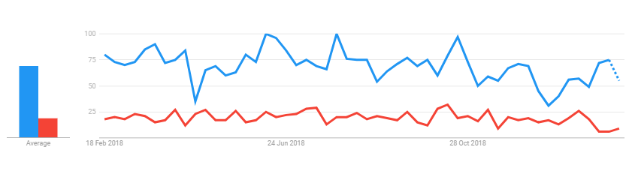
Build Tool : Maven
Apache Maven Vs Apache ANT
Satyam Kumar Pandey
DevopsTraining@December2018

Slide 5
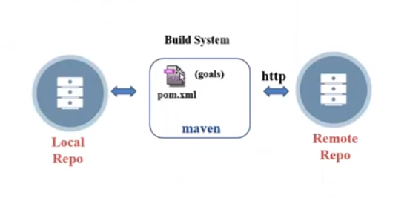
Build Tool : Maven
Overview of Maven Architecture
Maven is a build automation tool, used mainly for Java based Project.
Maven will provide libraries and dependencies for the code compilation.
Once you configure Maven in local system a folder (.M2)get created in (Local Repo).
Maven reads the pom.xml and execute accordingly, first it checks dependencies in local repo if not found then it will download the dependences from open internet & store in local
Downloads dependencies into local repository for the first time.
Execute life cycles, build phases and/or goals.
Execute plugins.
Satyam Kumar Pandey
DevopsTraining@December2018

Slide 6
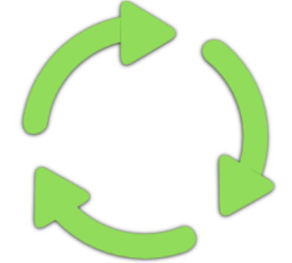
Build Tool : Maven
A Build Lifecycle is a well-defined sequence of phases, which define the order in which the goals are to be executed. Here phase represents a stage in life cycle. As an example, a typical Maven Build Lifecycle consists of the following sequence of phases.
Maven Build Lifecycle
validate - validate the project is correct and all necessary information is available
compile - compile the source code of the project.
satyam.java → satyam.class
kumar.java →kumar.class
test - test the compiled source code using a suitable unit testing framework. These tests should not require the code be packaged or deployed
JUnit Test : satyamtest.java → satyamtest.class
kumartest.java → kumartest.class
package - take the compiled code and package it in its distributable format, such as a JAR.
Artifact : Satyam.class →> (satyam.jar) | jar packaging is default
verify - run any checks on results of integration tests to ensure quality criteria are met
install - install the package into the local repository, for use as a dependency in other projects locally
usersignup.java → usersignup.class
userlogin.java → userlogin.class
deploy - done in the build environment, copies the final package to the remote repository for sharing with other developers and projects.
Satyam Kumar Pandey
DevopsTraining@December2018

Slide 7
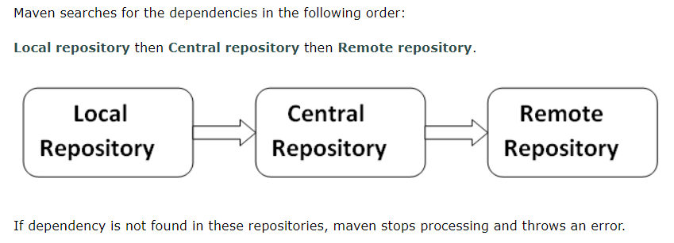
Build Tool : Maven
Maven Repository
There are three types of maven repository:
https://repo.maven.apache.org/maven2/s
Nexus
C:\Users\Satyam\.m2\repository
In House Hosted Repository
Satyam Kumar Pandey
DevopsTraining@December2018
Notes:
Local Repo : it is located in developers machine. By default, it is created in the home directory and when ever dependencies are downloaded from remote server, it is saved into developers machine.
Central Repo: the location of the repository is http://repo.maven.apche.org/maven2/ whenever build job is run , maven try to download it from local repository but when its not there, they downloaded the dependences from central repository
Remote Remo: Sometime, there are objects and modules which are specific to organization, for which remote repositories are created which are accessible within the organization.

Slide 8
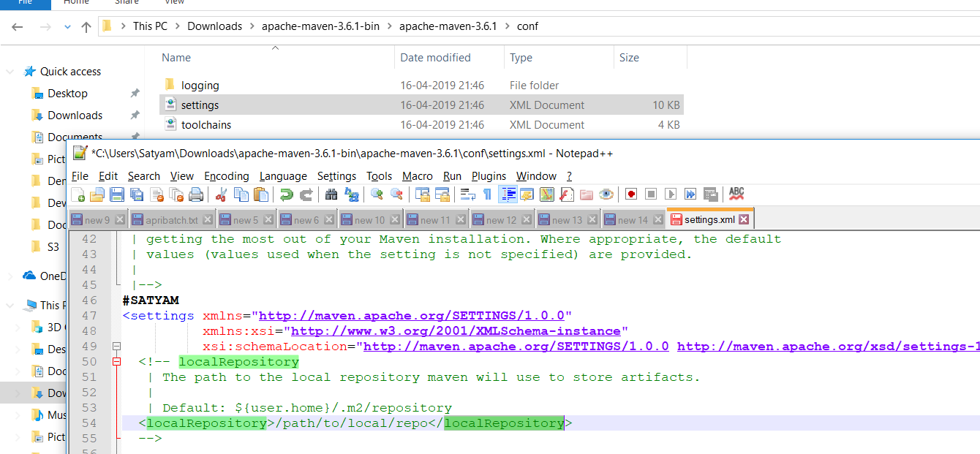
Build Tool : Maven
Update location of Local Repository : We can change the location of maven local repository by changing the settings.xml file. It is located in MAVEN_HOME/conf/settings.xml
In my case path is : C:\Users\Satyam\Downloads\apache-maven-3.6.1-bin\apache-maven-3.6.1\conf
Remote Repo
Satyam Kumar Pandey
DevopsTraining@December2018

Slide 9
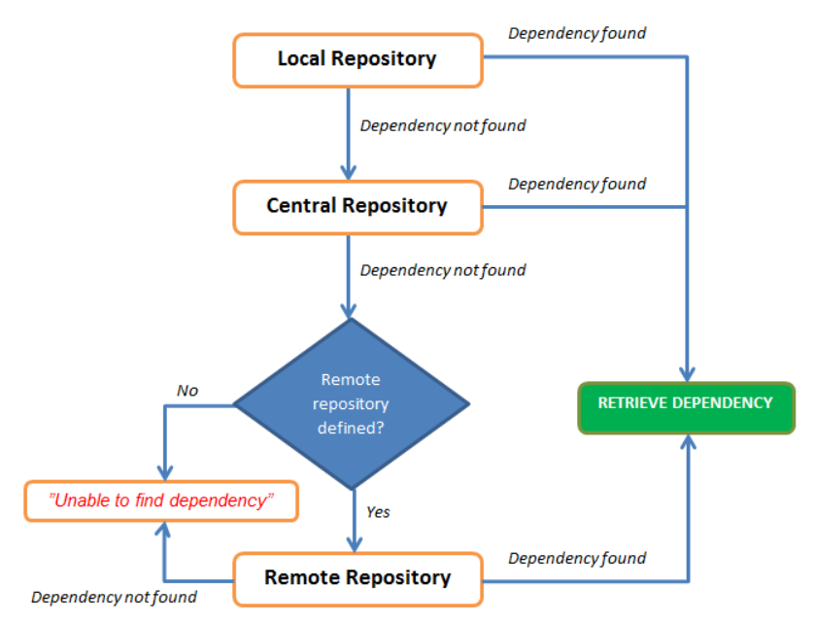
Build Tool : Maven
Maven Repository Flow
Automatic dependencies is one of the powerful feature of Apache maven and its one of the reason Maven is very popular in developer community.
Maven resolve the dependent library from local repository which is again connected with central repository or remote repository. thus
we can say that Maven has 3 kinds of repository concept.
1. Local repository: C:\Users\Satyam\.m2\repository
2. Central repository e.g http://repo.maven.apache.org/maven2/
3. Private repository:
https://www.sonatype.com/product-nexus-repository
https://jfrog.com/
Satyam Kumar Pandey
DevopsTraining@December2018

Slide 10
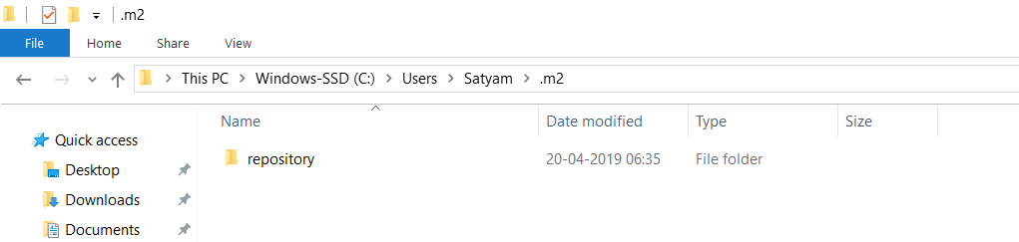
Build Tool : Maven
Local Repo
Maven local repository is located in your local system. It is created by the maven when you run any maven command.
Central Repo :
Maven central repository is located on the web. It has been created by the apache maven community itself.
The path of central repository is: http://repo1.maven.org/maven2/.
The central repository contains a lot of common libraries that can be viewed by this url http://search.maven.org/#browse.
Satyam Kumar Pandey
DevopsTraining@December2018

Slide 11
Build Tool : Maven
Maven Interview Question
What maven version you are using ?
What all phase of maven you are using?
What is .M2 directory in maven used for ?
What is the purpose of setting.xml file in Maven?
What are custom Maven Plugin you have used ?
What is Parent Pom?
Difference between Maven and Ant
Explain Pom.xml?
Satyam Kumar Pandey
DevopsTraining@December2018

Slide 12
Build Tool : Maven
Maven Custom Plugin
<maven.spotify.plugin.version>1.1.0</maven.spotify.plugin.version>
<maven.surefire.plugin.version>2.20</maven.surefire.plugin.version>
<maven.compiler.plugin.version>3.6.1</maven.compiler.plugin.version>
<sonar.maven.plugin.version>3.0.2</sonar.maven.plugin.version>
<docker.maven.plugin.version>1.0.0</docker.maven.plugin.version>
<jacoco.maven.plugin.version>0.8.0</jacoco.maven.plugin.version>
maven.spotify.plugin
maven.surefire.plugin
maven.compiler.plugin
sonar.maven.plugin
docker.maven.plugin
jacoco.maven.plugin
Satyam Kumar Pandey
DevopsTraining@December2018

