Slide 1
Information Retrieval and Web Search
Pandu Nayak and Prabhakar Raghavan
Lecture 18: Link analysis
+ New content by Crista Lopes

Slide 2
Today’s lecture – hypertext and links
We look beyond the content of documents
  We begin to look at the hyperlinks between them
Address questions like
  Do the links represent a conferral of authority to some pages? Is this useful for ranking?
  How likely is it that a page pointed to by the CERN home page is about high energy physics
Big application areas
  The Web
  Email
  Social networks

Slide 3
Links are everywhere
Powerful sources of authenticity and authority
  Mail spam – which email accounts are spammers?
  Host quality – which hosts are “bad”?
  Phone call logs
The Good, The Bad and The Unknown
?
Good
?
?
Bad
?

Slide 4
Simple iterative logic
The Good, The Bad and The Unknown
  Good nodes won’t point to Bad nodes
  All other combinations plausible
?
Good
?
?
Bad
?

Slide 5
Simple iterative logic
Good nodes won’t point to Bad nodes
  If you point to a Bad node, you’re Bad
  If a Good node points to you, you’re Good
?
Good
?
?
Bad
?

Slide 6
Simple iterative logic
Good nodes won’t point to Bad nodes
  If you point to a Bad node, you’re Bad
  If a Good node points to you, you’re Good
Good
?
Bad
?

Slide 7
Simple iterative logic
Good nodes won’t point to Bad nodes
  If you point to a Bad node, you’re Bad
  If a Good node points to you, you’re Good
Good
?
Bad
Sometimes need probabilistic analogs – e.g., mail spam

Slide 8
Many other examples of link analysis
Social networks are a rich source of grouping behavior
E.g., Shoppers’ affinity – Goel+Goldstein 2010
  Consumers whose friends spend a lot, spend a lot themselves
http://www.cs.cornell.edu/home/kleinber/networks-book/

Slide 9
Our primary interest in this course
Analogs of most IR functionality based purely on text
  Scoring and ranking
  Link-based clustering – topical structure from links
  Links as features in classification – documents that link to one another are likely to be on the same subject
Crawling
  Based on the links seen, where do we crawl next?

Slide 10
The Web as a Directed Graph
Sec. 21.1
Page A
Page B
hyperlink
Anchor
Assumption 1: A hyperlink between pages denotes a conferral of authority (quality signal)
Assumption 2: The text in the anchor of the hyperlink describes the target page (textual context)

Slide 11
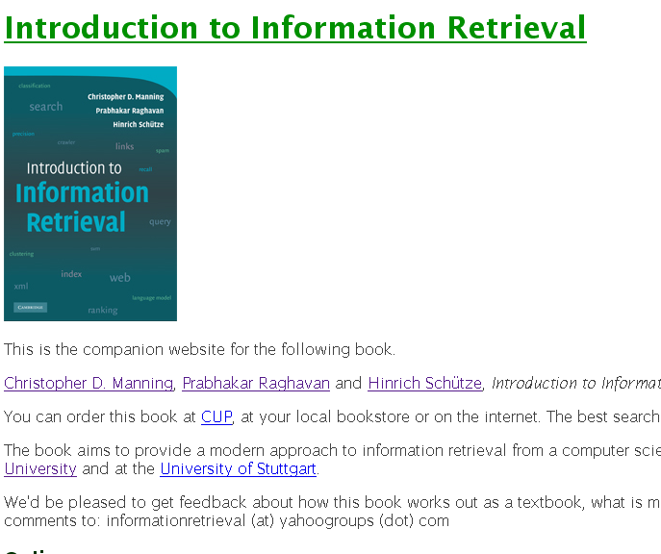
Assumption 1: reputed sites

Slide 12


Assumption 2: annotation of target

Slide 13
ANCHOR TEXT

Slide 14
Anchor Text
WWW Worm - McBryan [Mcbr94]
Sec. 21.1.1
For ibm how to distinguish between:
  IBM’s home page (mostly graphical)
  IBM’s copyright page (high term freq. for ‘ibm’)
  Rival’s spam page (arbitrarily high term freq.)
“ibm.com”
“IBM home page”
“ibm”
A million pieces of anchor text with “ibm” send a strong signal
www.ibm.com

Slide 15
Indexing anchor text
Sec. 21.1.1
When indexing a document D, include (with some weight) anchor text from links pointing to D.
Armonk, NY-based computer
giant IBM announced today
www.ibm.com
Joe’s computer hardware links
Sun
HP
IBM
Big Blue today announced
record profits for the quarter

Slide 16
Indexing anchor text
Sec. 21.1.1
Can sometimes have unexpected side effects - e.g., evil empire.
Can score anchor text with weight depending on the authority of the anchor page’s website
  E.g., if we were to assume that content from cnn.com or yahoo.com is authoritative, then trust the anchor text from them

Slide 17
Anchor Text
Sec. 21.1.1
Other applications
  Weighting/filtering links in the graph
  Generating page descriptions from anchor text

Slide 18
Citation Analysis
Citation frequency
Bibliographic coupling frequency
  Articles that co-cite the same articles are related
Citation indexing
  Who is this author cited by? (Garfield 1972)
Pagerank preview: Pinsker and Narin ’60s

Slide 19
The web isn’t scholarly citation
Millions of participants, each with self interests
Spamming is widespread
Once search engines began to use links for ranking (roughly 1998), link spam grew
  You can join a group of websites that heavily link to one another

Slide 20
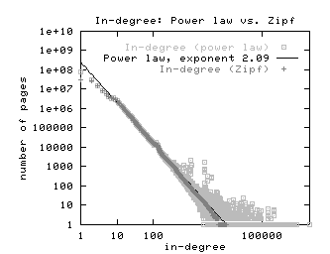
In-links to pages – unusual patterns ☺

Slide 21
HUBS AND AUTHORITIES

Slide 22
Hyperlink-Induced Topic Search (HITS)
Sec. 21.3
In response to a query, instead of an ordered list of pages each meeting the query, find two sets of inter-related pages:
  Hub pages are good lists of links on a subject.
    e.g., “Bob’s list of cancer-related links.”
  Authority pages occur recurrently on good hubs for the subject.
Best suited for “broad topic” queries rather than for page-finding queries.
Gets at a broader slice of common opinion.

Slide 23
Hubs and Authorities
Sec. 21.3
Thus, a good hub page for a topic points to many authoritative pages for that topic.
A good authority page for a topic is pointed to by many good hubs for that topic.
Circular definition - will turn this into an iterative computation.

Slide 24
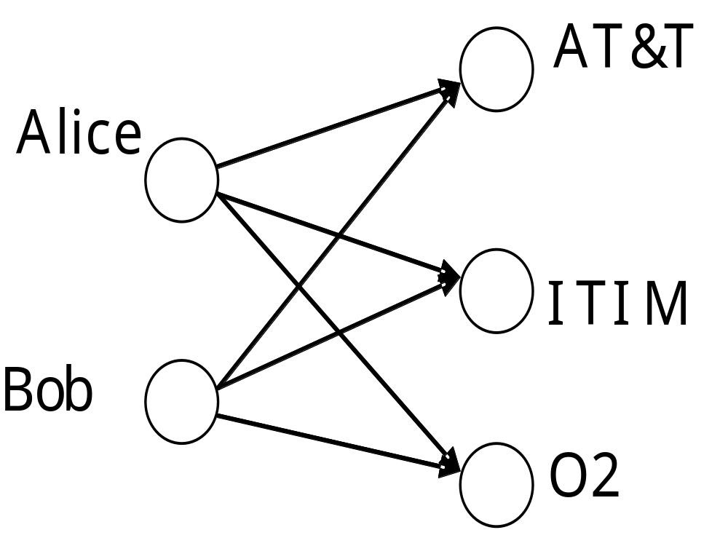
The hope
Sec. 21.3
Authorities
Hubs
Mobile telecom companies

Slide 25
High-level scheme
Sec. 21.3
Extract from the web a base set of pages that could be good hubs or authorities.
From these, identify a small set of top hub and authority pages;
  iterative algorithm.

Slide 26
Base set
Sec. 21.3
Given text query (say browser), use a text index to get all pages containing browser.
  Call this the root set of pages.
Add in any page that either
  points to a page in the root set, or
  is pointed to by a page in the root set.
Call this the base set.

Slide 27
Visualization
Sec. 21.3
Root
set
Base set
  Get in-links (and out-links) from a connectivity server

Slide 28
Distilling hubs and authorities
Sec. 21.3
Compute, for each page x in the base set, a hub score h(x) and an authority score a(x).
Initialize: for all x, h(x)←1; a(x) ←1;
Iteratively update all h(x), a(x);
After iterations
  output pages with highest h() scores as top hubs
  highest a() scores as top authorities.
Key

Slide 29
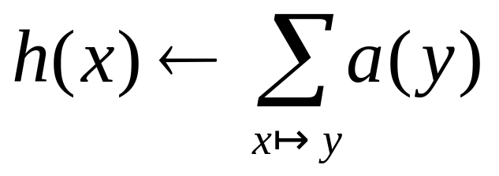
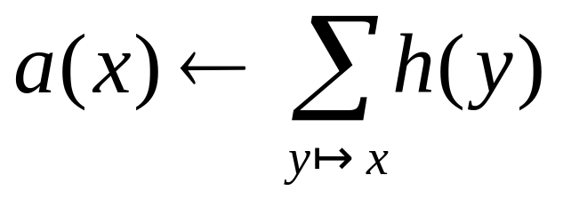
Iterative update
Sec. 21.3
Repeat the following updates, for all x:
x
x

Slide 30
Scaling
Sec. 21.3
To prevent the h() and a() values from getting too big, can scale down after each iteration.
Scaling factor doesn’t really matter:
  we only care about the relative values of the scores.

Slide 31
How many iterations?
Sec. 21.3
Claim: relative values of scores will converge after a few iterations:
  in fact, suitably scaled, h() and a() scores settle into a steady state!
  proof of this comes later.
In practice, ~5 iterations get you close to stability.

Slide 32
Japan Elementary Schools
Sec. 21.3
Hubs
Authorities
schools
LINK Page-13
“ú–{‚ÌŠwZ
a‰„¬ŠwZƒz[ƒƒy[ƒW
100 Schools Home Pages (English)
K-12 from Japan 10/...rnet and Education )
http://www...iglobe.ne.jp/~IKESAN
‚l‚f‚j¬ŠwZ‚U”N‚P‘g•¨Œê
ÒŠ—’¬—§ÒŠ—“Œ¬ŠwZ
Koulutus ja oppilaitokset
TOYODA HOMEPAGE
Education
Cay's Homepage(Japanese)
–y“ì¬ŠwZ‚Ìƒz[ƒƒy[ƒW
UNIVERSITY
‰J—³¬ŠwZ DRAGON97-TOP
Â‰ª¬ŠwZ‚T”N‚P‘gƒz[ƒƒy[ƒW
¶µ°é¼ÂÁ© ¥á¥Ë¥å¡¼ ¥á¥Ë¥å¡¼
The American School in Japan
The Link Page
‰ªès—§ˆä“c¬ŠwZƒz[ƒƒy[ƒW
Kids' Space
ˆÀés—§ˆÀé¼•”¬ŠwZ
‹{é‹³ˆç‘åŠw•‘®¬ŠwZ
KEIMEI GAKUEN Home Page ( Japanese )
Shiranuma Home Page
fuzoku-es.fukui-u.ac.jp
welcome to Miasa E&J school
_“ÞìŒ§E‰¡•ls—§’†ì¼¬ŠwZ‚Ìƒy
http://www...p/~m_maru/index.html
fukui haruyama-es HomePage
Torisu primary school
goo
Yakumo Elementary,Hokkaido,Japan
FUZOKU Home Page
Kamishibun Elementary School...

Slide 33
Things to note
Sec. 21.3
Pulled together good pages regardless of language of page content.
Use only link analysis after base set assembled
  iterative scoring is query-independent.
Iterative computation after text index retrieval - significant overhead.

Slide 34
Issues
Sec. 21.3
Topic Drift
  Off-topic pages can cause off-topic “authorities” to be returned
    E.g., the neighborhood graph can be about a “super topic”
Mutually Reinforcing Affiliates
  Affiliated pages/sites can boost each others’ scores
    Linkage between affiliated pages is not a useful signal

Slide 35
PAGE RANK

Slide 36
Pagerank scoring
Sec. 21.2
Imagine a browser doing a random walk on web pages:
  Start at a random page
  At each step, go out of the current page along one of the links on that page, equiprobably
“In the steady state” each page has a long-term visit rate - use this as the page’s score.
1/3
1/3
1/3

Slide 37
Not quite enough
Sec. 21.2
The web is full of dead-ends.
  Random walk can get stuck in dead-ends.
  Makes no sense to talk about long-term visit rates.
??

Slide 38
Teleporting
Sec. 21.2
At a dead end, jump to a random web page.
At any non-dead end, with probability 10%, jump to a random web page.
  With remaining probability (90%), go out on a random link.
  10% - a parameter.

Slide 39
Result of teleporting
Sec. 21.2
Now cannot get stuck locally.
There is a long-term rate at which any page is visited (not obvious, will show this).
How do we compute this visit rate?

Slide 40
Computing PageRank
Algebraic calculation (given in Google paper)
Markov chain model

Slide 41
PageRank -- Algebraic
PR(A) = (1-d) + d ∑ (PR(Ti)/C(Ti))
PR(A) = (1-d) + d (PR(T1)/C(T1) + ... + PR(Tn)/C(Tn))
Where
A is a page
d is a damping factor (usually 0.85)
T1...Tn are pages that link to A
PR(Ti) is the PageRank of Ti
C(Ti) is the number of outgoing links from Ti

Slide 42
Example
A
B
PR(A) = 0.15 + 0.85 * PR(C)/2
PR(B) = 0.15 + 0.85 * (PR(A)/1 + PR(C)/2)
PR(C) = 0.15 + 0.85 * (PR(B)/1)
C
How do we start?!?
Guess: PR(p) = 1 for starters
Then, iterate

Slide 43
Example – Iterations
A
B
PR(A) = 0.15 + 0.85 * PR(C)/2
PR(B) = 0.15 + 0.85 * (PR(A)/1 + PR(C)/2)
PR(C) = 0.15 + 0.85 * (PR(B)/1)
C
PR(A) = 0.15+0.85 * 1/2 = 0.575
PR(B) = 0.15+0.85 * (1+1/2) = 1.425
PR(C) = 0.15+0.85 * 1 = 1
Iter 1
PR(A) = 0.15+0.85 * 1/2 = 0.575
PR(B) = 0.15+0.85 * (0.575+1/2) = 1.06375
PR(C) = 0.15+0.85 * 1.425 = 1.36125
Iter 2
...

Slide 44
Example -- Iterations
Algorithm converges after N iterations
Once converged, normalized probability distribution (average PageRank for all pages) will be 1

Slide 45
Pagerank summary
Sec. 21.2.2
Preprocessing:
  Given graph of links, build matrix P.
  From it compute page rank
Query processing:
  Retrieve pages meeting query.
  Rank them by their pagerank.
  But this rank order is query-independent …

Slide 46
The reality
Pagerank is used in google and other engines, but is hardly the full story of ranking
  Many sophisticated features are used
  Some address specific query classes
  Machine learned ranking (Lecture 19) heavily used
Pagerank still very useful for things like crawl policy

Slide 47
Connectivity servers

Slide 48
Connectivity Server
Sec. 20.4
Support for fast queries on the web graph
  Which URLs point to a given URL?
  Which URLs does a given URL point to?
Stores mappings in memory from
    URL to outlinks, URL to inlinks
Applications
  Crawl control
  Web graph analysis
    Connectivity, crawl optimization
  Link analysis

Slide 49
Resources
IIR Chap 21
http://www2004.org/proceedings/docs/1p309.pdf
http://www2004.org/proceedings/docs/1p595.pdf
http://www2003.org/cdrom/papers/refereed/p270/kamvar-270-xhtml/index.html
http://www2003.org/cdrom/papers/refereed/p641/xhtml/p641-mccurley.html
The WebGraph framework I: Compression techniques (Boldi et al. 2004)

