Slide 1

Basic Details of the Team and Problem Statement
Organization Name: Government of Maharashtra.
PS Code:OS872
Problem Statement Title: Real time tracking of students learning’s outcomes and their academic progress across schools.
Team Name: TEAMX
Team Leader Name: Ahmad Rafi
Institute Code (AISHE):
Institute Name: INDIAN INSTITUTE OF INFORMATION TECHNOLOGY, Allahabad
Theme Name:Smart Education

Slide 2
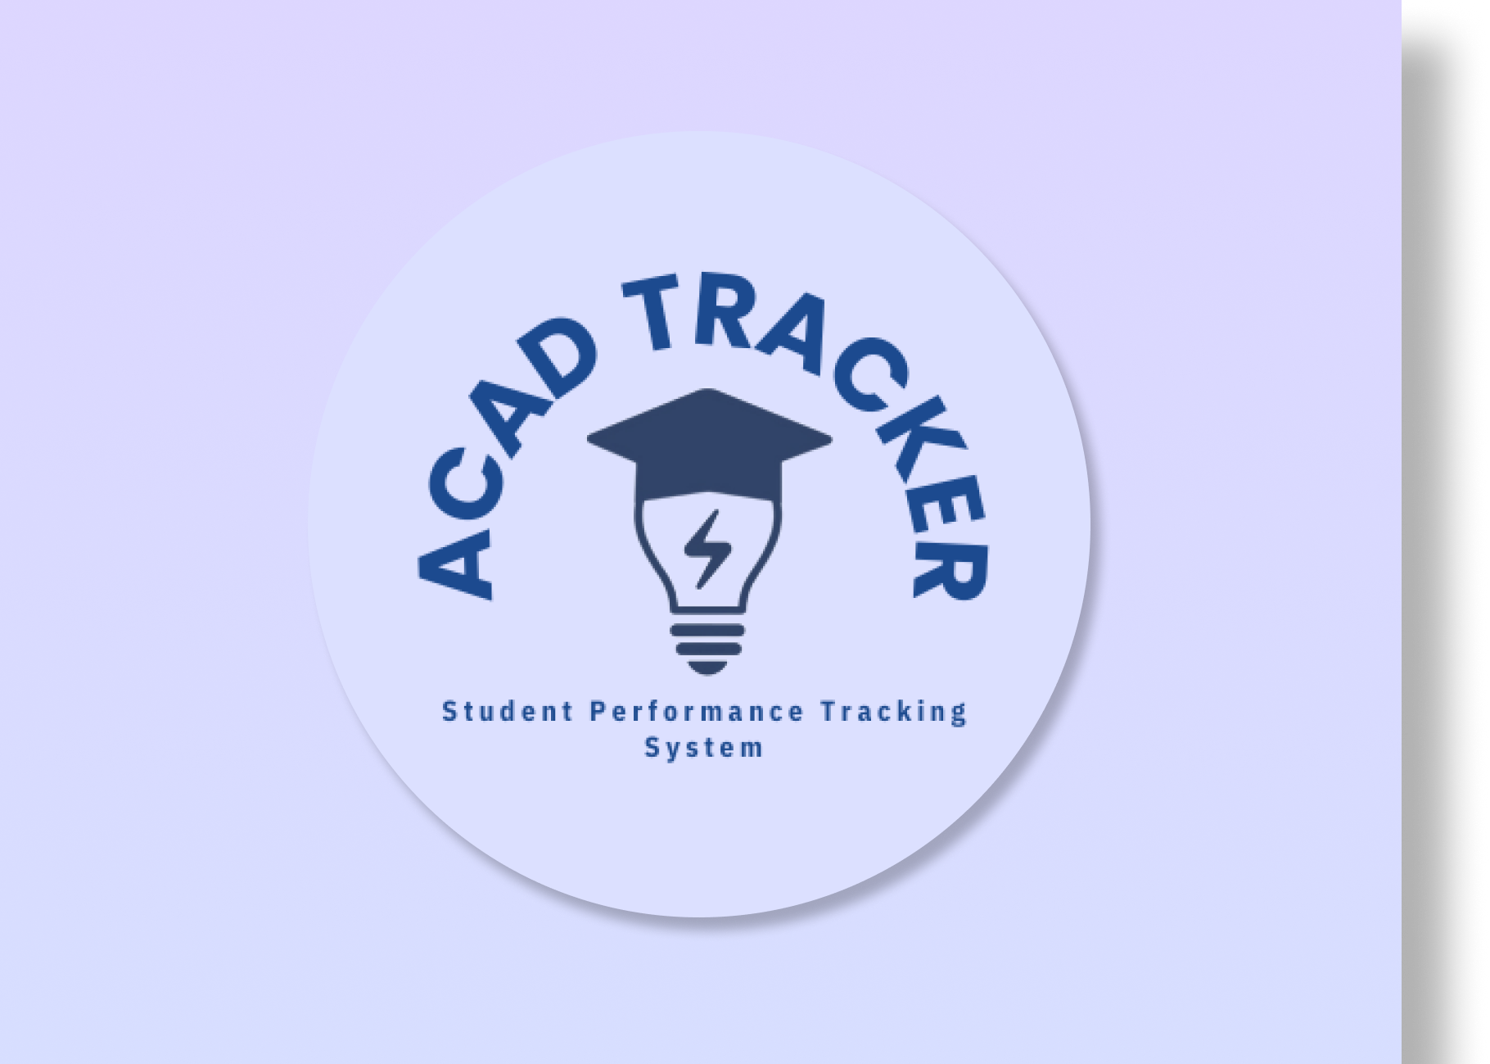
Idea/Approach Details
Describe your idea here:
A full scale performance recording system
Accessible from mobile
Teachers and parents can acess
Compares and Analyses through out the state
Generates reliable feedback
Personalized attention through
Describe your Technology stack here:
An android application for teachers and students
A server backend based on Node.js

Slide 3
Idea/Approach Details
Describe your Use Cases here
Describe your Dependencies / Show stopper here
Can be used to store marks for every possible assessment
Special care given to extra-curriculars to generalise the marking across different venues
Students can get updates and feedback on their performance immediately
Teachers and students can get an understanding of their performance in comparision to every other student i the statement.
To implement this app on a large scale we need a server network.
Teachers and students need to have a stable internet connection to acsess the information
This app will depend upon the demographic data of Maharastra government school including information of no. of schools situated, name of the students and other related information.

Slide 4
Team Member Details
Team Leader Name: Ahmad Rafi
Branch : Btech Stream (ECE, CSE etc): ECE Year (I,II,III,IV): I
Team Member 1 Name: Farhan Haider
Branch : Btech Stream (ECE, CSE etc): ECE Year (I,II,III,IV): I
Team Member 2 Name: Mohd Kaif
Branch : Btech Stream (ECE, CSE etc): ECE Year (I,II,III,IV): I
Team Member 3 Name: Ram Santhosh Patnaik Belagam
Branch : Btech Stream (ECE, CSE etc): ECE Year (I,II,III,IV): I
Team Member 4 Name: Kusum Chandra Kumar
Branch : Btech Stream (ECE, CSE etc): ECE Year (I,II,III,IV): I
Team Member 5 Name: Neha Meena
Branch : Btech Stream (ECE, CSE etc): ECE Year (I,II,III,IV): I
Team Mentor 1 Name: Type Your Name Here
Category (Academic/Industry): Expertise (AI/ML/Blockchain etc): Domain Experience (in years):
Team Mentor 2 Name: Type Your Name Here
Category (Academic/Industry): Expertise (AI/ML/Blockchain etc): Domain Experience (in years):

Slide 5
Important Pointers
Please ensure below pointers are met while
Kindly keep the maximum slides limit to 4 pages
All the topics should be utilized for description of your idea
Try to avoid paragraphs and post your idea in points
Keep your explanation precisely and easy to understand
Idea should be unique and novel. If it has a business potential more weightage will be given.
Apart from this PPT abstract of your idea will be asked separately while submitting
You need to save the file in PDF and upload the same on portal. No PPT, Word Doc or any other format will be supported
You can delete this slide (Important Pointers) when you upload the details of your idea on SIH portal.

