Slide 1

PRESENTATION on Box Office MANAGEMENT
BY
Sridevi Muthukumar
C19102PCA6052
MINI PROJECT

Slide 2
CONTENTS
Abstract
Introduction
Software Requirements
Modules
Data Flow Diagram
Class Diagram
Conclusion

Slide 3
ABSTRACT
Movie Cruiser–Office Management is a web-based application developed using Jsp,Java,servlet, css, javascript and mysql to register data . The proposed project for Movie Cruiser – Box Office Management is developed to provide the Movie details to the users.
This is beneficial to both the admins and users. Using the online web application, the admin can do managing activities such as add new Movie items , edit and delete the statistics and update or modify the existing details. It helps the user to track the movie details .

Slide 4
INTRODUCTION
The website is fully focused on viewing the movie box office statistics up to date and enabling the user to add the items to favorite label to get easy handling .So, we have developed a website by providing item details and user-friendly platform for users
WebSite Admins to add / delete and update the existing movie items details in the application

Slide 5
PROJECT DESCRIPTION
This project describes Movie Cruiser – Box office collection management facilitates user to avail the movie details instantly and accurately. This System will provide facility for user to check the statistics anytime from anywhere.
This System allows the user to add their movie to wish list .
Admin can perform backend operations – Add , Delete , Update existing movies to the website which will stores in the Database

Slide 6
SOFTWARE REQUIREMENTS
Hardware Requirement:
Developer Desktop PC with 4GB RAM
Software Requirement
SQL SERVER
JSP , CSS, JAVA, Servlet , JDBC
Eclipse IDE

Slide 7
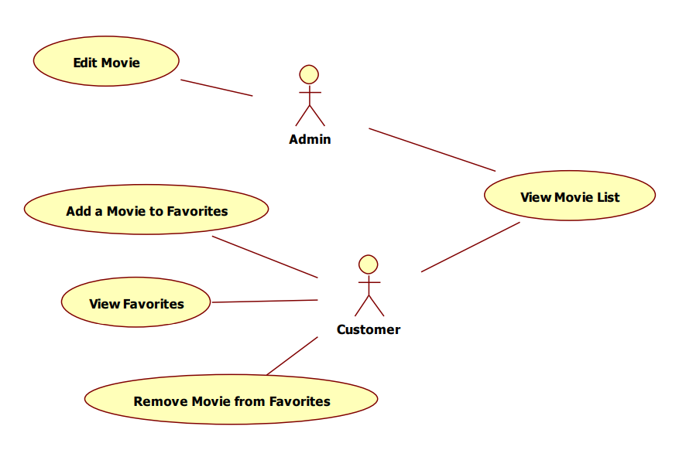
Use Case Diagram

Slide 8
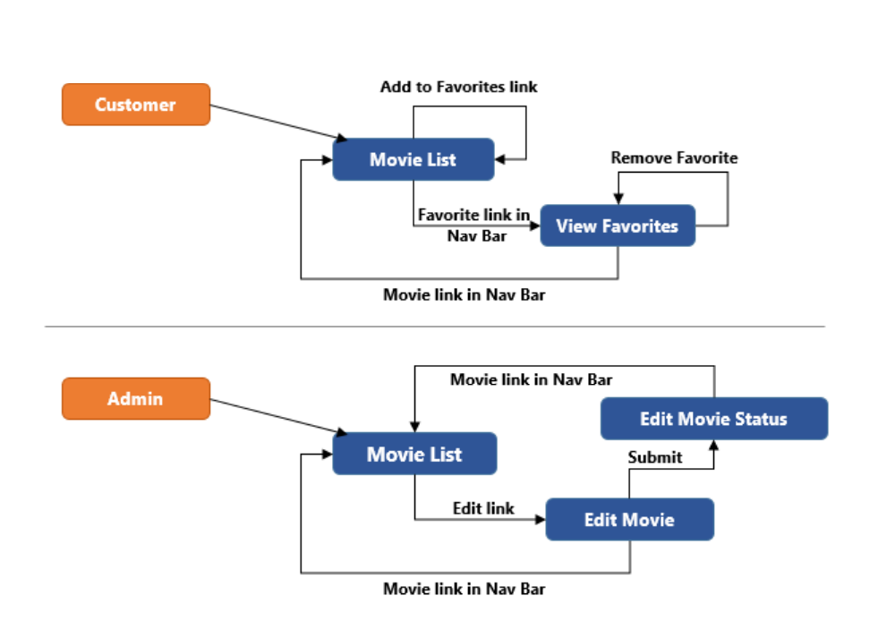
FLOW-DIAGRAM

Slide 9
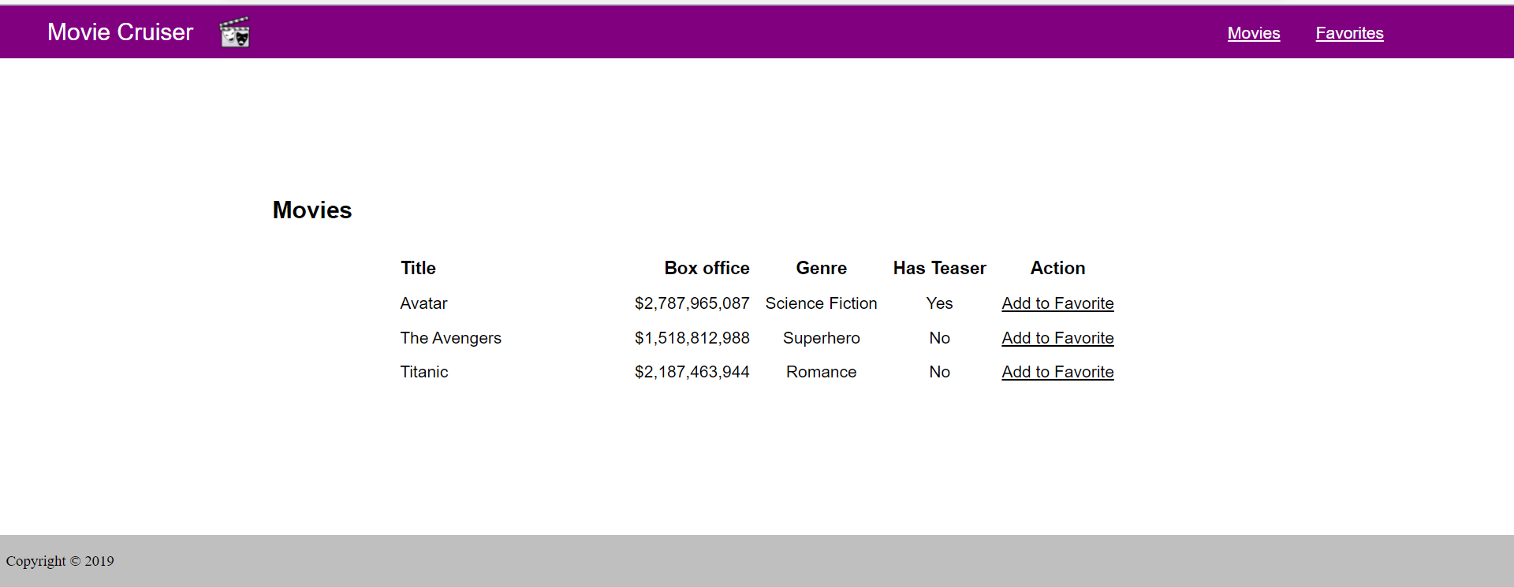
HOME PAGE - Customer

Slide 10
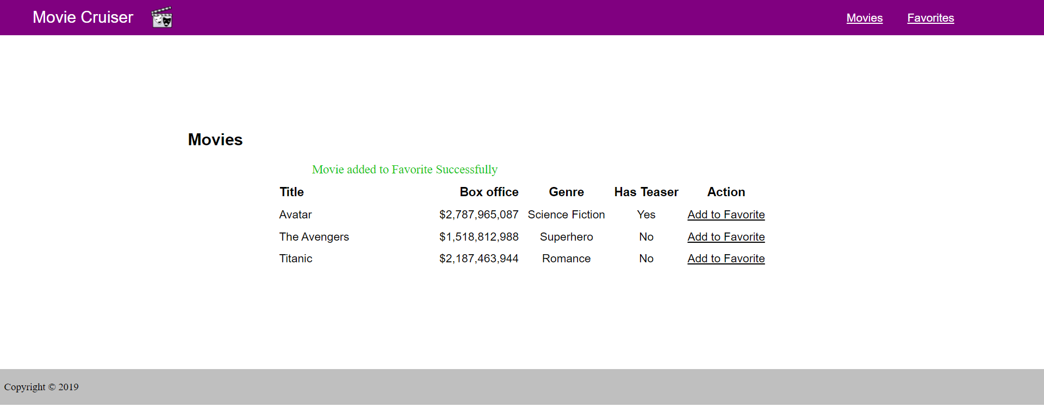
Items saved to Favorite -Customer page

Slide 11
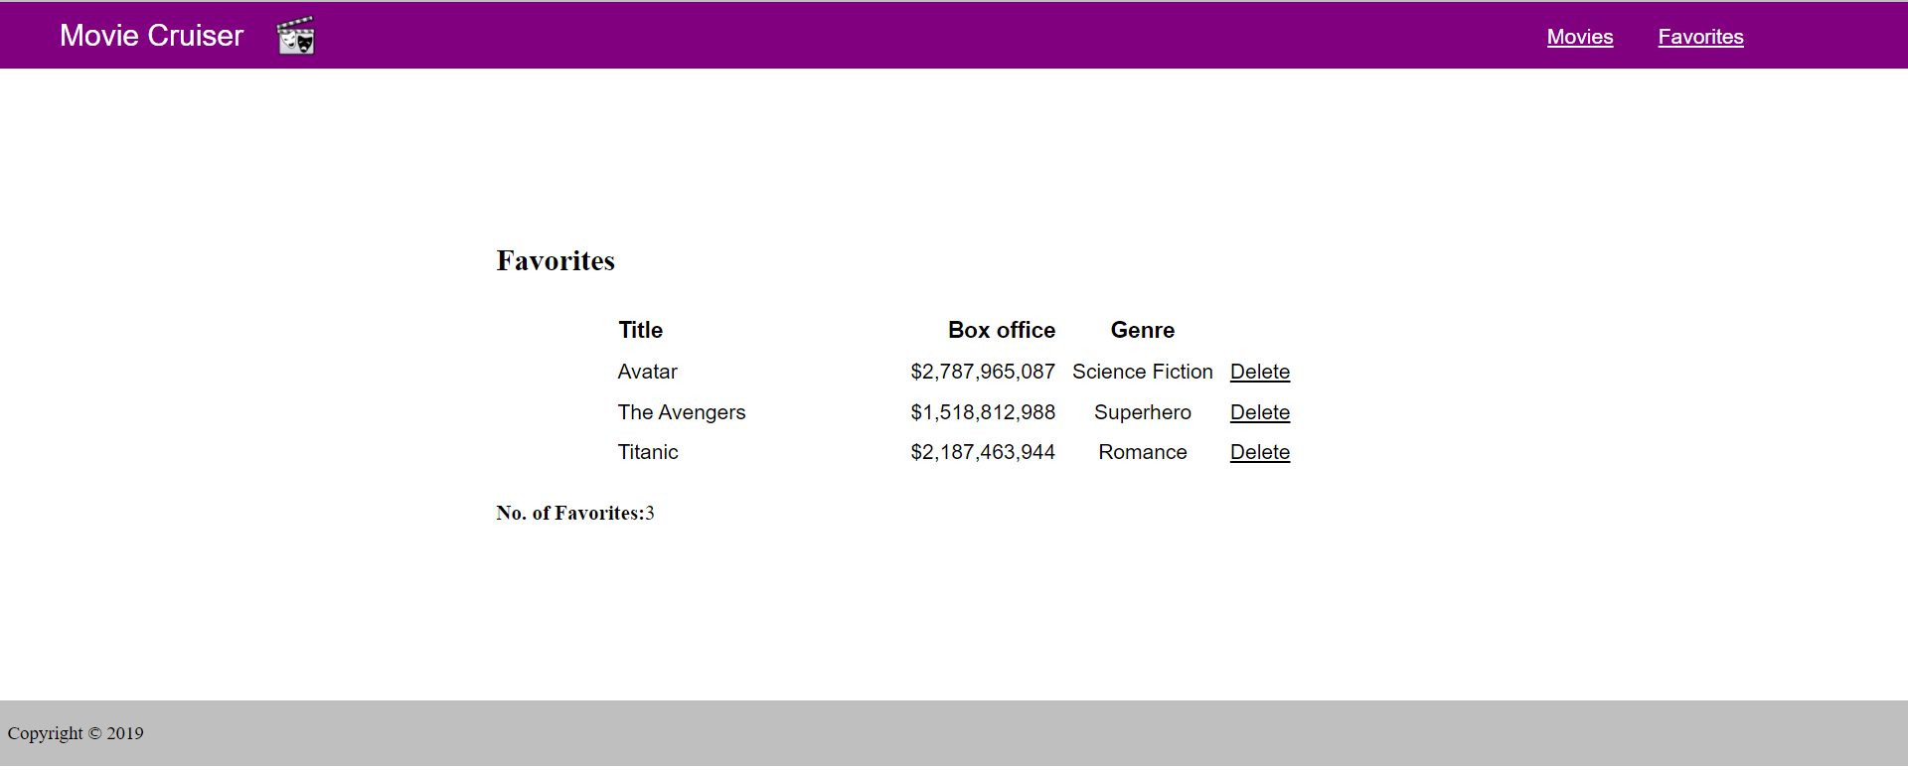
Favorite page - customer

Slide 12
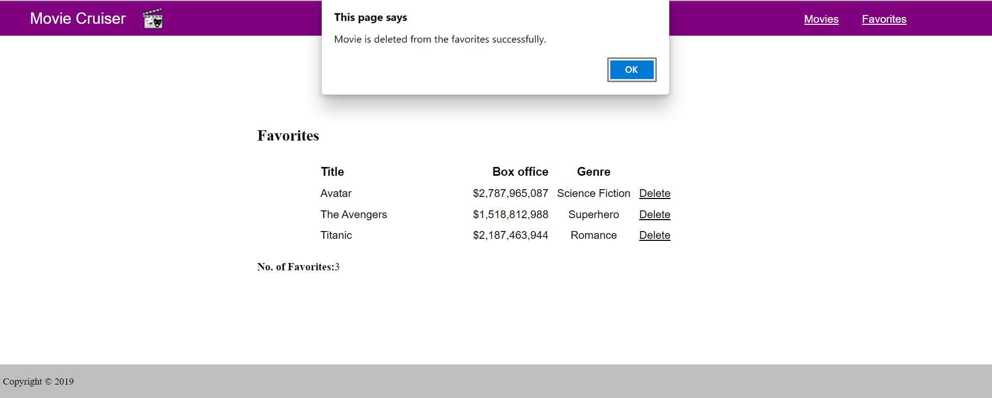
ITEM Remove from Favorite

Slide 13
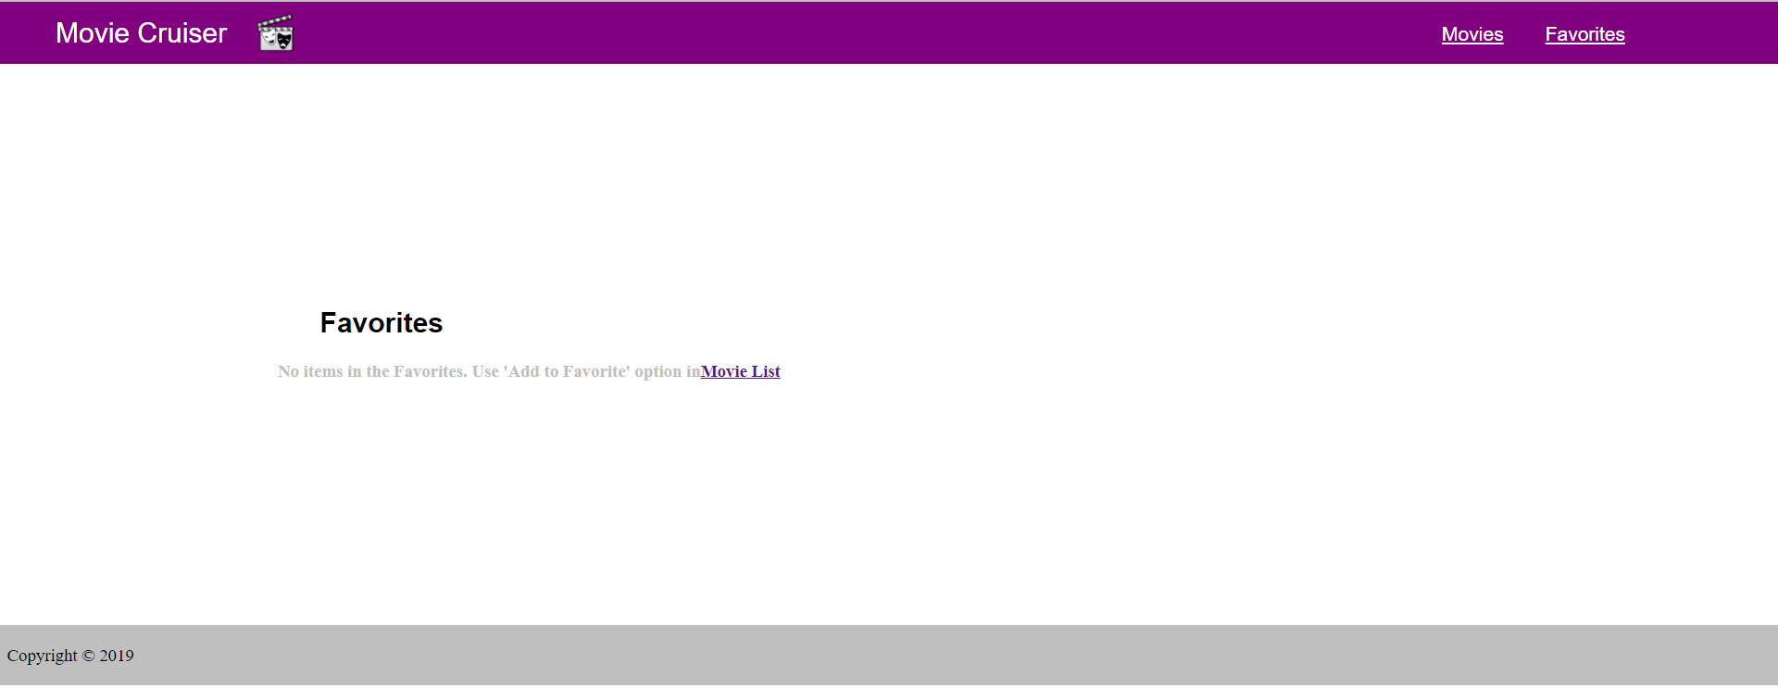
Favorite page – When no items

Slide 14
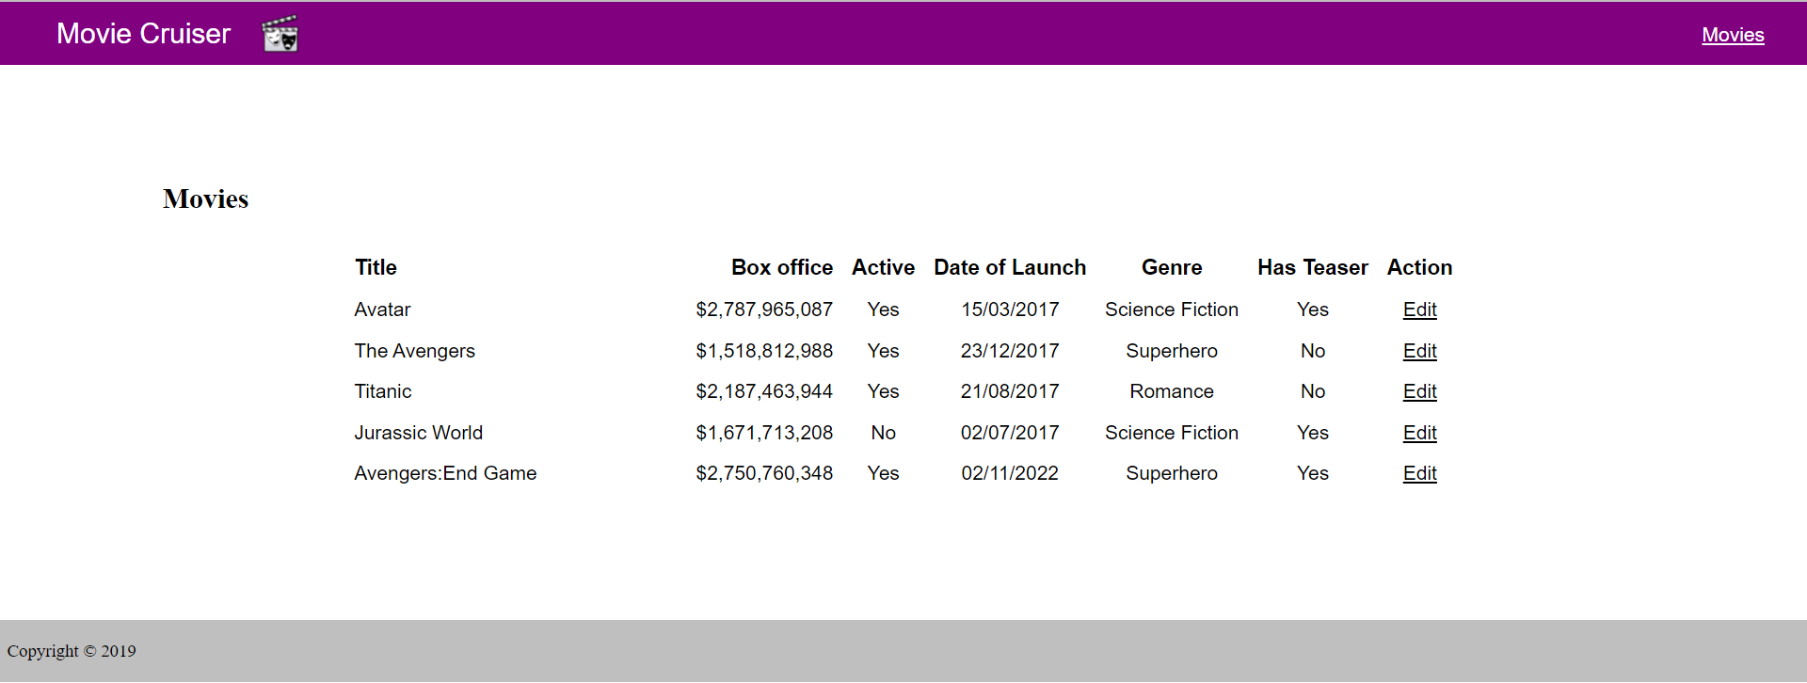
Home page - Admin

Slide 15
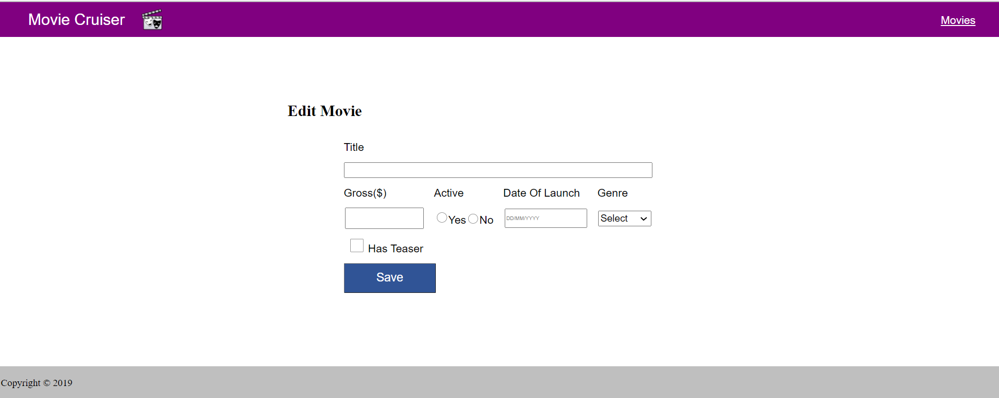
ADMIN – EDIT ITEM PAGE

Slide 16
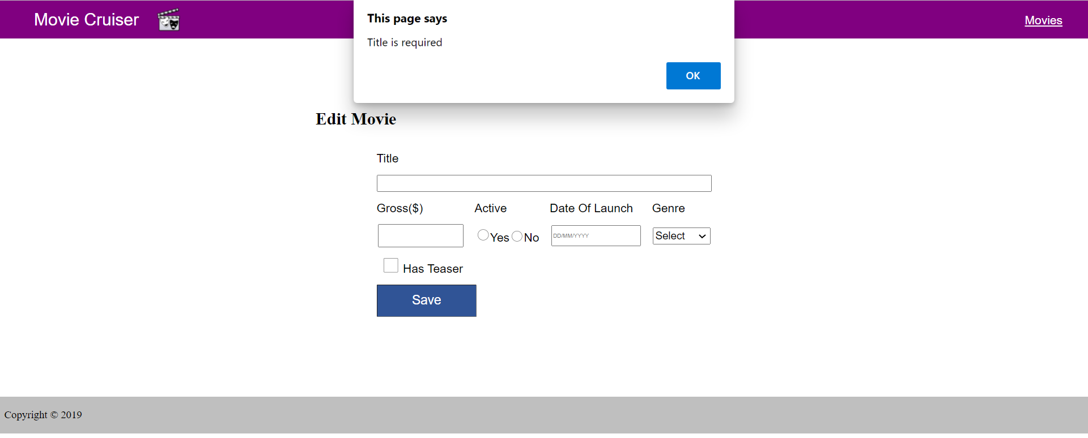

Validation on Item Edit page - ADMIN

Slide 17
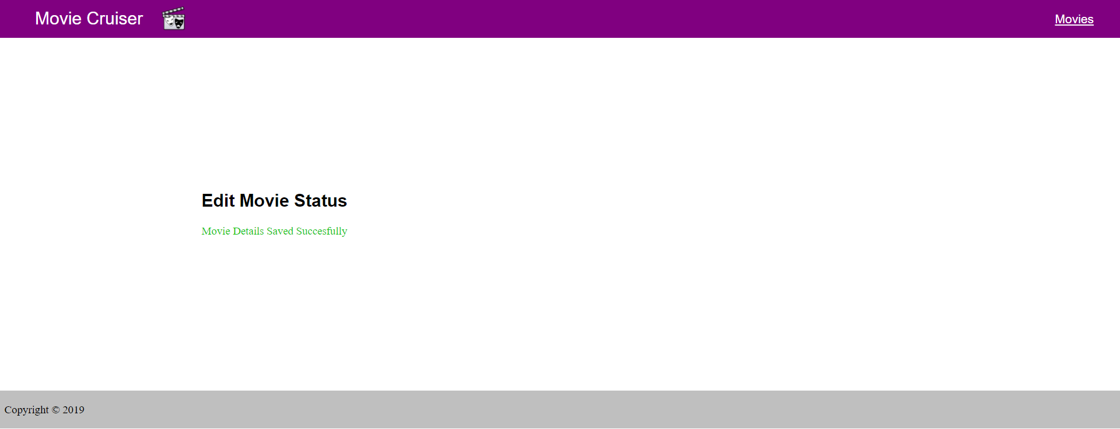
Item edit status – Admin Page

Slide 18
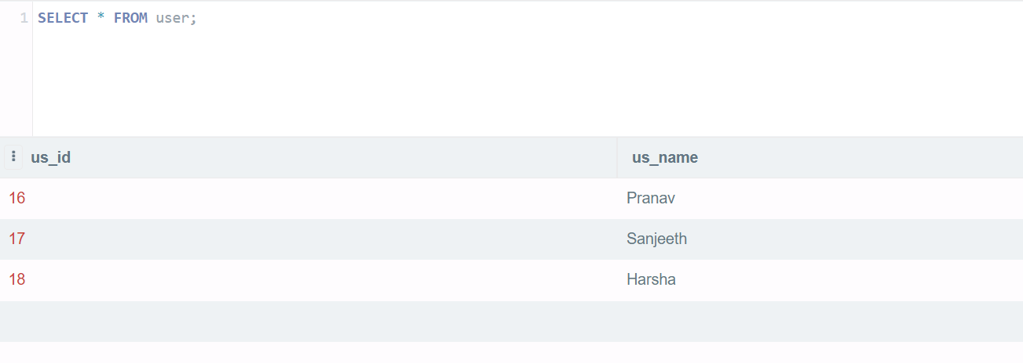
User table

Slide 19
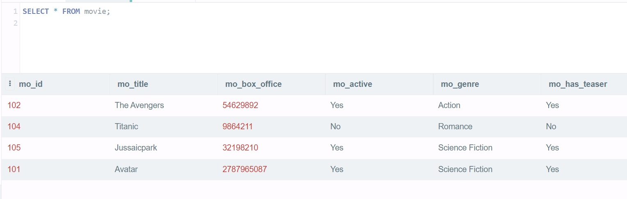
Item list

Slide 20
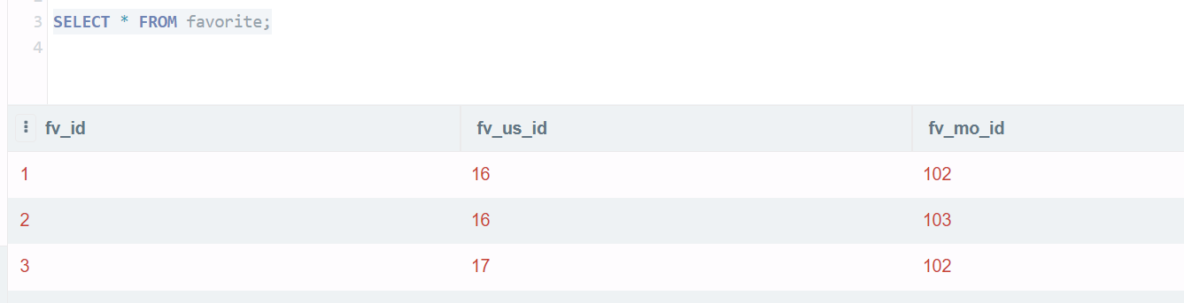
Favorite Table

Slide 21
Conclusion:
The main aim of developing is to provide user a friendly and easy way to track the Movie box office statistics The project greatly helped in understanding the various phase in website development and exposure to a new developer platform .

Slide 22
THANK YOU

