Slide 1

PRESENTATION on Truyum Stock & Cart MANAGEMENT
BY
RAMASAMY JAYARAMAN
C19102PCA6048
MINI PROJECT

Slide 2
CONTENTS
Abstract
Introduction
Software Requirements
Modules
Data Flow Diagram
Class Diagram
Conclusion

Slide 3
ABSTRACT
Truyum stock & cart management is a web-based application developed using Jsp,Java,servlet, css, javascript and mysql to register data . The proposed project for truyum Stock & Cart management is developed to provide the item stock details to the users. The is beneficial to both the admins and users. Using the online web application, the admin can do managing activities such as add new cart items , new services, edit and delete the offers and update or modify the existing price plans. It helps the users in submitting the service request and queries.

Slide 4
INTRODUCTION
The website is fully focused on viewing the stock items & price before purchasing in real for user and managing of item , helping customer with details .
So, we have developed a website by providing item details and user friendly platform for users/customers.
Store Admins to regulate the stock in real .

Slide 5
PROJECT DESCRIPTION
This project describes the Automobile spare parts &Management facilitates user to book for service. This System provides submission of all services as well as all kinds of parts are possible. This System will provide facility for user to book anytime from anywhere. This System keeps the history of the past .

Slide 6
SOFTWARE REQUIREMENTS
Hardware Requirement:
Developer Desktop PC with 4GB RAM
Software Requirement
ECLIPSE IDE
JSP , CSS , JAVA , SERVLET ,JDBC , Javascript
SQL SERVER

Slide 7
Use Case DIAGRAM

Slide 8
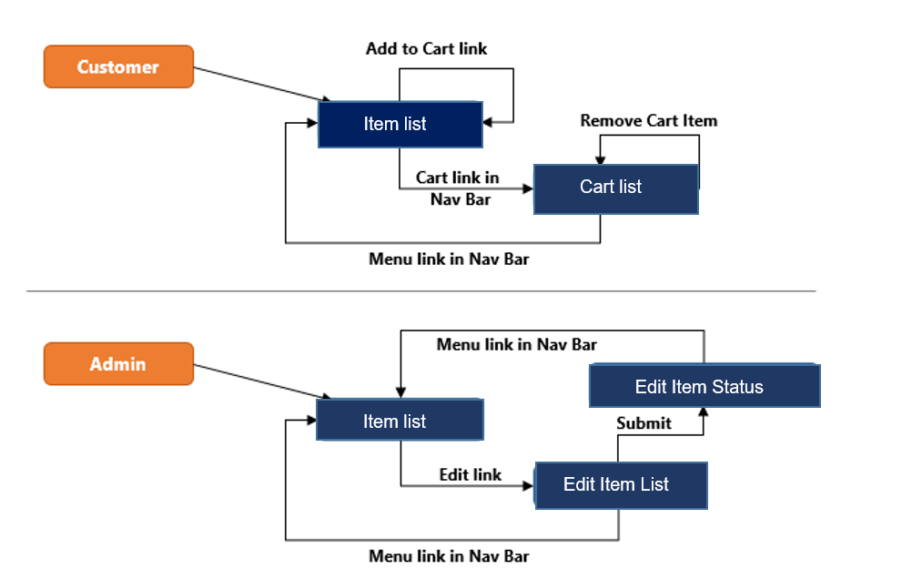
FLOW-DIAGRAM

Slide 9
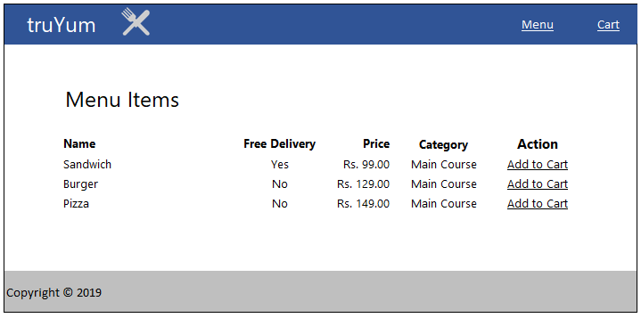
HOME PAGE - Customer

Slide 10
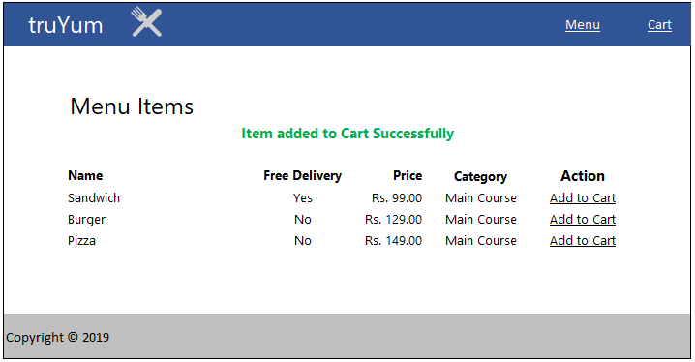
Items saved to cart – Customer page

Slide 11
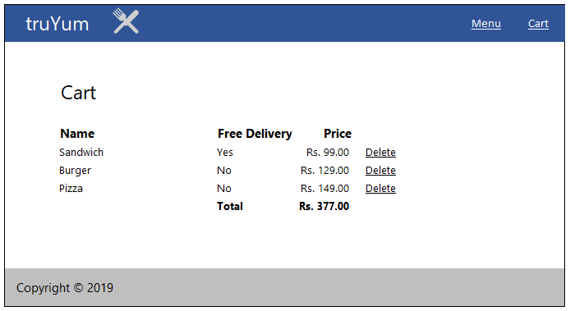
Cart page - customer

Slide 12
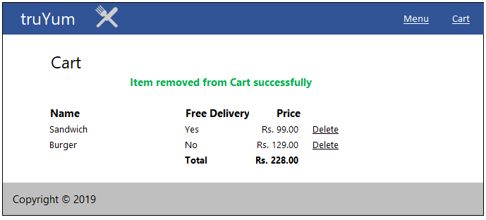
ITEM Remove from Cart

Slide 13
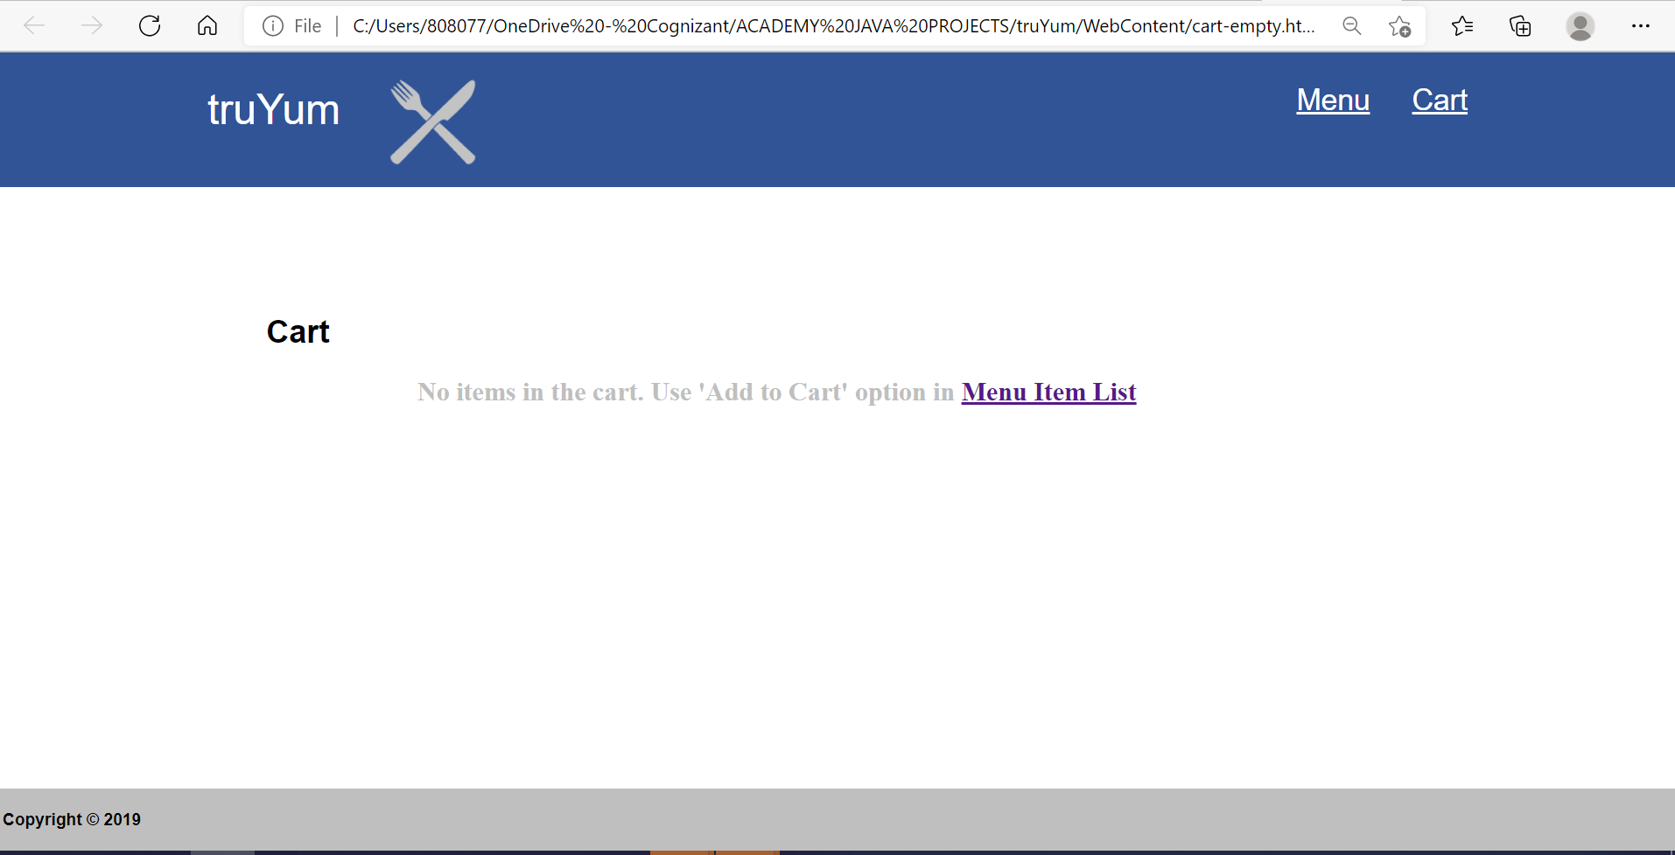
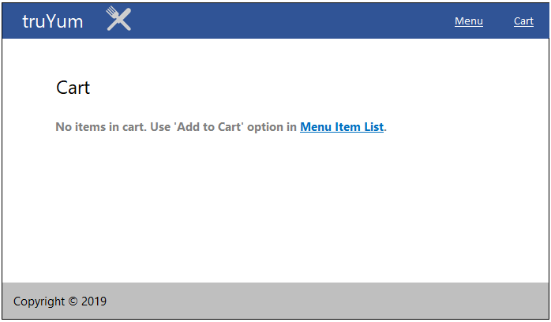
Cart page – When no items

Slide 14
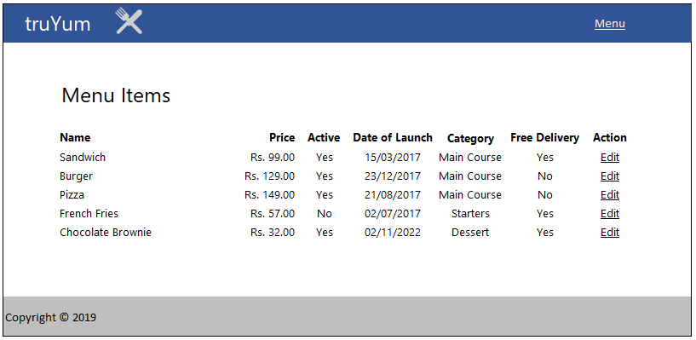
Home page - Admin

Slide 15
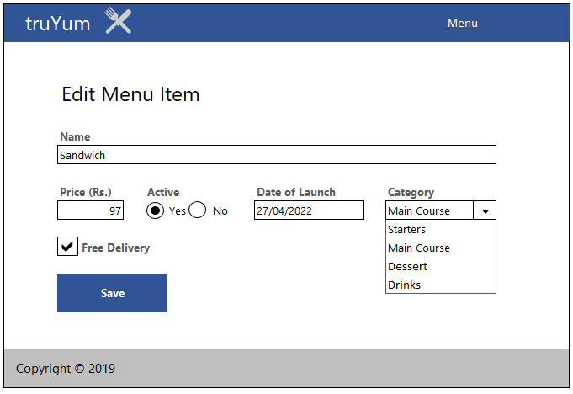
ADMIN – EDIT ITEM PAGE

Slide 16
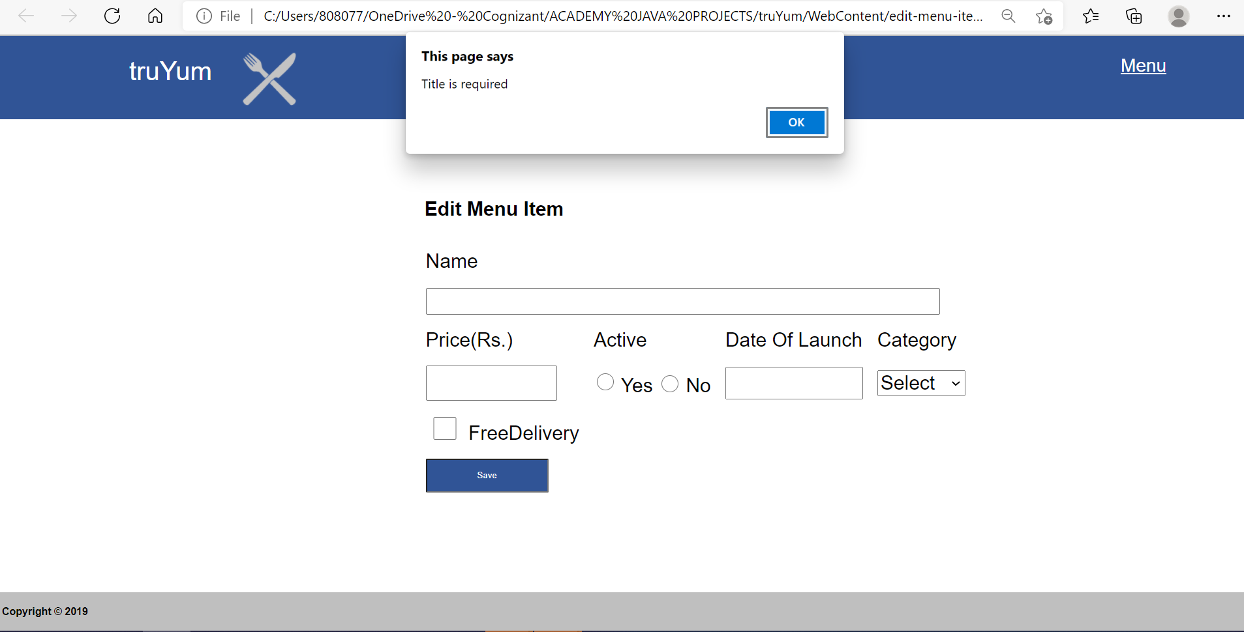
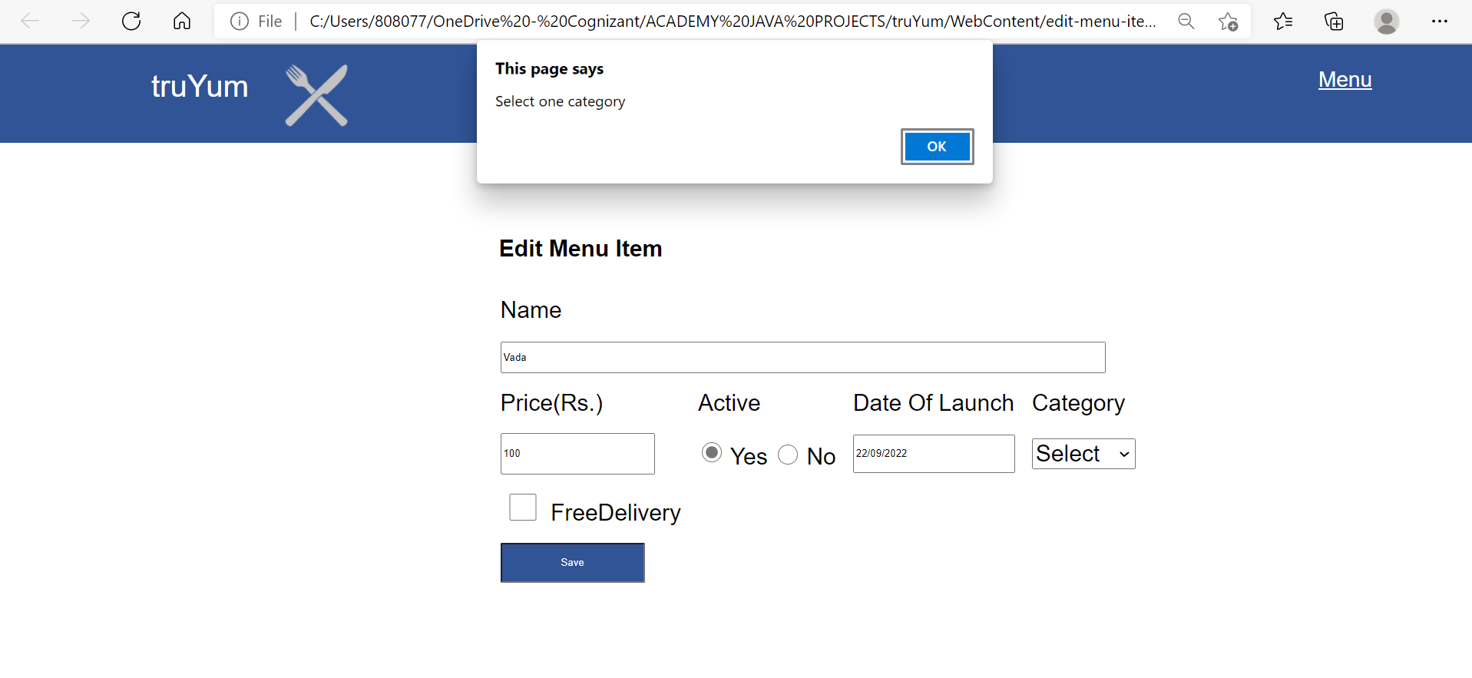
Validation on Item Edit page - ADMIN

Slide 17
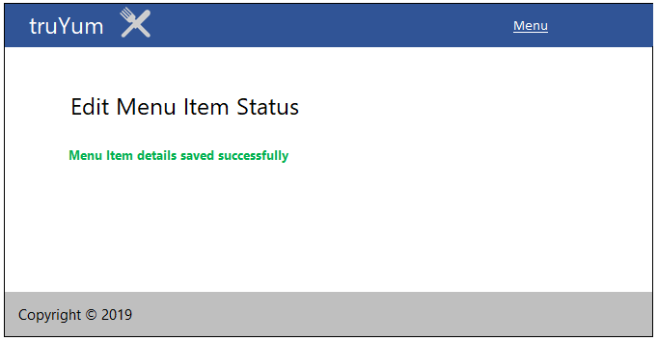
Item edit status – Admin Page

Slide 18
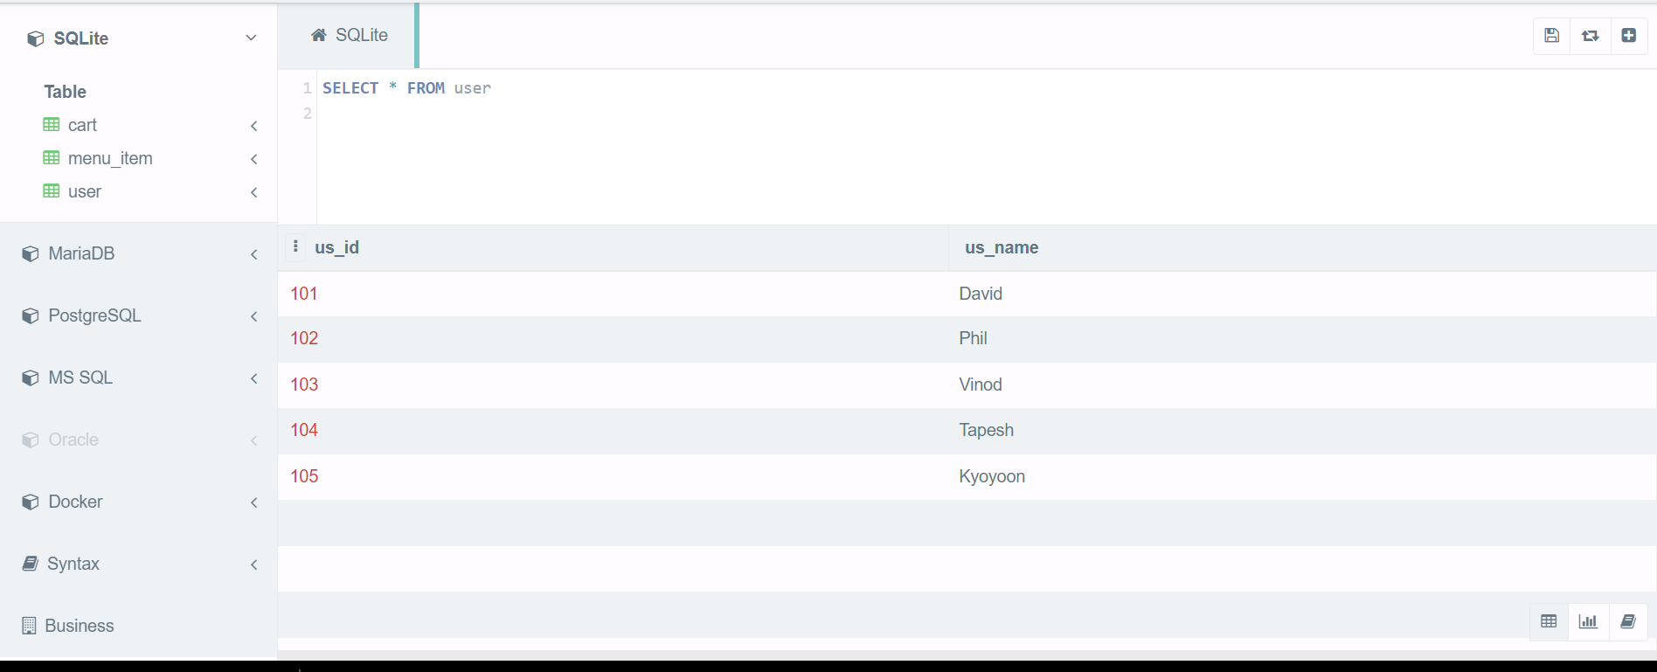
User table

Slide 19
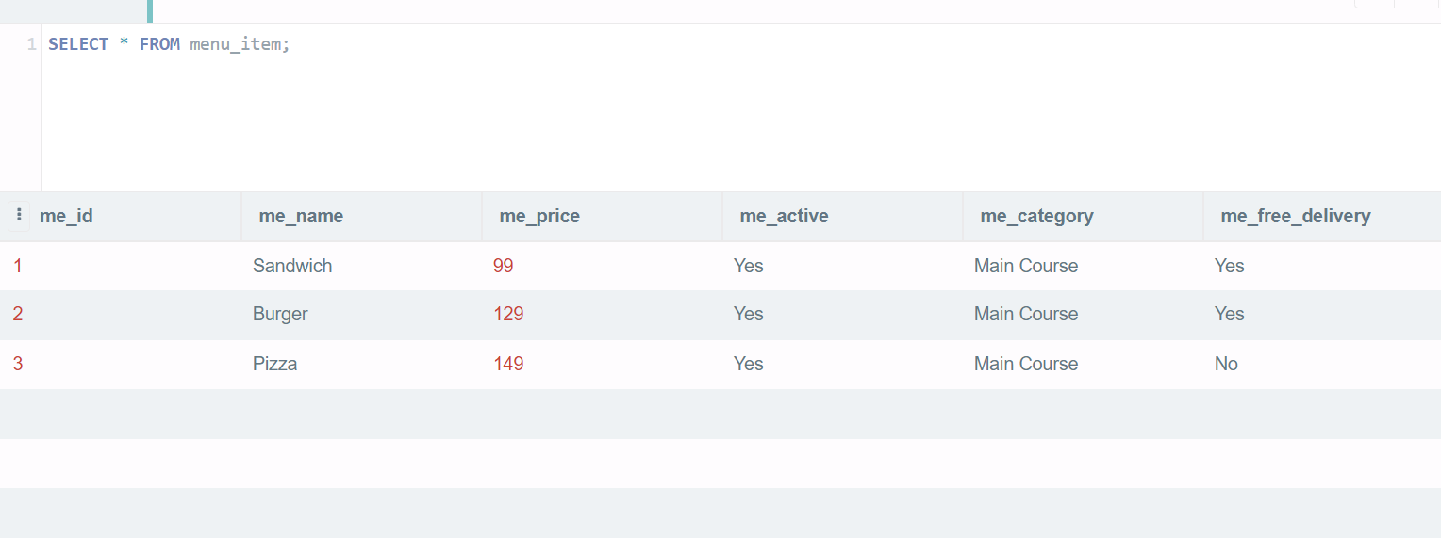
Item list

Slide 20
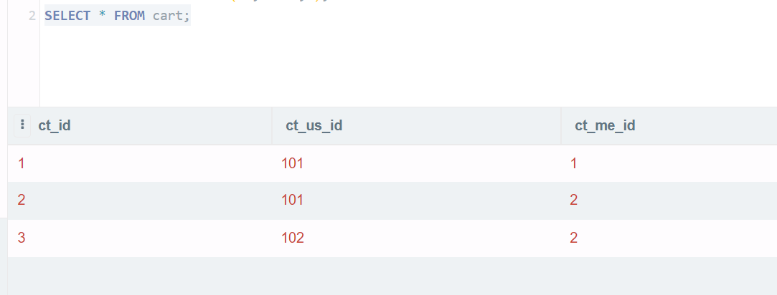
Cart Item Table

Slide 21
CONCLUSION
The main aim of developing Truyum Stock & Cart Management system is to provide user a friendly and easy way to handle inventory in our website.
The project greatly helped in understanding the various phase in website development and exposure to a new developer platform .

Slide 22
THANK YOU

