Slide 1
Data Cleaning and Preprocessing for Housing Dataset
Created by : - Sai Prakhya
Date: - 8/26/2024
Role: - Junior Data Scientist

Slide 2

Project Overview
The primary objective of this project is to preprocess and clean a housing dataset to ensure its suitability for predictive modeling. The process involved conducting an initial exploratory analysis to understand the dataset's structure, identify key issues like missing values and outliers, and address these challenges through careful data cleaning. Key transformations included encoding categorical variables and scaling numerical features to standardize the data for machine learning algorithms. Throughout the process, every decision was documented and justified to ensure transparency and provide clear guidance to the modeling team. The final outcome is a clean, well-structured dataset, ready for use in building accurate and effective models.

Slide 3
Initial Data Exploration
The initial data exploration phase involved loading the housing dataset and conducting a preliminary analysis to gain insights into its structure and content. Key steps included examining the dataset’s dimensions, checking for missing values, and understanding the distribution of numerical and categorical features. This exploration helped identify potential issues such as incomplete data and outliers, setting the stage for more focused cleaning and transformation. Summary statistics and visualizations were used to highlight these aspects, providing a clear picture of the dataset's current state before any modifications were made.

Slide 4
Dataset Overview
The dataset comprises 5,000 entries with 16 columns, including both numerical and categorical features. Key attributes include property details such as sold_price, zipcode, lot_acres, bedrooms, and bathrooms, among others. The dataset is mostly complete, with a few missing values across columns like lot_acres, bathrooms, sqrt_ft, garage, kitchen_features, and HOA. The initial exploration revealed some significant outliers, especially in attributes like bedrooms, bathrooms, and sqrt_ft, which have unusually high maximum values. This exploration set the stage for targeted data cleaning, addressing issues such as missing values and outliers to ensure the dataset's suitability for predictive modeling.

Slide 5
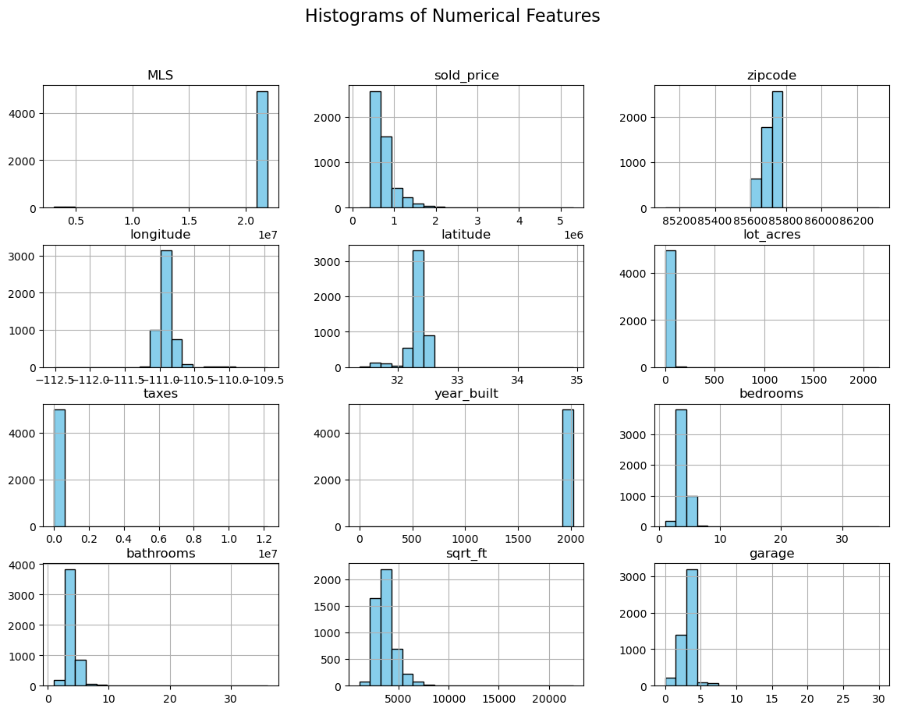

Slide 6
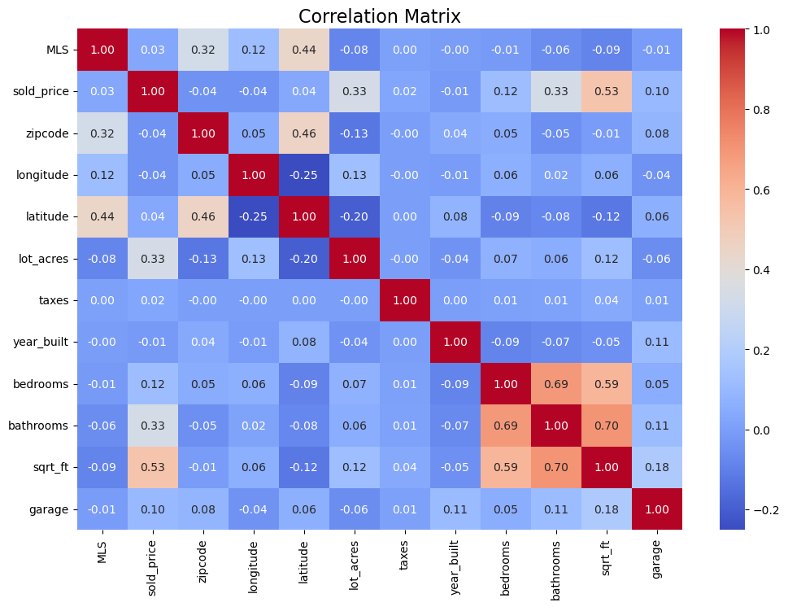

Slide 7
