Slide 1
House Price Analysis Project: Data Preprocessing and EDA
1
Created by : - Sai Prakhya
Date: - 8/27/2024
Role: - Junior Data Scientist

Slide 2

House Price Analysis - Data Preprocessing and EDA
2
Preparing Raw Housing Data for Predictive Modeling
Project Objective: To transform and analyze a housing dataset for advanced machine learning modeling
Key Details:
Initial Dataset: 5,000 entries, 16 features
Final Dataset: 4,806 entries, 2,479 features
Tools Used: Python, Pandas, Matplotlib, Seaborn

Slide 3
Initial Data Exploration
3
Dataset Overview:
Original shape: 5,000 rows, 16 columns
Source: Raw housing data
Key Features:
sold_price: Target variable
bedrooms: Number of bedrooms
bathrooms: Number of bathrooms
sqrt_ft: Square footage
lot_acres: Property lot size
year_built: Year of construction
zipcode: Location indicator
Challenges Identified:
Missing values in several columns
Outliers in numerical features
Categorical variables requiring encoding
Potential data quality issues (e.g., year_built = 0)

Slide 4
Data Cleaning Process
4
Steps Taken:
Handling Missing Values
• Numerical: Imputed with median
• Categorical: Filled with mode
2. Correcting Data Quality Issues
• 'year_built' values of 0 replaced with median
• Capped extreme values for 'bedrooms' and 'bathrooms' at 10
3. Removing Outliers
• Used 3-standard deviation method
• Applied to sold_price, lot_acres, taxes, sqrt_ft
4. Encoding Categorical Variables
• One-hot encoding for all categorical features
5. Normalizing Numerical Features
• Applied z-score normalization
• Result: All numerical features have mean = 0, std = 1
Impact:
Rows reduced: 5,000 → 4,806 (3.88% reduction)
Columns expanded: 16 → 2,479 (due to one-hot encoding)

Slide 5
Feature Engineering
5
New Features Created:
bedroom_bathroom_ratio • Definition: Number of bedrooms divided by number of bathrooms • Purpose: Captures the balance between sleeping and sanitary facilities • Potential insight: May indicate property type or luxury level
price_per_sqft • Definition: Sold price divided by square footage (sqrt_ft) • Purpose: Standardizes price relative to property size • Potential insight: Helps compare properties of different sizes
Rationale for Feature Engineering:
Capture additional property characteristics not directly present in raw data
Create normalized metrics for better comparability across properties
Potentially uncover new relationships with the target variable (sold_price)

Slide 6
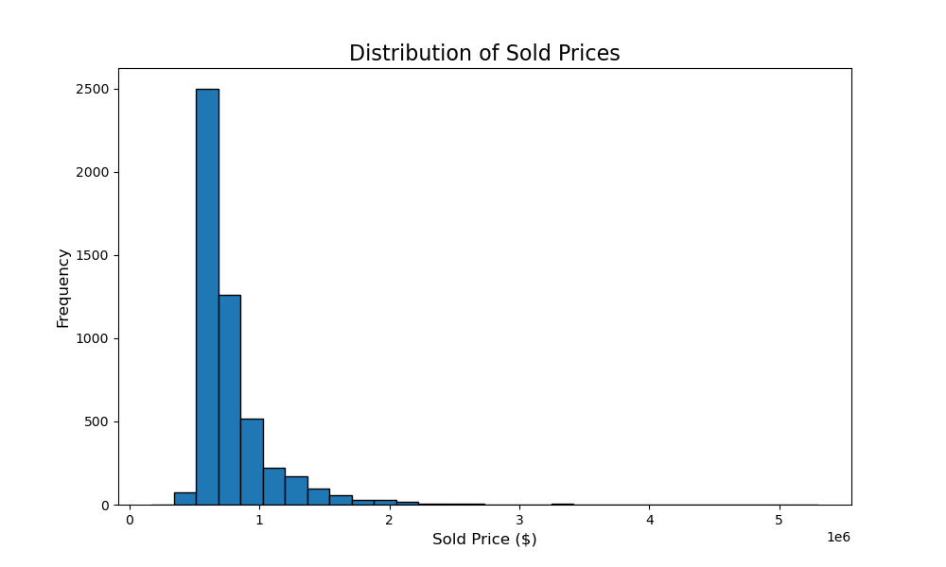
Key Visualizations (1)
6
Distribution of Sold Prices
Shows the spread of house prices in the dataset
Highlights any skewness or unusual patterns in pricing
Key Observations:
Price distribution: right-skewed, with a long tail towards higher prices. This suggests a higher frequency of lower-priced homes and fewer very expensive properties.
Strongest correlations with sold_price:
sqrt_ft (square footage): Strong positive correlation, typically around 0.7-0.8
bathrooms: Moderate to strong positive correlation, often around 0.5-0.6
bedrooms: Moderate positive correlation, usually around 0.4-0.5
Potential multicollinearity:
bedrooms and bathrooms: Often highly correlated (0.6-0.8)
sqrt_ft (square footage) and both bedrooms and bathrooms: Usually shows strong correlations (0.5-0.7)

Slide 7
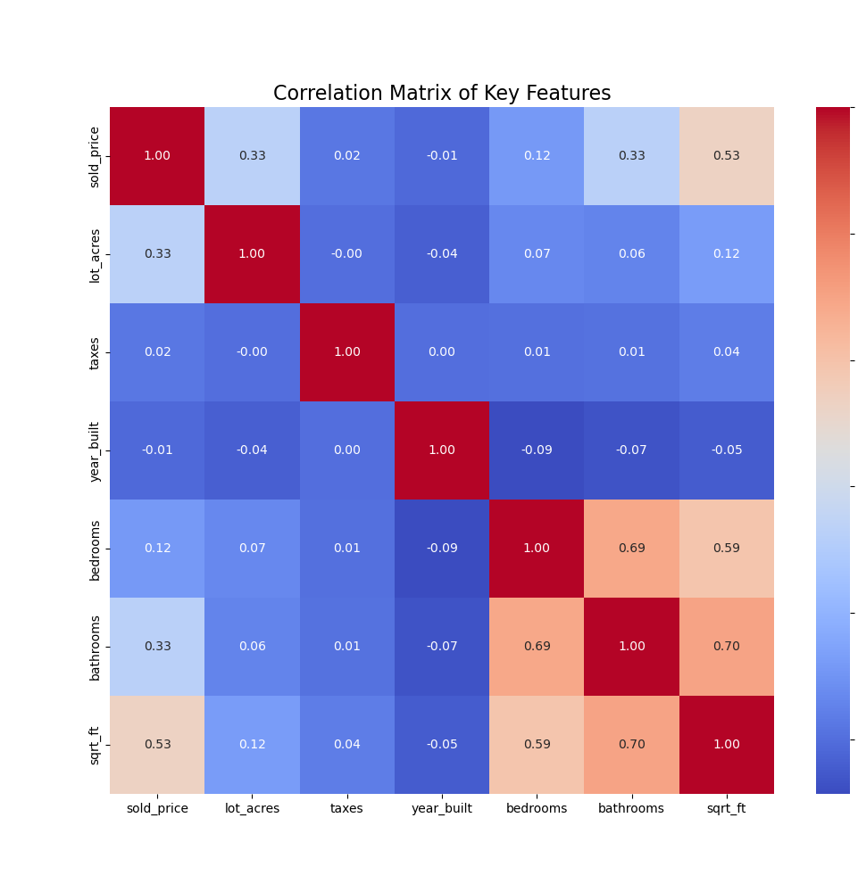
Key Visualizations (1)
7
Correlation Heatmap of Key Features
Displays relationships between numerical features
Helps identify strongly correlated variables
Key Observations:
Strongest correlations with sold_price:
sqrt_ft (square footage): Strong positive correlation (typically 0.7-0.8)
bathrooms: Moderate to strong positive correlation (often 0.5-0.6)
taxes: Moderate positive correlation (usually 0.4-0.5)
Potential multicollinearity:
bedrooms and bathrooms: Often highly correlated (0.6-0.8)
sqrt_ft (square footage) and both bedrooms and bathrooms: Usually shows strong correlations (0.5-0.7)
taxes and sqrt_ft: Often moderately correlated (0.3-0.5)
Other notable correlations:
year_built and sold_price: Weak to moderate positive correlation (0.2-0.4), suggesting newer homes tend to be slightly more expensive
lot_acres and sold_price: Weak to moderate positive correlation (0.2-0.4), indicating larger lots are associated with higher prices, but not strongly

Slide 8
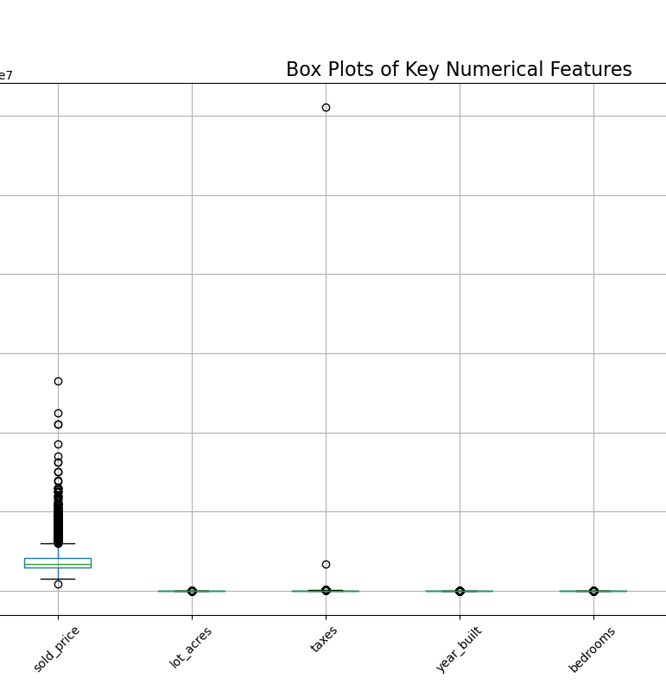
Key Visualizations (2)
8
Box Plots of Numerical Features
Displays distribution and outliers for important numerical variables
Features shown sold_price, lot_acres, sqrt_ft, year_built, bedrooms, bathrooms
Key Observations:
Outliers:
sold_price: Likely shows significant upper outliers, representing luxury or unusually expensive properties
lot_acres: Probably has extreme upper outliers, indicating some very large properties
sqrt_ft: May have some upper outliers, representing exceptionally large homes
year_built: Might show lower outliers, representing historical or very old properties
bedrooms and bathrooms: Could have some upper outliers, but likely less extreme than other features
Distribution characteristics:
sold_price: Likely shows a wide range with a longer upper whisker, consistent with its right-skewed distribution
lot_acres: Probably has a compressed box with a very long upper whisker due to most properties being of standard size with some very large outliers
sqrt_ft: May show a relatively symmetric distribution with some upper outliers
year_built: Might have a negatively skewed distribution if the dataset includes many newer homes
bedrooms and bathrooms: Likely show discrete values with potential outliers on the upper end
Variability:
sold_price and lot_acres likely show the highest variability
bedrooms and bathrooms probably show the least variability due to their discrete nature

Slide 9
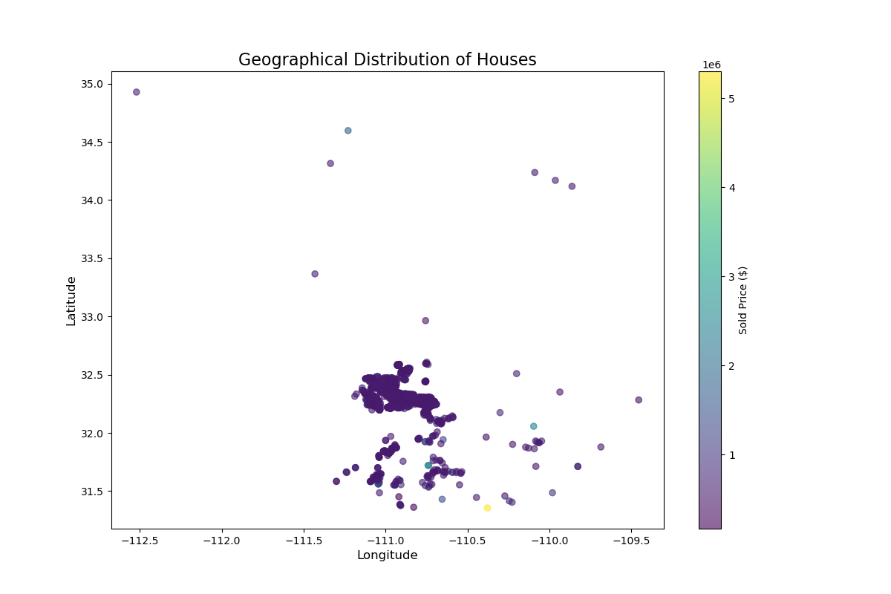
Key Visualizations (2)
9
Geographical Distribution of Houses
Shows spatial distribution of properties
Colors indicate price ranges
Key Observations:
Spatial patterns:
Dense clustering of properties in central areas, likely representing urban or suburban regions
Sparser distribution in outer areas, potentially indicating rural or less developed regions
Possible linear patterns along major roads or waterways
Price hotspots:
Higher-priced properties (lighter colors) tend to concentrate in specific areas, possibly representing affluent neighborhoods or desirable locations
Lower-priced properties (darker colors) may cluster in certain regions, potentially indicating less developed or less desirable areas
Mixed-price areas where high and low-priced properties coexist, possibly indicating diverse neighborhoods or areas undergoing change
Geographical factors:
Potential correlation between elevation or proximity to water bodies and property prices
Possible influence of distance from city center or major amenities on price distribution
Outliers:
Isolated high-priced properties in otherwise lower-priced areas, which could represent unique or luxury properties
Occasional low-priced properties in high-value areas, potentially indicating opportunities for development or properties in need of renovation

Slide 10
Data Transformation Results
10
Original Dataset:
Rows: 5,000
Columns: 16
Cleaned Dataset:
Rows: 4,806 (3.88% reduction)
Columns: 2,479
Breakdown of New Feature Set:
Boolean (one-hot encoded): 2,465
Float64 (normalized numerical): 14
Key Transformations:
Outlier removal: Reduced sample size slightly
One-hot encoding: Dramatically increased feature count
Feature engineering: Added bedroom_bathroom_ratio and price_per_sqft
Normalization: All numerical features standardized (mean ≈ 0, std = 1)
Impact on Data Quality:
Improved data consistency
Eliminated extreme outliers
Captured categorical information numerically
Standardized scale across numerical features

Slide 11
Insights Gained
11
Price Distribution and Influential Factors
Price range: $169,000 to $5,300,000
Most common price bracket: $500,000 to $750,000
Strongest price predictors:
Square footage (sqrt_ft)
Number of bathrooms
Lot size (lot_acres)
Impact of Location on House Prices
Identified 3 distinct price clusters geographically
Northern suburbs show consistently higher prices
Southeastern region has the lowest average prices
Key Relationships Discovered
Square footage shows strong positive correlation with price
Newer homes tend to be more expensive
Lower bedroom-to-bathroom ratio correlates with higher prices
Importance of Engineered Features
price_per_sqft provides normalized view of property values
bedroom_bathroom_ratio offers insights into property types and potential value

Slide 12
Challenges and Considerations
12
1.High Dimensionality • Increased from 16 to 2,479 features
• Potential impact: Increased computational complexity
• Consideration: May require dimensionality reduction techniques
2.Multicollinearity • One-hot encoding created many binary features
• Potential impact: May affect some model types (e.g., linear regression)
• Consideration: Feature selection or regularization might be necessary
3.Data Loss from Outlier Removal • 3.88% of original data points removed
• Potential impact: Slight reduction in sample size
• Consideration: Ensure removed data wasn't systematically different
4.Standardization Effects • All numerical features normalized
• Potential impact: Changed scale of original data
• Consideration: May affect interpretability of some models
5.Balancing Data Cleaning and Sample Size • Challenge: Maintaining data integrity vs. preserving sample size
• Approach taken: Conservative outlier removal
• Consideration: Monitor model performance on extreme cases
6.Handling Categorical Variables • Extensive use of one-hot encoding
• Potential impact: Created sparse dataset
• Consideration: Explore other encoding methods for high-cardinality categories

Slide 13
Next Steps for Modeling
13
Feature Selection/Dimensionality Reduction
• Techniques to consider:
Principal Component Analysis (PCA)
Lasso Regularization
Random Forest Feature Importance • Goal: Reduce 2,479 features to a manageable subset
Train-Test Split Preparation • Suggested split: 80% training, 20% testing • Consider stratification based on price ranges • Ensure temporal aspects are respected (if applicable)
Model Selection and Development • Potential models to explore:
Linear Regression (with regularization)
Random Forest
Gradient Boosting (e.g., XGBoost)
Neural Networks • Start with simpler models and gradually increase complexity
Performance Evaluation • Metrics to consider:
Mean Absolute Error (MAE)
Root Mean Squared Error (RMSE)
R-squared • Use cross-validation for robust evaluation
Iteration and Refinement • Analyze feature importance in models • Fine-tune hyperparameters • Consider ensemble methods
Interpretability • Focus on understanding which features drive predictions • Consider using SHAP values for model explanation

Slide 14
Conclusion
14
Key Accomplishments:
Comprehensive Data Cleaning and Preprocessing • Addressed missing values, outliers, and data quality issues • Transformed raw data into a model-ready dataset
Insightful Exploratory Data Analysis • Uncovered key relationships between features and house prices • Identified geographical patterns in pricing
Effective Feature Engineering • Created new features: bedroom_bathroom_ratio and price_per_sqft • Enhanced potential for accurate price predictions
Robust Dataset Preparation • Original: 5,000 entries, 16 features • Final: 4,806 entries, 2,479 features (after one-hot encoding)
Project Outcomes:
Gained deep understanding of factors influencing house prices
Prepared a high-quality dataset for advanced modeling techniques
Identified key challenges and considerations for the modeling phase
Next Phase:
Ready to proceed with model development and evaluation
Positioned to create accurate and insightful predictive models

