Slide 1
Trace Cache
Ramachandran Sekanipuram Srikanthan
Hari Vignesh Baskar

Slide 2
Key Idea
Fetch bandwidth requirements increase with increase in issue width.
IPC decrease due to non contiguous instruction location.
Aggressive ILP techniques are hindered by fetch bandwidth bottleneck.
Idea is to supplement conventional I cache with a trace cache.
This caches the dynamic instruction traces.
This aligns non contiguous instructions together to be fetched directly from the trace cache.

Slide 3
Micro Architecture Description
Checks for hit logic of T$ and checks in core fetch unit
Fetch 1
Trace Cache
Core Fetch unit
Mux to select based on T$ hit logic
Build the Trace on miss and passes to decode
Fetch 2

Slide 4
Trace selection Policy
For T$ with associativity more than 1, we use a Least Recently Used (LRU) Replacement Policy to replace the victim block.
T$ can contain maximum n instructions and maximum m branches.
Terminate T$ filling mechanism once call direct, jump indirect, call indirect, return and system calls.
Traces with no branches are discarded.

Slide 5
T$ filling mechanism
Conditions:
Max Conditional branch reached.
Call direct.
Jump indirect.
Call indirect.
Return.
System Calls.
T$ hit?
Y
N
Fill Trace buffer
Get instructions from T$
N
conditions
Y
Continue filling
Terminate

Slide 6
Trace Cache structure configuration
Fetch Width = 16
Decode Width = 16
Issue Width = 16
Retire Width = 16
Fetch Queue = 64
Active List Size = 1024
LSQ = 512
Issue Queue = 256

Slide 7
Performance Overview
Various Configurations (Benchmark: 473.astar_rivers_ref.252.0.28).
Perfect Baseline
Real T$ Real T$ and branch prediction
Branch prediction -> perfect
L1 data cache -> perfect
L1 Instruction cache -> Perfect
Trace cache -> Perfect
Oracle Memory disambig
Branch prediction -> Real
L1 data cache -> perfect
L1 Instruction cache -> Real
Trace cache -> No
Oracle Memory disambig
Branch prediction -> perfect
L1 data cache -> perfect
L1 Instruction cache -> Real
Trace cache -> Real
Oracle Memory disambig
Branch prediction -> Real
L1 data cache -> perfect
L1 Instruction cache -> Real
Trace cache -> Real
Oracle Memory disambig

Slide 8
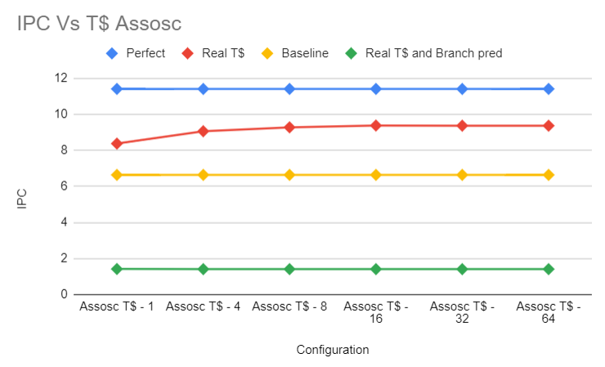
IPC VS T$ Associativity

Slide 9
IPC VS T$ Associativity Inference
The T$ size is fixed with 32KB and associativity is varied from 1,4,8,16,32 to 64.
There is a good increase from the baseline no T$ configuration to all perfect T$ configuration.
The reason being that having a larger associativity can increase the number of locations to store the traces whose start PC’s maps to same address in the T$.
We can also observe that having a real branch predictor with a real T$ decreases the performance clearly stating that performance improvement of T$ depends on the Branch predictor accuracy.

Slide 10
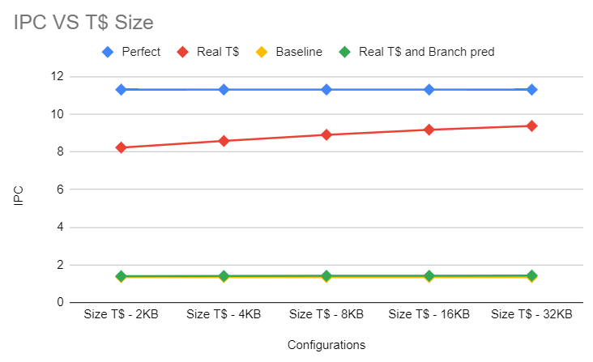
IPC Vs T$ size

Slide 11
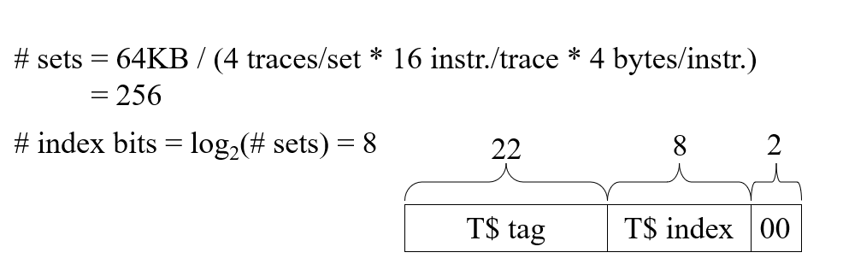
IPC Vs T$ size - Inference
The size of T$ is varied from 2KB to 32KB by keeping associativity fixed at 4.
The IPC while using a Real Trace cache with a perfect branch prediction increases from that of IPC without using Trace cache.
The increase in size of T$ causes increase in number of sets for a given associativity thereby increasing the number of available slots to store the dynamic instructions.

Slide 12
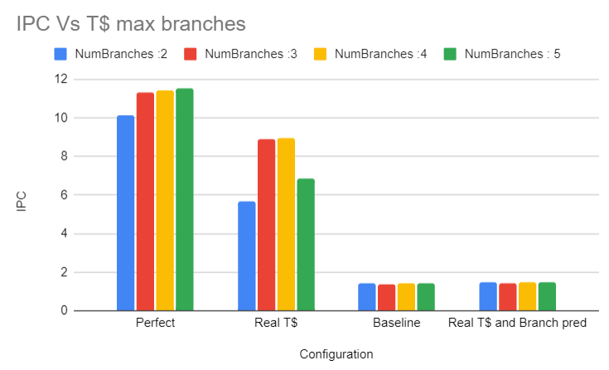
IPC VS T$ Max branches

Slide 13
IPC VS T$ Max Cond.branches Inference
The T$ size is fixed for 2KB and the maximum number of conditional branches are increased from 2 to 5 keeping all other parameters fixed.
We can observe that increase in number of branches increases the IPC in case of Perfect config and Real T$ config.
They tend be much more than the base line no T$ config.

Slide 14
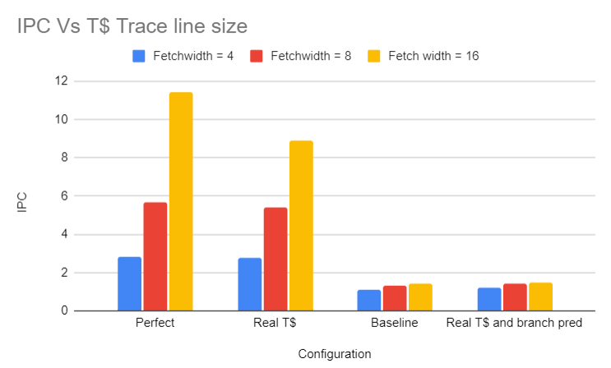
IPC Vs T$ Trace line Size

Slide 15
IPC Vs T$ Trace line Size Inference
The T$ trace line size is increased from 4 to 16 which same as increasing the fetch unit width by keeping all other parameters fixed.
We can see that increase in the trace line size causes a drastic increase in performance for perfect and Real T$.
The performance also improves for Real T$ and Real branch prediction mechanism.

Slide 16
Phase 2 – Adding Victim cache.
Augment T$ with Victim cache to prevent eviction of valuable traces due to the LRU policy.
The Victim cache is a fully associative cache which stores the traces which are being evicted from the T$.
This might be useful in cases where multiple branch prediction possibilities for the same PC causing more misses occurs.

Slide 17
Phase 2 – Indexing Method
Instead of having the LRU based indexing method to evict the trace blocks in set associative trace cache, we can have index derived from the fetch address and branch prediction bits.

Slide 18
Trace Selection Policy : Multiple Line fill Buffer
While the line buffer is forming a new trace, misses happening during this period is ignored currently.
Instead of ignoring, we create a new line buffer for each miss and add it to the T$.
This means that more entries will be added to the Trace Cache.

Slide 19
Questions ?

Slide 20
Thank You!!!

