Slide 1
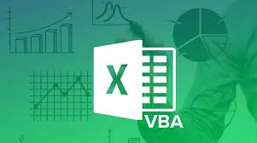
Consolidation Tool-Excel VBA
Consolidates data from multiple Excel files into a single master sheet with one-click automation.

Slide 2
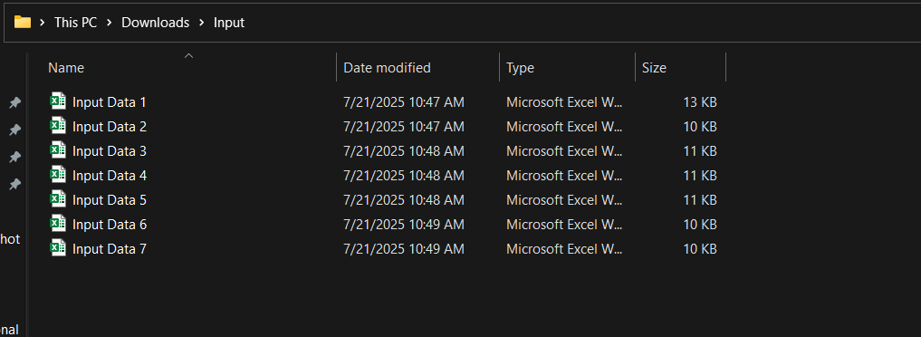
Problem Statement
Manually merging Excel files from different sources is repetitive and error-prone.
This tool allows users to select a folder, then automatically reads and appends data from all Excel files into a single master sheet.

Slide 3
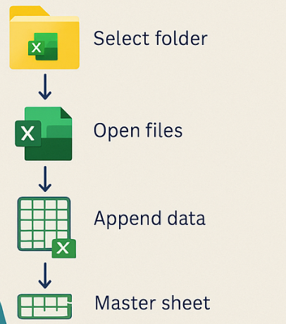
Project Overview
Prompts user to select a folder
Reads each Excel file in the folder
Extracts and appends data to a master sheet
Handles dynamic data ranges and multiple files

Slide 4
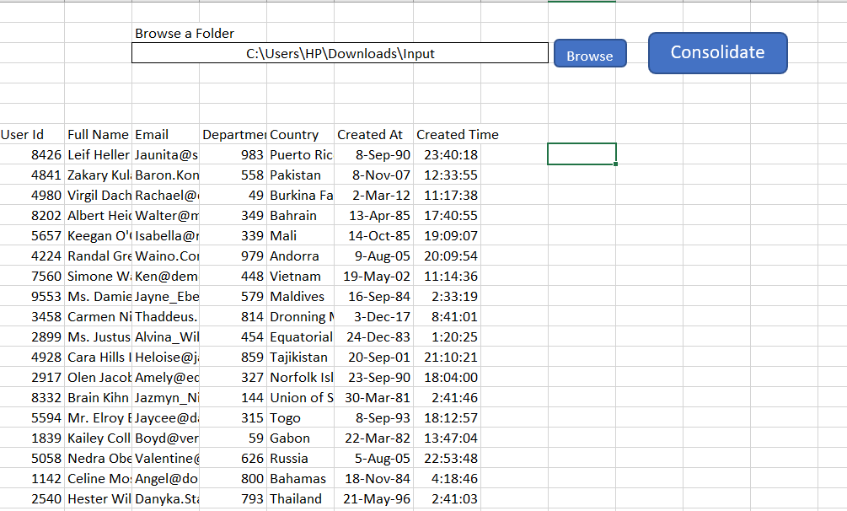
Objectives
1. Automate repetitive consolidation tasks
2. Reduce manual errors
3. Enable one-click merging of Excel files
4. Build a scalable and reusable solution

Slide 5
Key Achievements
Developed macro: `Consolidate Data From Folder`
Supports batch file processing
Streamlined data merging across files
Reusable and adaptable logic

Slide 6
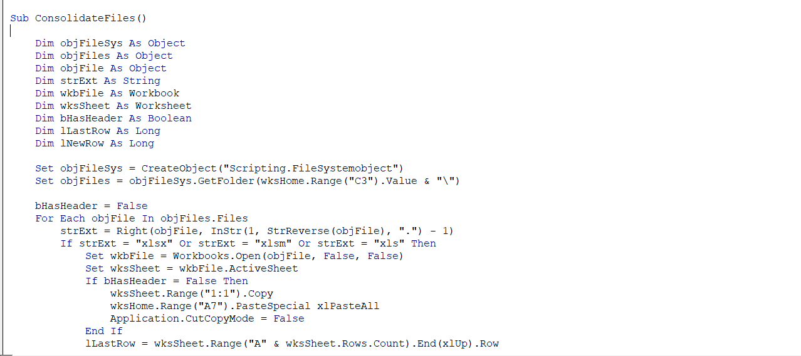
Tools & Techniques
Excel VBA (Macros)
FileSystemObject
Folder Dialog Box
Dynamic Range Handling
Error Handling
Code Snippet

Slide 7
Takeaways & Learning Outcomes
Strengthened VBA file handling and automation
Gained experience with folder/file logic
Built a scalable tool for repetitive reporting tasks

