Slide 1
Analysis of Trends in American Filmmaking
Chaitanya Shashi Kumar, Robert Lignowski, and Ram Kishore Karuppiah Nadar Venkateswaran

Slide 2
Members
Robert Lignowski
Background in Python
Data Acquisition
Ideas
Ram Kishore KV
Analysis
Data Acquisition
Ideas
Chaitanya Shashi Kumar
Machine Learning
Data Analysis
ideas

Slide 3
INTRODUCTION
For this dataset, we dissect the basic financial aspects of the film industry and look at the top-rated directors and actors. We explore insightful details on budgets, box office earnings, ratings, genres, and more on 7000 movies for each decade, giving a great overview on the movie’s performance both financially and in the audience perspectives.
Genre prediction with nlp and ml:
We used Naive bayes classifier to classify the genres using the plot as features.
By using analytics methods we built a movie recommendation system and made a genre popularity chart over the decades ranging from 1950-2010.We also found the top rated and profitable actors and directors for each decade.

Slide 4
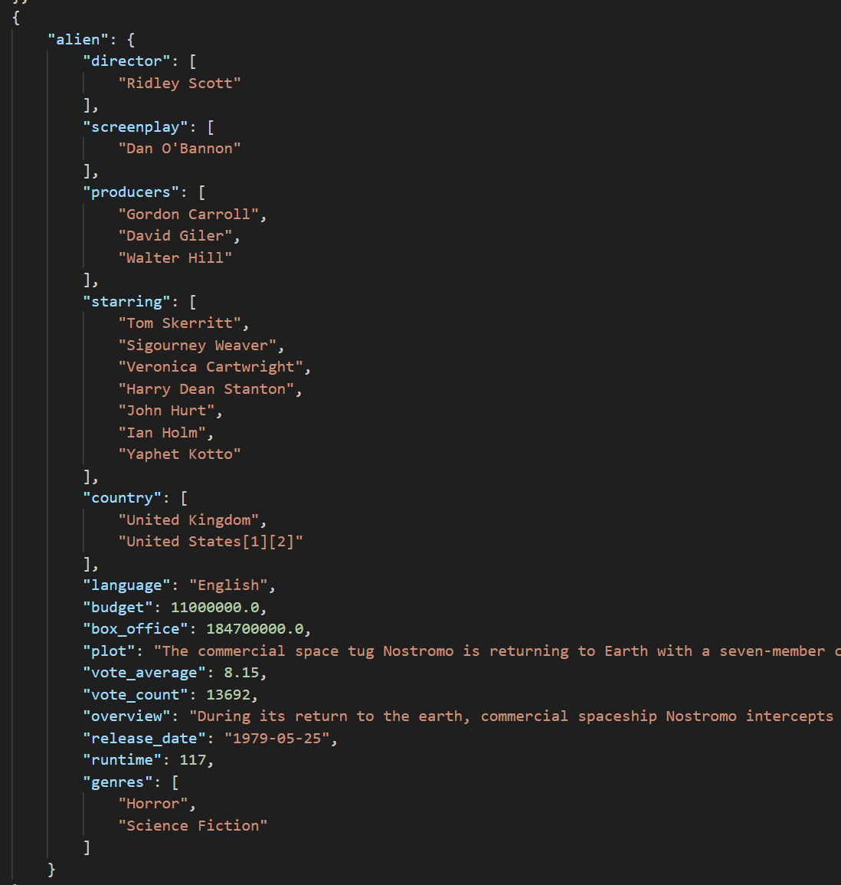
Data Acquisition
Our code collected information on movies released over a sixty year period.
Our acquisition code would take more time to run,so we split the data into 3 parts (1950-1970,1971-1990,1991-2010)
It was initially in the JSON format, we merged all the json file and changed it to CSV format for easier access.
Data was collected to the JSON file as a list of dictionaries

Slide 5
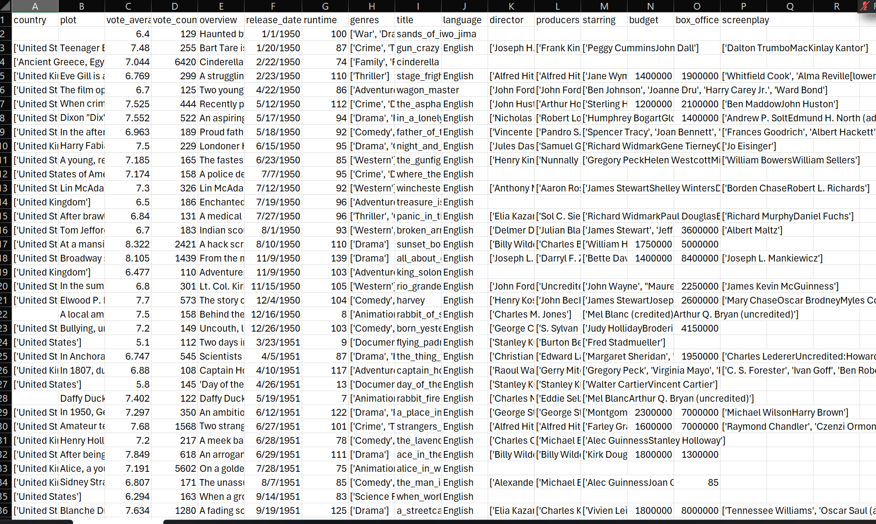
Data Distribution
Our final data is in csv format with 7037 rows (movies) and 16 columns.
The columns consists of title, plot, overview, director, actors, genre, budget,grossing etc.
For our analysis, the most important information were a film’s plot,overview and its box office gross.

Slide 6
Overview
SpaCy:
Used to separate films’ plot summaries into important words
Important words were compared against words associated with particular genres
Each genre then received a percentage score based on how many genre words appeared in that film’s summary
Movie Recommendation:
Missing values in overview column is filled with empty string
The 'title' is refined to retain only the alphanumeric characters, removing any additional symbols or characters.
Top Actors ,Directors and Movies::
The 'starring' and 'director' columns are formatted to include only names. Given that some movies feature multiple actors and directors, these entries are split into individual names, resulting in duplicate rows for films with more than one actor or director to facilitate detailed analysis.
Created a new column for year from release data for decade calculation
A new column called profit(box office - budget) is added
A new column called weighted rating is introduced to calculate the weighted rating
Genre Prediction Using Naive Bayes
Converted the release date from string to date format
Converted the genre column from string to list format
Filtered the data to get movies from 1990 to 2010
Dropped rows with null values in budget and genre and plot columns
Removed Duplicate Values

Slide 7
Results
NLP with spaCy
NLP
spaCy allows us to break down the plots and overviews into lists of the important words of all sentences
This allows us to compare them against given words for a genre
We tested lists of words associated with each genre and determined how many appeared in each plot
By determining what percentage of words in a plot summary were associated with certain genres, we were able to get an idea of what genre each movie was.
This was determined to be reasonably accurate when used for analysis

Slide 8
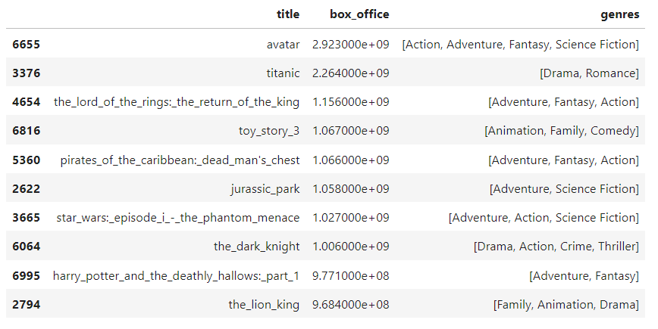
Results
Genre Prediction Using ML
Filtered the dataset to give movies from 1990 to 2010
Made a new dataframe with only title, box office, and genres
Sorted them based on box office to get the movies with highest box office from 1990 - 2010
Created a new dataset called genreData and added a column that gives the number of movies for each genre
Created a new column in genreData to get the average box office for each genre
Plotted a genre vs box office bar graph using this dataframe.
Plotted a pie chart which shows number of movies for each genre

Slide 9
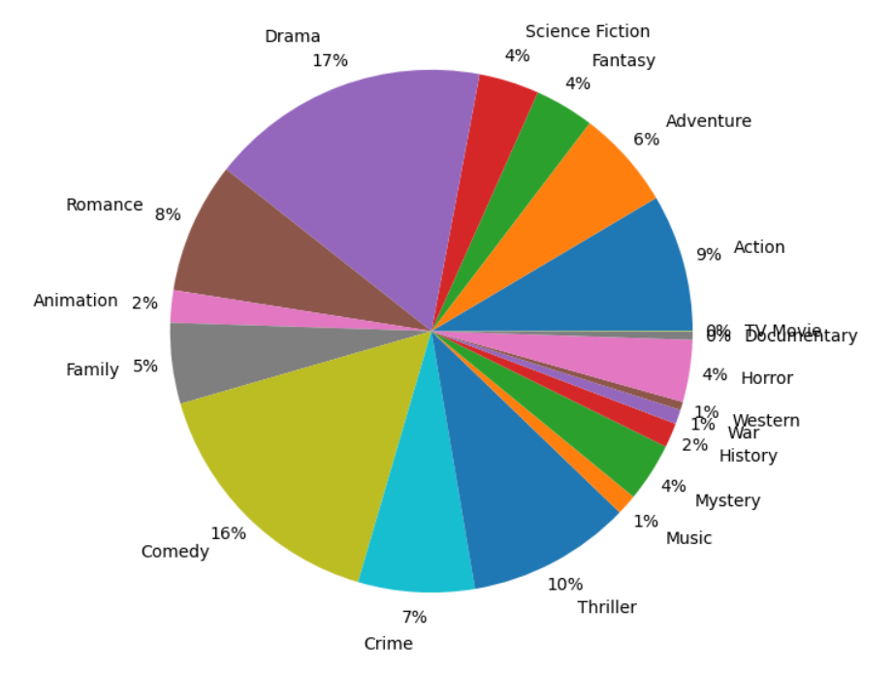
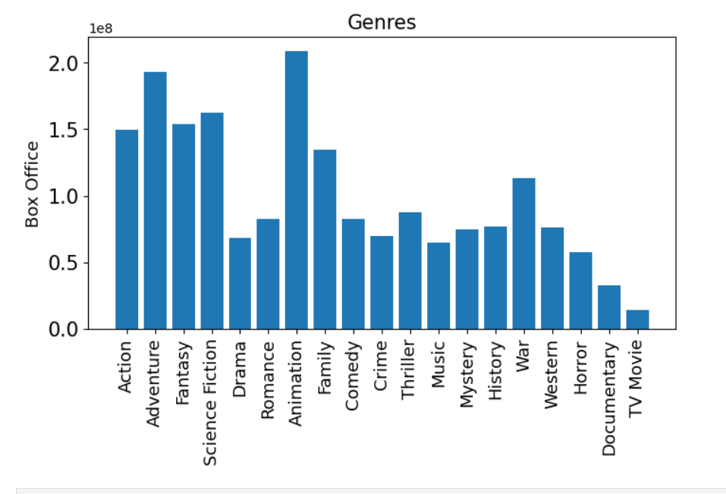

Slide 10
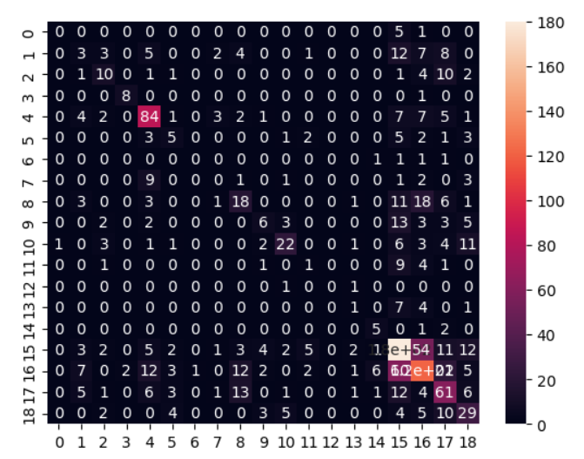
Created new DataFrame called movie_df with title, genre and plot for genre prediction
The genre column consists of only one genre per movie for simplification.
There were 5864 before removing duplicate values and 5814 after.
Gave each label a number for classification
Cleaned the data using nltk library
Converted the plot column into vectors and ran them through the naive bayes classifier
Achieved an accuracy of 47%

Slide 11
Challenges
Genre Prediction Using ML
Data
Preprocessing. Eg:
Selecting specific words related to genre
Neural Networks to learn better
Use other features to predict

Slide 12
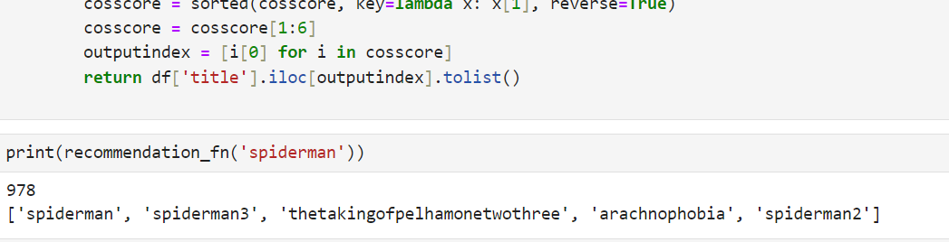
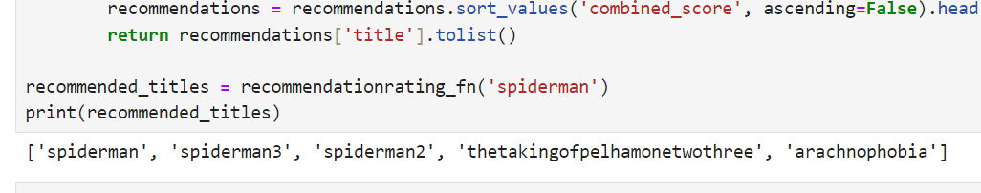
Results
Movie Recommendation System
The movie recommendation system is built with two methods
Movie is recommended by overview match .
Movie is recommended by both overview match and weighted mean ratings.
Used Term Frequency Inverse Document Frequency(TF-IDF) and cosine similarity for calculation of similarity values
For recommendation with rating and similarity a new score is calculated which is the product of cosine similarity and weighted mean rating values of the movie

Slide 13
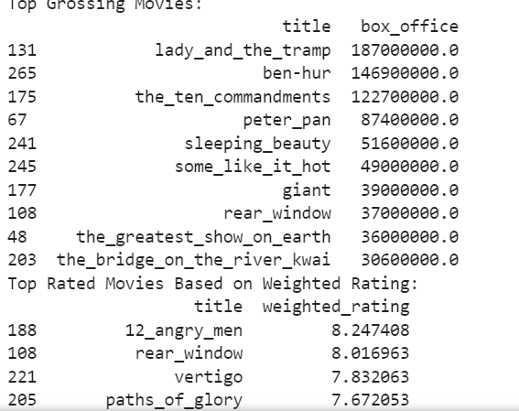
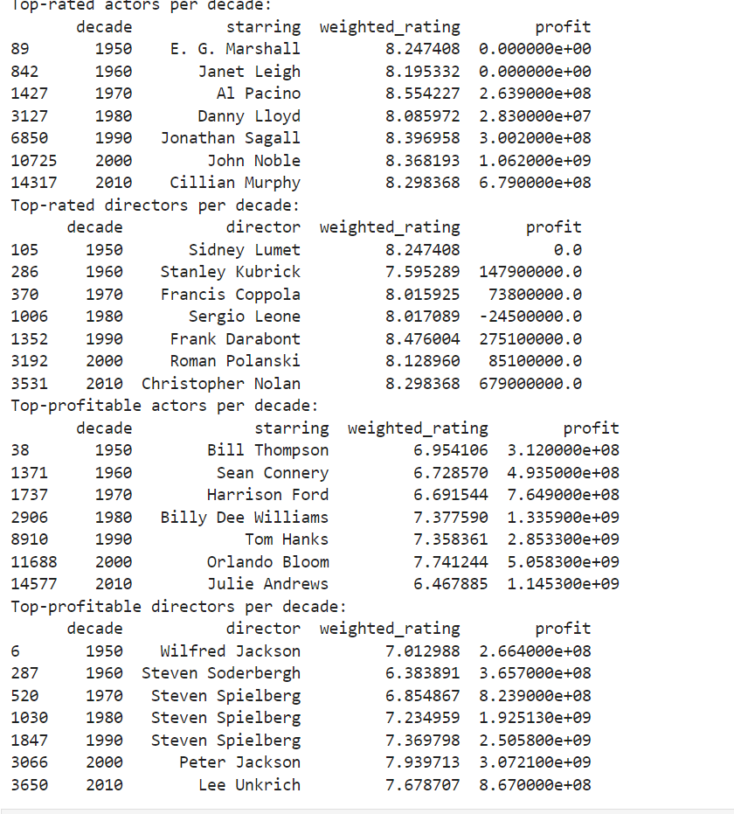
Results
Top Movies, Directors and Actors Per Decade
From our dataset we found out the top rated movies,actors and directors .
We found top profitable directors and actors .
We also found top grossing movies.

Slide 14
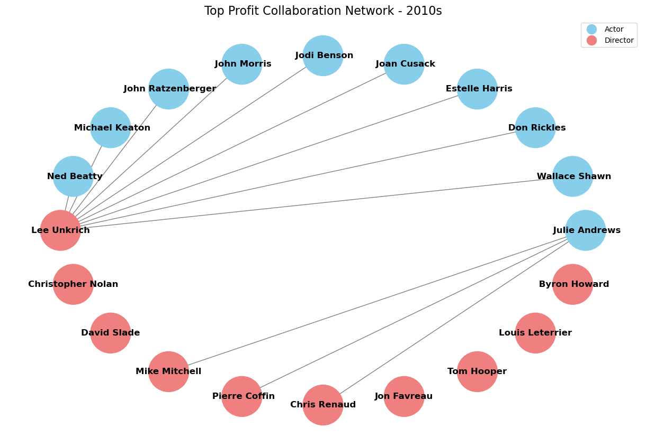
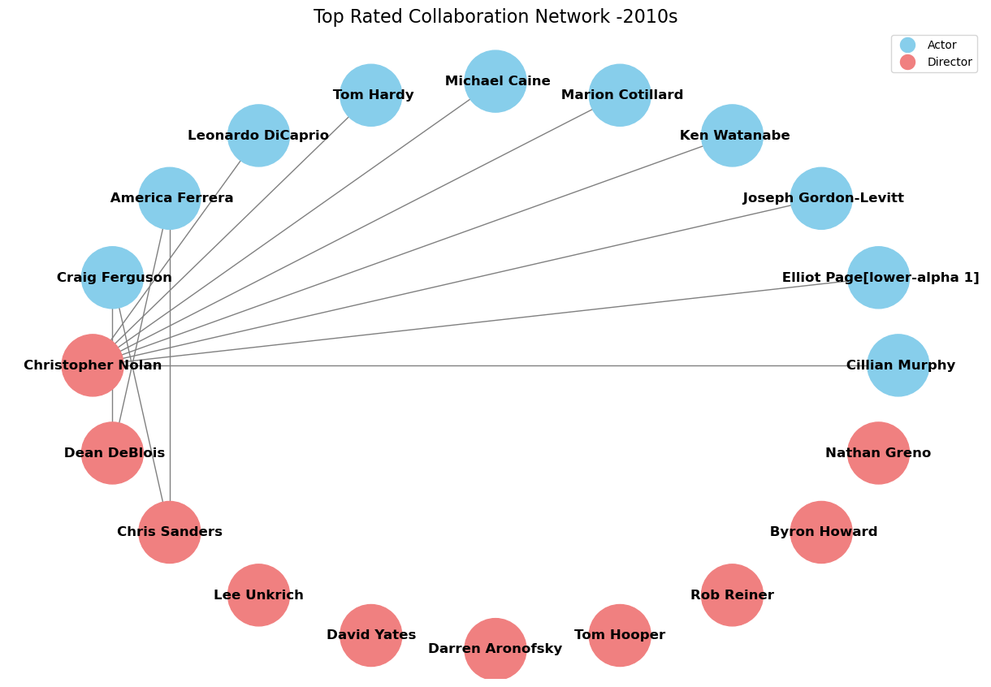
Results
Top Actors and Directors per Decade Network
We also built a network graph to see how the top rated and top profitable actors and directors are related over each decade
We used a circular layout for our network as it was easy to interpret
We made nodes like actors and directors and added some edges if they are in the same movie together

Slide 15
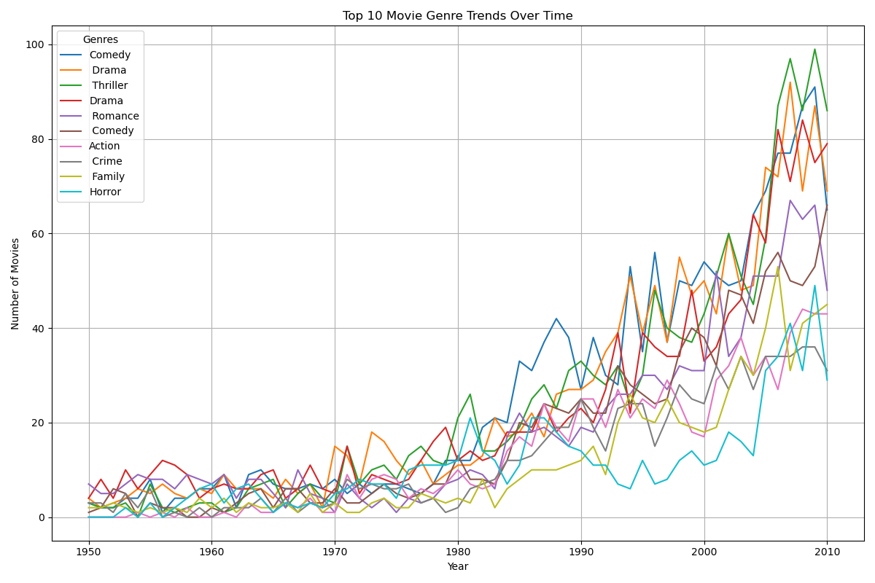

Slide 16
Challenges
Data limitations
Certain decades had less movie entries overall
Some movies had incomplete summaries
Films were 95% US productions or co-productions, but analysis might have been slightly thrown off by presence of non-American movies

Slide 17
Questions?

