Slide 1


Food-Home
Online Mess Service
Presented By-
Sagar G. Satav(229195)
Rambhau T. Manjare(229172)

Slide 2
Project Introduction
The Food-Home is an online mess service system that locates nearby messes and their menus.
The mess owners can register and share their mess menus with the consumers through this portal.
Consumers can register to the portal and can be a member of a specific mess of their choice.
Consumers can search messes as per locality, category, prices, ratings, reviews.
Consumer searching efforts are reduced and increases the scope of business for mess owners.

Slide 3
Objective (Purpose):
The online Mess Service is a Web Application is intended to provide complete solution for Service provider and Consumers through a single Gateway using internet.
The main objective of this project is to give a common platform for the customers and service provider.
This system will help consumers from various places to communicate with various providers(mess owners) and ease their searching efforts.
The main interest of the Project is to create a central service system that will act as a bridge between providers and consumers.

Slide 4
Scope:
Online Mess Service System is a web application.
There are mainly two types of users. One is the provider(Mess Owner) and the other is the consumer.
Consumers can search for mess menus, and special dishes at their convenience.
Online Mess Service System provides the functions which connect the consumers and the mess owners through the portal.
The online Mess Service System will be Administrated by Admin.

Slide 5
Technology Used:
Front End: ReactJS
Back End: Java Spring Boot API.
Database: MySQL

Slide 6
S/W and H/W Requirements
Server Side:
Processor: Intel core i5 or above
HDD: 500 GB or above
RAM: 4GB or above
Database: MySQL
Client Side (minimum requirement):
Processor: Intel Dual Core
HDD: Minimum 80GB Disk Space
RAM: Minimum 2GB
OS: Windows 7, Linux

Slide 7
Functionalities - Module wise /user wise
Online Mess Service Portal consists of three modules named below
1. Admin
2. Mess Provider
3. Customer
User Roles:
Admin :Approves Messes, manage logins.
Mess Provider : Register’s itself and Mess, logins, provides menus , verifies member consumers, see customers list ,view mess rating and Reviews.
Customer : register itself, logins ,search messes using filters ,give rating and reviews ,select mess ,view menus.

Slide 8
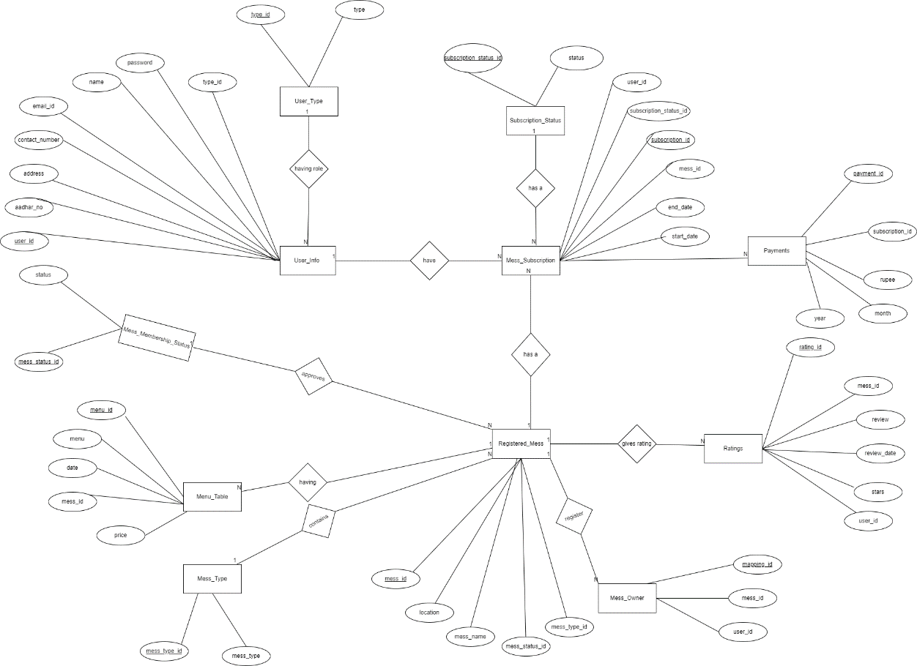
UML Diagrams: E-R Diagram

Slide 9
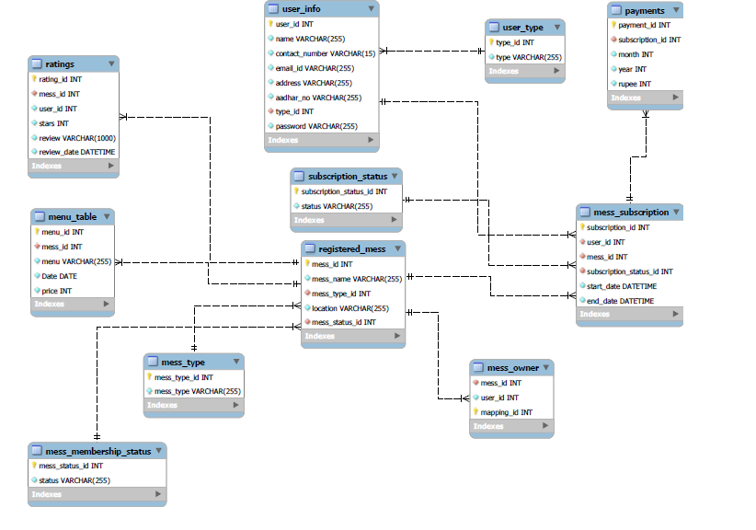
E-R Diagram(MySQL Auto generated)

Slide 10
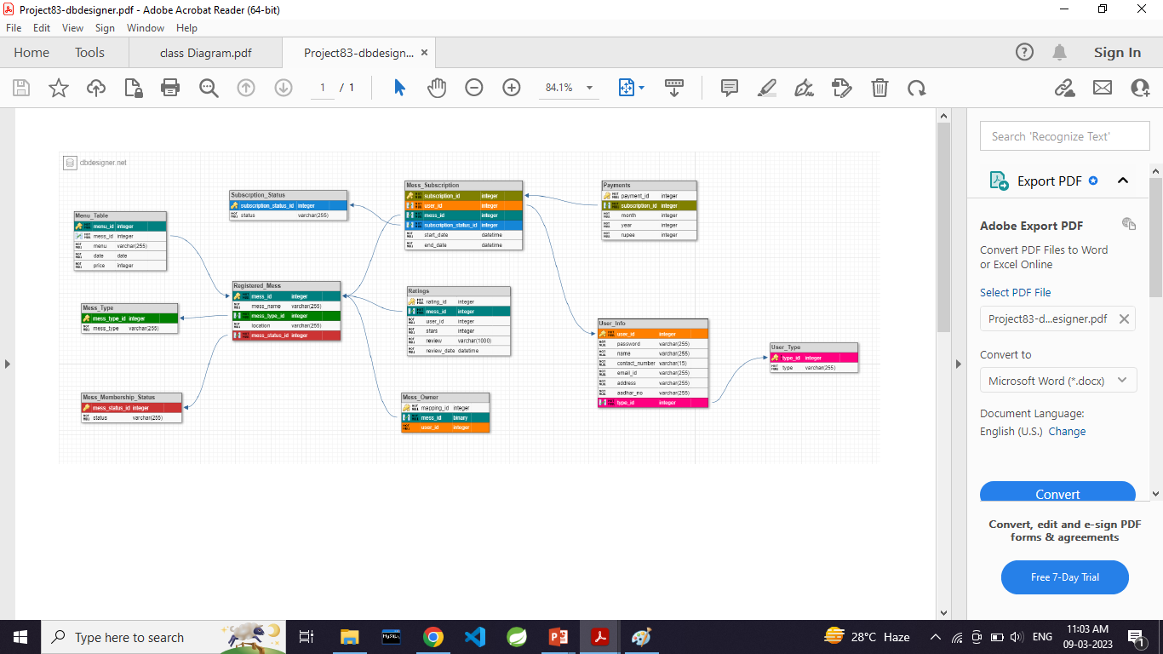
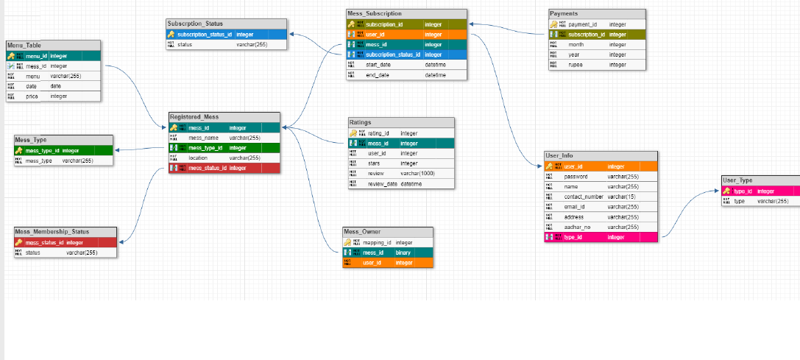
Class Diagram

Slide 11
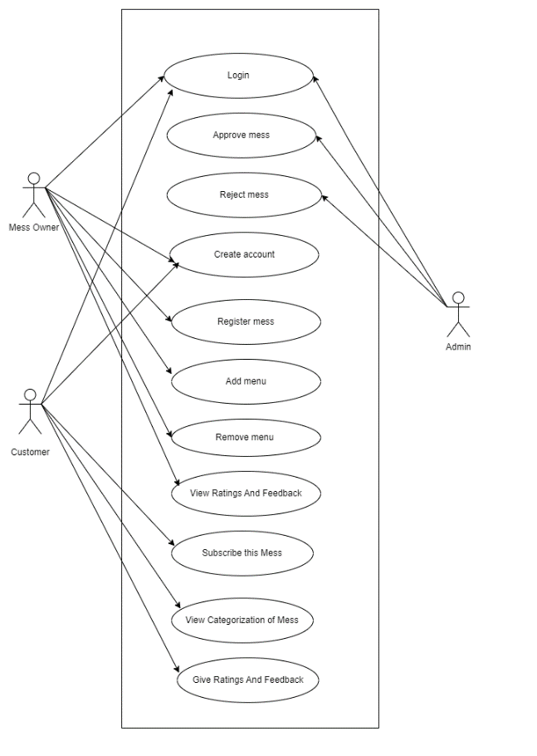
Use Case

Slide 12
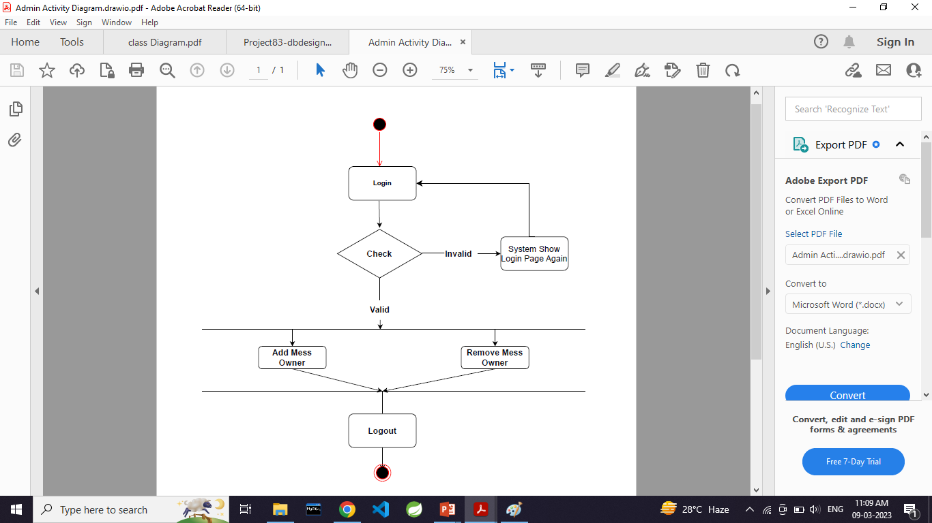
Activity Diagram Of Admin

Slide 13
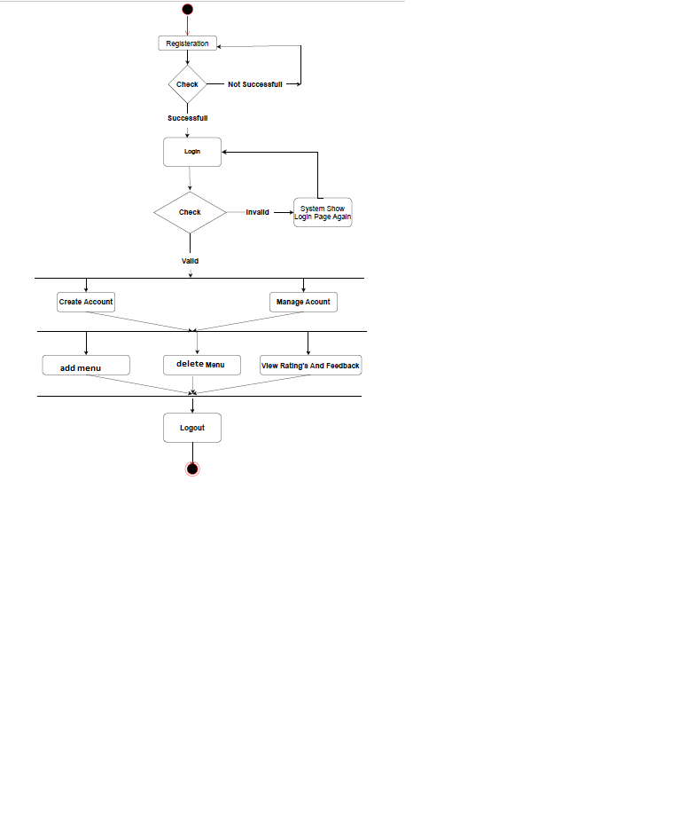
Activity Diagram Of Mess Owner

Slide 14
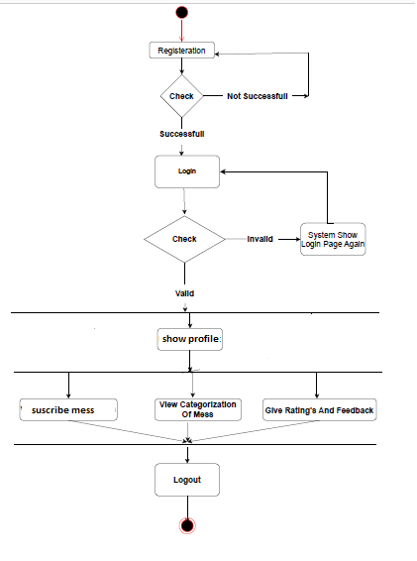
Activity Diagram Of Customer

Slide 15
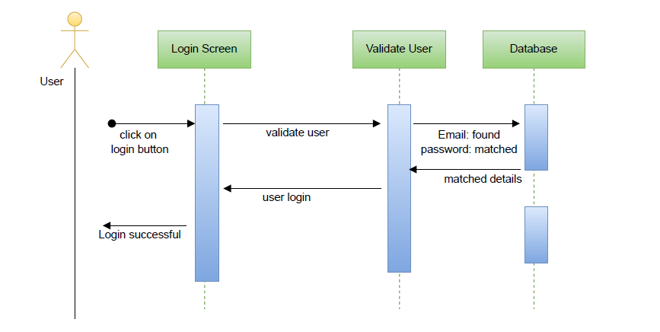
sequence diagram for login

Slide 16
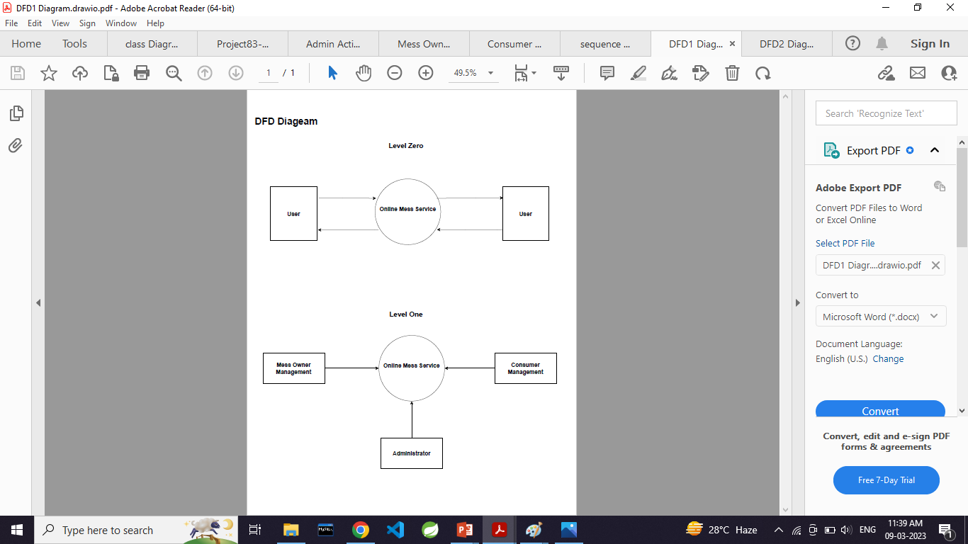
DFD diagrams

Slide 17
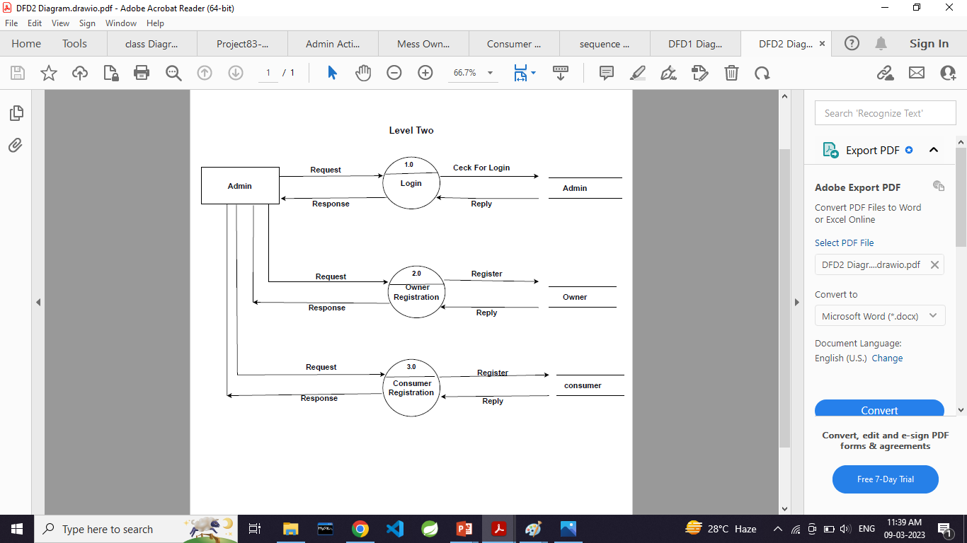

Slide 18
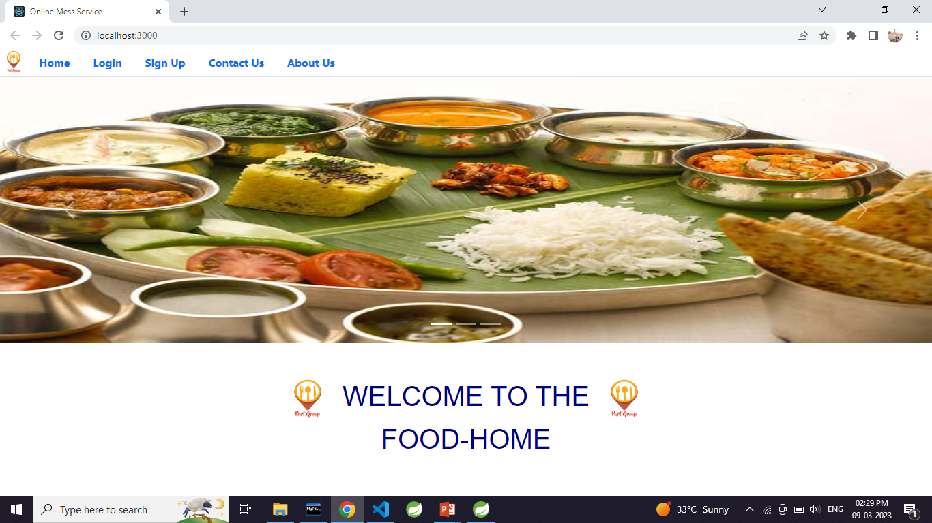
UI Screen Shots

Slide 19
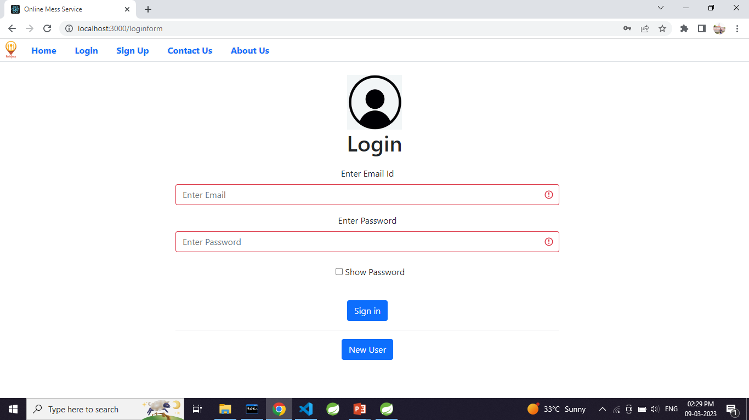
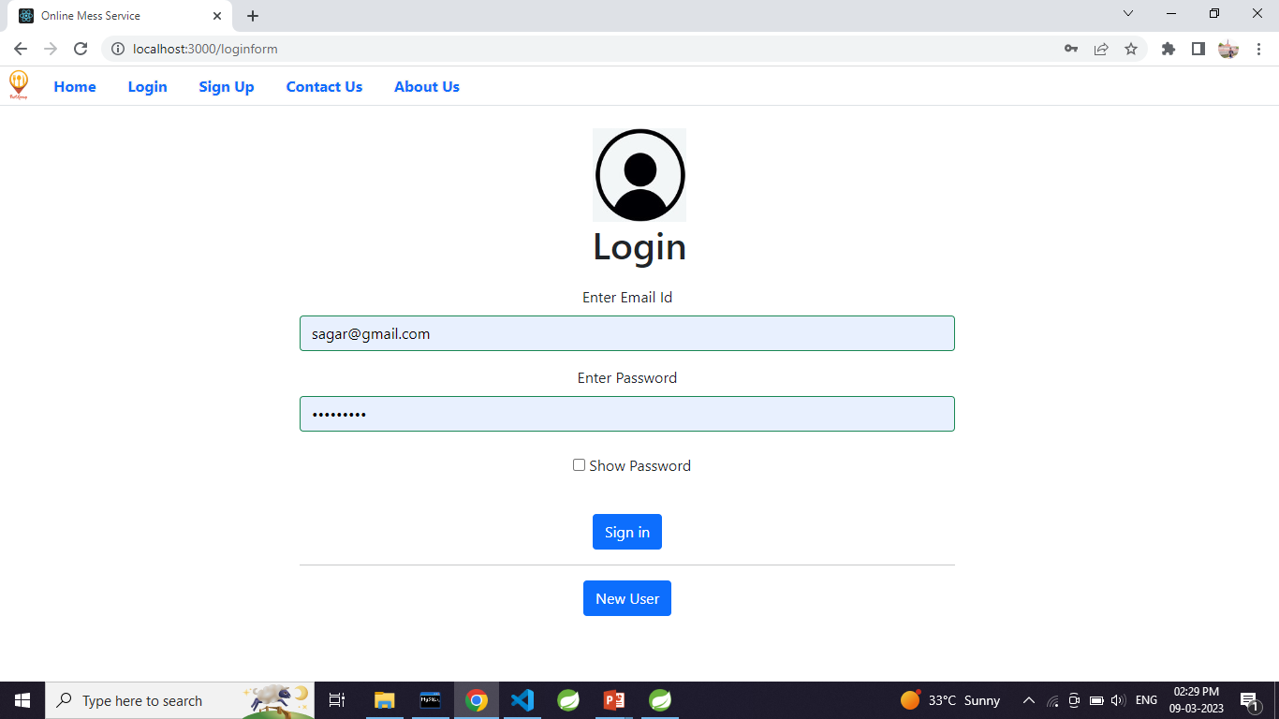
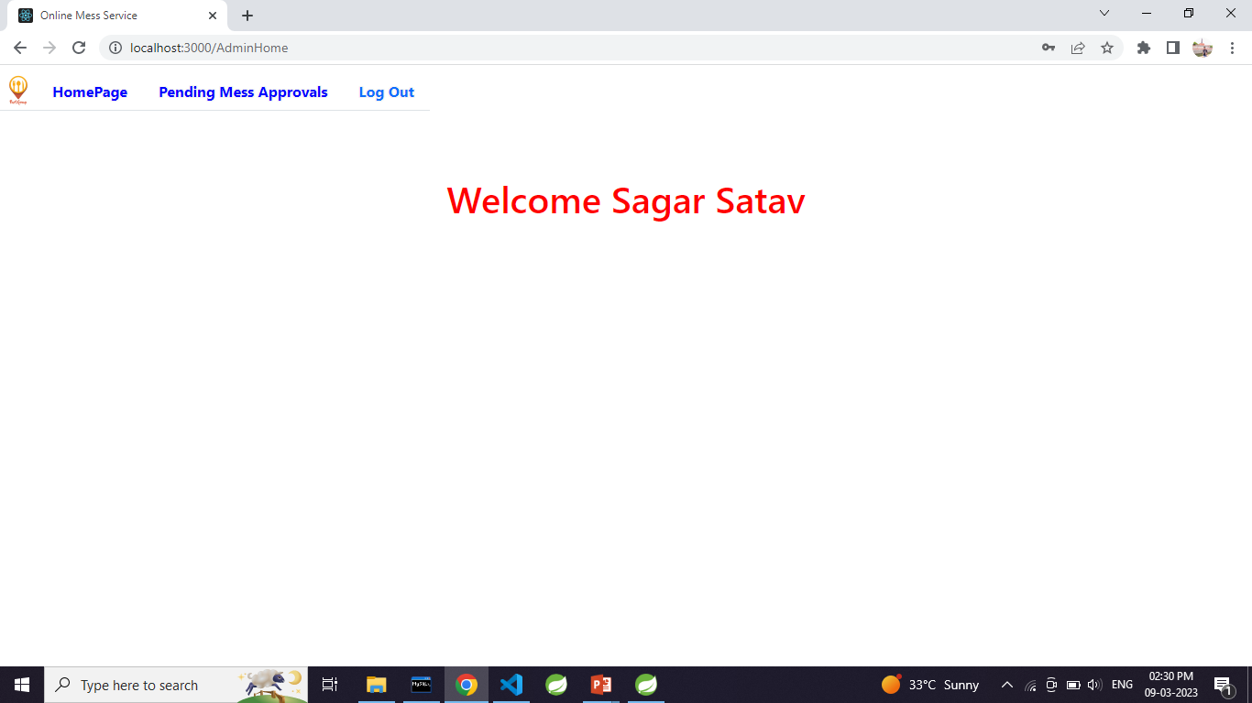
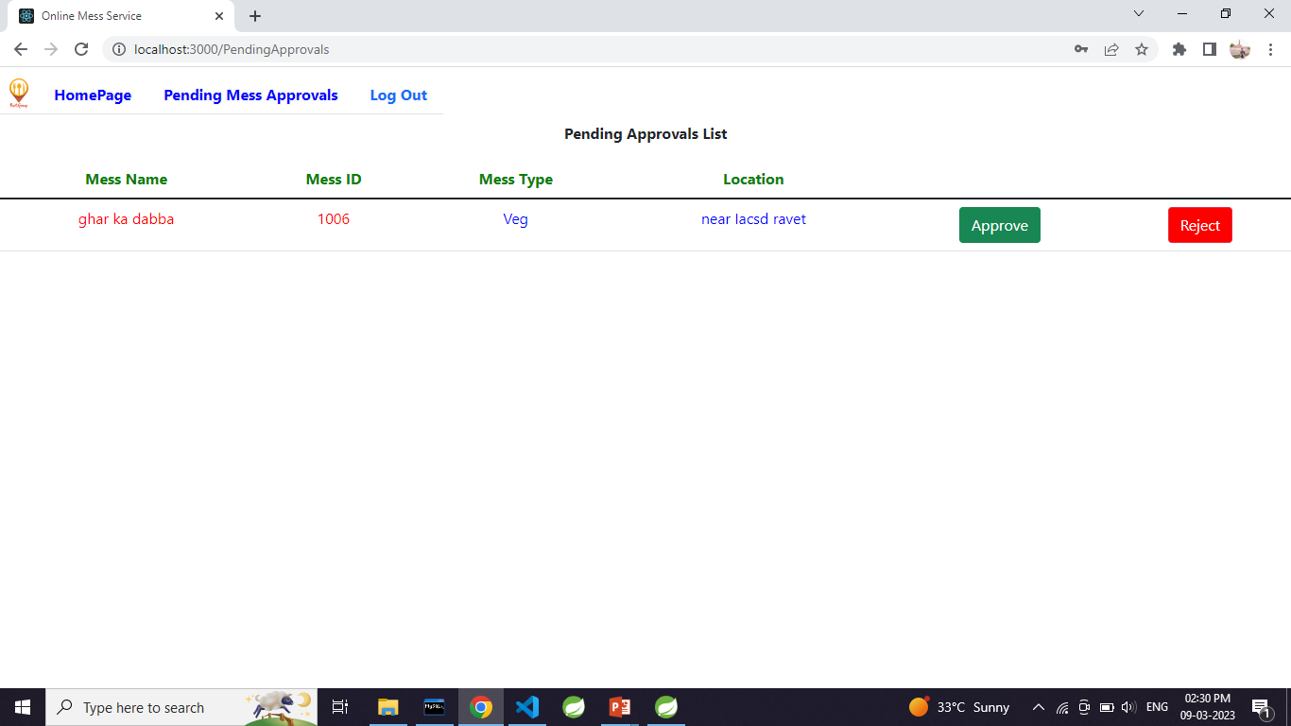

Slide 20
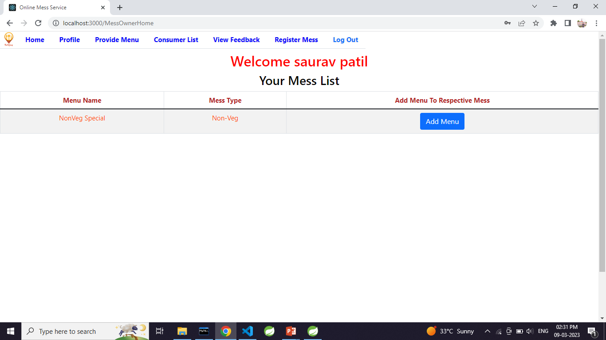
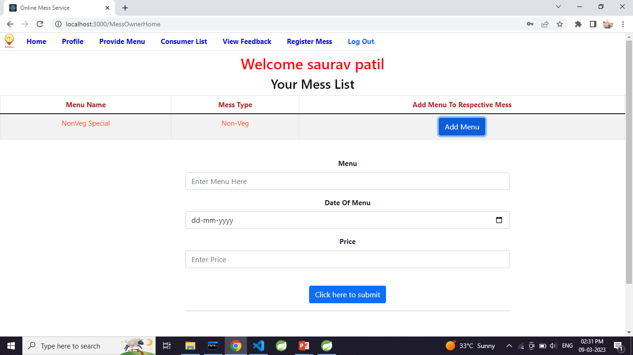
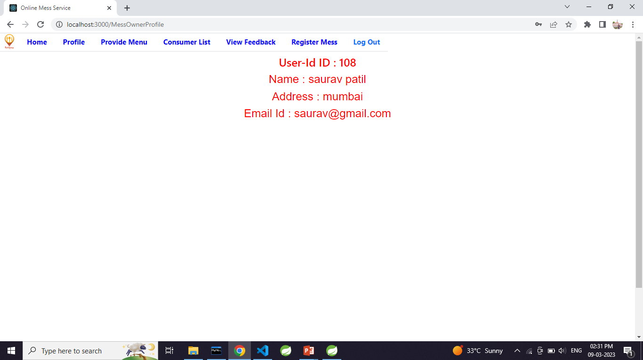
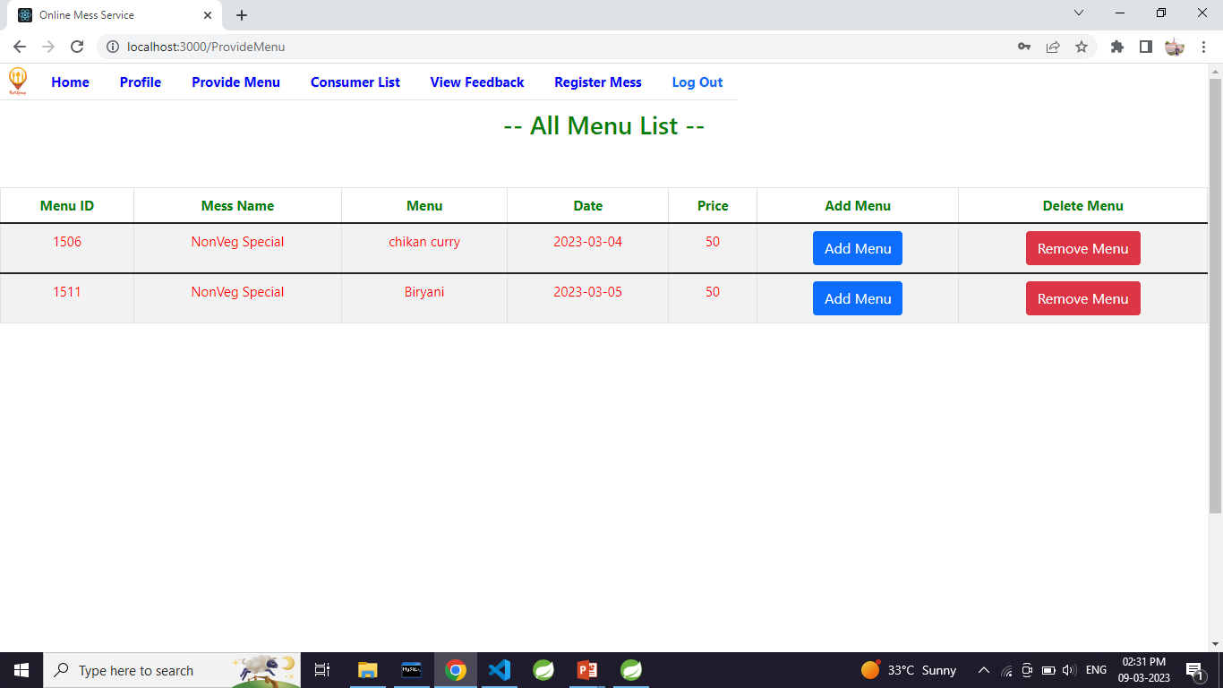

Slide 21
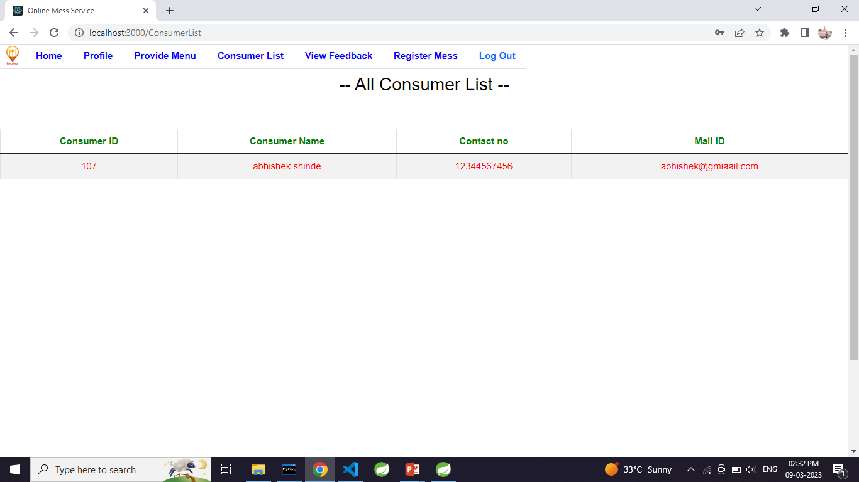
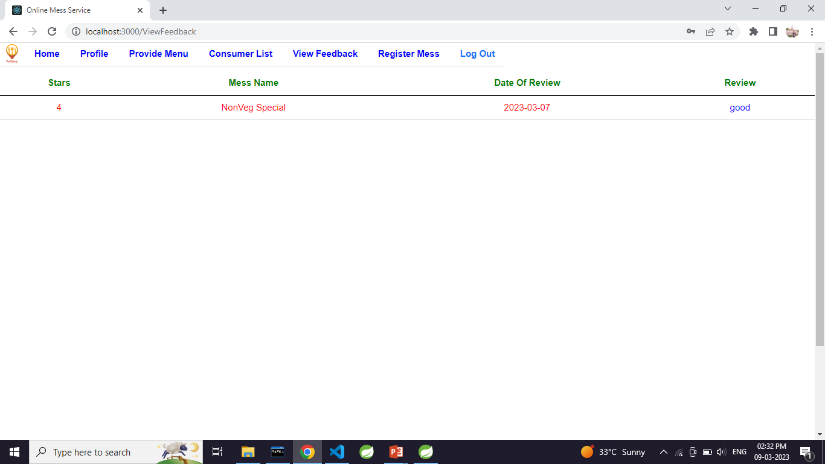
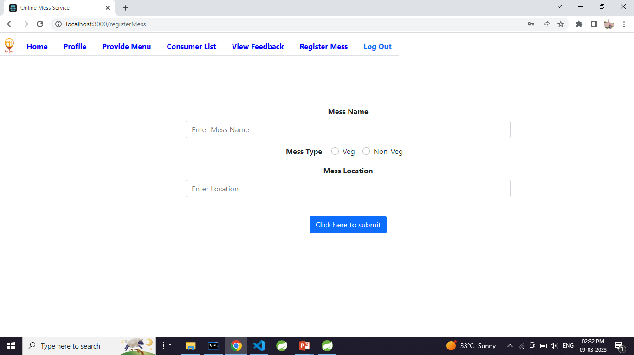
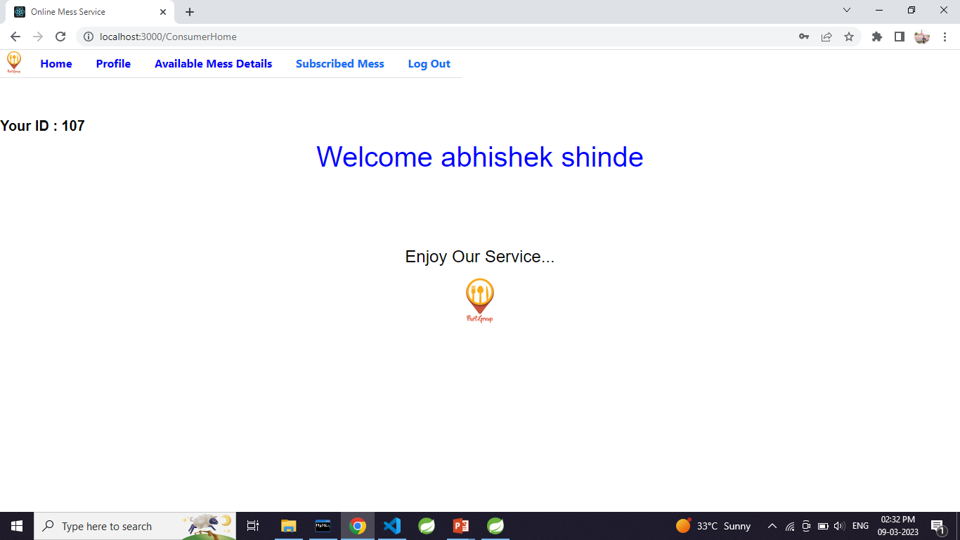

Slide 22
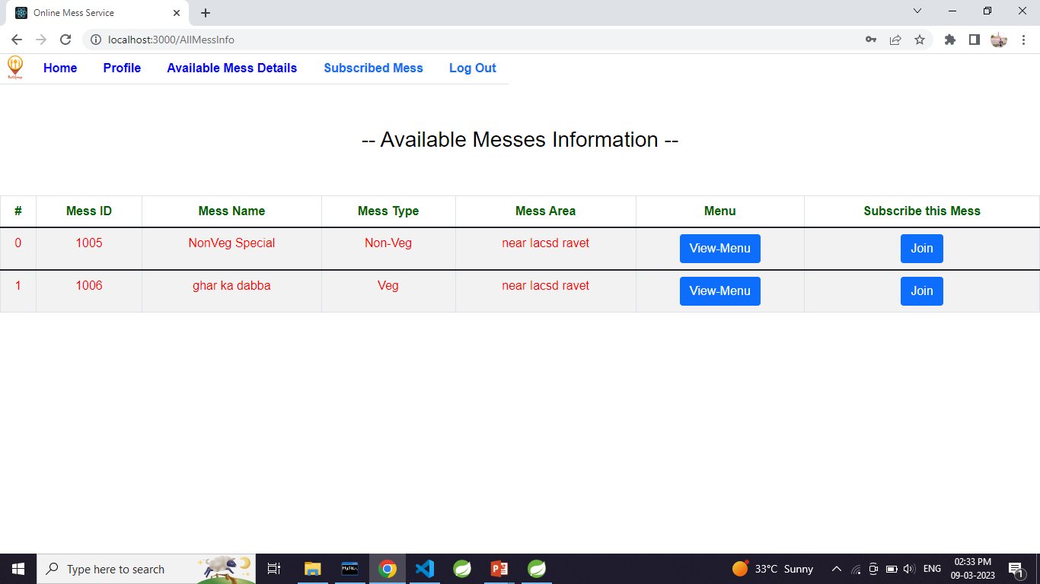
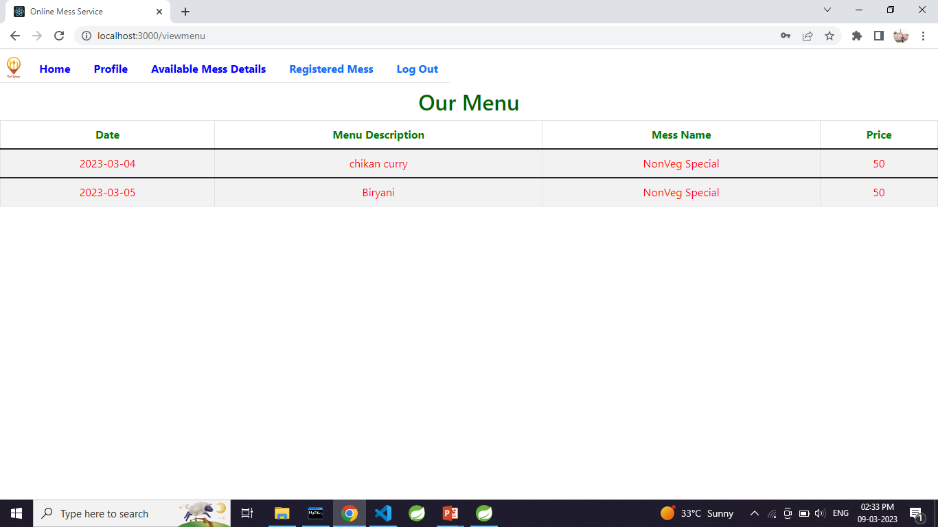
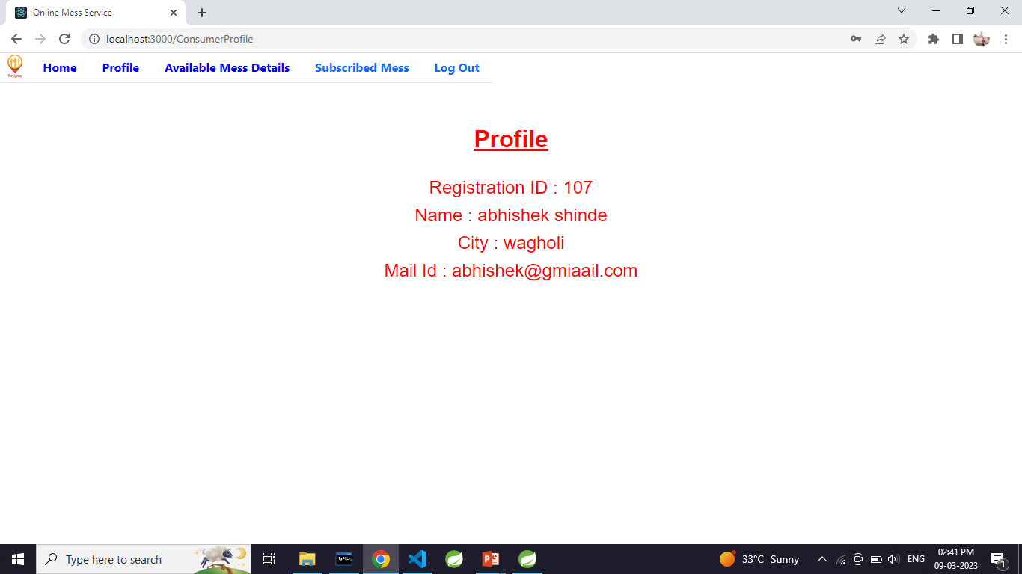
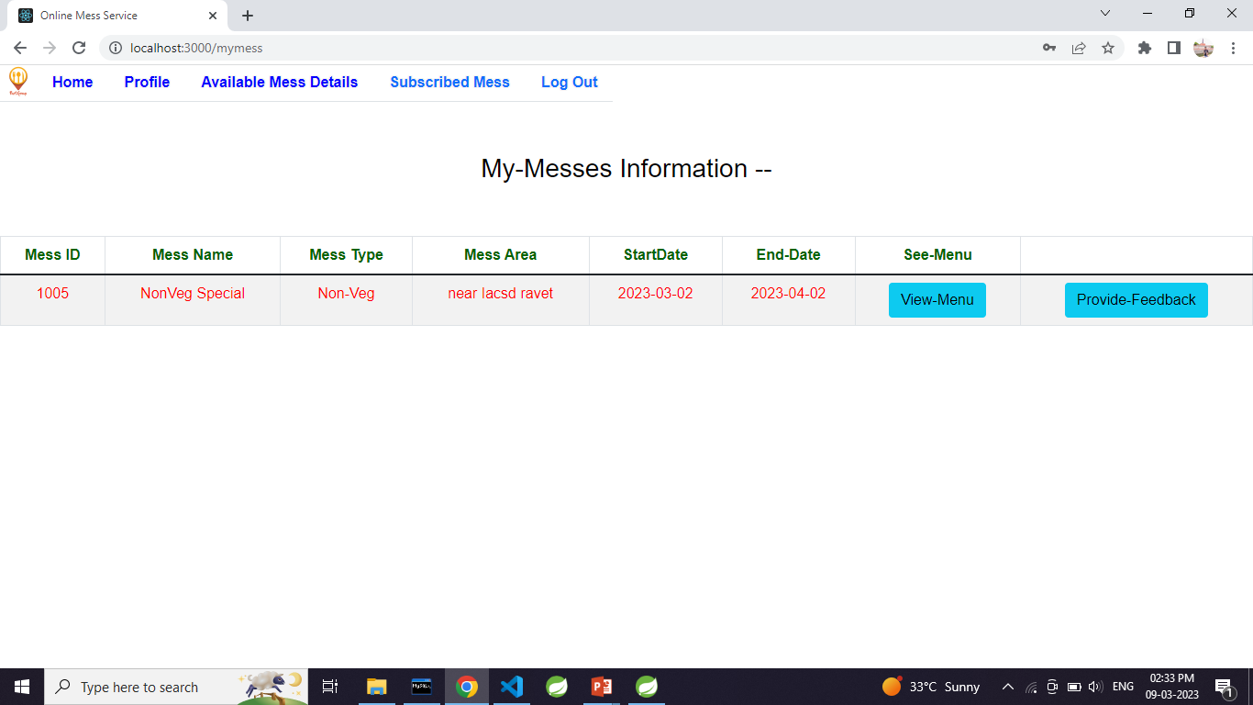

Slide 23
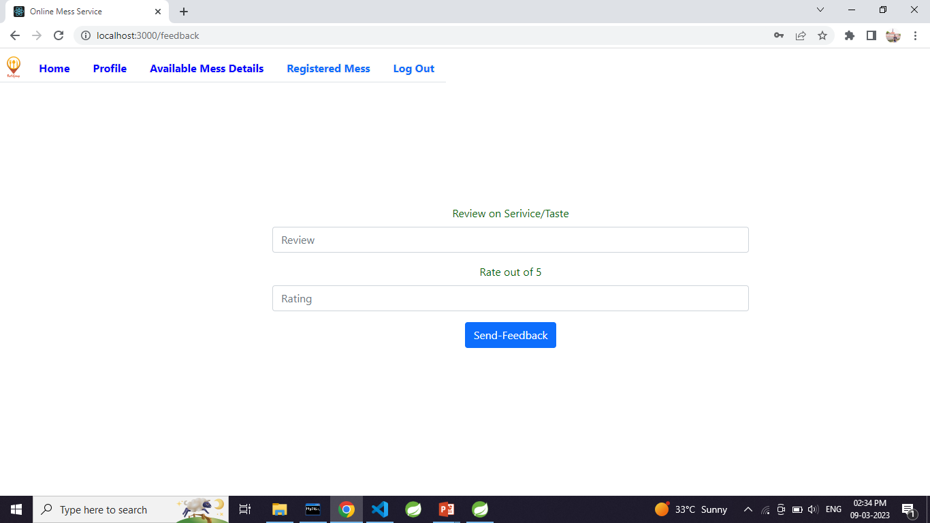
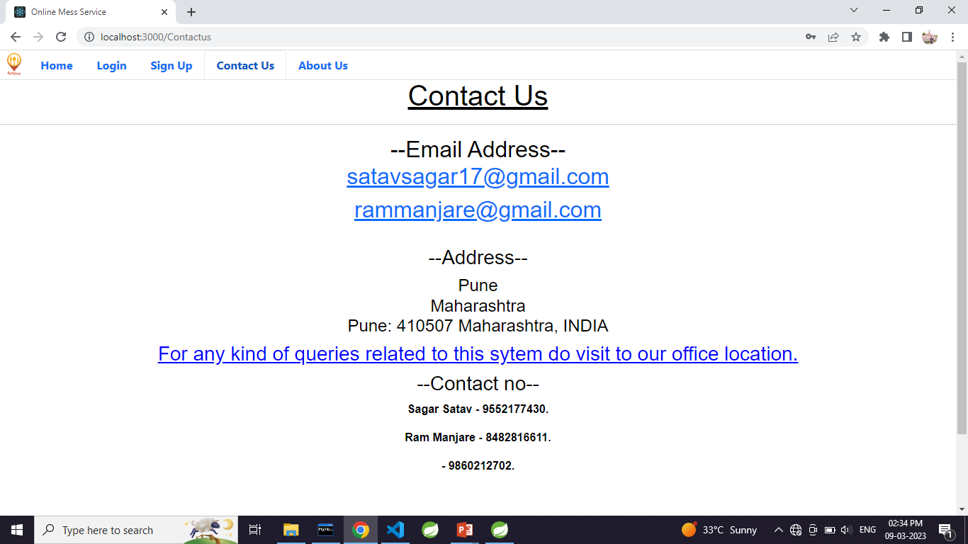
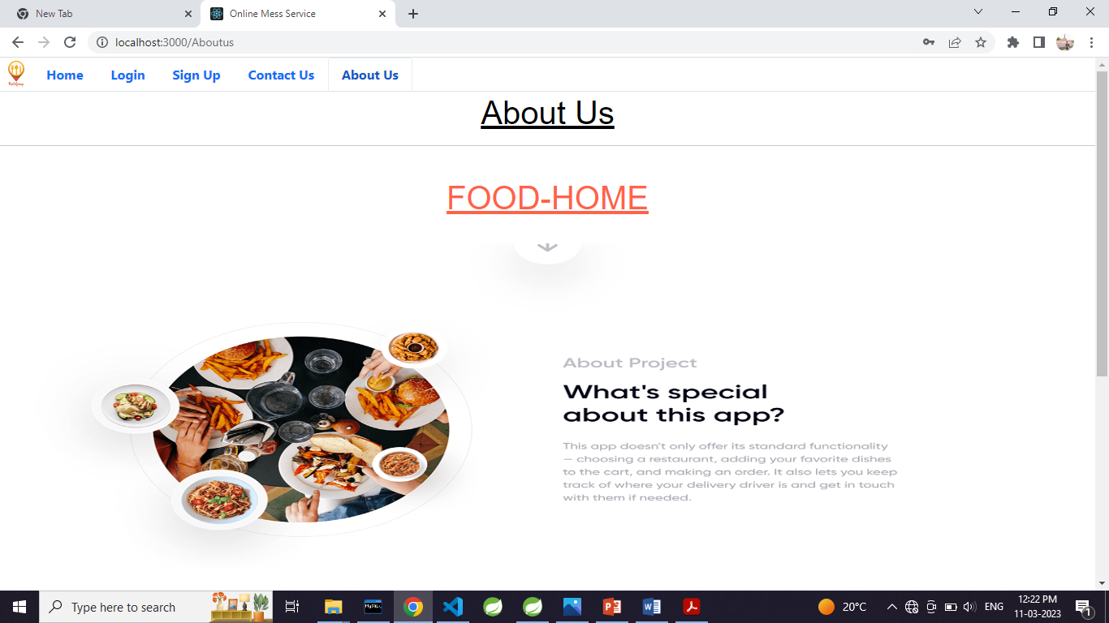
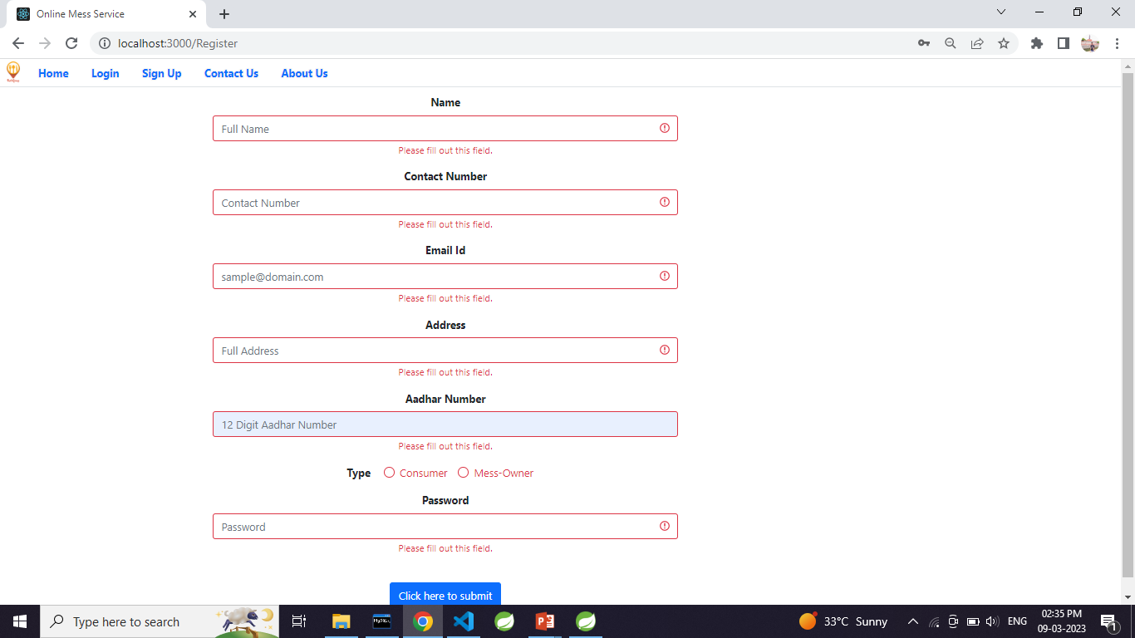

Slide 24
Futures Extensions
Future extensions for step-up of project.
Association with Google maps
Payment mode
Discount /offer management
Billing
Estimated time of implementation.
4 weeks
Benefits of future extension.
Growth for registered messes through advertisements
Attractive UI
Richer user experience
Robustness in application

Slide 25
Conclusion
In the current competitive world, many youths travel to different unknown locations for their basic education or jobs. The main problem they face is the food they get, and they crave for homemade food, but it is difficult to find it. On the other hand, some housewives wish to work and earn money to gain financial independence. It is difficult for these ladies to reach customers and market their products. So this online mess service will provide the common platform for those mess owner and students or youths to register mess and spend money according to service provided by owner. And also reduces the searching efforts of messes for youths and also giving financial help to mess owner.

Slide 26
References
https://www.w3schools.com/
https://react-bootstrap.github.io/components/carousel/
https://www.geeksforgeeks.org/reactjs-tutorials/
https://javaee.github.io/javaee-spec/javadocs/
https://reactjs.org/docs/getting-started.html

Slide 27


THANK YOU

