Slide 1
UNIT-III TRANSFORMERS

Slide 2
DEFINITION
Electrical Power transformer is a static device which transforms electrical energy from one circuit to another without any direct electrical connection and with the help of mutual induction between two windings. It transforms power from one circuit to another without changing its frequency but may be in different voltage level.

Slide 3
Working Principle of Transformer
The working principle of transformer depends upon Faraday's law of electromagnetic induction. Actually, mutual induction between two or more winding is responsible for transformation action in an electrical transformer.
Faraday's Laws of Electromagnetic Induction :
According to these Faraday's laws, "Rate of change of flux linkage with respect to time is directly proportional to the induced EMF in a conductor or coil".

Slide 4
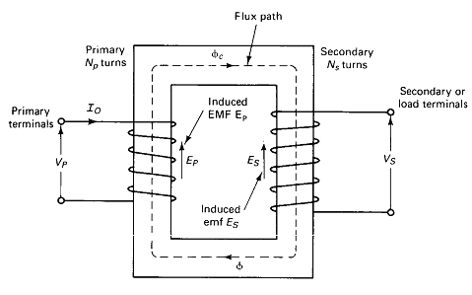
Basic Theory of Transformer

Slide 5
The alternating current through the winding (Primary) produces a continually changing flux or alternating flux that surrounds the winding.
If any other winding (secondary) is brought nearer to the previous one, obviously some portion of this flux will link with the second.
As this flux is continually changing in its amplitude and direction, there must be a change in flux linkage in the second winding or coil. According to Faraday's law of electromagnetic induction, there must be an EMF induced in the second.
If the circuit of the later winding is closed, there must be an current flowing through it. This is the simplest form of electrical power transformer and this is the most basic of working principle of transformer.

Slide 6
So, Finally
A transformer is a device which transfers electrical energy (power) from one voltage level to another voltage level.
Unlike in rotating machines, there is no energy conversion.
A transformer is a static device and all currents and voltages are AC.
The transfer of energy takes place through the magnetic induction.

Slide 7
Main Constructional Parts of Transformer
The three main parts of a transformer are given below:
Primary Winding of transformer - which produces magnetic flux when it is connected to electrical source.
Laminated Magnetic Core of transformer - the magnetic flux produced by the primary winding, that will pass through this low reluctance path linked with secondary winding and create a closed magnetic circuit.
Secondary Winding of transformer - the flux, produced by primary winding, passes through the core, will link with the secondary winding. This winding also wounds on the same core and gives the desired output of the transformer.

Slide 8
Construction of the Core
The two most common and basic designs of transformer construction are the core type transformer and the Shell-type transformer.
In the “core” type (core form) transformer, the primary and secondary windings are wound outside and surround the core ring. In the “shell type” (shell form) transformer, the primary and secondary windings pass inside the steel magnetic circuit (core) which forms a shell around the windings as shown below.

Slide 9
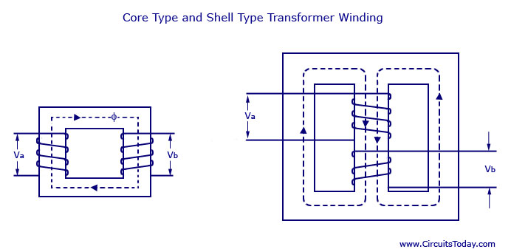

Slide 10
In the core type transformer construction, half of the primary and secondary windings are placed around each leg (or limb) of the transformers magnetic circuit as shown above to reduce the leakage flux. Here winding insulated by a part of core area.
In small size core type transformers, Rectangular core is used and for large size round/ cylindrical core is used.
Shell type transformer core involves the use of double magnetic circuit.
Both the windings are placed around the central limb, the other two limbs are acting simply as a low reluctance flux path. Here core is surrounded by winding.
The core type is generally more suitable for high voltage and small output, While the shell type is suitable for low voltage and high output.

Slide 11
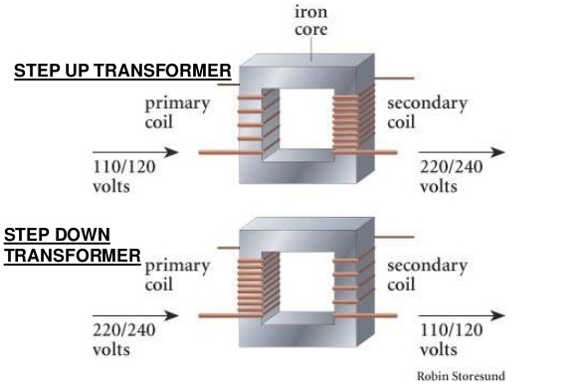
Types of Transformers Based on voltage step up & down

Slide 12
EMF EQUATION
Let
N₁ = Number of turns in primary windings.
N₂ = Number of turns in second windings.
Φ_{m}= Maximum flux in core.
Φ_{m} = B_{m*}A
f = Frequency of A.C input in Hz
As shown in fig flux increases from its zero value to maximum value Ø_{m} in one quarter of the cycle i.e in ¼ second.
Average rate of change of flux = (Ø_{m} /(1/(4f) )= 4f Ø_{m} Wb/s or volt. i.e., Average e.m.f /per turn = 4f Ø_{m} volt.
If flux Ø_{m} varies sinusoidally, then r.m.s value of induced e.m.f is obtained by multiplying the average value with form factor.
Form factor =r.m.s value / Average value =1.11

Slide 13
R.m.s value of e.m.f/turn = 1.11. 4 f Ø_{m=} 4.44f Ø_{m} volt
Now, r.m.s value of the induced e.m.f in the whole primary winding=( induced e.m.f/turn) *(number of primary turns)
E₁ = 4.44fN₁ Ø_{m………………………………………(1)}
E₁ = 4.44fN₁B_{m}A. (Ø_{m}= B_{m}A)
Similarly, r.m.s value of the e.m.f. induced in secondary is,
E₂ = 4.44fN₂ Ø_{m}
E₂ = 4.44fN₂B_{m}A. (Ø_{m}= B_{m}A)…………..(2)

Slide 14
Transformation Ratio of Transformer(K):
This constant ‘k’ is called transformation ratio of transformer, if N₂>N₁, K > 1, then the transformer is step up transformer. If N₂ < N₁, K < 1, then the transformer is step down transformer.
K = E₂/E₁=N₂/N₁=I₁/I₂

Slide 15
Ideal Transformer
Definition: An ideal transformer is an imaginary transformer which does not have any loss in it, means no core losses, copper losses and any other losses in transformer. Efficiency of this transformer is considered as 100%.
Ideal transformer model is developed by considering the windings of the transformer are purely inductive, the core of transformer is loss free and there is zero leakage reactance of transformer.

Slide 16
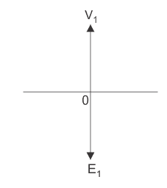
Now if an alternating source voltage V₁ is applied in the primary winding of that ideal transformer, there will be a counter self emf E₁ induced in the primary winding which is purely 180° in phase opposition with supply voltage V₁.

Slide 17
Practical Transformer
Iron or core losses in magnetic core of transformer
Cu losses due to winding resistance
Leakage flux giving rise to leakage reactance

Slide 18
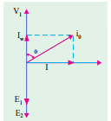
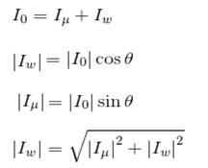
Practical Transformer on No-Load:
The primary input current is not wholly reactive. The primary input current under no-load conditions has to supply
(i) iron losses in the core i.e. hysteresis loss and eddy current loss and
(ii) A very small amount of copper loss in primary (there being no Cu loss in secondary as it is open). Hence, the no-load primary input current I₀ is not at 90° behind V₁ but lags it by an angle φ₀ < 90°.

Slide 19
No Load input Power (W0)= V₁I₀Cosφ₀
where cos φ₀ is primary power factor under no-load conditions. primary current I₀ has two components :
One in phase with V ₁. This is known as active or working or iron loss component I_{w} , which supplies the core losses (eddy current and hysteresis).
Other component is in quadrature with v₁ and is known as magnetizing (or) Reactive component I_{μ} which sets up the magnetic flux.

Slide 20
The following points should be noted carefully :
The no-load primary current I₀ is very small as compared to the full-load primary current (It is about 1 per cent of the full-load current). Hence Cu loss is negligibly small which means that no-load primary input power is practically equal to the iron loss in the transformer.

Slide 21
Practical Transformer on Load:
When the secondary is loaded, the secondary current I₂ is set up. The V₁ magnitude and phase of I₂ with respect to V₂ is determined by the characteristics of the load. Current I₂ is in phase with V₂ if load is non-inductive, it lags if load is inductive and it leads if load is capacitive.
The secondary current sets up its own m.m.f= N₂I₂ and hence its own flux Φ₂ which is in opposition to the main primary flux Φ which due to I₀. The secondary ampere-turns N₂I₂ are known as demagnetizing amp-turns.

Slide 22
The opposing secondary flux Φ₂ weakens primary flux Φ momentarily, hence primary back e.m.f E₁ tends to be reduced. Let the additional primary current be I₂’. It is known as load component of primary current.
This current is anti phase with I₂.The additional primary m.m.f N₁ I₂’ sets up its own flux Φ₂’ which is in opposition to Φ₂(but is in the same direction as Φ) and is equal to it in magnitude. Hence, the two cancel each other out.
So, we find that the magnetic effects of secondary current I₂ are immediately neutralized by the additional primary current I₂’ which is brought into existence exactly at the same instant as I₂.

Slide 23
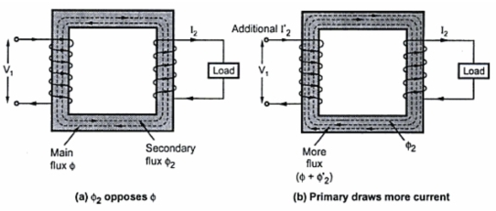

Slide 24
Transformer with Resistive Winding, but No Magnetic Leakage
An ideal transformer was supposed to possess no resistance, but in an actual transformer, there is always present some resistance of the primary and secondary windings. Due to this resistance, there is some voltage drop in the two windings. The result is that :
(i) The secondary terminal voltage V₂ is vectorialy less than the secondary induced e.m.f E₂ by an amount I₂R₂ where R₂ is the resistance of the secondary winding. Hence, V₂ is equal to the vector difference of E₂ and resistive voltage drop I₂ R₂.

Slide 25
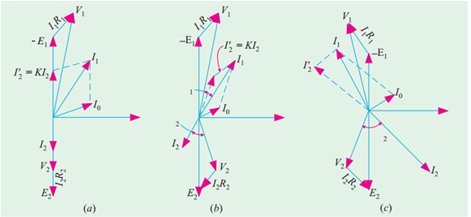
The vector diagrams for non-inductive, inductive and capacitive loads are shown in Fig (a), (b) and (c) respectively.

Slide 26
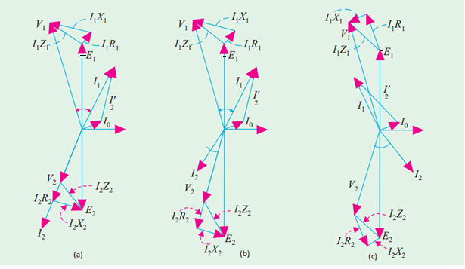
Transformer With Resistive Winding and with Magnetic Leakage

Slide 27
The vector diagram for such a transformer for different kinds of loads is shown in Fig above.
In these diagrams, vectors for resistive drops are drawn parallel to current vectors whereas reactive drops are perpendicular to the current vectors. The angle Φ₁ between V ₁ and I₁ gives the power factor angle of the transformer.
It may be noted that leakage reactance can also be transferred from one winding to the other in the same way as resistance.

Slide 28

Equivalent Resistance
In Fig above a transformer is shown whose primary and secondary windings have resistances of R1 and R2 respectively.
The resistances of the two windings can be transferred to any one of the two windings. The advantage of concentrating both the resistances in one winding is that it makes calculations very simple and easy. It will be proved that a resistance of R₂ in secondary is equivalent to R₂/K² the equivalent secondary resistance as referred to primary.
The copper loss in secondary is I₂R₂. This loss is supplied by primary which takes a current of I₁.
Hence if R₂‘ is the equivalent resistance in primary which would have caused the same loss as R2 in secondary

Slide 29
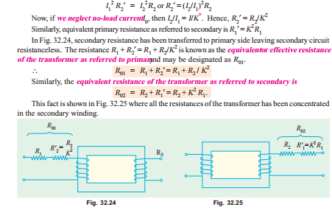

Slide 30
Note : It is important to remember that
(a) when shifting any primary resistance to the secondary, multiply by K₂² i.e. (transformation ratio).
(b) when shifting secondary resistance to the primary, divide it by K₂² .
(c) However, when shifting any voltage from one winding to another only K is used.
If referred to primary: V₂/= V₂/k
If referred to secondary: V₁/= V₁*k
(d) when shifting any current from one winding to another only K is used.
If referred to primary: I₂/= I₂*k
If referred to secondary: I₁/= I₁/k

Slide 31
Leakage Reactance
Similar to the resistance:
Equivalent primary reactance referred to secondary:
X₂/= X₂/k²
Equivalent secondary reactance referred to primary:
X₁/= X ₁* k²
Total reactance referred to secondary winding:
X₀₂= X₂+X₁/ i.e., X₀₂= X₂+ X₁*k²
Total reactance referred to primary winding:
X₀₁= X₁+X₂/ i.e., X₀₁= X₁+ X₂/k²

Slide 32
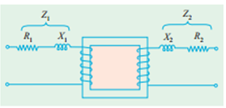
Transformer With Resistance and Leakage Reactance
In Fig below the primary and secondary windings of a transformer with reactance taken out of the windings are shown. The primary impedance is given by
Similarly Impedance Z₂/= Z₂/k²
Z₁/= Z₁* k²
Z₀₂= Z₂+Z₁/ i.e., Z₀₂= Z₂+ Z₁*k²
Z₀₁= Z₁+Z₂/ i.e., Z₀₁= Z₁+ Z₂/k²

Slide 33
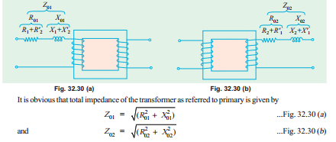

Slide 34
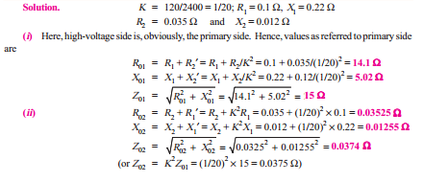
Example 32.15. A 30 kVA , 2400/120-V, 50-Hz transformer has a high voltage winding resistance of 0.1W and a leakage reactance of 0.22W. The low voltage winding resistance is 0.035 W and the leakage reactance is 0.012 W. Find the equivalent winding resistance, reactance and impedance referred to the (i)high voltage side and (ii) the low-voltage side.

Slide 35
Equivalent Circuit
In a practical transformer -
Some leakage flux is present at both primary and secondary sides. This leakage gives rise to leakage reactance at both sides, which are denoted as X₁ and X₂ respectively.
(b) Both the primary and secondary winding possesses resistance, denoted as R₁ and R₂ respectively. These resistances causes voltage drop as, I₁R₁ and I₂R₂ and also copper loss I₁²R₁ and I₂²R₂.
(c) Permeability of the core can not be infinite, hence some magnetizing current is needed. Mutual flux also causes core loss in iron parts of the transformer.
We need to consider all the above things to derive equivalent circuit of a transformer.

Slide 36
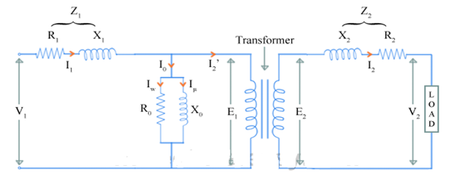
The no load current I₀ is divided into, pure inductance X₀ (taking magnetizing components I_{μ}) and non induction resistance R₀ (taking working component I_{w}) which are connected into parallel across the primary. The value of E₁ can be obtained by subtracting I₁Z₁ from V₁. The value of R₀ and X₀ can be calculated as, R₀ = E₁ / I_{w} and X₀ = E₁/I_{μ}.
But, using this equivalent circuit does not simplifies the calculations. To make calculations simpler, it is preferable to transfer current, voltage and impedance either to primary side or to the secondary side.

Slide 37
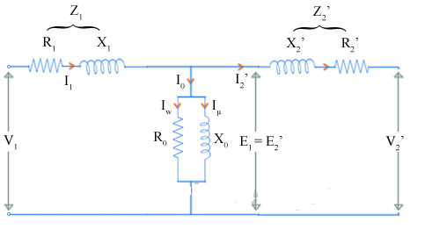
The figure below shows the equivalent circuit of transformer with secondary parameters referred to the primary.

Slide 38
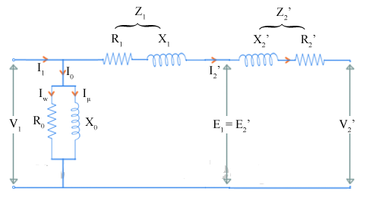
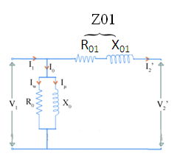
Now, let R₁ + R₂' = R₀₁ and X₁ + X₂' = X₀₁ Then the equivalent circuit of transformer becomes as shown in the fig below

Slide 39
****Why Transformer Rating in kVA ?
Cu loss of a transformer depends on current and iron loss on voltage. Hence, total transformer loss depends on volt-ampere (VA) and not on phase angle between voltage and current i.e. it is independent of load power factor. That is why rating of transformers is in kVA and not in kW.

Slide 40


Voltage Regulation
The voltage regulation is the percentage of voltage difference between no load (₀V₂) and full load voltages(V₂) of a transformer with respect to its no load or full load voltage.
%Reg up= (₀V₂-V₂₎/V₂* 100 or
%Reg down= (₀V₂-V₂₎/₀V₂* 100
Voltage regulation of transformer at lagging power factor
Voltage regulation of transformer at leading power factor

Slide 41
Efficiency
%η = (Output/ Input ) * 100
%η = ( Vi cosφ / Vi cosφ +W _{i}+W _{cu})*100
η at any load ‘x’ is defined as
%η = ( x*Vi cosφ / x*Vi cosφ+W_{i}+x²*W _{cu})*100
Condition for maximum efficiency is core losses= copper losses

