Slide 1
STUDENT FEE PAYMENT AND EMPLOYE PAYROLL MANAGEMENT SYSTEM
Team No:8
K.Deepak Ram Nath
Roll No: 1602-19-7370130
Sai Sri Ram
Roll No:1602-19-737-160

Slide 2
STUDENT FEE PAYMENT AND EMPLOYEE PAYROLL MANAGEMENT SYSTEM
ABSTRACT: Student fee payment and employment payroll management
application in C is to be run by administrator
This application keeps the records of all the students and staff of the institution. The administrator can add, modify, delete the records according to the need.
The basic feature of application is that it shows fees that the student need to pay and advance of the student.
It also records the information related to salary of the staff in the organization.
Team No:8
GITHUB LINK: Name : K.Deepak Ram Nath
https://github.com/RamNath512 Dubasi Sai Sri Ram
https://github.com/Sriramd01 Roll No: 1602-19-737-130
1602-19-737-160
Section: IT-C

Slide 3
Features Of The Project
USER : Administrator.
Administrator:
Login.
Add student and staff details.
Search student and staff details.
Modify student and staff details.
Delete student and details.
Calculate the fee for student and salary for the staff.

Slide 4
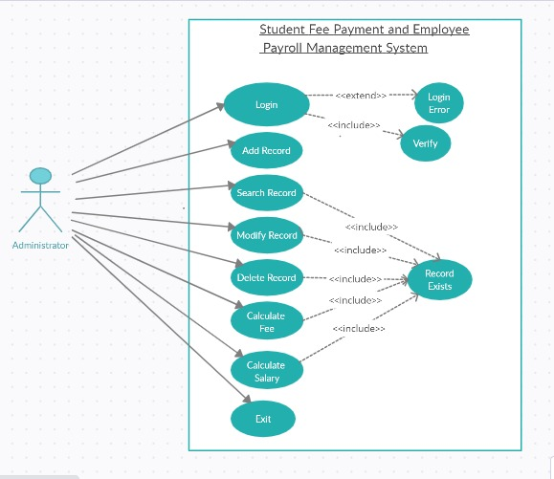
.

Slide 5
TECHNOLOGY USED
All computer software needs certain hardware components or other software resources to be present, in order for computers to be used efficiently. These prerequisites are known as System Requirements. Within this, we have two types – Software Requirements and Hardware Requirements.
SOFTWARE REQUIREMENTS
Software Requirements deal with defining the software resource requirements and prerequisites that need to be installed on a computer to provide optimal functioning of an application. These preconditions are generally not included in the software installation package and need to be installed separately.
Operating System: Windows 7 and above
C Compiler: GNU Compiler Collection (GCC)
Editor: Any text editor .
HARDWARE REQUIREMENTS
Hardware requirements refer to the common set requirements defined by any operating system or software application and are usually the physical computer resources. In this, we look into the architecture, processing power, memory, secondary memory, display adapter and peripherals.
In order to use this project, one should have the following:
Processor: Intel Pentium processor and above
Memory: 4 GB RAM and above

Slide 6
Use Case id:UC_01
Name :Login.
Actor : Administrator.
Description : Allows the Administrator to login (allotted user id and password).
Pre-Condition : Admin must enter the id and password.
Post-Condition : After Admin logs in , all the options displayed on the screen.
Main Flow:
User | System
1.Enter the username and password to login.
 | 2.Validates username and password. 2.1) If username and password are incorrect displays invalid details. 2.2)If the given credentials are given for three times it terminates the application.

Slide 7
Use Case id:UC_02
Name : Add Record
Actor : Administrator.
Description : Admin add the details of the student and staff by their requirements.
Pre-Condition : Admin have to choose the option to add details.
Post-Condition :Asks the details to be recorded.
Main Flow:
User | System
1.Choose to add details.
 | 2.Asks for the details like according to the student and staff.
3.Enter the required details.
 | 4.The Details are recorded sucessfully.

Slide 8
Use Case id:UC_03
Name : Search details
Actor : Administrator
Description : Allows admin to search details of student and staff.
Pre-condition : User should log in successfully and details of student and staff exist
Post-condition : Admin have to provide the details to search the previous record.
Main Flow :
User | System
1.Choose to search the record
 | 2.Asks the details like name,id etc, to search the record.
3.Enter the required details
 | 4.Record will be displayed.

Slide 9
Use Case id:UC_04
Name : Modify details
Actor : Administrator
Description : Allows admin to modify details of student and staff.
Pre-condition : User should log in successfully and details of student and exist
Post-condition : Records of student are updated successfully.
Main Flow:
Ueser | System
1.Choose to modify the details.
 | 2.Ask to modify the details like name id etc.
3.Enter the details to be modified.
 | 4.Details are successfully modified.

Slide 10
Use Case id:UC_05
Name : Delete details
Actor : Administrator
Description : Allows admin to Delete details of student and staff.
Pre-condition : User should log in successfully and details of student and staff exist
Post-condition : Amin have to provide the details to delete the record.
Main Flow :
User | System
1.Choose to delete the record.
 | 2.Asks the details to delete the record.
3.Enter the required details.
 | 4.Delete the record Successfully

Slide 11
Use Case id:UC_06
Name : Calculate Fee
Actor : Administrator
Description : Allows admin to check the fee details of student.
Pre-condition : User should log in successfully and details of student exists.
Post-condition : Amin have to provide the details to search the previous record.
Main Flow :
User | System
1.Choose the option fee for students .
 | 2.Asks the details of the student.
3.Enter the required details.
 | 4.Displays the fee details of student.

Slide 12
Use Case id:UC_07
Name : Calculate Salary
Actor : Administrator
Description : Allows admin to check the salary details of staff.
Pre-condition : User should log in successfully and details of staff exist
Post-condition : Admin have to provide the details to search the previous record.
Main Flow :
USER | SYSTEM
1.Choose the option salary for the staff.
 | 2.Asks the details of the staff.
3.Enter the required details.
 | 4.Displays the salary details of the staff.

Slide 13
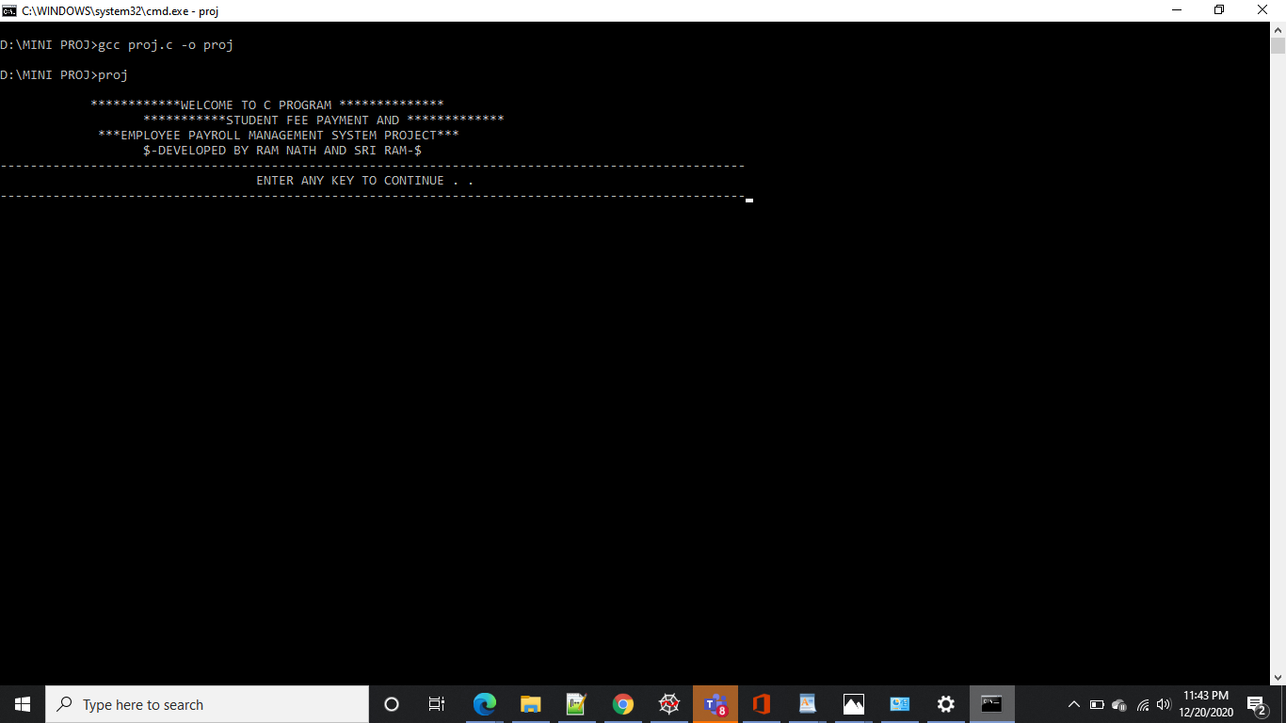
Execution

Slide 14
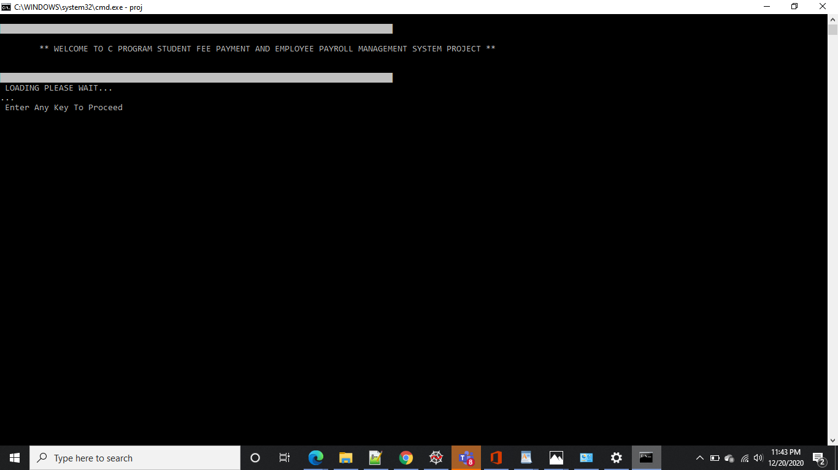

Slide 15
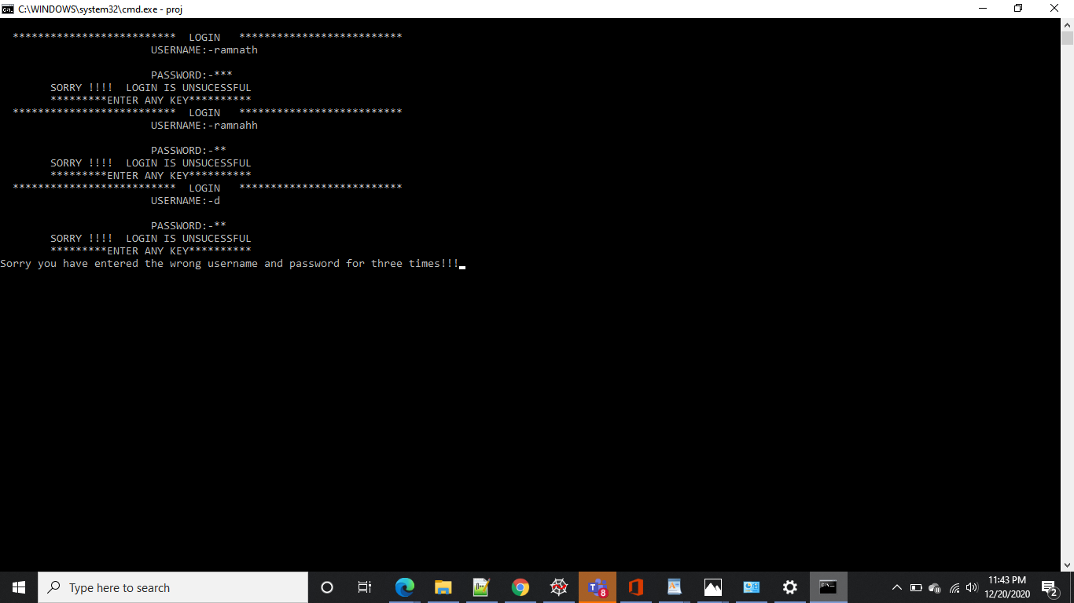

Slide 16
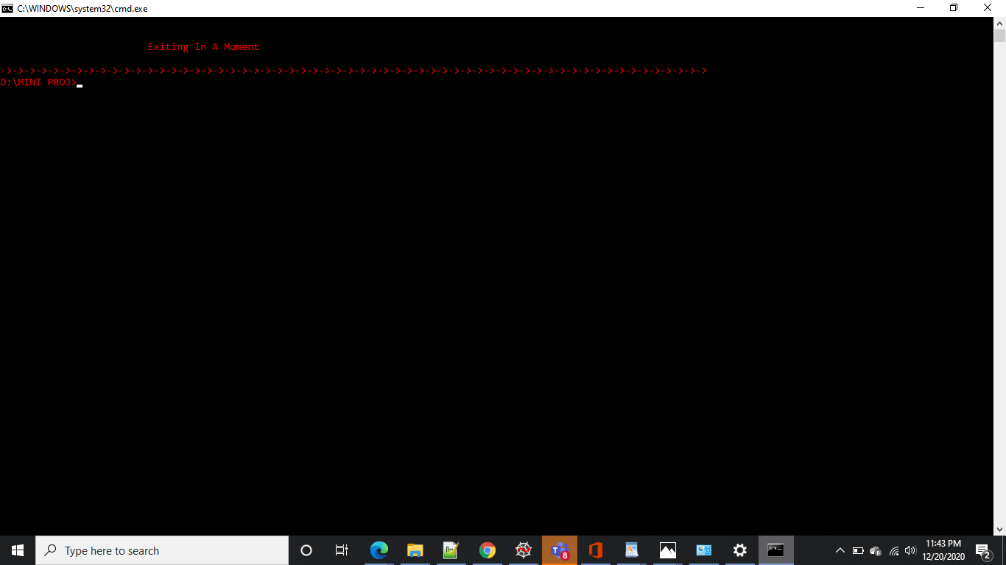

Slide 17
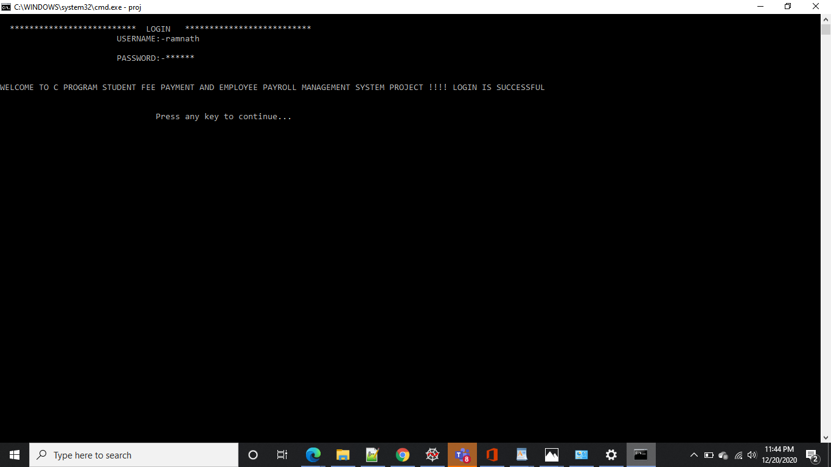

Slide 18
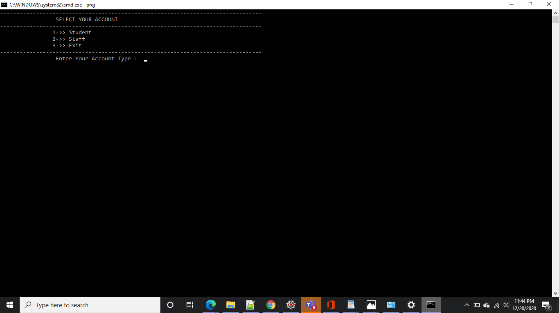

Slide 19
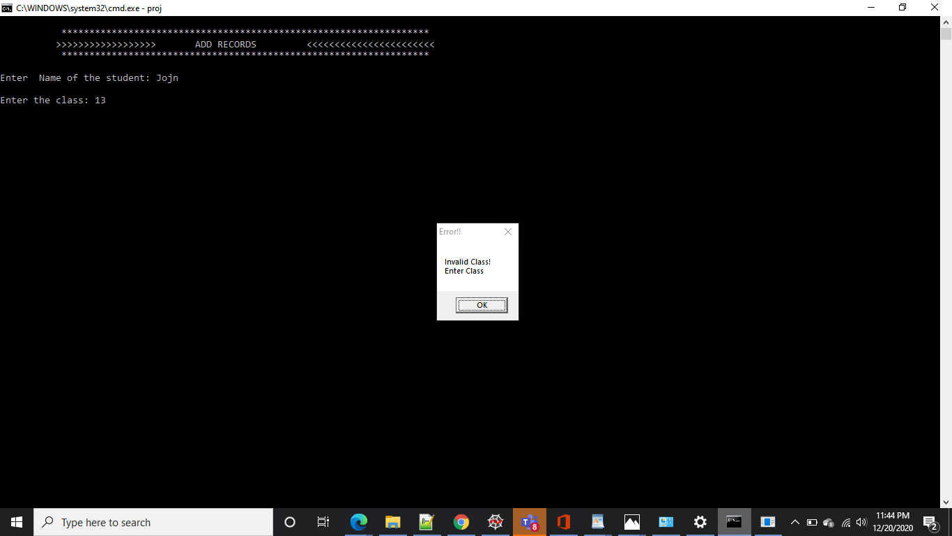

Slide 20
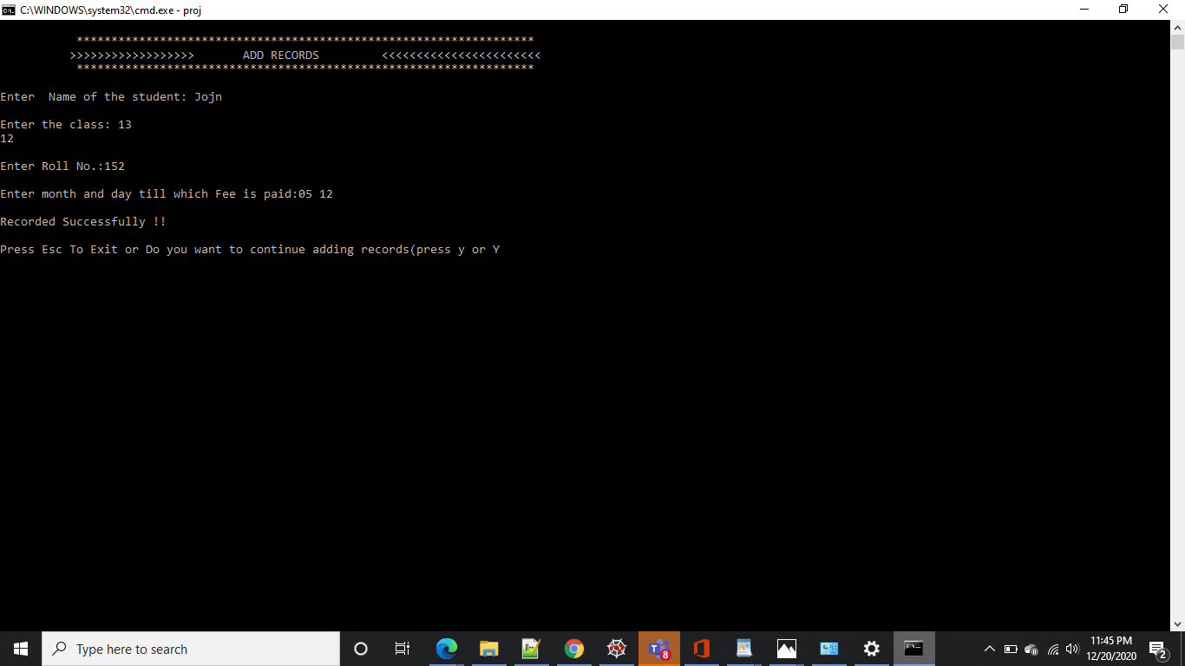

Slide 21
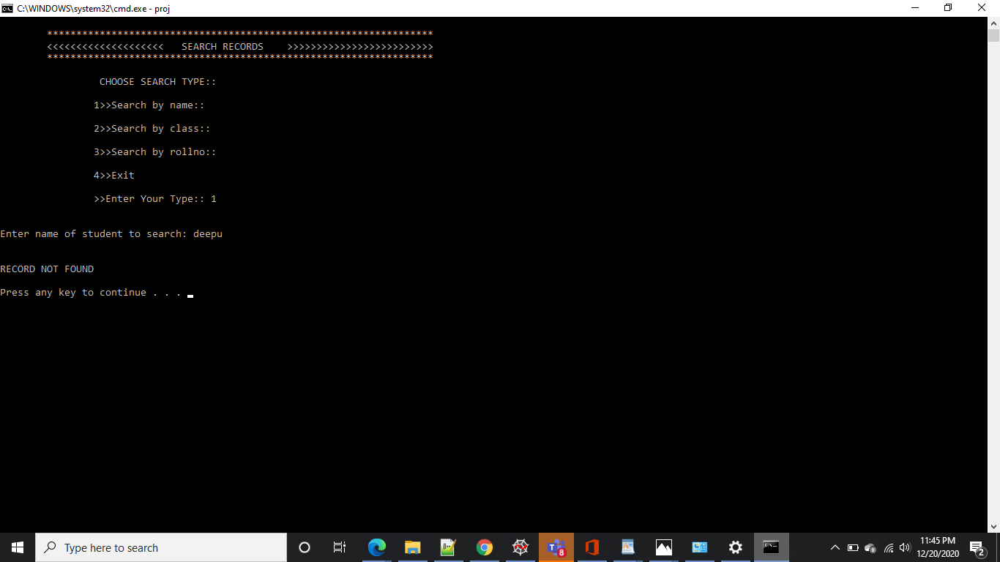

Slide 22
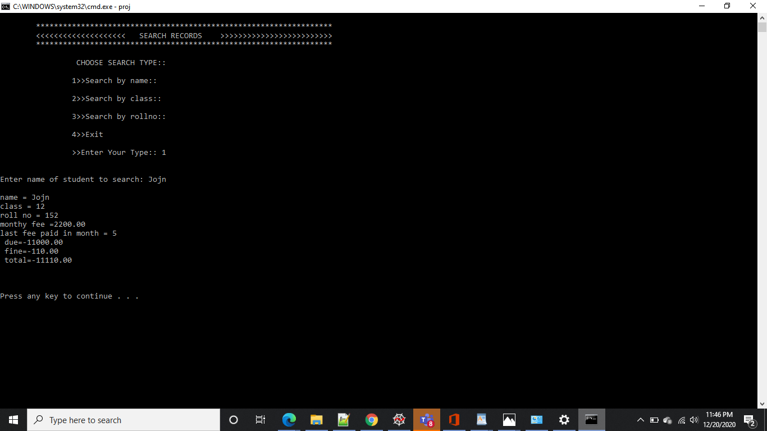

Slide 23
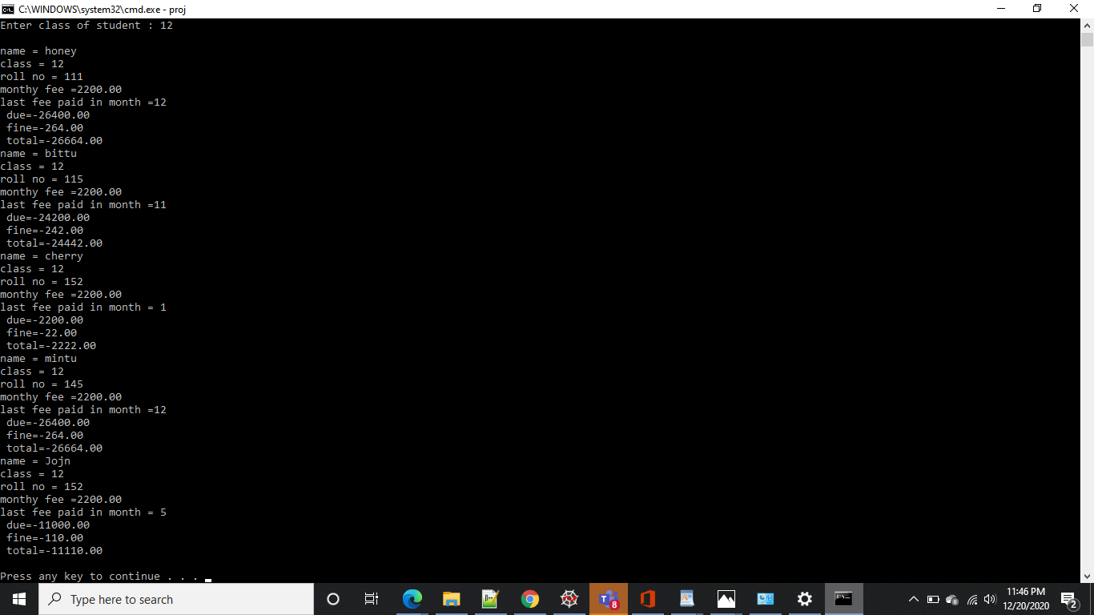

Slide 24
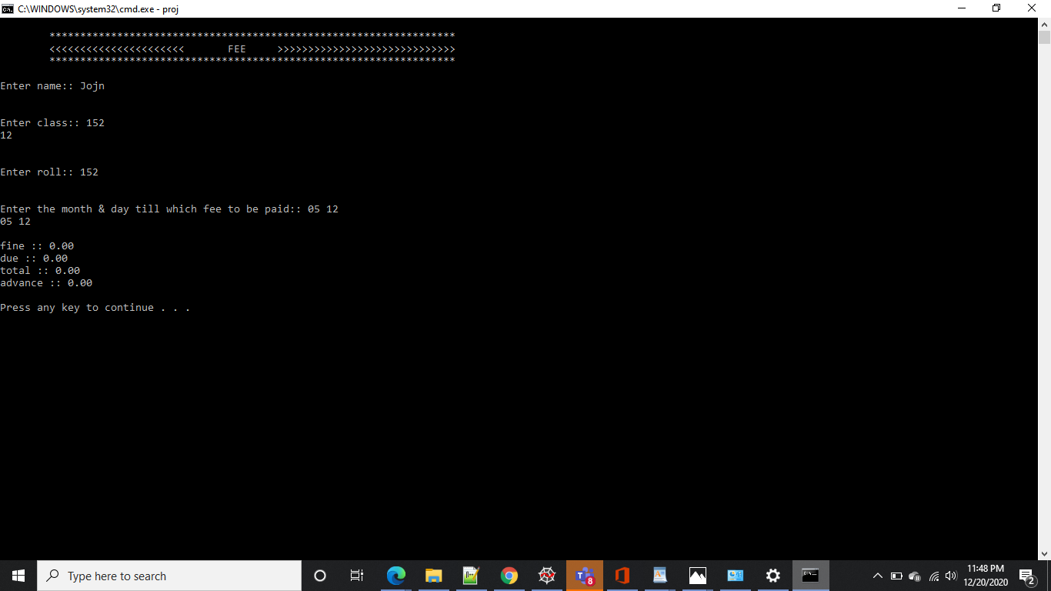

Slide 25
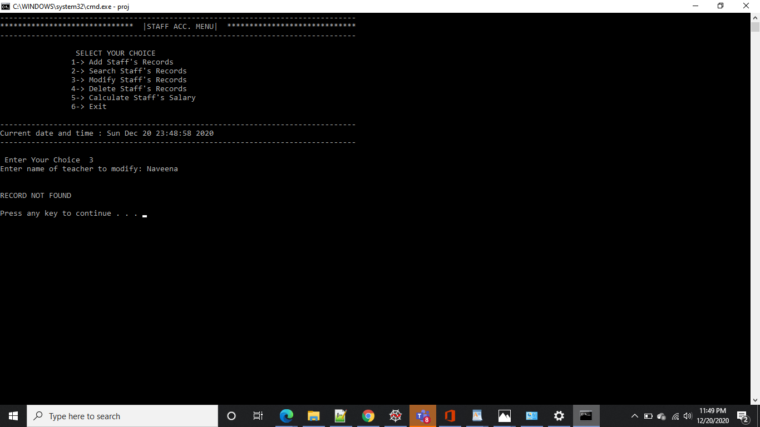

Slide 26
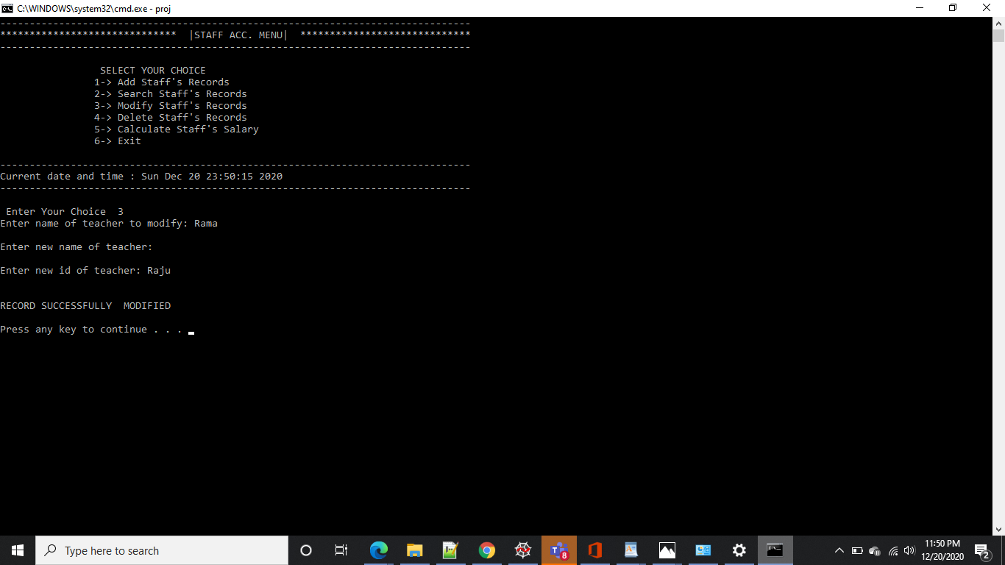

Slide 27


Slide 28
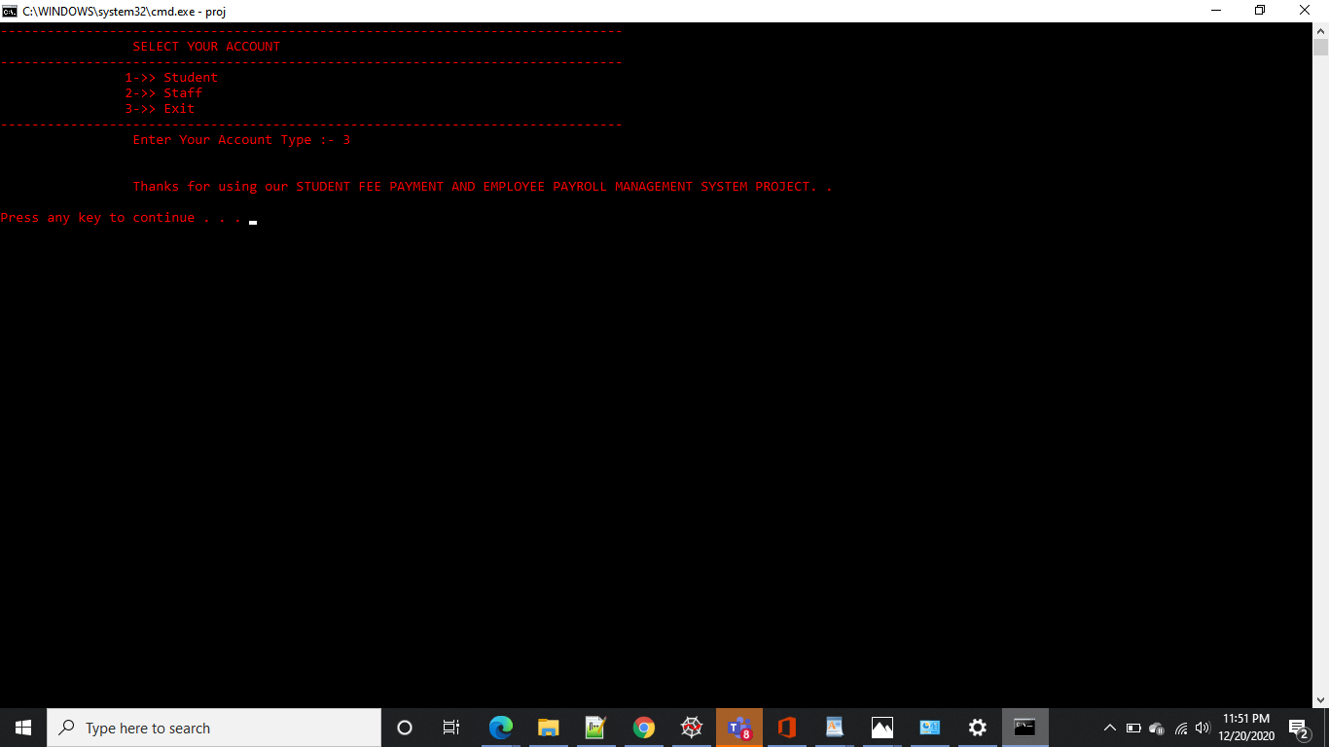

Slide 29
CONCLUSION AND FUTURE WORK
To conclude, this application is useful not only for educational institution but also for any other organization who are keen to utilize this kind of application. It can be operated very easily.
Future work is to we develop the application in PHP Or HTML to make the real payment, make this console application as a web application.

