Slide 1

Advancing Game AI with Reinforcement Learning
CSCI-6660-01-Introduction to Artificial Intelligence
Submitted by:
Ram Prasanth Chintoju (00790169)
Venkata Durga Sunanda Reddy Gangula (00879541)

Slide 2
Project Topic:
Content:
Advancing Game AI with Reinforcement Learning
Brief description:
We are embarking on a project to train a Mario agent to independently master a Mario game using the Double Deep Q-Networks (DDQN) algorithm.
Our training environment of choice is Open AI Gym, designed for Super Mario Bros, and we're utilizing the nes-py emulator to facilitate the agent's learning process.
Throughout this project, we will evaluate the agent's performance by measuring key metrics, including the Mean Reward Value, Mean Loss Value, and Mean Q Value, collected over a set of episodes.
The ultimate aim of our project is to simulate the training of a Mario Agent, demonstrating its ability to autonomously learn and excel in the Mario game environment.

Slide 3
Reinforcement Learning
Definition- RL involves training agents to make decisions by interacting with an environment to maximize rewards.
Key components of RL with an example - Training Mario:
Agent: Mario (controlled by AI).
Environment: Super Mario Bros game world.
Actions: Jump, move left/right.
States: Different game screens or positions.
Rewards: Points gained, coins collected, level completion.

Slide 4
Reinforcement Learning
Process:
Exploration vs. Exploitation: Mario tries various moves (exploration) while leveraging successful actions (exploitation).
Learning: Mario learns from experiences - which actions lead to rewards or penalties.
Policy Improvement: Adapts strategy to navigate obstacles, defeat enemies, and finish levels efficiently.
Goal:
Teach Mario to navigate levels, avoid obstacles, defeat enemies, and maximize points by learning from successes and failures.

Slide 5
Project Objectives:
Implement reinforcement learning algorithms, including Q-learning, A3C, and policy gradient methods, into the game AI to enable dynamic decision-making.
Train AI agents through competitive self-play to optimize in-game strategies.
Enhance player engagement and satisfaction by offering more intelligent and challenging in-game NPCs.

Slide 6
Approach:
Executed on: Anaconda-Jupyter Lab
Framework: Gym for RL algorithm development.
Environment: gym-super-mario-bros==7.3.0 for Super Mario Bros.
Platform: PyTorch for RL.
Actions: Control using joypad space from nes-py.
Wrappers: Preprocess data for better agent learning.

Slide 7
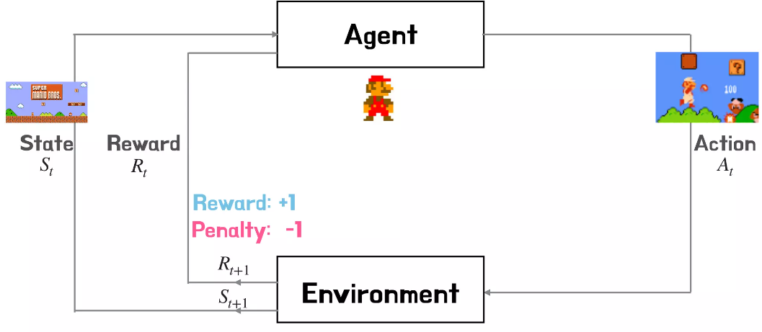
MARKOV DECISION PROCESS

Slide 8
Agent:
Mario Class:
- Agent representation & game control.
Optimal Action Policy:
- Act based on current state.
Experience Log:
- Record state, action, reward, next state.
Learning from Experience:
- Improve decisions using stored data.
Exploration vs. Exploitation:
- Balance between known & new actions.

Slide 9
Double DQN vs. Model-Free Methods
Enhancing Decision-Making in RL Gaming with Double DQN:
- Utilizes dual networks to maximize rewards and refine decisions.
Model-Free Methods (e.g., Policy Gradients):
- Optimizes policies via gradient descent without specific environment knowledge.
Performance Contrast:
- Double DQN displays superior gameplay via improved decision-making.
- Model-free methods leverage parameterized policies for optimization without network integration.

Slide 10
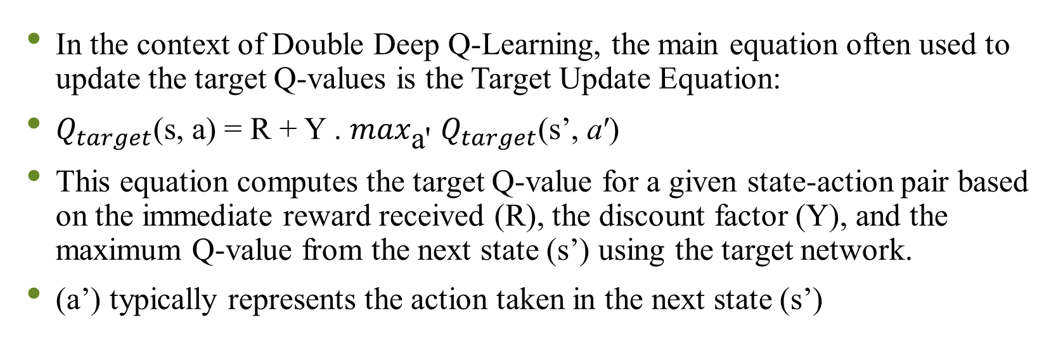
Double DQN:
In the context of Double Deep Q-Learning, the main equation often used to update the target Q-values is the Target Update Equation:
$Q_{target}$(s, a) = R + Υ . $\max_{\text{a}\text{′}}$ $Q_{target}$(s’, a′)
This equation computes the target Q-value for a given state-action pair based on the immediate reward received (R), the discount factor (Υ), and the maximum Q-value from the next state (s’) using the target network.
(a’) typically represents the action taken in the next state (s’)

Slide 11
Deliverables:
Reinforcement Learning Model: Develop an effective reinforcement learning model designed for gaming, particularly for the Mario game environment.
Python-Based Implementation with OpenAI Gym: Implement the project in Python, utilizing the OpenAI Gym framework to create a practical and accessible platform for AI to interact with gaming environments.

Slide 12
Evaluation Methodology:
Define success metrics, including:
Sample complexity and the number of episodes needed for convergence.
Regret, measuring the difference between the agent's performance and the best possible performance.
Average total rewards per episode to assess in-game AI quality.
Conduct A/B testing by comparing gameplay experiences with different RL-powered AI algorithms (Q-learning, A3C, and policy gradient).

Slide 13
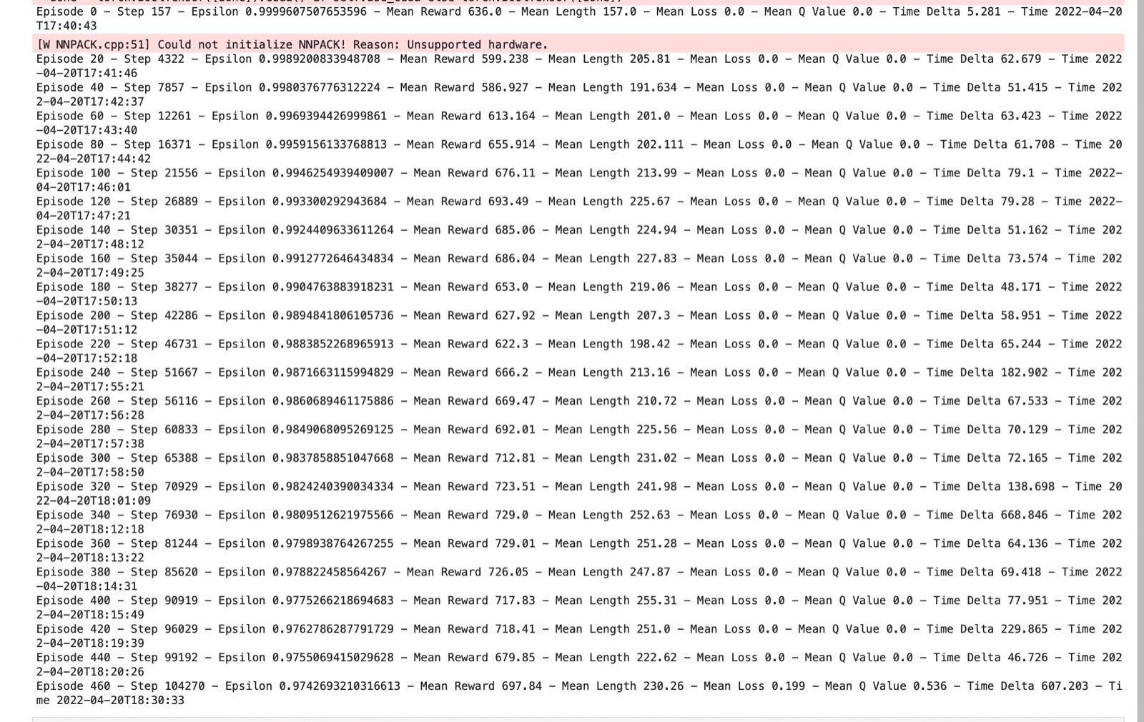
Result:

Slide 14
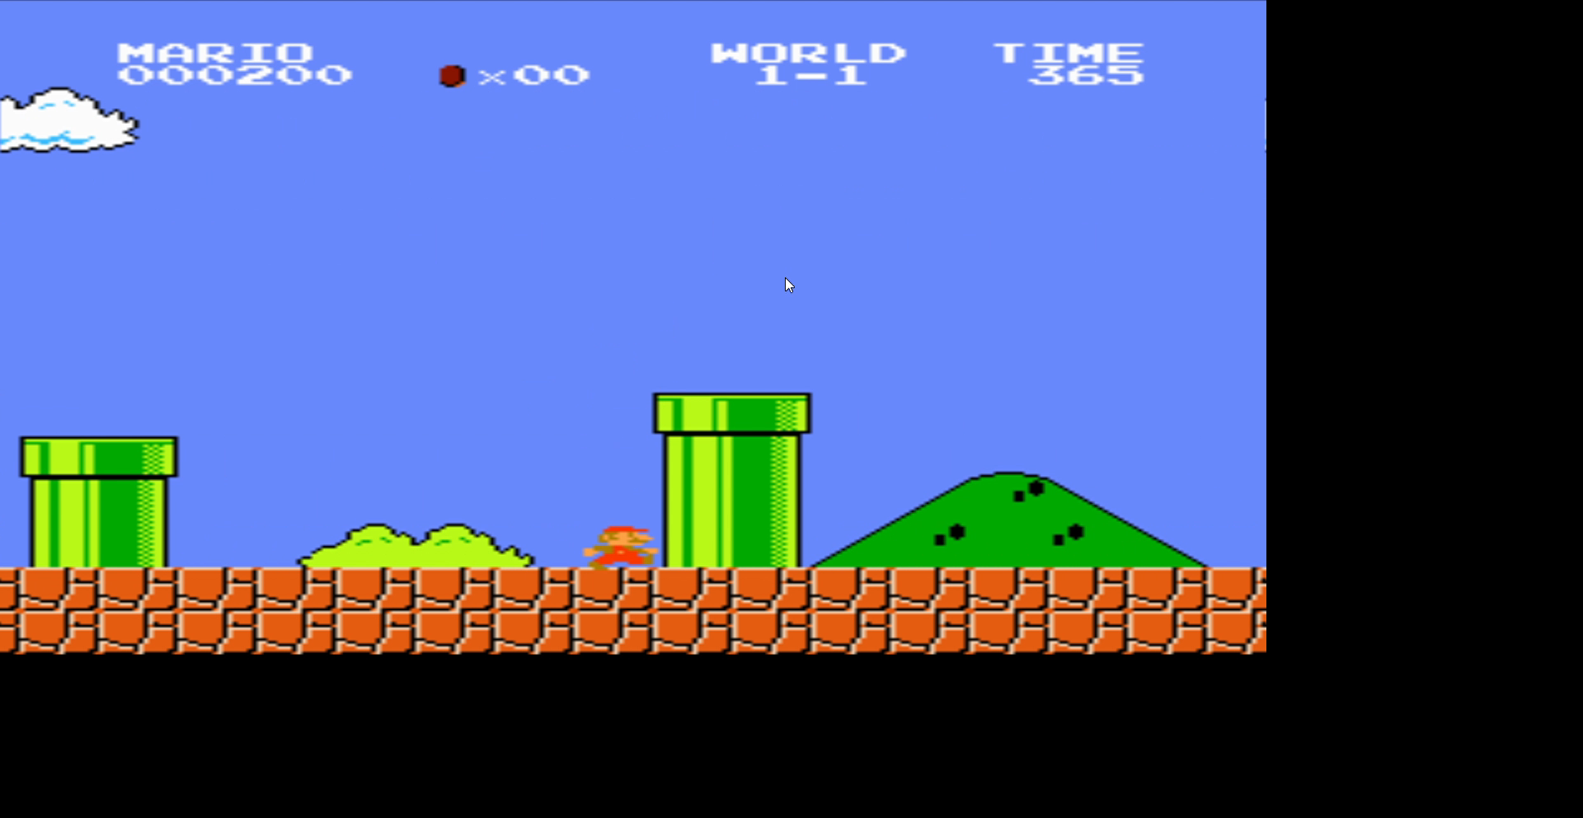
Mario playing:

Slide 15
Applications:
RL can be applied in some of the applications like:
Self driving cars
Industry automation
Trading and finance
NLP

Slide 16
Conclusion:
Incorporating Double Deep Q-Network (Double DQN) into our gaming reinforcement learning model showcased enhanced learning stability, improved efficiency, better policy generalization, reduced overestimation bias, and optimized decision-making. This implementation significantly elevated the agent's performance within the gaming environment.

Slide 17
References
Concepts of RL: https://spinningup.openai.com/en/latest/
Paper on Deep RL with Double Q-learning: https://arxiv.org/pdf/1509.06461.pdf
OpenAI Gym Documentation: https://www.gymlibrary.dev/index.html
Stable Baselines Documentation: https://stable-baselines3.readthedocs.io/en/master/
"Reinforcement Learning: An Introduction" by Richard S. Sutton and Andrew G. Barto: A comprehensive book covering RL fundamentals, algorithms, and applications.

Slide 18
THANK YOU

