Slide 1
Help me with my Mood with Social-media Health Analysis and Display Engine (SHADE).
Team MoodSeek

Slide 2
Tools/platform/APIs used in the solution
Python3 with Flask
IBM Watson’s Tone Analyzer API
IBM Watson’s Visual Recognition API
Musixmatch’s API
Tweepy for tweet extraction

Slide 3
Team member roles
Ramya Ramanathan - Twitter scraping and mood identification using IBM Watson, movie/TV show classification, books classification, image classification.
Ram Rohan Ramanathan - Music analysis and classification, implementation of dynamic playing of songs using SoundCloud and quote extraction.
Radha Kumaran - Music analysis and automated playlist curation, user interface development, system integration.

Slide 4
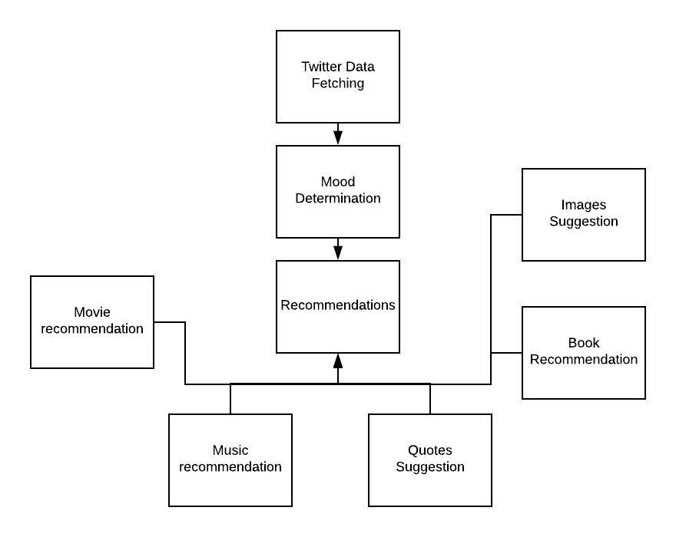
Implemented Components - High Level Design

Slide 5
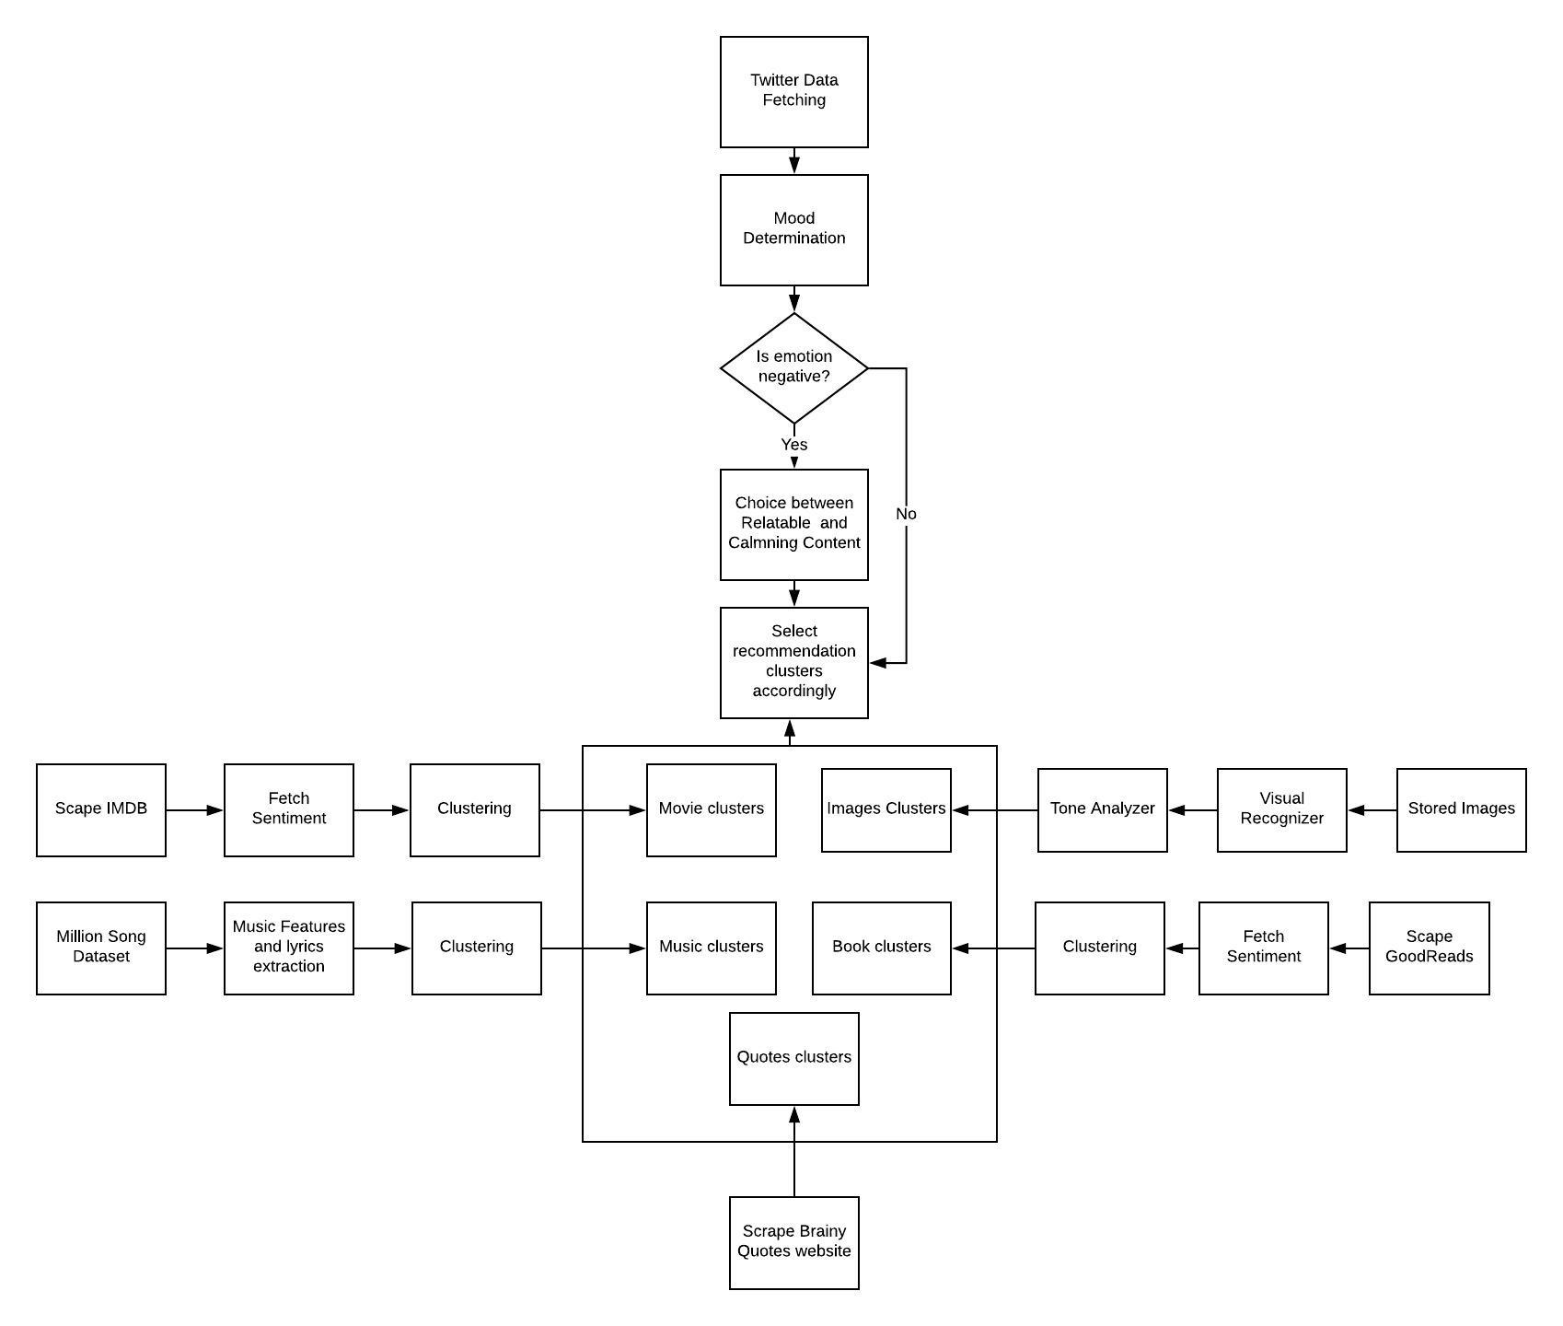
Implemented
Components -
Detailed Design

Slide 6
Implemented components - Description
MoodSeek is organized into the following modules:
Twitter Scraping: extracts the tweets based on the twitter handle for a fixed period . These are preprocessed and the sentiment is analysed.
Book/Movie Classification: Beautiful Soup based web crawlers scrape data from IMDB website for movies, and GoodReads website for books. Sentiment analysis using the nltk based vader sentiment. K-means based clustering is perfomed to cluster it into required emotion classes.
Image Classification - identifies image classes using the IBM Watson’s Visual Recognizer API and then uses sentiment analysis using IBM Watson’s Tone Analyzer to identify the emotion classes.

Slide 7
Implemented components - Description
Quotes - Beautiful Soup based web crawlers scrape quotes for each category of an emotion from the ‘Brainy Quotes’ website.
Music classification - Music features are extracted from Million Songs Database and lyrics from Musixmatch website for a given dataset of songs which are then clustered into different emotions.
User interface - The user interface was developed with the objective of integrating all the above modules in an efficient and easy-to-use manner, in order to provide the user with an enjoyable experience.

Slide 8
Key functionalities of the developed solution
Allows the user to enter his/her twitter handle and extracts his current mood from the contents
Allows the user to enter some text that he/she has written if they lack a twitter account
Asks the user to choose if he would like to be cheered up or would like to relate to his current state if he is in a negative mood
Provides a list of songs and the links to play them online, a list of books and a list of movies for the user to choose from and a bunch of pictures and a lot many quotes for him to read.
Allows the user to save a PDF of any of the lists of activities that we suggest for further references.

Slide 9
Usage of IBM services in the solution
IBM’s Tone Analyzer API was used to determine the user’s mood from the user’s Twitter presence, or any piece of text written by the user.
IBM’s Visual Recognition API was used to classify images based on the mood they represented, and this helped recommend images to the user that they would enjoy in their current state of mind.

Slide 10
Focus on UI/UX
Ease of use by all users - simple interface
Accomodation of different types of users - suggesting different forms of entertainment such as books/movies/music
Allow users to save their recommendations for later reference

