Slide 1
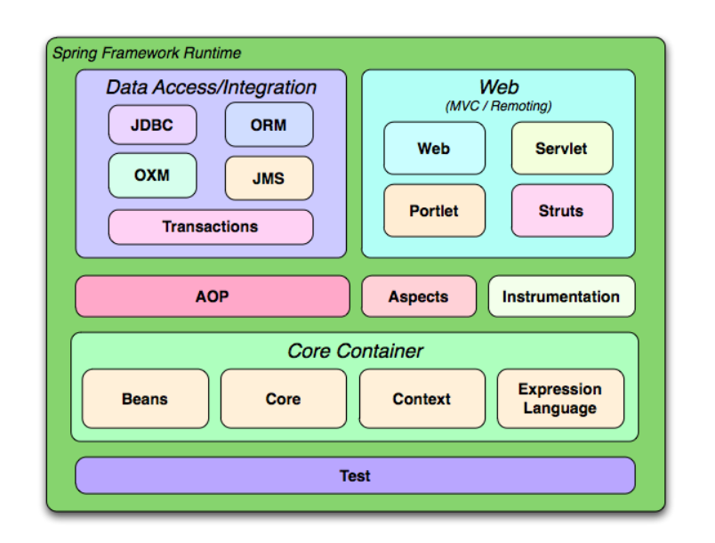

Slide 2
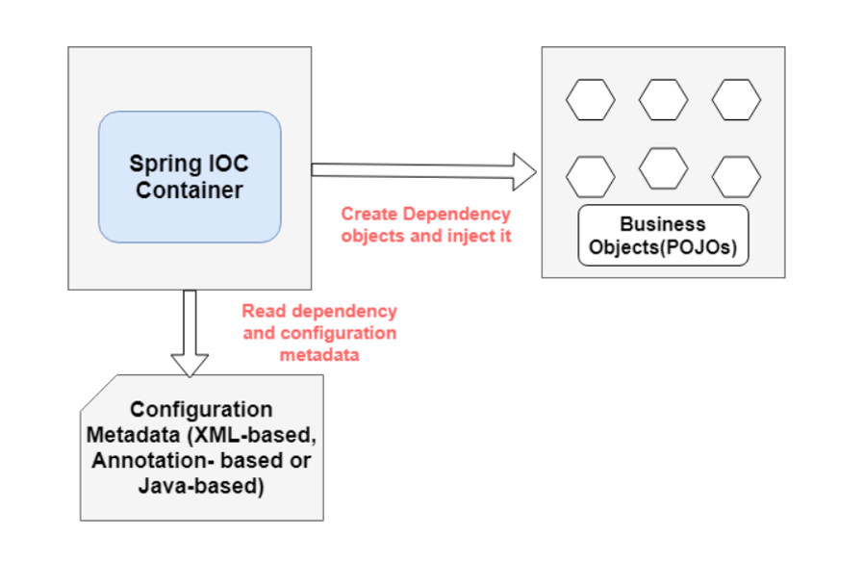
Spring IOC Container Overview
In the Spring framework, the IoC container is represented by the interface ApplicationContext. The Spring container is responsible for instantiating, configuring and assembling objects known as beans, as well as managing their lifecycle.

Slide 3
Inversion of Control
Inversion of Control is a principle in software engineering by which the control of objects or portions of a program is transferred to a container or framework.
Dependency Injection
Dependency injection is a pattern through which to implement IoC, where the control being inverted is the setting of object's dependencies.
The act of connecting objects with other objects, or “injecting” objects into other objects
Create an object dependency
in traditional programming:
Using DI, we can rewrite the example without specifying the implementation
public class Store {
private Item item;
public Store(Item item) {
this.item = item;
}
}
public class Store {
private Item item;
public Store() {
item = new ItemImpl1();
}
}

Slide 4
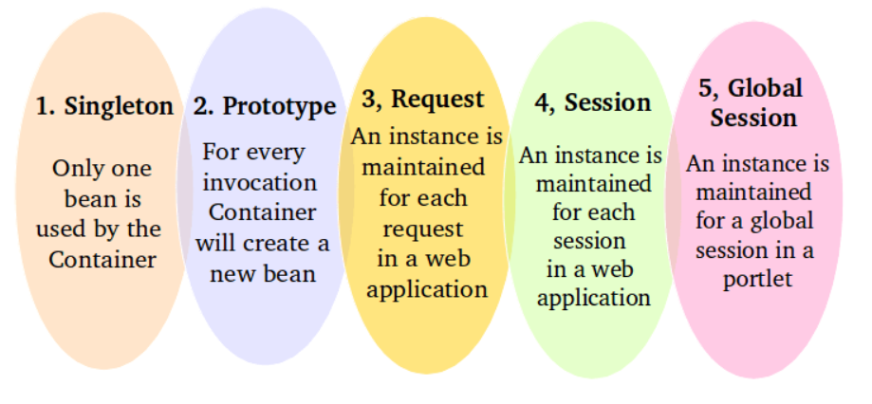
Spring Bean
Spring Bean is any object in the Spring framework that we initialize through Spring container is called Spring Bean. Any normal Java POJO class can be a Spring Bean if it’s configured to be initialized via container by providing configuration metadata information.
Spring Bean Scopes

Slide 5
Modes of autowiring a bean using an XML configuration:
no: the default value – this means no autowiring is used for the bean and we have to explicitly name the dependencies
byName: autowiring is done based on the name of the property, therefore Spring will look for a bean with the same name as the property that needs to be set
byType: similar to the byName autowiring, only based on the type of the property. This means Spring will look for a bean with the same type of the property to set. If there's more than one bean of that type, the framework throws an exception.
constructor: autowiring is done based on constructor arguments, meaning Spring will look for beans with the same type as the constructor arguments
@autowired
Dependency Injection @autowired can be done through
Constructor-Based Dependency Injection
Setter-Based Dependency Injection
Field-Based Dependency Injection

Slide 6
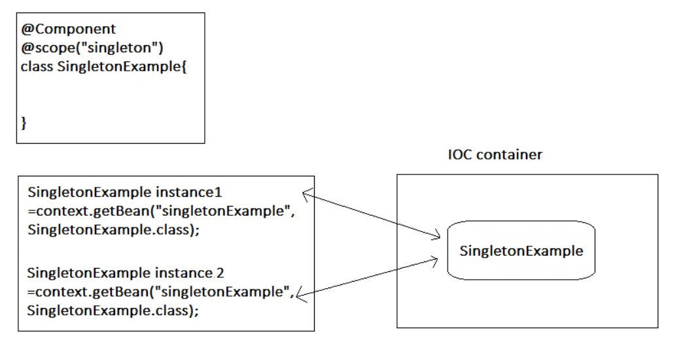

Slide 7
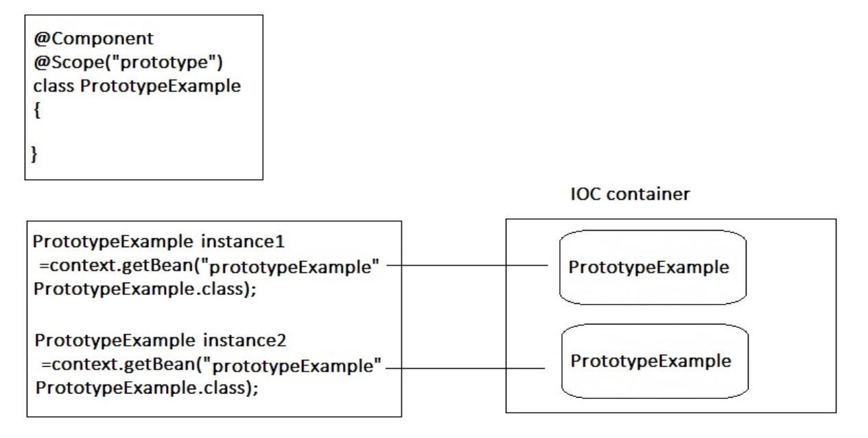

Slide 8
@Component
The @Component annotation marks a java class as a bean so the component-scanning mechanism of spring can pick it up and pull it into the application context. To use this annotation, apply it over class as below:
@Component
public class EmployeeDAOImpl implements EmployeeDAO {
...
}
Enable component scanning
Above four annotations will be scanned and configured only when they are scanned by DI container of Spring framework. To enable this scanning, we will need to use “context:component-scan” tag in our applicationContext.xml file.

Slide 9
@Autowired
Autowiring feature of spring framework enables you to inject the object dependency implicitly.
Use @Autowired annotation to auto wire bean on the setter method, constructor or a field.
The @Autowired annotation is auto wire the bean by matching data type.
@Service annotation
The @Service annotation is also a specialization of the component annotation. It doesn’t currently provide any additional behavior over the @Component annotation, but it’s a good idea to use @Service over @Component in service-layer classes because it specifies intent better. Additionally, tool support and additional behavior might rely on it in the future.
@Controller annotation
@Controller annotation marks a class as a Spring Web MVC controller. It too is a @Component specialization, so beans marked with it are automatically imported into the DI container. When we add the @Controller annotation to a class, we can use another annotation i.e. @RequestMapping; to map URLs to instance methods of a class.

Slide 10
@Qualifier
annotation is used to avoid conflicts in bean mapping and we need to provide the bean name that will be used for autowiring. This way we can avoid issues where multiple beans are defined for same type. This annotation usually works with the @Autowired annotation
@Repository annotation
Although above use of @Component is good enough but we can use more suitable annotation that provides additional benefits specifically for DAOs i.e. @Repository annotation. The @Repository annotation is a specialization of the @Component annotation with similar use and functionality. In addition to importing the DAOs into the DI container, it also makes the unchecked exceptions (thrown from DAO methods) eligible for translation into Spring DataAccessException.

Slide 11
Multiple container and global scope
Advnatage and disadvantage of xml annotation

