Slide 1
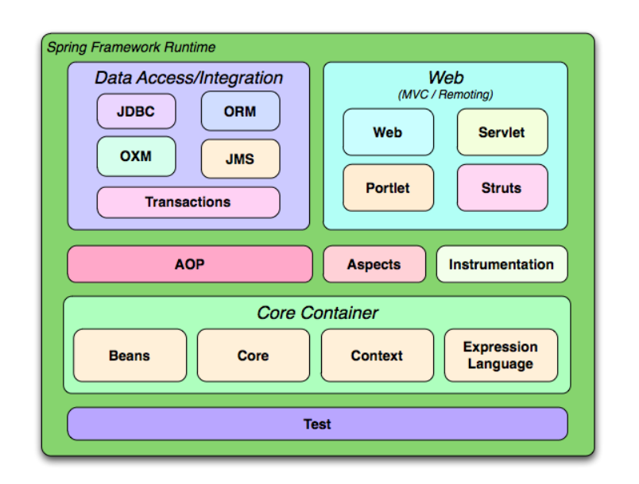
Spring framework architecture

Slide 2
The advantages of IoC architecture are:
Decoupling the execution of a task from its implementation
Making it easier to switch between different implementations
Greater modularity of a program
Greater ease in testing a program by isolating a component or mocking its dependencies
Dependency injection is a pattern through which to implement IoC, where the control being inverted by setting object's dependencies.

Slide 3
public Interface Engine() { ... }
public class Car {
private Engine engine;
public Engine getEngine() { ... }
public void setEngine(Engine engine) { ... }
}
Car newCar = new Car();
Engine sixCylEngine = new InlineSixCylinderEngine();
newCar.setEngine(sixCylEngine );
Example of using the @Inject annotation in Spring
public class Car {
@Inject
private Engine engine;
// ...
}
Annotating a class with @Component tells Spring that it is available for fulfilling injections
@Component
public class InlineSixCylinderEngine implements Engine{
//...
}

Slide 4
Why Spring MVC
Lightweight: Spring is a lightweight framework
High productive: Spring MVC is a productive framework which can boost your development.
Secure: Fully secure, that’s why most of the online baking web applications are developed using Spring MVC. Spring Security is a great API for enterprise grade security implementation.
MVC Supported: As its based on MVC. Its a great way to develop modular web applications.
TDD Supported: Fully support for Test Driven Development(TDD) technique.
Fit for Agile Development: Best fit for Agile based web application development.
Role Separation: Separate class for specific roles like Model, Command, Validator etc..
RESTful Service Support: In-build RESTful web services supported.
Mature and Great Community Support

Slide 5
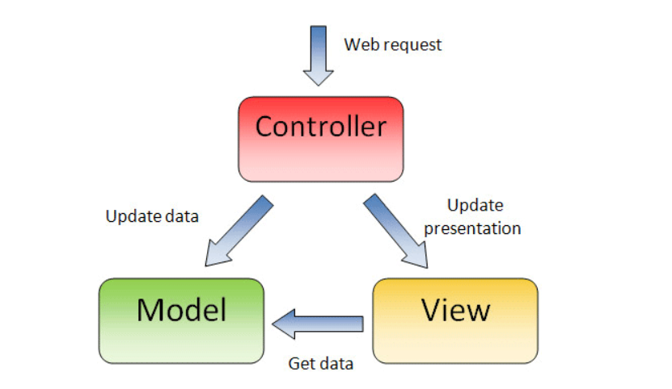
MVC

Slide 6
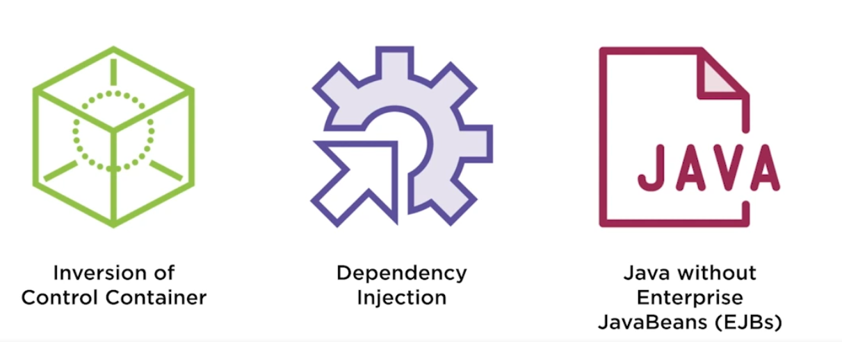
What is Spring

Slide 7
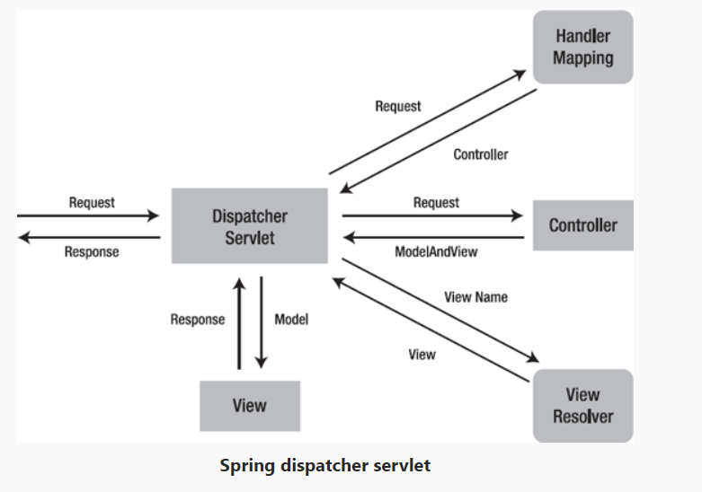
Request Processing

Slide 8
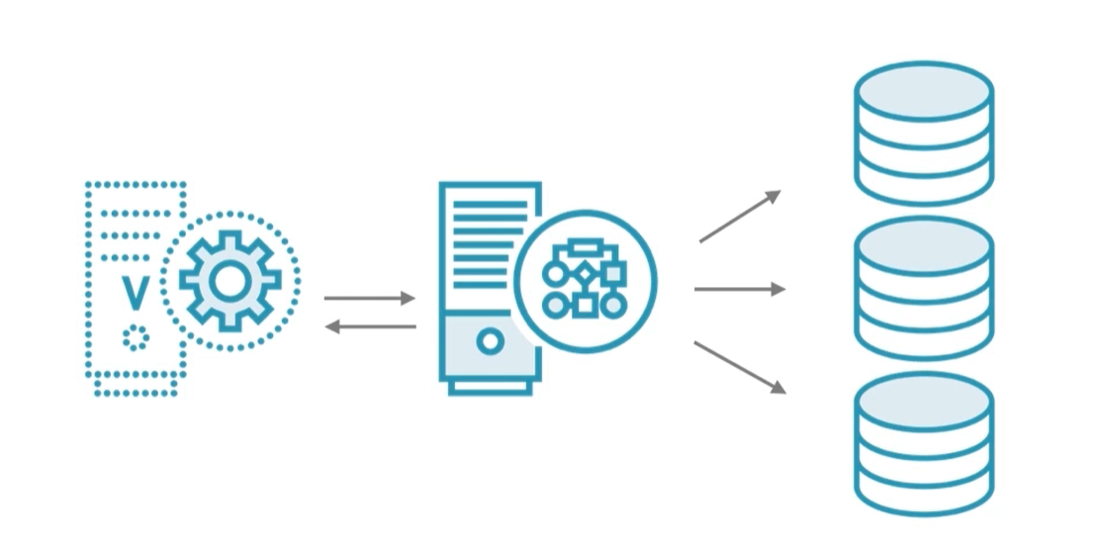
Components

Slide 9
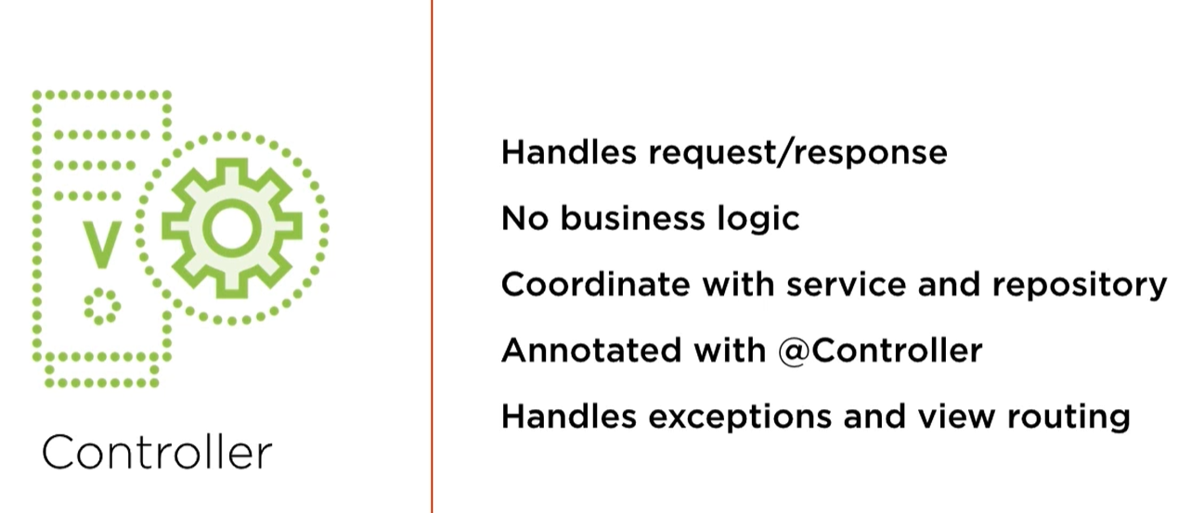

Slide 10
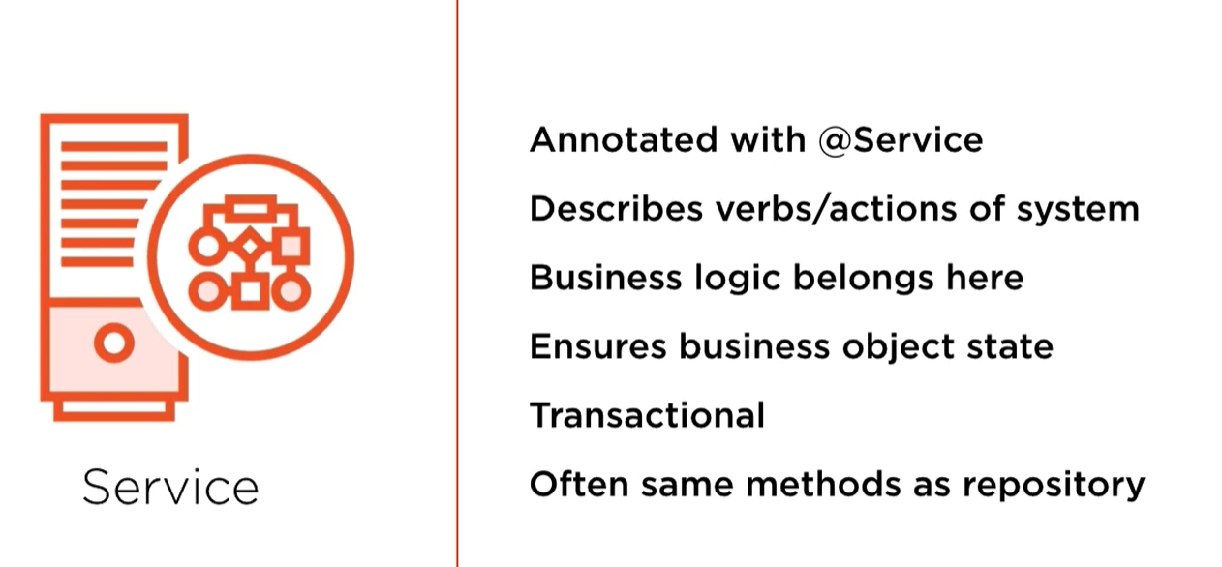

Slide 11
