Slide 1
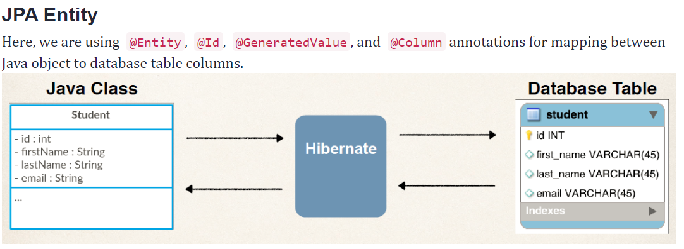
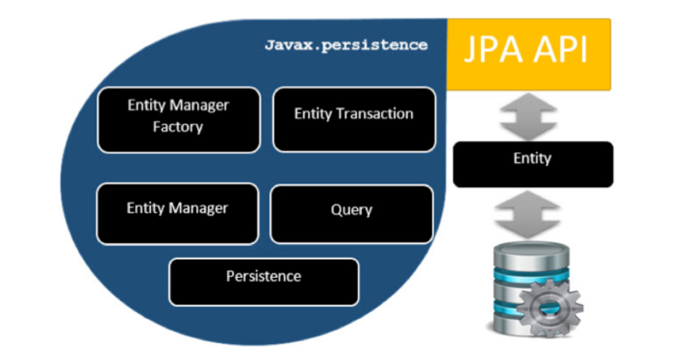
JPA
Mapping Java objects to database tables and vice versa is Object-relational mapping (ORM).
The Java Persistence API (JPA) is one possible approach to ORM.
Via JPA the developer can map, store, update and retrieve data from relational databases to Java objects and vice versa
JPA popular implementations are Hibernate, EclipseLink, Apache OpenJPA, Spring data / Spring Data JPA.

Slide 2
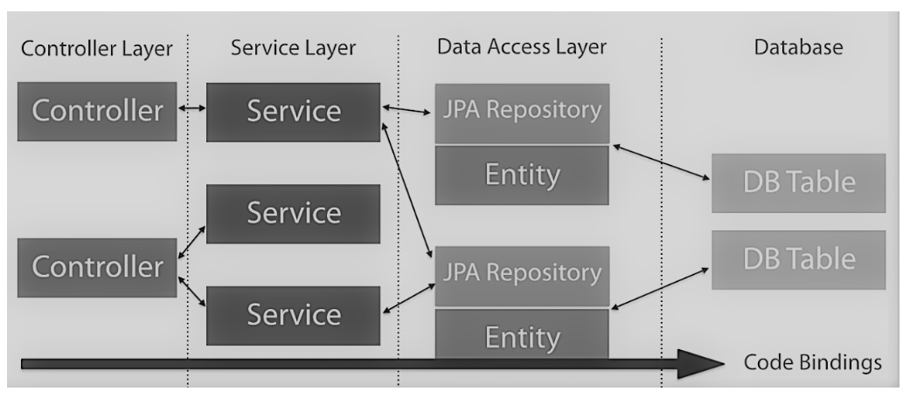
Spring Data provides Repository interfaces, which extend the Marker interface Repository. =
Two important Repository interfaces are:
CRUDRepository
PagingAndSortingRepository
Benefits(Why) of Spring Data
Get rid of boilerplate DAO classes.
Easily switch from repository one to another.
You don’t have to be an expert in JPA or Mongo queries. Spring will take care of it in an optimized way.
Highly flexible and support to add your own custom queries.

Slide 3
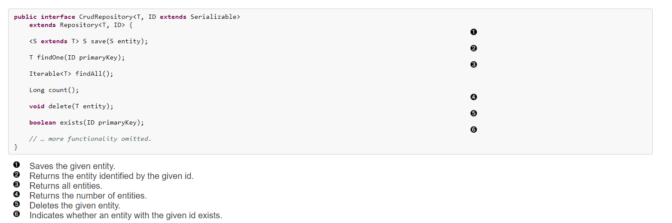
Spring Data Repository-Custom Query
CrudRepository interface
Query Creation from Method Name
JPA Named Queries
@Query Annotation

Slide 4
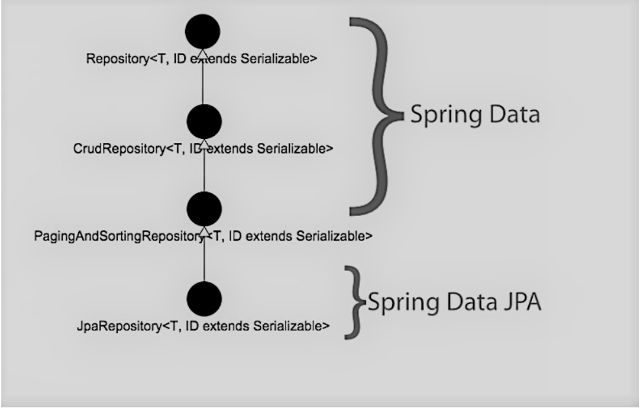
Spring Data, Spring Data JPA

