Slide 1
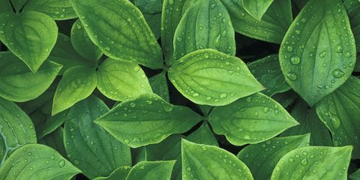

Photosynthesis

Slide 2
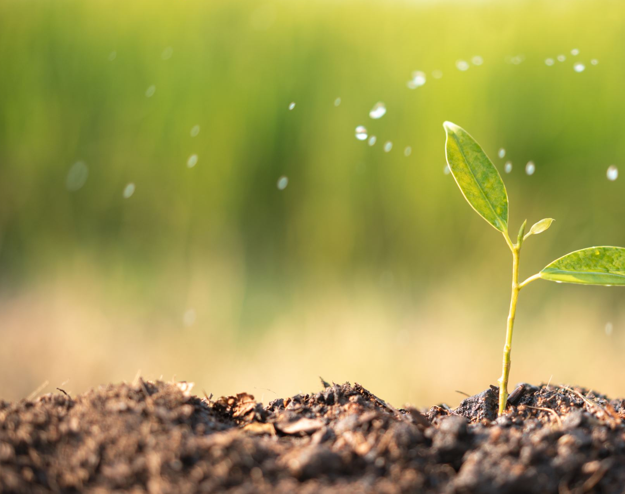
What is it?
Photosynthesis is a process that where a substance called chlorophyll absorbs energy from sunlight. Green plants use this light energy to change water and carbon dioxide into oxygen and nutrients called sugars. The plants use some of the sugars and store the rest. The oxygen is released into the air.

Slide 3

What is needed in Photosynthesis?
There are 4 substances needed for Photosynthesis. The four are Sunlight, Chlorophyll, Carbon Dioxide and Water. Without these 4 elements Photosynthesis will not be able to happen. In the next few slides, I will be explaining you the purpose of each element.

Slide 4
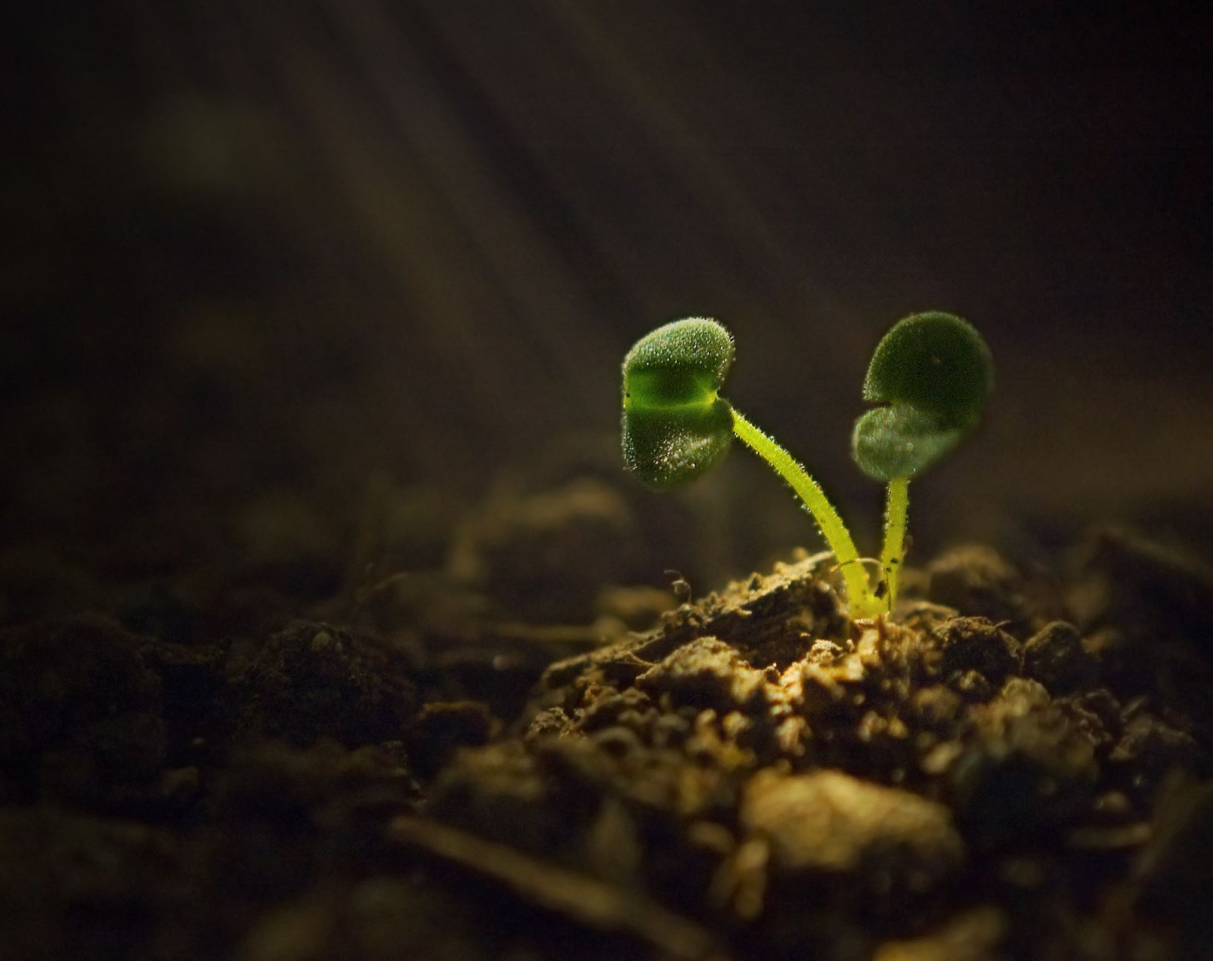
Sunlight
Sunlight is needed for Photosynthesis because it is used to power the conversion process and the plant. This process is where the plant changes water and carbon dioxide into a sugar called glucose. Glucose is used by plants for energy and to make other substances like cellulose and starch.

Slide 5
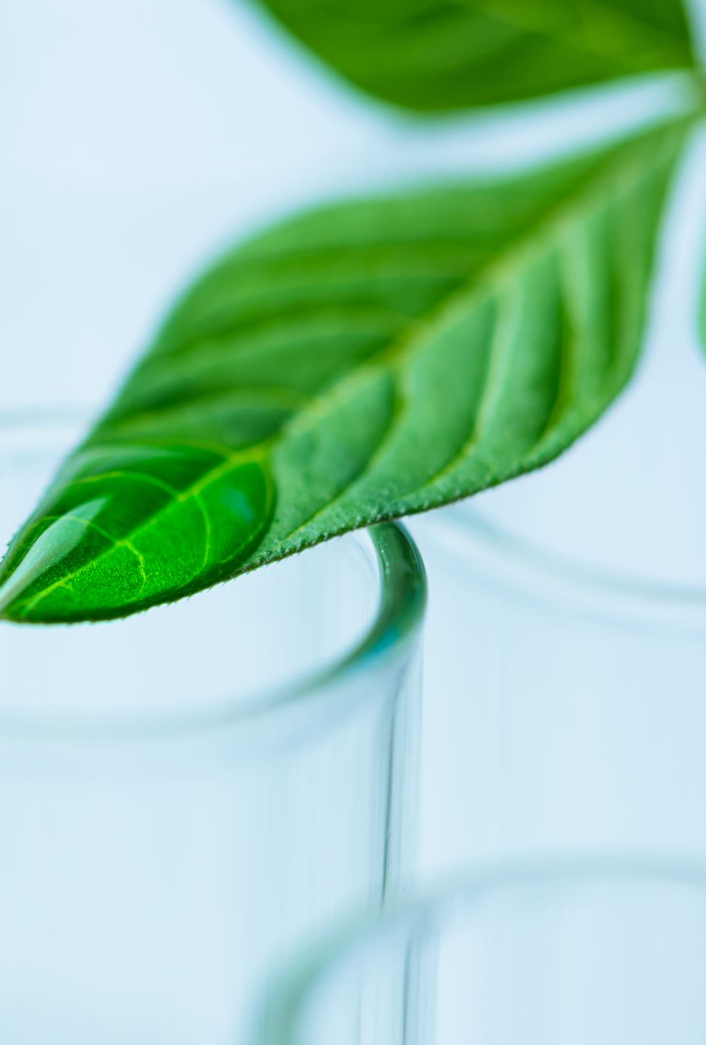
Chlorophyll
Chlorophyll is needed for Photosynthesis because it is used to absorb the light for the plant to create the Glucose, converts carbon dioxide to oxygen and etc…

Slide 6
Carbon Dioxide
Carbon Dioxide is needed for Photosynthesis because it is used to feed the plants and help create the Glucose that is used and stored in the plant.

Slide 7
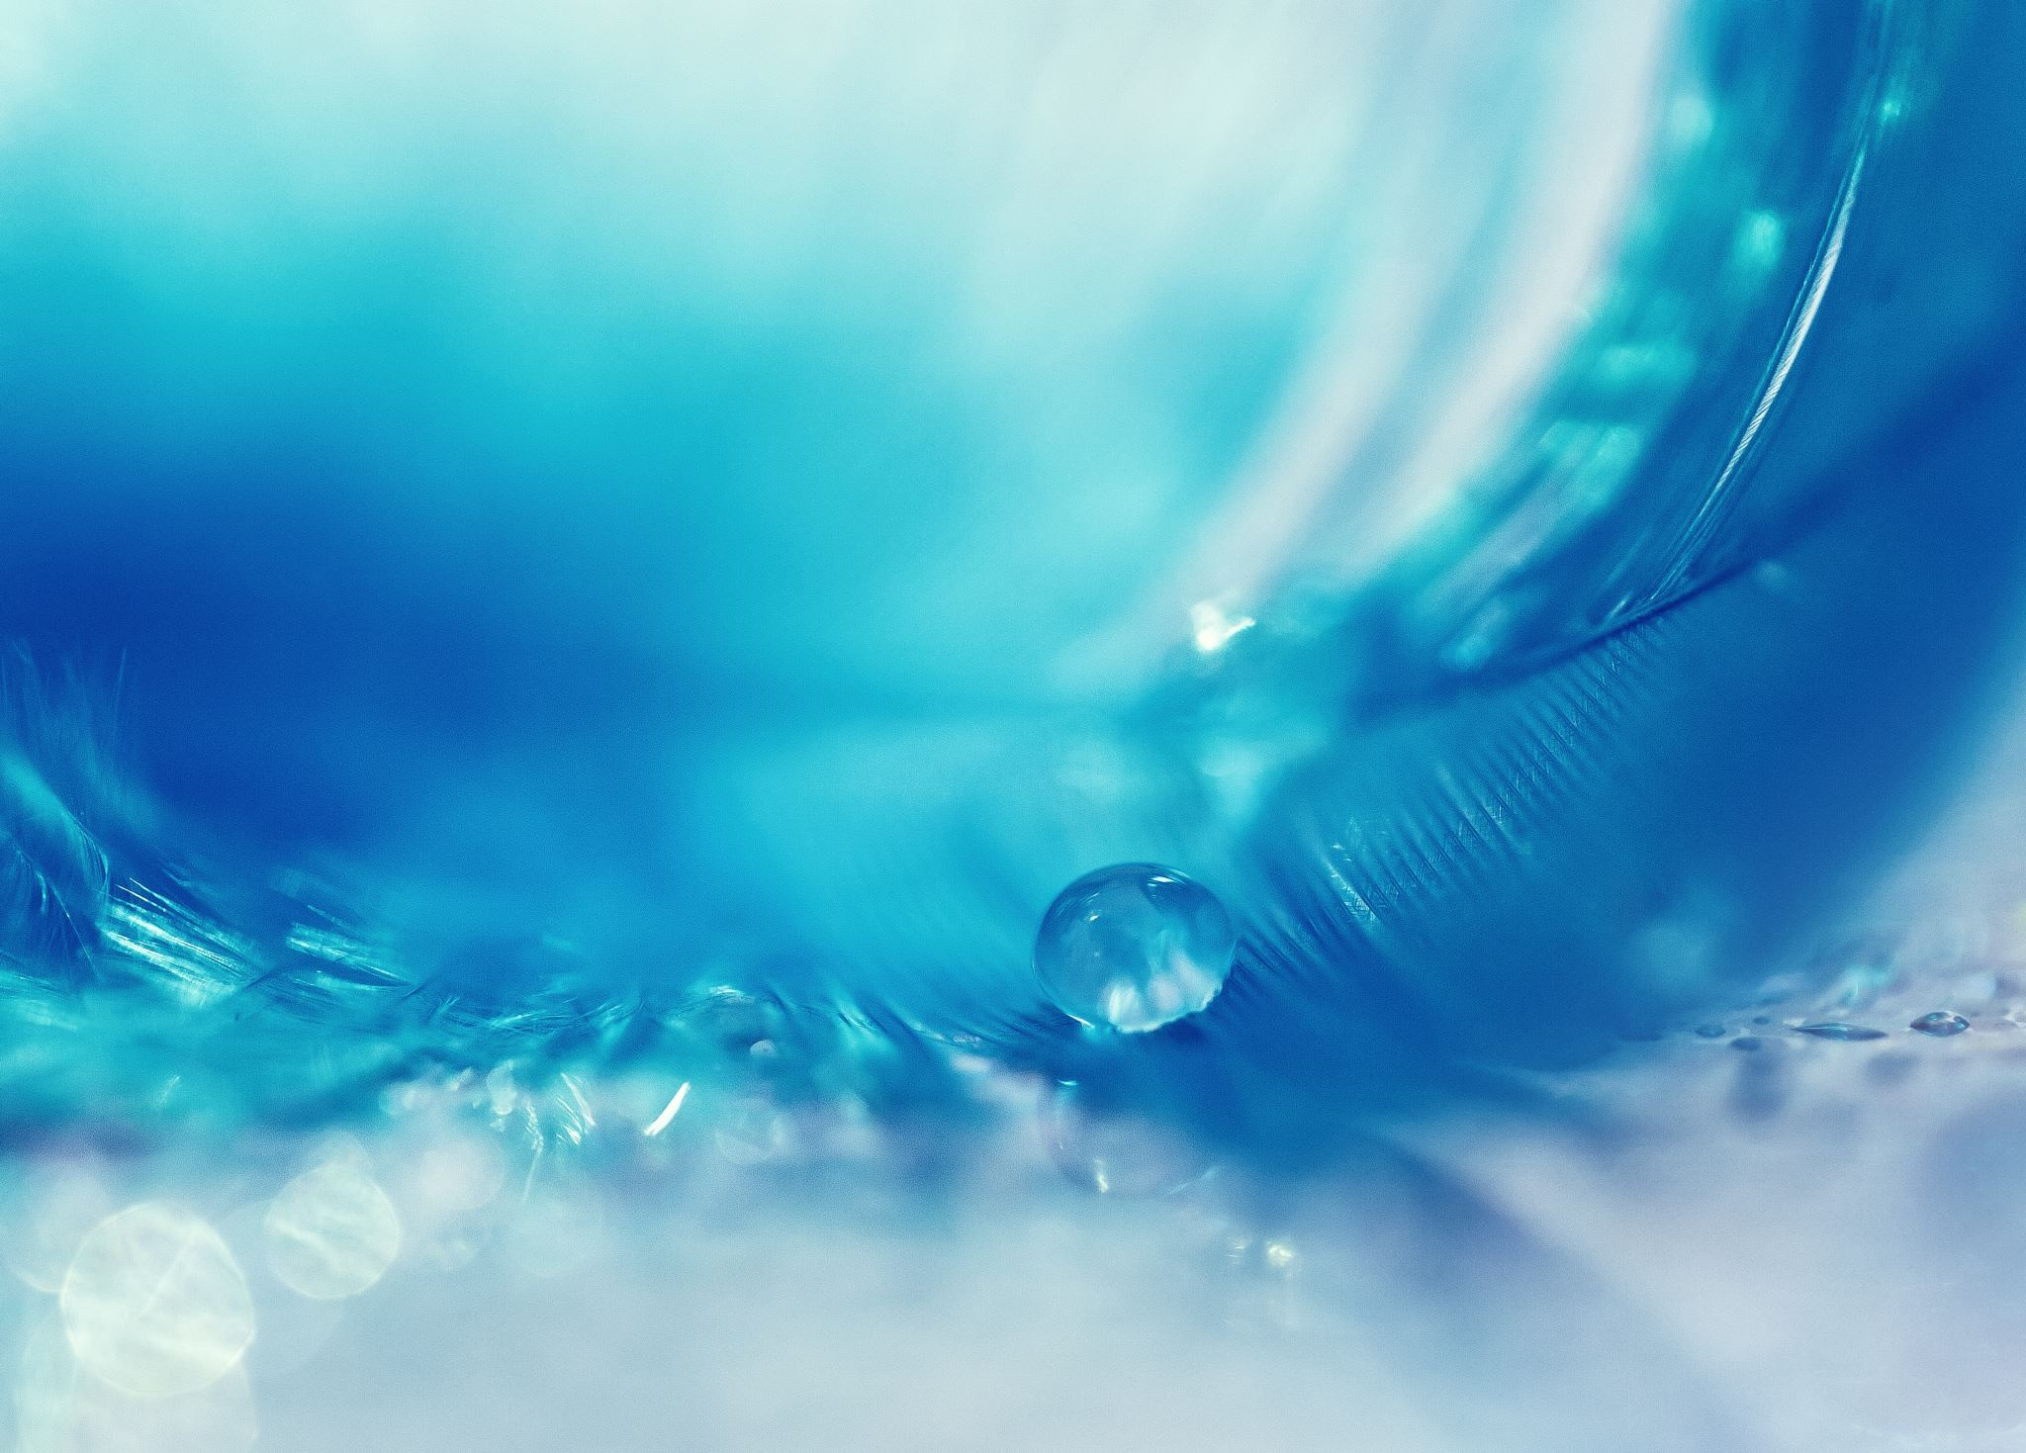
Water
Water is needed in Photosynthesis because it provides hydrogen which is needed to create Glucose.

Slide 8
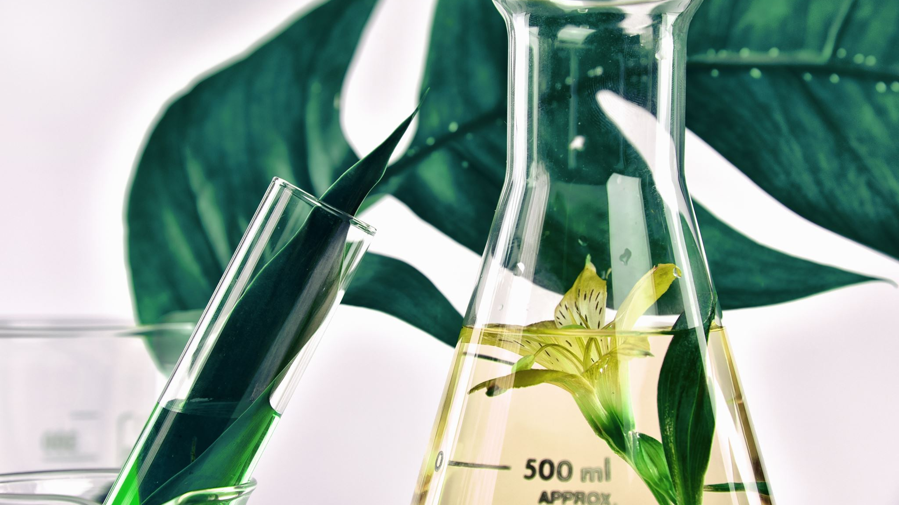
How does it happen?
During photosynthesis, plants take in carbon dioxide (CO2) and water (H2O) from the air and soil. Within the plant cell, the water is oxidized, meaning it loses electrons, while the carbon dioxide is reduced, meaning it gains electrons. This transforms the water into oxygen and the carbon dioxide into glucose. The plant then releases the oxygen back into the air, and stores energy within the glucose molecules.

Slide 9
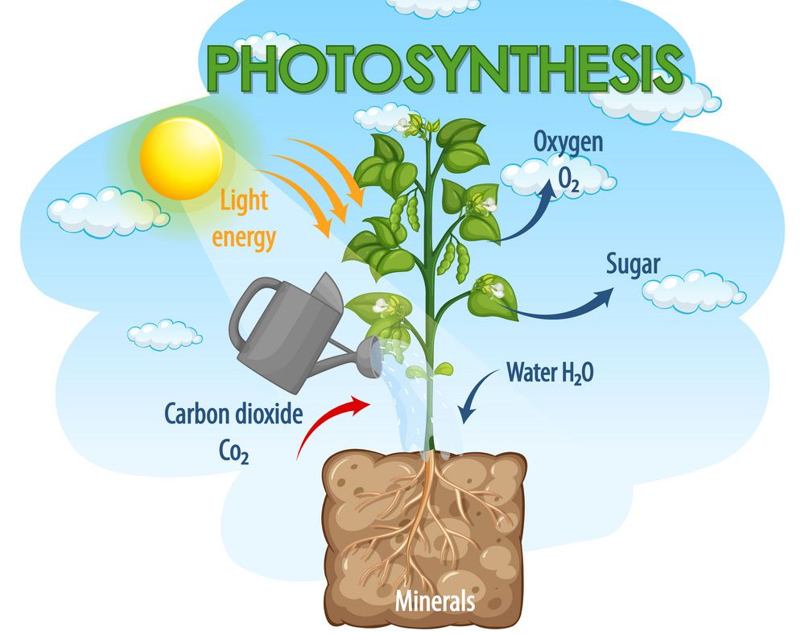
Image of process
This is an image of the process of Photosynthesis.

Slide 10
Meanings:
Chlorophyll: This is the sugars produced by the plant.
Cellulose: The main substance for plant cell walls and of vegetable fibres such as cotton.
Starch: Tasteless white substance occurring widely in plant tissue and obtained chiefly from cereals and potatoes.
Electrons: A stable subatomic particle with a charge of negative electricity, found in all atoms and acting as the primary carrier of electricity in solids.
Molecules: A group of atoms bonded together, representing the smallest fundamental unit of a chemical compound that can take part in a chemical reaction.

Slide 11

Thank you for looking through my Presentation I hope you liked it
This is Made By Samhith

