Slide 1

Pharmachain: A Closed-Loop Relational System for Pharmaceutical Traceability
MCA Semester II Project

Slide 2
Scope
Operational Boundary Focused strictly on Mid-Stream operations (Factory Gate → Distributor → Retailer Shelf).
Relational Complexity A table schema categorized into six major functional modules: Identity, Product, Warehouse, Fulfillment, Returns, and Finance
Reverse Flow Management Comprehensive handling of non-saleable goods, including return request, gatekeeping inspections, and financial credit notes.
Access Governance Implementation of Role-Based Access Control (RBAC) for six distinct organizational roles.
Exclusions Does not include raw material procurement (Upstream) or patient-level medical records/billing (Downstream).

Slide 3
Objectives
Achieve End-to-End Traceability Implement a "Batch Pedigree" system to solve the "Information Asymmetry" between manufacturers and retailers.
Automate Triggers Proactively identify and flag inventory for return prior to expiration using database-level automation.
Automate Waste Classification Implement logic-based routing to automatically categorize returned stock for recycle, remanufacturing, or disposal based on inspection outcomes
Enforce Safety Standards Generate "Disposal Certificates" to ensure expired or recalled medications never re-enter the market.
Enable Granular Cost Analysis Shift from general accounting to "Batch-Level Profitability”, allowing precise calculation of net margins after factoring in specific return logistics and disposal fees.

Slide 4
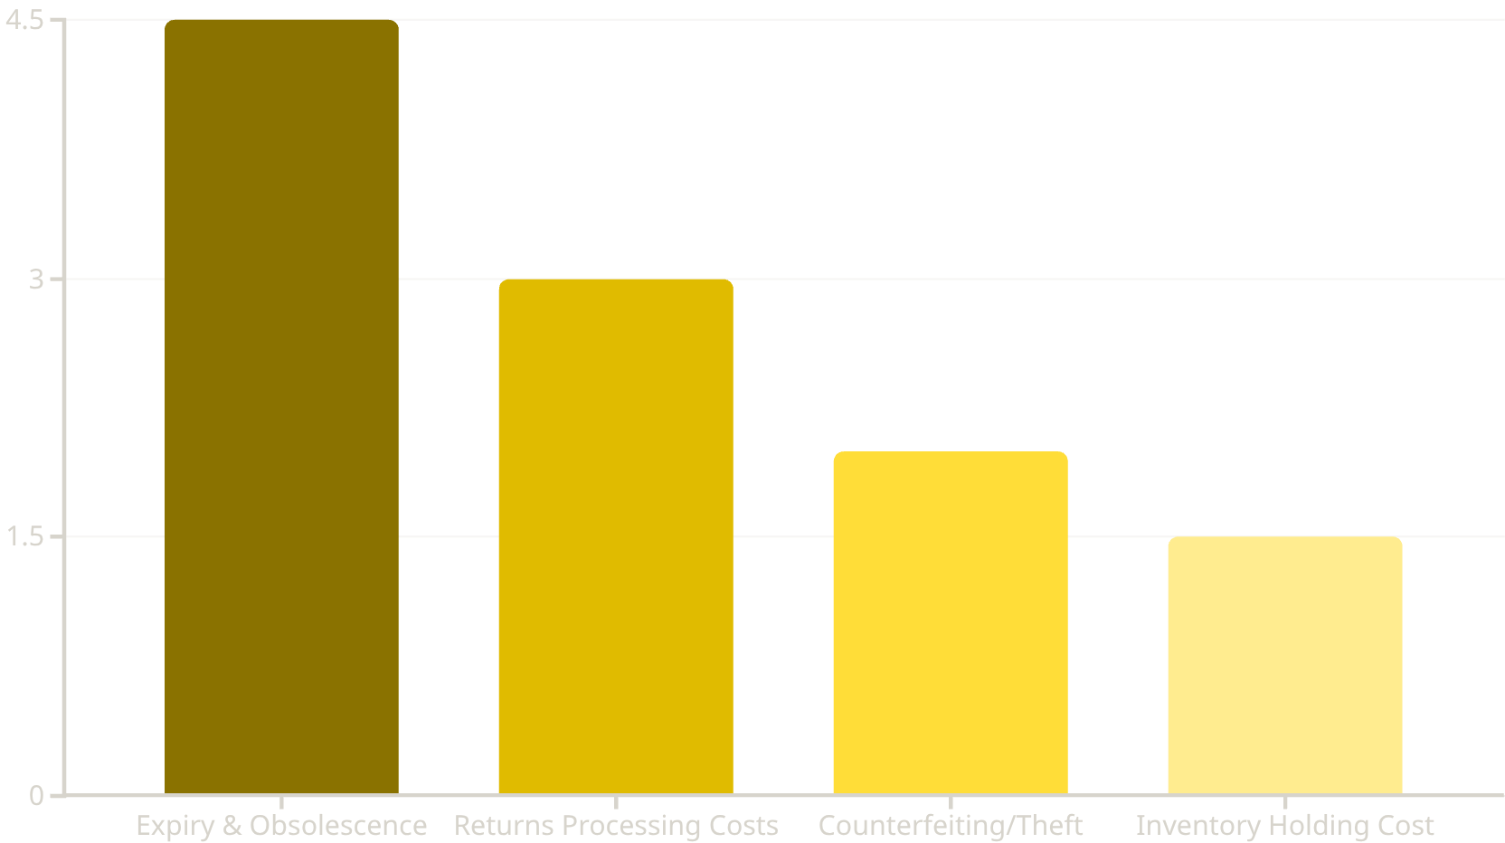
Revenue Leakage in Pharmaceutical Supply Chains
Understanding the Losses
This chart illustrates key areas of revenue leakage within the pharmaceutical supply chain. Expiry, accounting for 4.5% of total revenue, represents the largest single area of loss.
This significant percentage highlights a critical inefficiency, making it the primary target area for PharmaChain's intervention. Our system aims for a potential 40% recovery in this category through automated reverse logistics and enhanced traceability. The 40% recovery in this case refers to solving issues caused by human made errors which were estimated to be about 40% from the given research paper.
Source: Industry estimates on Reverse Logistics inefficiencies (Narayana et al., 2014; PMC Case Studies). Total impact: ~11% of annual revenue.
Other substantial losses include Returns Processing Costs, Counterfeiting/Theft, and Inventory Holding Costs, all contributing to the overall ~11% annual revenue impact.

Slide 5

RESEARCH FOUNDATION
Evidence-Based Design
PMC7868907: Closed-Loop Analysis
PMC6706717: Traceability Standards
This paper used a logic method DEMATEL to rank the biggest "barriers" that make reverse logistics fail. It found that poor return policies and lack of infrastructure are the main reasons supply chains lose money.
This paper deals with "Blind Spots." It explains that recalls fail because the Manufacturer knows a batch is bad, but the Retailer doesn't know until it's too late. This is called "Information Asymmetry".
Returns are messy. If you don't have a strict rule for how to return something, bad drugs get mixed with good ones. The paper proved that you need to separate "Quarantine" items from "Saleable" items immediately
Our central Batch Pedigree table solves the "information asymmetry" problem by connecting every stakeholder with real-time visibility.

Slide 6
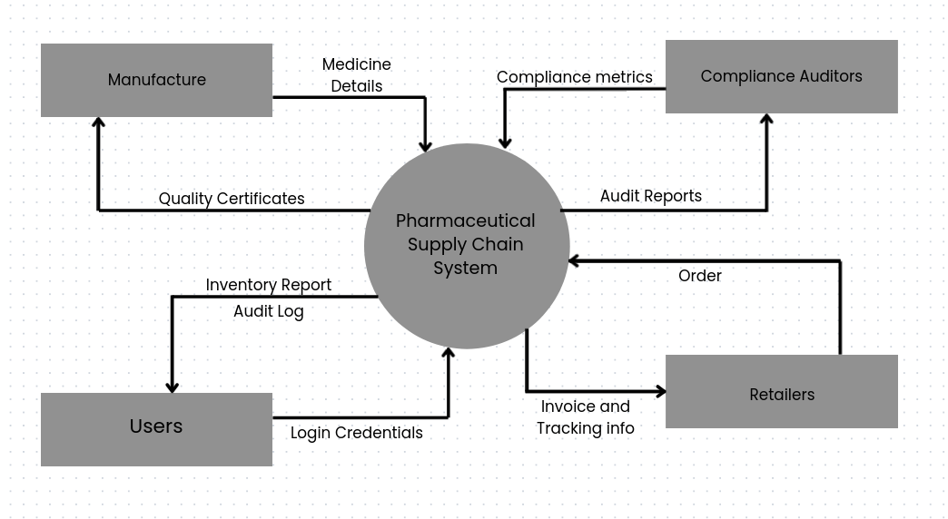
DFD Level - 0

Slide 7
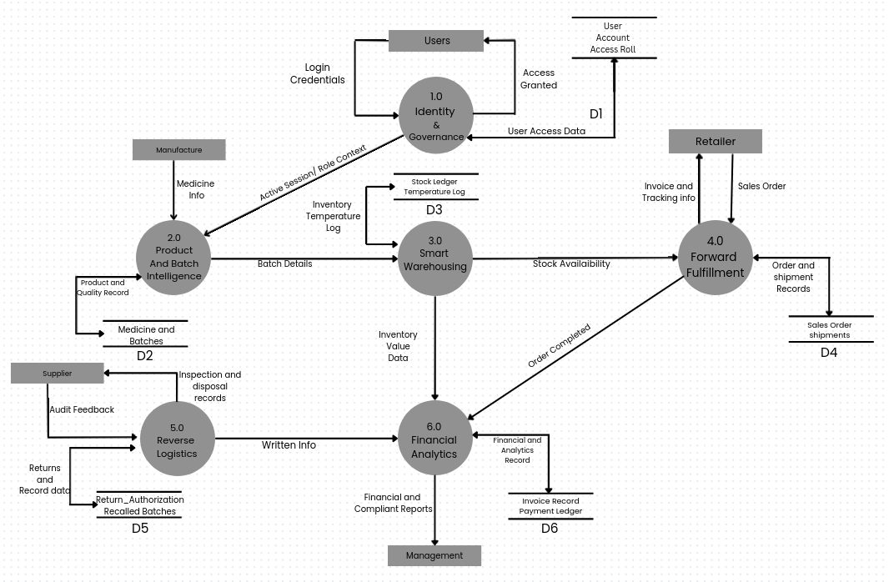
DFD Level - 1

Slide 8
SYSTEM ARCHITECTURE
The Architectural Modules
Tables we have thought so far
Identity & Governance
Smart Warehousing
Reverse Logistics & Compliance
Organizations
Locations
User_Accounts
Access_Roles
Contact_Directory
System_Audit_Log
Warehouses
Storage_Zones
Stock_Ledger
Inventory_Adjustments
Temperature_Logs
Quarantine_Hold
Return_Authorizations
Return_Shipping
Inspection_Reports
Disposal_Certificates
Credit_Notes
Recalled_Batches
Manages user access, organizational hierarchy, and system activity logging for security and accountability.
Manages physical inventory locations, stock levels, adjustments, and environmental conditions, including quarantine.
Facilitates product returns, inspections, secure disposal, and management of recalled batches, ensuring compliance.
Product & Batch Intelligence
Forward Fulfillment
Financial & Analytics
Medicines
Drug_Categories
Batches
Secondary_Packaging
Manufacturing_Orders
Quality_Certificates
Sales_Orders
Order_Line_Items
Shipments
Shipment_Tracking
Carrier_Fleet
Proof_of_Delivery
Invoice_Records
Payment_Ledger
Cost_Allocation
Revenue_Recognition
Batch_Profitability
Compliance_Metrics
Catalogs product details, tracks batches through manufacturing, and manages quality certifications.
Handles sales order processing, shipment logistics, tracking, and final proof of delivery to retailers.
Processes financial transactions, tracks costs and revenues, and generates key compliance and profitability metrics.

Slide 9
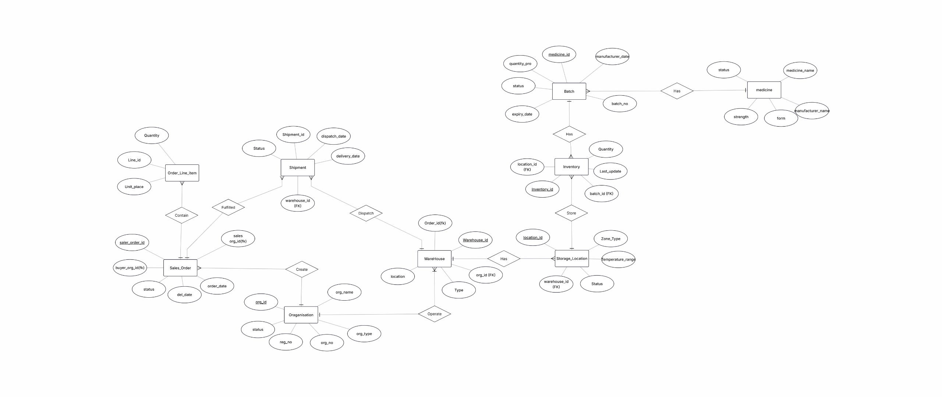
ER Diagram Basic

Slide 10

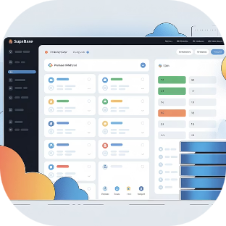
INFRASTRUCTURE
Our Collaborative Stack
GitHub Version Control
Supabase PostgreSQL
SQL schema development managed through pull requests, enabling collaborative logic verification and code review across the entire team.
Shared, real-time cloud database instance allowing all six team members to build and query simultaneously across environments.

Slide 11



Project Phasing & Progress Trajectory
Completed ✅
In Progress 🚧
Future Scope 🚀
Foundation & Architecture
The Closed-Loop Core
AI & Smart Integration
Established DevOps workflow (GitHub + Supabase Cloud)
Outlined 36-table 'Mid-Stream' Schema
Developed DFD level 0 and 1
Developed Basic ER diagram
Implementation of 3NF Relational Database
Coding the 'Reverse Logistics' & 'Disposal' modules
Deploying Temporal Triggers for Auto-Expiry
Integration of Python-based ML models
Smart Demand Forecasting based on return rates
Anomaly detection for counterfeit tracking

Slide 12
CONCLUSION
PharmaChain: Closing the Loop
Audit Trail Excellence
Financial Impact
Public Health Protection
Bulletproof traceability from factory gate to pharmacy counter and back, ensuring medicine safety at every step.
Minimizing pharmaceutical losses through proactive expiry management and efficient recall processes.
Reducing the risk of expired or recalled medications reaching consumers through automated temporal monitoring.
A research-grade database system that transforms pharmaceutical supply chain management from reactive to proactive, protecting both revenue and patient safety.

