Slide 1
WHIZUNIK
BUSINESS MANAGEMENT PLATFORM
PREMIUM BOOKLET · PRODUCT GUIDE
Every moving part.
One clear decision.
A premium operating view for promoters and leadership teams.
WHIZUNIK · BUSINESS MANAGEMENT PLATFORM
01
Notes:
Cover. WhizUnik gives promoters and leadership teams a premium operating view of the business — sales, demand, stock and cash in one place.

Slide 2
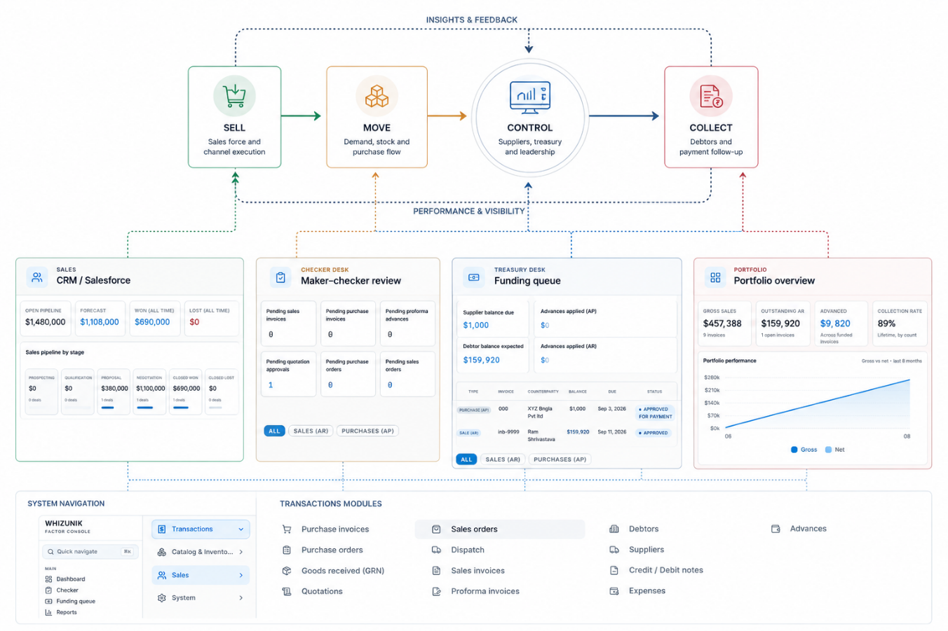
THE LEADERSHIP PROBLEM
The business does not run in departments. Neither should management visibility.
WhizUnik brings the commercial, operational and financial signals together — so management can understand the business and act early.
ONE VIEW
Commercial, operational and financial signals in one place.
ONE LANGUAGE
Sales, stock and cash talked about together.
ONE RHYTHM
THE OPERATING VIEW · ILLUSTRATIVE
Early action instead of late surprises.
WHIZUNIK · BUSINESS MANAGEMENT PLATFORM
02
Notes:
The leadership problem: departments each hold a piece of the truth. WhizUnik connects the signals so management can see the whole business and act early.

Slide 3
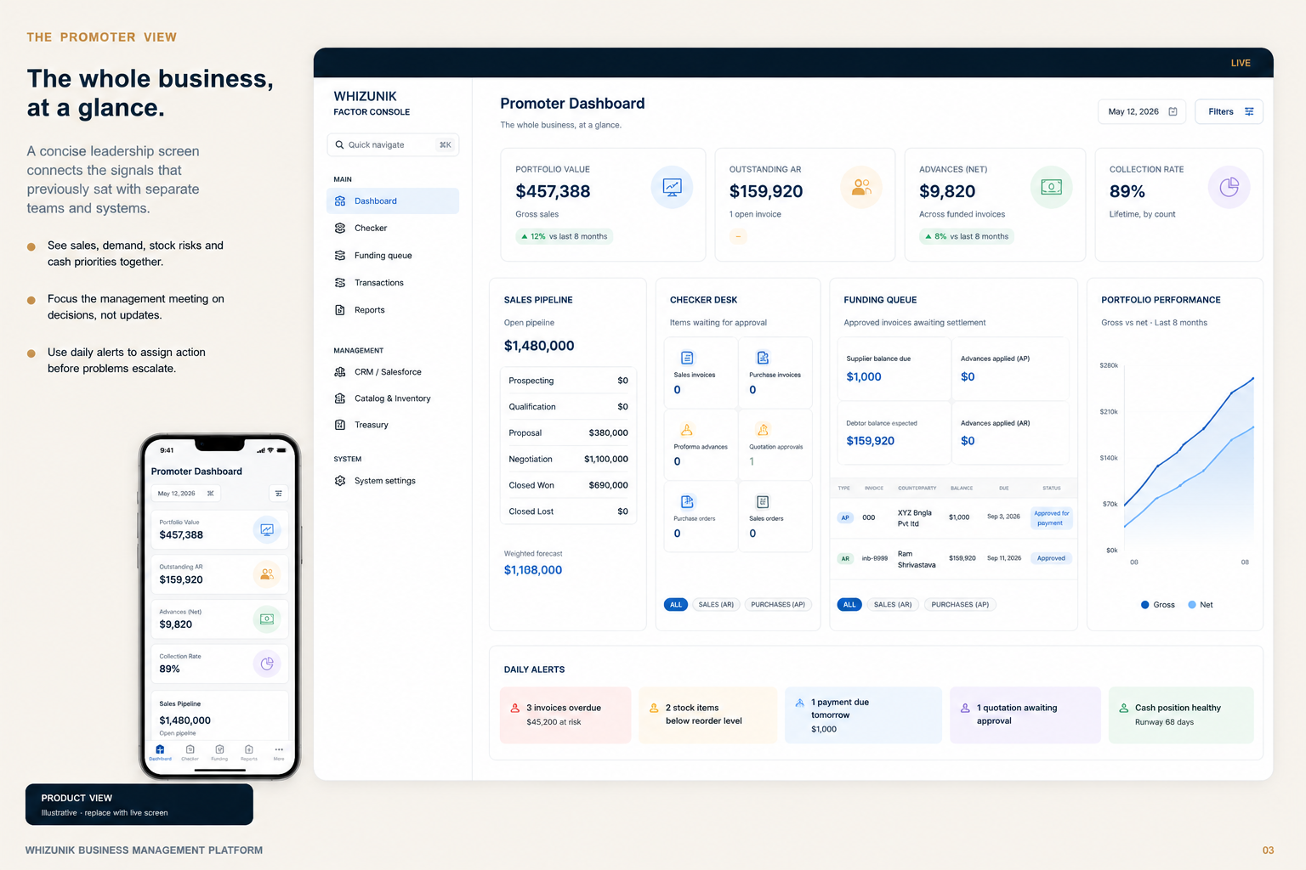
LIVE · THE PROMOTER VIEW
MODULE 01 / 07
The whole business, at a glance.
whizunik.com/app/overview
LIVE
A concise leadership screen that connects the signals which previously sat with separate teams and systems.
See it together
Sales, demand, stock risk and cash priorities on one screen.
Decide, don't update
Focus the management meeting on decisions, not status.
Act before it escalates
Daily alerts assign action while there is still time.
PRODUCT VIEW · ILLUSTRATIVE
WHIZUNIK · BUSINESS MANAGEMENT PLATFORM
03
Notes:
The promoter view: one leadership screen for sales, demand, stock risk and cash priorities. Management meetings become decision meetings.

Slide 4
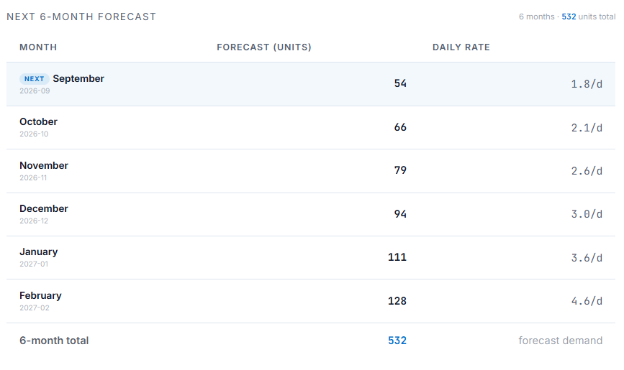
DEMAND INTELLIGENCE
MODULE 02 / 07
Forecast and reorder with confidence.
whizunik.com/app/demand
LIVE
Movement history turned into a practical view of future demand — and the stock decisions required now.
Forecast
Monthly demand from weighted baseline, trend and seasonality.
Cover
Days of cover, stockout risk and reorder-by date.
Reorder
Recommended order from demand, lead time and safety buffer.
PRODUCT VIEW · ILLUSTRATIVE
WHIZUNIK · BUSINESS MANAGEMENT PLATFORM
04
Notes:
Demand intelligence: a monthly forecast from weighted baseline, trend and seasonality, with days of cover, stockout risk and a recommended reorder quantity.

Slide 5
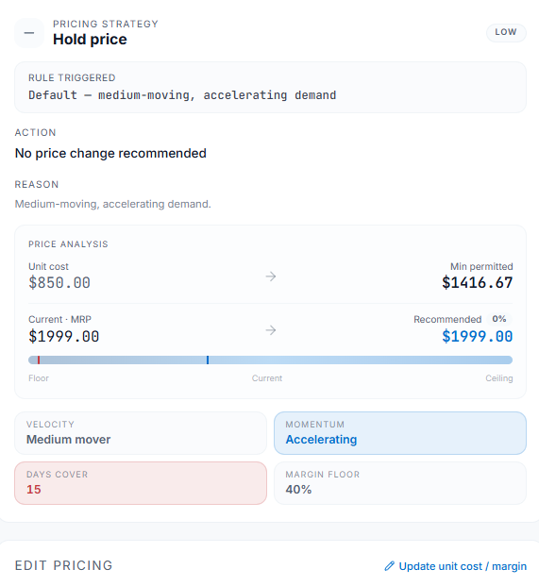
COMMERCIAL ACTION
MODULE 03 / 07
Protect margin. Release excess stock.
whizunik.com/app/pricing
LIVE
PRICING LEVERS
Stock position and sales behaviour translated into a pricing indication that supports commercial judgement.
INCREASE
momentum strong
HOLD
Momentum
within guardrail
Velocity flags products gaining or losing pace.
REDUCE
excess stock, slow pace
Guardrail
Hold, increase or reduce price within a minimum margin.
Every move is checked against a minimum-margin guardrail.
Release
Excess-stock insight shows where action pays.
PRODUCT VIEW · ILLUSTRATIVE
WHIZUNIK · BUSINESS MANAGEMENT PLATFORM
05
Notes:
Commercial action: momentum and velocity show which products are gaining or losing pace. Price levers (hold / increase / reduce) are always checked against a minimum-margin guardrail, and excess stock is flagged for release.

Slide 6
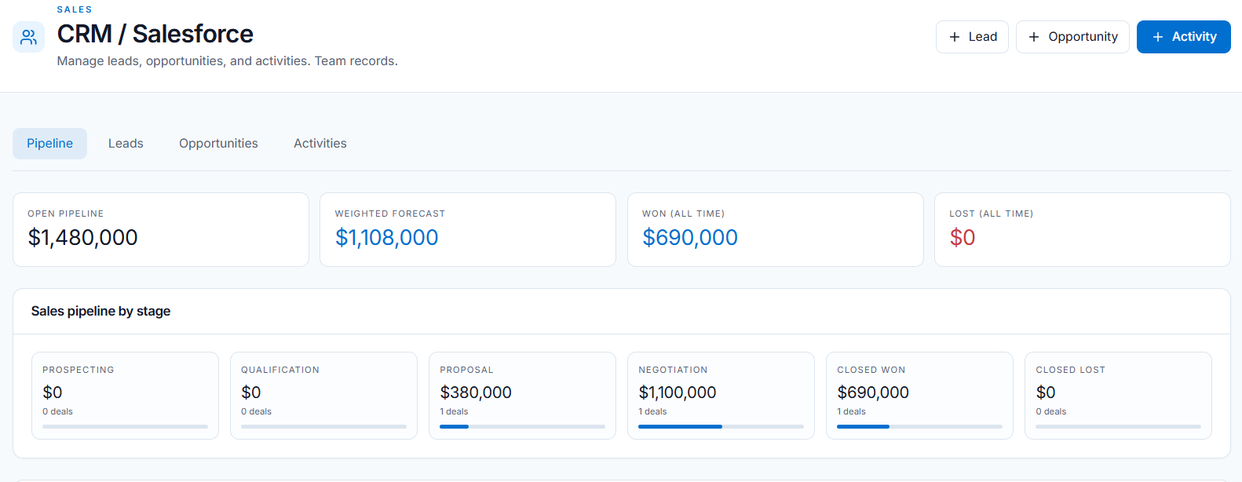
SALES EXECUTION
MODULE 04 / 07
Every account has an owner and a next move.
whizunik.com/app/sales
LIVE
The complete sales motion across retailers, marketplaces, stores, institutions and gifting.
Pipeline
Lead stages, opportunity value, visits, tasks and timelines.
Accountability
Every salesperson has KPIs and clear ownership.
PRODUCT VIEW · ILLUSTRATIVE
100%
KPI
1 TRAIL
Coverage
ACCOUNTS WITH AN OWNER
PER SALESPERSON
VISITS · TASKS · TIMELINES
Neglected accounts and priorities visible from one place.
WHIZUNIK · BUSINESS MANAGEMENT PLATFORM
06
Notes:
Sales execution: every account has an owner and a next move. Lead stages, opportunities, visits, tasks and KPIs give each salesperson clear accountability — and neglected accounts surface automatically.

Slide 7
WORKING CAPITAL
MODULE 05 / 07
Collections become a management priority.
whizunik.com/app/collections
LIVE
Working Capital
Debtor book · ageing · follow-up
A live debtor view tells the team what is overdue, who needs a call and where cash is concentrated.
OVERDUE BALANCE
COLLECTION RATE
ACCOUNTS TO CALL
₹38.2L
91.4%
12
Ageing
Invoice ageing and overdue alerts, live.
Apex Retail
₹12.4L
Overdue 45d
REMINDER SENT
Vega Stores
₹9.8L
Overdue 21d
FOLLOW-UP
Follow-up
Payment reminders with an assigned next action.
Northwind Mart
₹6.1L
Due in 5d
ON TRACK
Summit Traders
₹4.2L
Overdue 60d
ESCALATE
Concentration
Customer concentration visible to leadership.
Cash concentration — Apex Retail holds 32% of receivables. Leadership is alerted before it becomes a risk.
ILLUSTRATIVE MOCKUP
WHIZUNIK · BUSINESS MANAGEMENT PLATFORM
07
Notes:
Working capital: invoice ageing and overdue alerts, payment reminders with assigned follow-up, and customer concentration visible to leadership. The screen shown is an illustrative light-theme mockup — replace with a live screenshot.

Slide 8
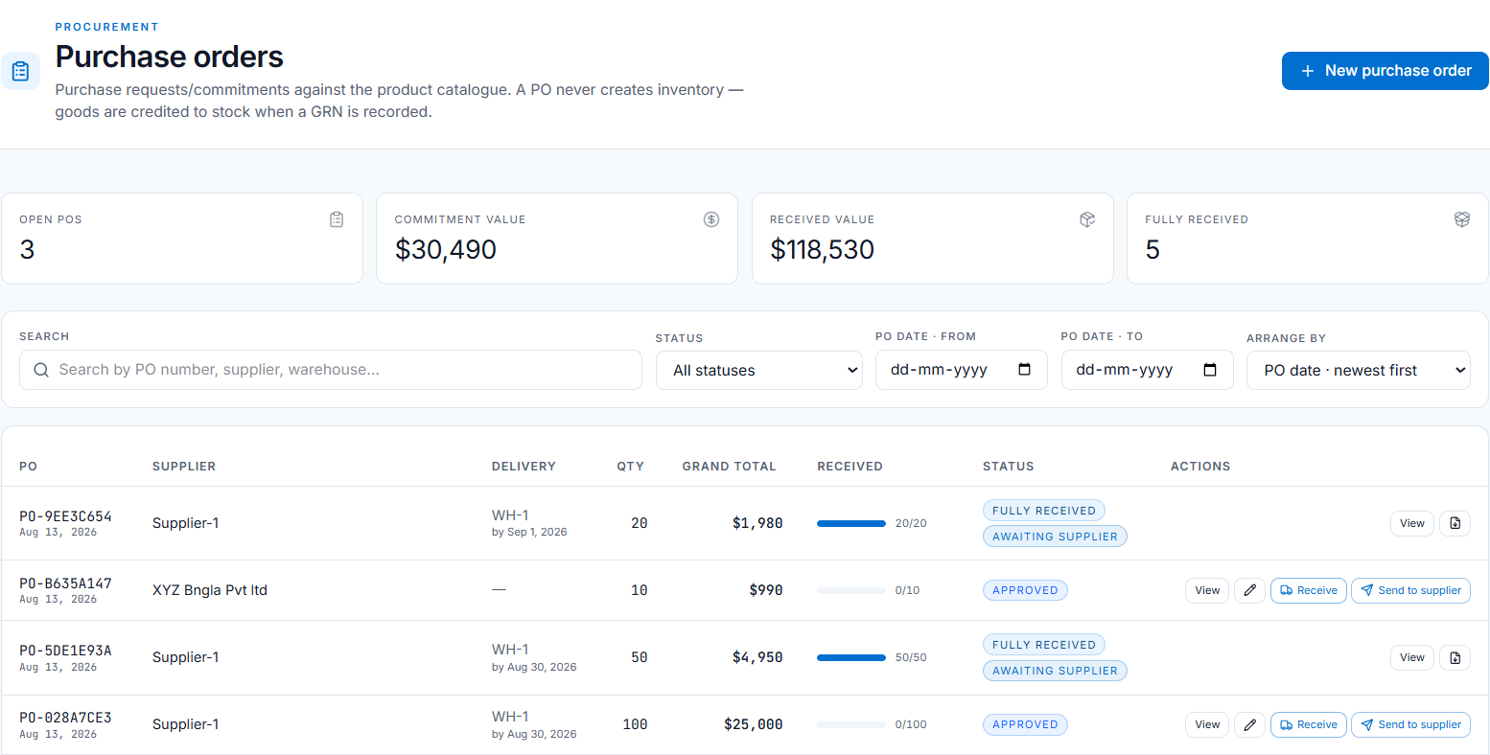
PURCHASE CONTROL
MODULE 06 / 07
Supplier documents and stock movement, connected.
whizunik.com/app/purchases
LIVE
The purchase journey from supplier proforma to goods received and payment — with a clear operational trail.
Trail
Supplier PI, PO, GRN and purchase invoice linked.
Visibility
Incoming stock, delivery status and due dates.
Accuracy
PRODUCT VIEW · ILLUSTRATIVE
Inventory movement tied to the business event.
PI → PO
LIVE
1:1
→ GRN → INVOICE
SUPPLIER DUE DATES
MOVEMENT ↔ EVENT
WHIZUNIK · BUSINESS MANAGEMENT PLATFORM
08
Notes:
Purchase control: the supplier PI, PO, GRN and purchase invoice stay linked, incoming stock and due dates are visible, and inventory movement is tied to the actual business event.

Slide 9
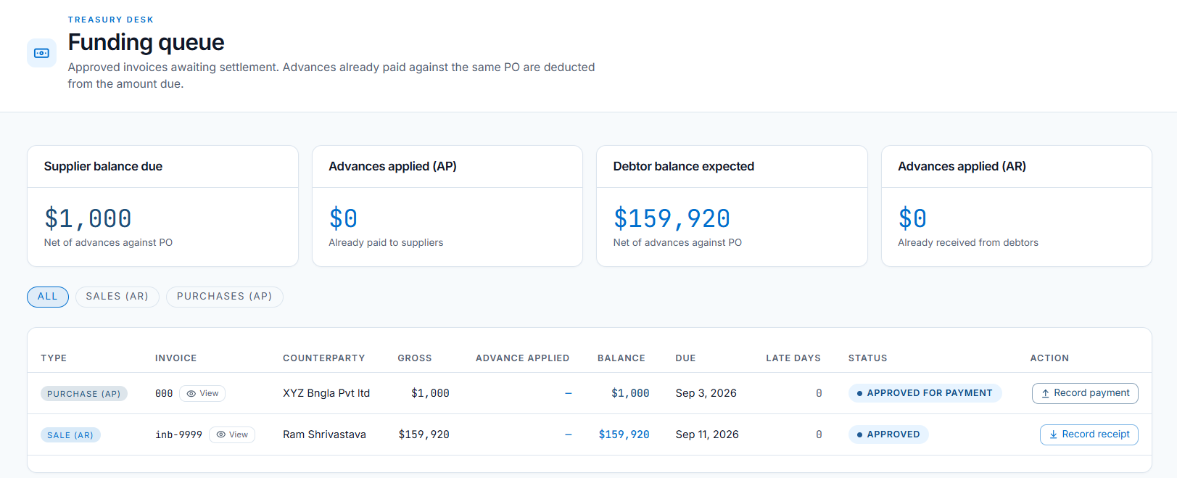
TREASURY
MODULE 07 / 07
Expected inflows and planned outflows, together.
whizunik.com/app/treasury
LIVE
Receivables, payables and planned payment commitments brought into one decision view.
Collections
Expected inflows prioritise supplier payments.
Pressure
Upcoming cash pressure flagged before payment dates.
PRODUCT VIEW · ILLUSTRATIVE
42.6L
12.1L
30d
Alignment
Commercial and finance teams on the same picture.
EXPECTED COLLECTIONS
SUPPLIER COMMITMENTS
CASH PRESSURE WINDOW
WHIZUNIK · BUSINESS MANAGEMENT PLATFORM
09
Notes:
Treasury: expected inflows and planned outflows in one view. Supplier payments are prioritised with visibility of expected collections, and cash pressure is flagged before the payment date arrives.

Slide 10
CONNECTED ACTIVITY
One event. A smarter business view.
Every confirmed sale, dispatch, receipt, invoice or payment updates the management picture that matters.
01
02
03
04
ACTIVITY
POSITION
PRIORITY
ACTION
A sale, receipt, dispatch or payment is recorded.
Stock, sales, cash or customer position updates.
The platform highlights the risk or opportunity.
Management sees the right next move.
The platform connects the operational event to the financial position — automatically, in real time.
WHIZUNIK · BUSINESS MANAGEMENT PLATFORM
10
Notes:
Connected activity: every operational event (sale, dispatch, receipt, invoice, payment) flows into the position, surfaces a priority, and points management to the next action.

Slide 11
WHIZUNIK · EXECUTIVE CARE
A premium platform. Backed by people.
Premium service is part of the relationship — not an afterthought.
01
02
Designated Relationship Manager
Priority Support
One accountable point of contact for the business.
Real-time troubleshooting and structured escalation.
03
04
Executive Reviews
Continuous Optimisation
Regular review of business priorities and adoption.
Dashboards and workflows evolve as the business changes.
Your accounting system records the books. WhizUnik helps management run the business.
WHIZUNIK · BUSINESS MANAGEMENT PLATFORM
11
Notes:
Executive care: a designated relationship manager, priority support with structured escalation, regular executive reviews, and continuous optimisation of dashboards and workflows.

Slide 12
WHIZUNIK
BUSINESS MANAGEMENT PLATFORM
NEXT STEP
One view of the business.
Better decisions every day.
A guided WhizUnik discovery session — walk the platform with your own numbers.
DISCOVER
·
CONFIGURE
·
PILOT
·
SCALE
www.whizunik.com
[ add contact details ]
12
Notes:
Next step: a guided WhizUnik discovery session. Discover, configure, pilot, scale. Contact via www.whizunik.com.

