Slide 1
Every moving part. One clear decision.
WHIZUNIK
BUSINESS MANAGEMENT PLATFORM
A premium operating view for promoters and leadership teams.
STOCK
DEMAND
NOW
MATTERS
CASH
PREMIUM BOOKLET PRODUCT GUIDE
01

Slide 2
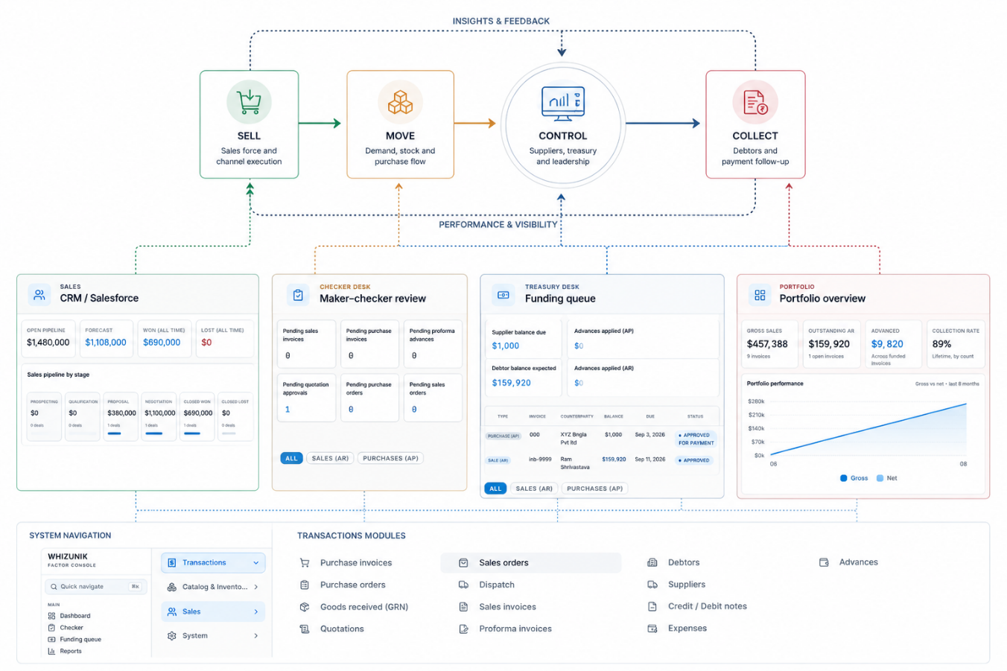
The business does not run in departments. Neither should management visibility.
THE LEADERSHIP PROBLEM
WhizUnik brings the commercial, operational and financial signals together so management can understand the business and act early.
02

Slide 3
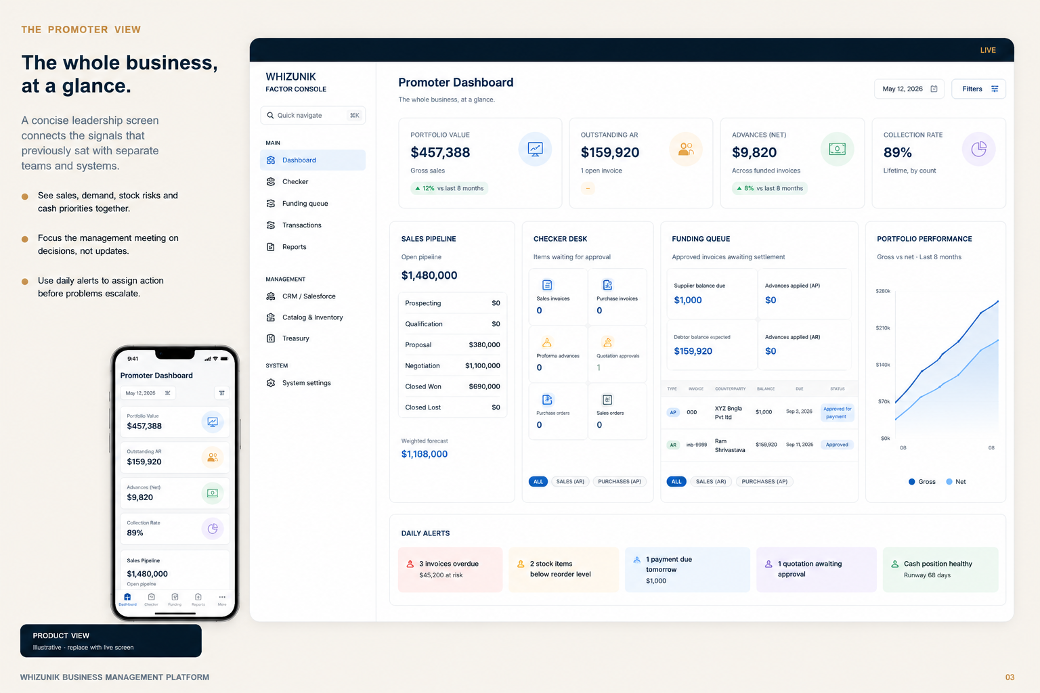
The whole business, at a glance.
THE PROMOTER VIEW
A concise leadership screen connects the signals that previously sat with separate teams and systems.
See sales, demand, stock risks and cash priorities together.
Focus the management meeting on decisions, not updates.
Use daily alerts to assign action before problems escalate.
LIVE
PRODUCT VIEW
Illustrative - replace with live screen
03

Slide 4
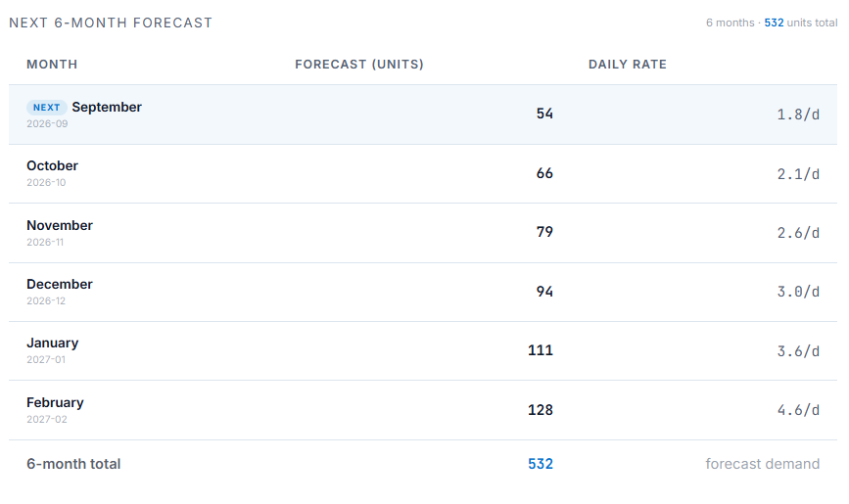
Forecast and reorder with confidence.
DEMAND INTELLIGENCE
Turn movement history into a practical view of future demand and the stock decisions required now.
Monthly forecast based on weighted baseline, trend and seasonality.
Days of cover, stockout risk and reorder-by date.
Recommended order based on demand, lead time and safety buffer.
PRODUCT VIEW
Illustrative - replace with live screen
04

Slide 5
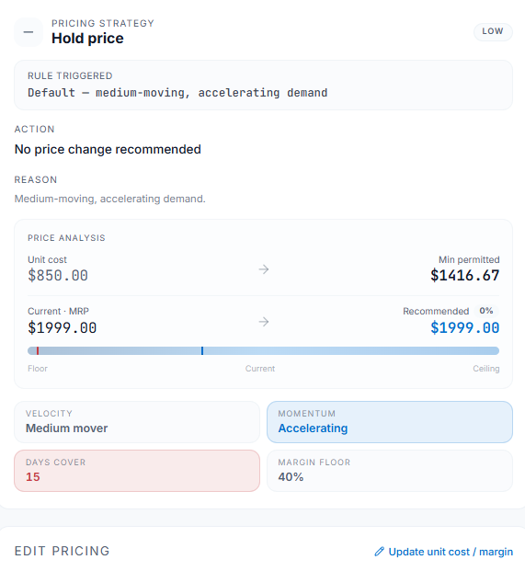
Protect margin. Release excess stock.
COMMERCIAL ACTION
WhizUnik translates stock position and sales behaviour into a pricing indication that supports commercial judgement
velocity and momentum identify product gaining or losing pace.
Hold, increase or reduce price with a minimum-margin guardrail.
Use excess-stock insight to decide where action is needed.
PRODUCT VIEW
Illustrative - replace with live screen
05

Slide 6
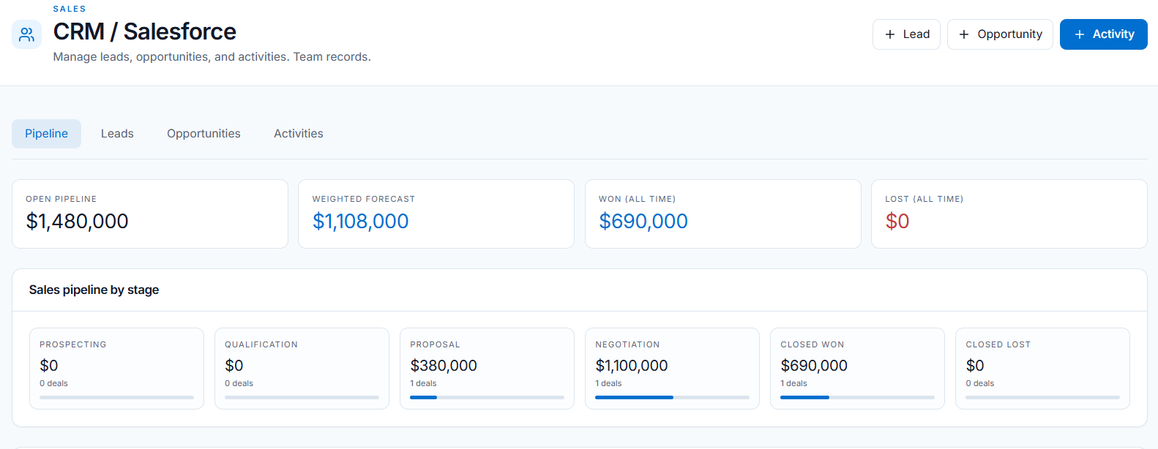
Every account has an owner and a next move.
SALES EXECUTION
Manage the complete sales motion across retailers, marketplaces, stores, institutions and gifting.
Track lead stages, opportunity value, visits, tasks and timelines.
Give every salesperson KPIs and clear accountability.
See neglected accounts and sales priorities from one place.
LIVE
Overview Sales Inventory Treasury
PRODUCT VIEW
Illustrative - replace with live screen
06

Slide 7
Collections become a management priority.
WORKING CAPITAL
A live debtor view tells the team what is overdue, who needs a call and where cash is concentrated.
Invoice ageing and overdue alerts.
Payment reminders and assigned follow-up action.
Customer concentration visibility for leadership.
PRODUCT VIEW
Illustrative - replace with live screen
07

Slide 8
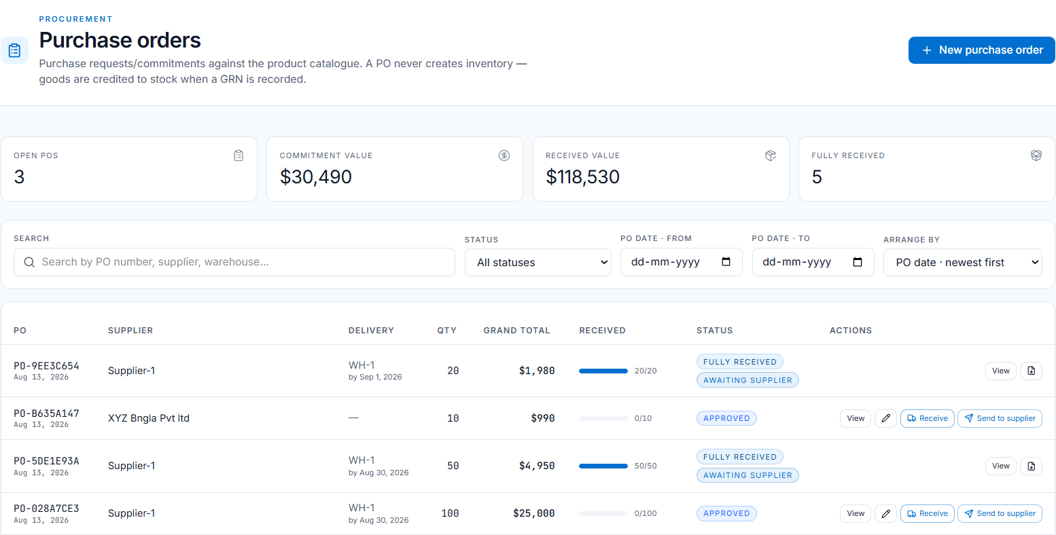
Supplier documents and stock movement, connected.
PURCHASE CONTROL
Follow the purchase journey from supplier proforma to goods received and payment, with a clear operational trail.
Link supplier PI, PO, GRN and purchase invoice.
See incoming stock, delivery status and supplier due dates.
Keep inventory movement tied to the actual business event.
WHIZUNIK
LIVE
Overview Sales Inventory Treasury
PRODUCT VIEW
Illustrative - replace with live screen
08

Slide 9
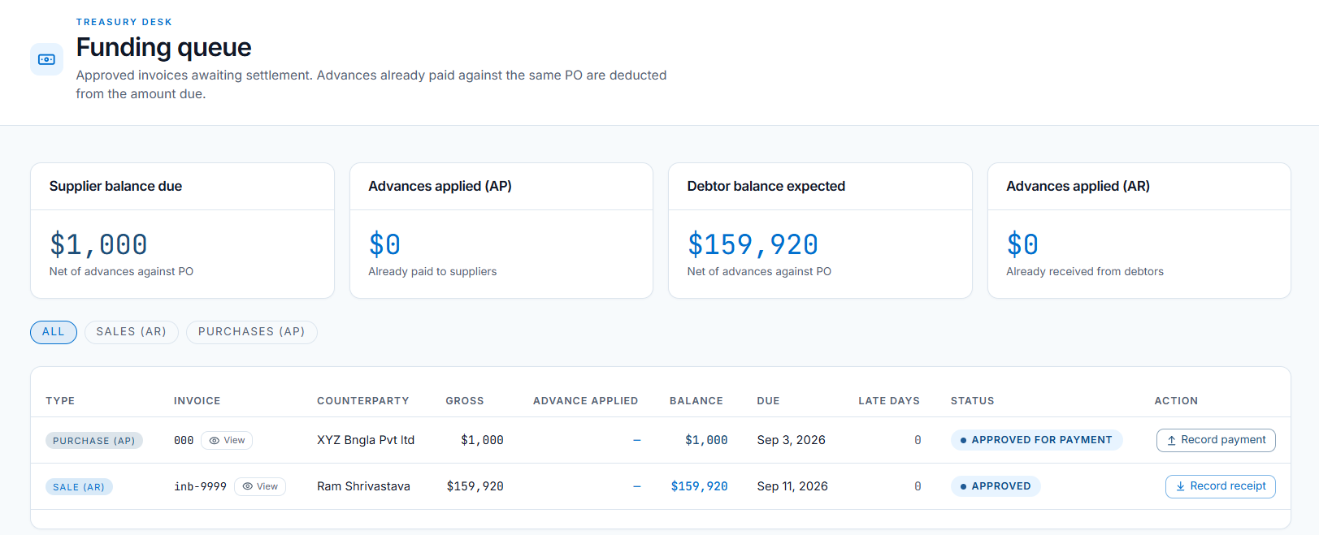
See incoming and outgoing cash together.
TREASURY
Treasury brings receivables, payables and planned payment commitments into one decision view.
Prioritise supplier payments with visibility of expected collections.
Spot upcoming cash pressure before the payment date arrives.
Bring commercial and finance teams into the same picture.
WHIZUNIK
LIVE
Overview Sales Inventory Treasury
Treasury view
Expected inflows and planned outflows
42.6L
EXPECTED COLLECTIONS
12.1L
SUPPLIER COMMITMENTS
PRODUCT VIEW
Illustrative - replace with live screen
09

Slide 10
One event. A smarter business view.
CONNECTED ACTIVITY
Every confirmed sale, dispatch, receipt, invoice or payment updates the management picture that matters.
01
ACTIVITY
A sale, receipt, dispatch or payment is recorded.
02
POSITION
Stock, sales, cash or customer position updates.
03
PRIORITY
The platform highlights the risk or opportunity.
04
ACTION
Management sees the right next move.

Slide 11
A premium platform. Backed by people.
WHIZUNIK EXECUTIVE CARE
Premium service is part of the relationship - not an afterthought.
Designated Relationship Manager
One accountable point of contact for the business.
Priority Support
Real-time troubleshooting and structured escalation.
Executive Reviews
Regular review of business priorities and adoption.
Continuous Optimisation
Dashboards and workflows evolve as the business changes.
Your accounting system records the books. WhizUnik helps management run the business.

Slide 12
One view of the business. Better decisions every day.
WHIZUNIK
Discover. Configure. Pilot. Scale.
NEXT STEP
A guided WhizUnik discovery session
www.whizunik.com | [add contact details]

