Slide 1

INTERNSHIP PORTAL
A Web-Based Internship Management System
FINAL PROJECT DEFENSE
Programme
Bachelor of Computer Engineering
Submitted by
[Your Name] · Roll No. [Your Roll Number]
College
[Your College Name]
Supervisor
[Supervisor Name]
Academic Year
[Academic Year]
Notes:
Introduce yourself and the project in one sentence: a web based system that brings students, companies, supervisors and an administrator onto one platform for the whole internship life cycle.

Slide 2



CONTEXT
Introduction
Internships are a required part of every technical degree, but the process around them is still handled by hand.
A centralized portal instead
One place for every opening
Openings circulate on notice boards, messaging groups and email
Applications tracked with a status
Selection results are communicated informally, with no record
Weekly progress recorded and evaluated
The work a student does each week is rarely documented at all
Institutional oversight of all accounts
Four roles · One workflow · One database
Internship Portal · Final Project Defense
2
Notes:
Set up the problem before the solution: the information exists, but it is scattered and nothing is recorded.

Slide 3





WHY THIS PROJECT
Problem Statement
Scattered information
Hard to find opportunities
Manual, inefficient handling
Openings are spread across notice boards, chats and email with no single source.
Students cannot search or filter openings by the skills they actually have.
Companies collect applications informally and lose track of who applied.
No progress record
No institutional control
Weekly work during the internship is not documented or evaluated anywhere.
Nobody verifies who joins the platform or keeps a record of what was done.
Internship Portal · Final Project Defense
3
Notes:
Five problems, each one answered by a feature you will demonstrate later.

Slide 4
WHAT THE PROJECT SET OUT TO DO
Objectives
01
Build a centralized, web based internship portal
02
Provide role based access for students, companies, supervisors and an administrator
03
Store and manage all information in a relational database
04
Let students search and apply for internships online
05
Record weekly progress with supervisor feedback and marks
06
Demonstrate practical use of Flask and database technologies
Internship Portal · Final Project Defense
4
Notes:
Each objective maps to something the examiner can see running.

Slide 5





HOW IT WORKS
Proposed System
User
Browser
Flask Routes
MySQL Database
Student, company,
supervisor or admin
HTML pages built
with Bootstrap
Checks the role,
runs the logic
Nine related
tables
Request
Query
The browser never touches the database. Every request goes to a Flask route, which checks the session role, works with the data through SQLAlchemy model objects, and returns a rendered HTML page. Business logic stays on the server.
Internship Portal · Final Project Defense
5
Notes:
Walk the arrows left to right. This is the slide to return to if you are asked how a request flows.

Slide 6



IMPLEMENTED AND DEMONSTRATED
System Features
Role based accounts
Admin verification
Student, company, supervisor and administrator, each with its own pages
New accounts stay pending until the admin approves or rejects them
Internship posting
Search and apply
Companies post, edit and close openings with skills, duration and stipend
Students search by keyword or skill and apply with a cover letter
Weekly log book
Notifications
Selected students record work; supervisors add feedback and marks
Bell with an unread count for applications, decisions, logs and feedback
Exports and management
CSV export of applicants and of the searchable user list
Internship Portal · Final Project Defense
6
Notes:
Everything on this slide is implemented and can be shown live. Nothing here is planned work.

Slide 7



TOOLS USED
Technology Stack
Frontend
HTML5 · CSS3 · Bootstrap 5 · Bootstrap Icons
Development
VS Code
Templates
Jinja2 — one base layout inherited by every page
Git and GitHub
Backend
pytest — 33 tests
Python 3 · Flask · Werkzeug password hashing
MySQL client
Data access
SQLAlchemy ORM · PyMySQL driver
Database
Runs fully offline
MySQL — nine related tables
Internship Portal · Final Project Defense
7
Notes:
Bootstrap, its icons and every asset are served from the static folder, so the demo needs no internet.

Slide 8
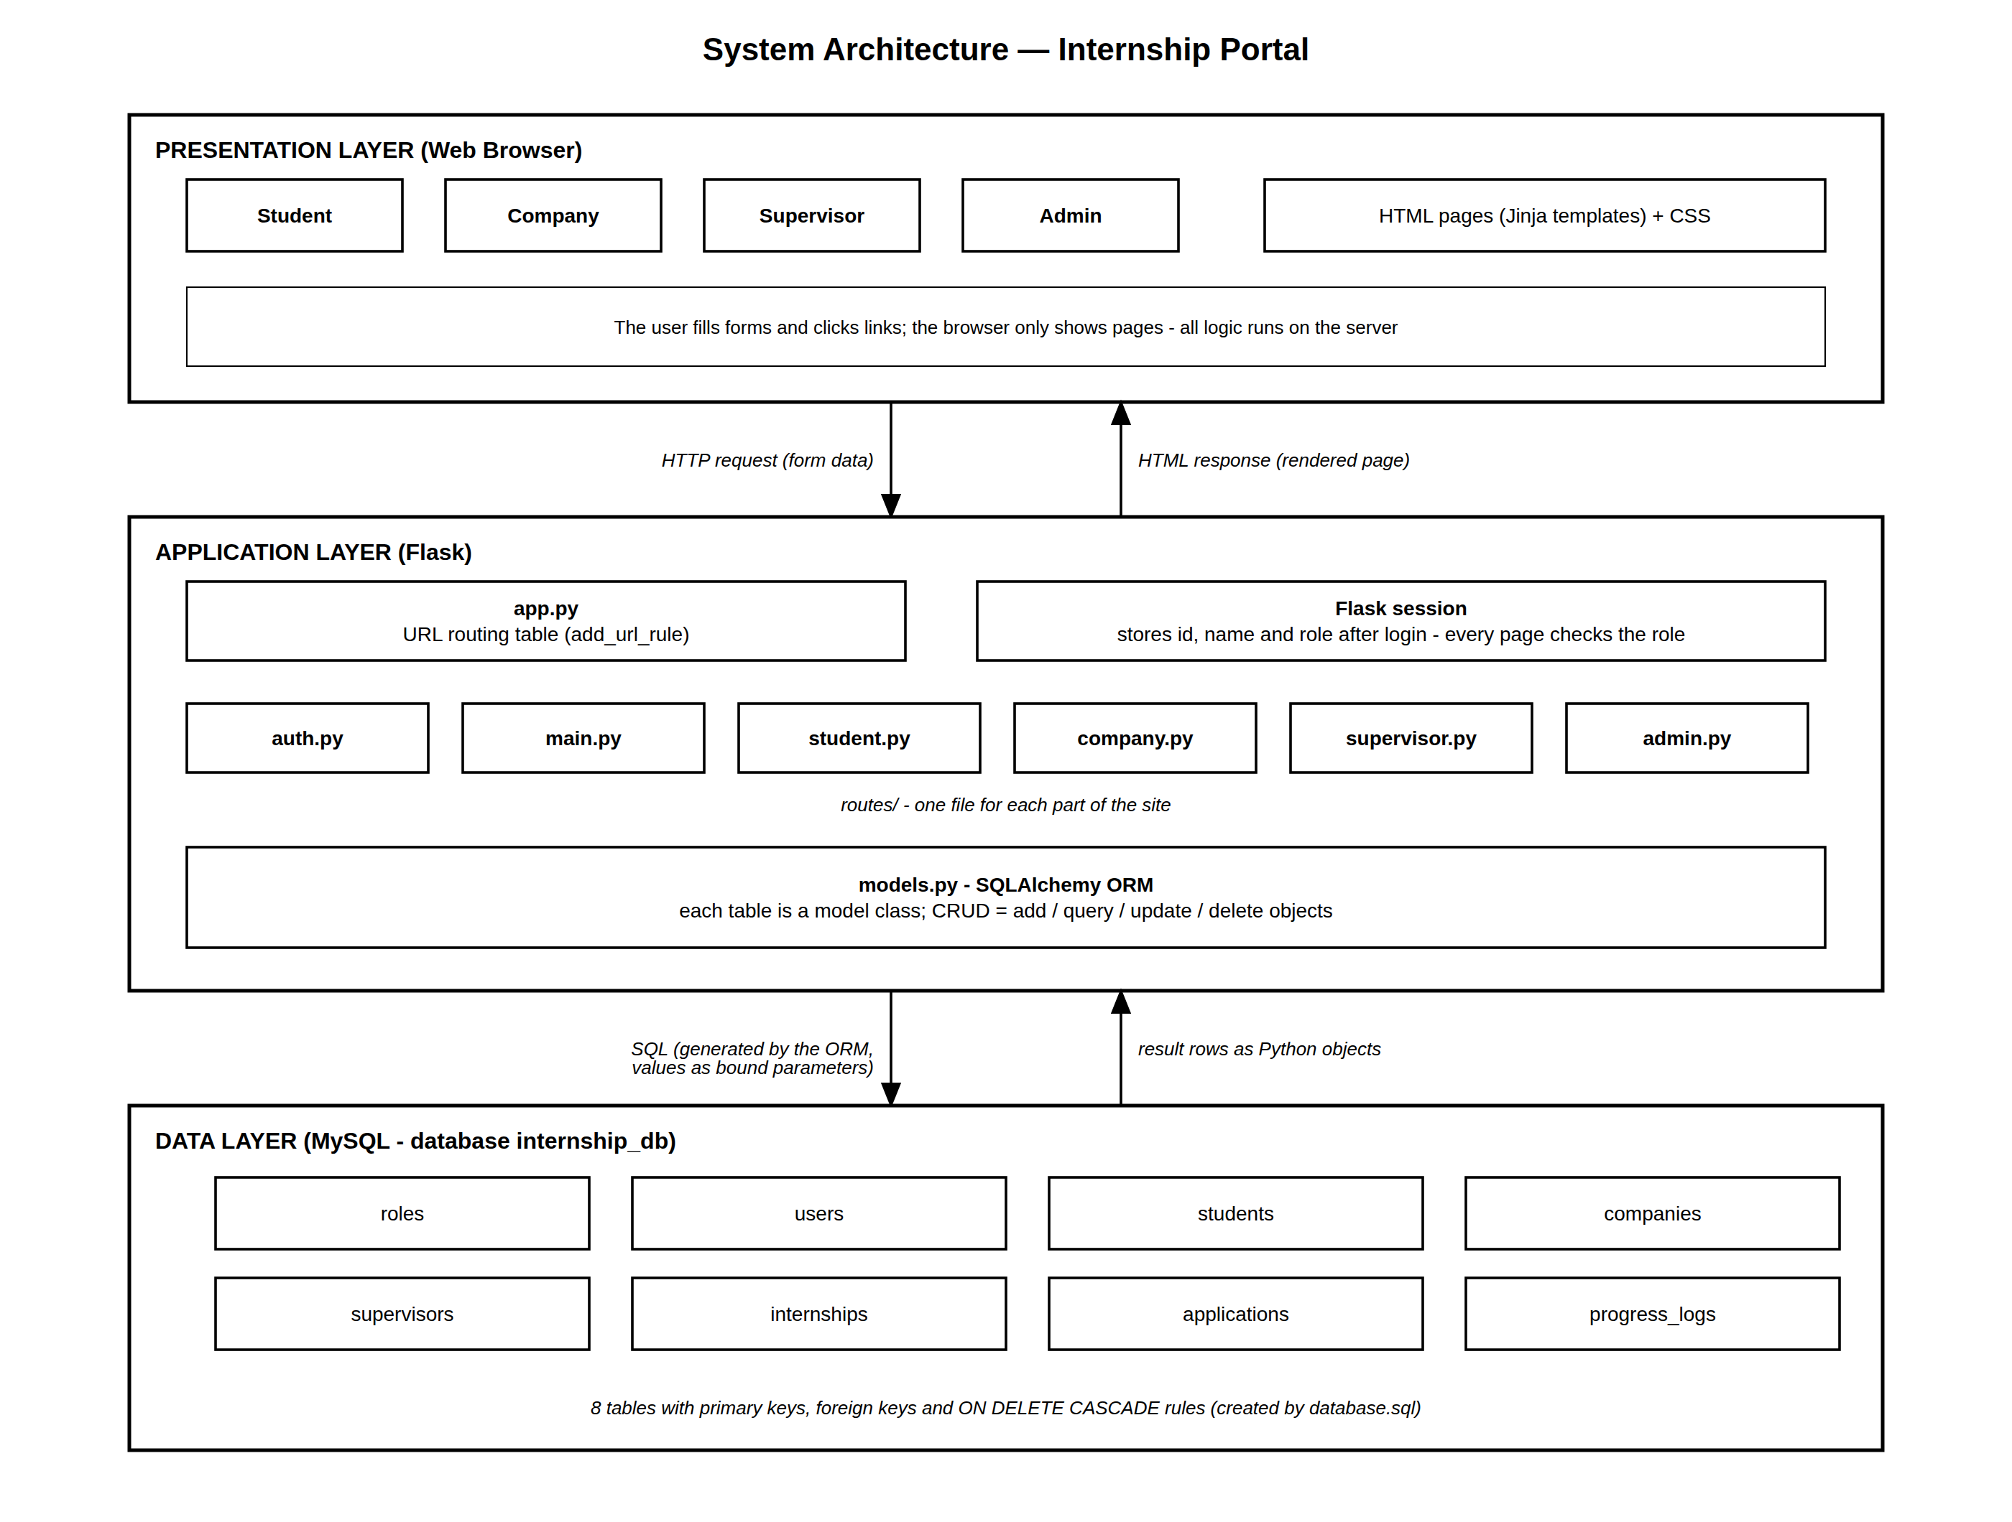
THREE TIER DESIGN
System Architecture
How a request flows
1
The browser submits a form
2
app.py matches the URL to a function
3
The function checks the session role
4
SQLAlchemy reads or writes the data
5
A Jinja template renders the page
Internship Portal · Final Project Defense
8
Notes:
Point at the three boxes: presentation, application, data. Then trace one request through them.

Slide 9
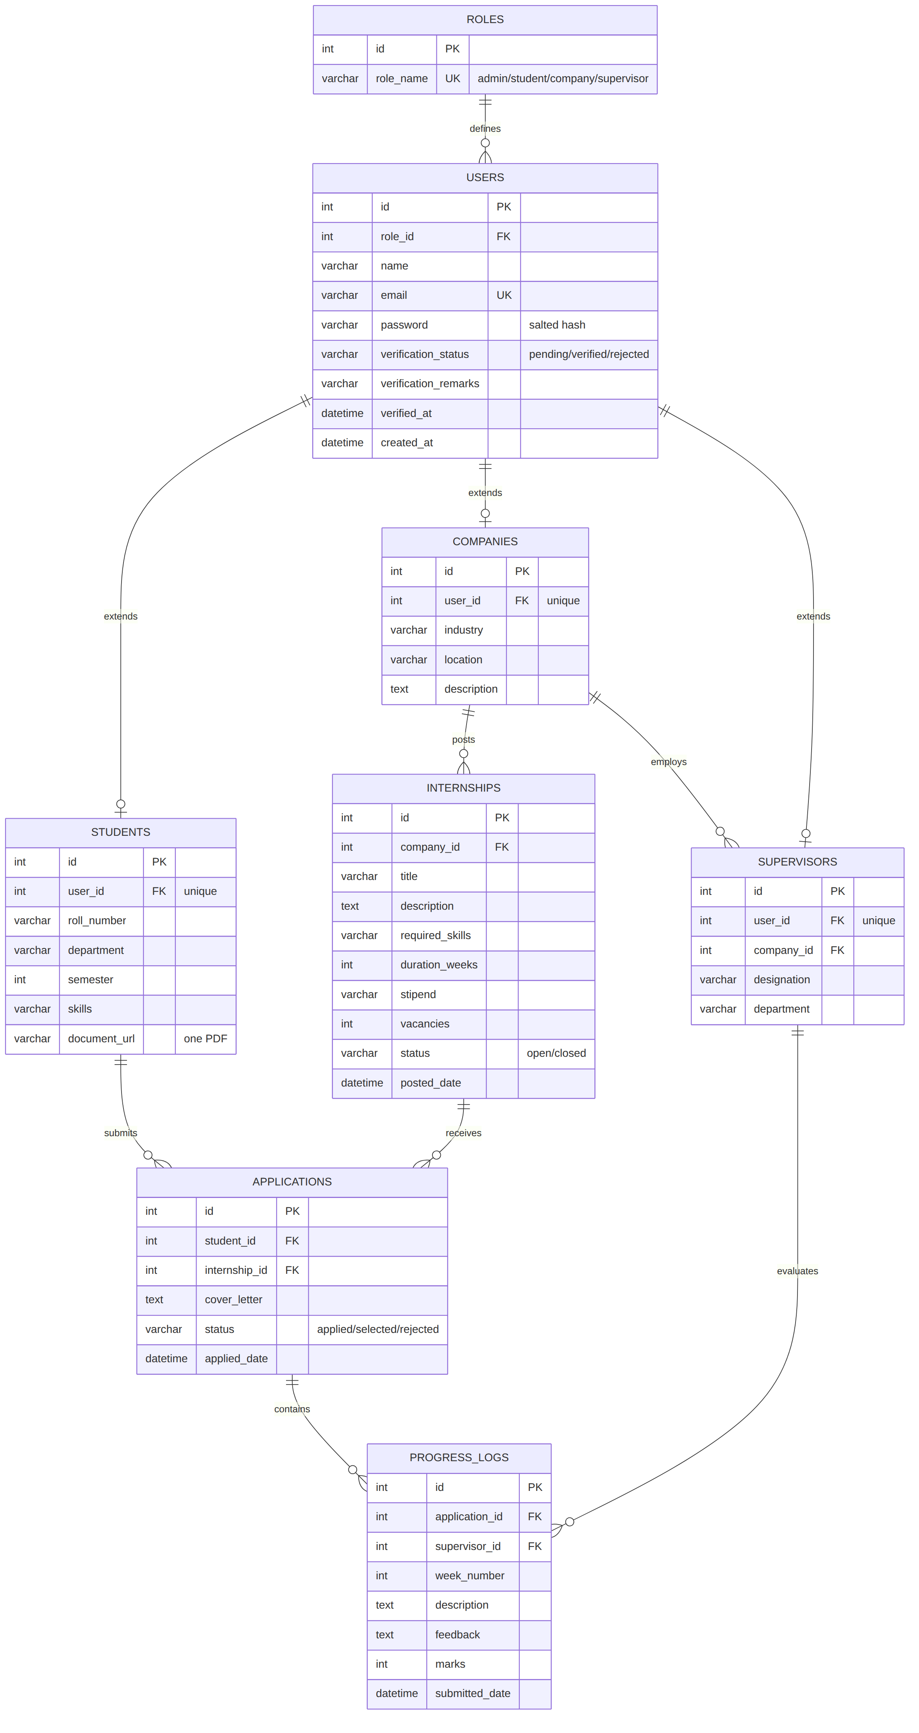
NINE RELATED TABLES
Database Design
Key points
users
Central login table; students, companies and supervisors extend it
Keys
Every table has a primary key; foreign keys join the tables
Cascade
Deleting a company removes its internships and applications
Unique
A student cannot apply twice to the same internship
3NF
No repeated data; role details kept in their own tables
Internship Portal · Final Project Defense
9
Notes:
If asked to name the tables: roles, users, students, companies, supervisors, internships, applications, progress_logs, notifications.

Slide 10
ONE FILE, ONE RESPONSIBILITY
Flask Application Structure
Internship_Portal/
├── app.py URL table
├── models.py database tables
├── database.sql schema
├── seed_demo.py sample data
├── routes/
│ ├── auth.py register, login
│ ├── main.py landing, dashboard
│ ├── student.py apply, logs
│ ├── company.py post, applicants
│ ├── supervisor.py feedback
│ └── admin.py users, verify
├── templates/ 19 HTML pages
├── static/ CSS, icons, logo
└── tests/ 33 tests
app.py
Connects every URL to one function using add_url_rule — the table of contents of the site
routes/
One file per part of the site; each function checks the role, works with the data, renders a page
models.py
Each table is a Python class with its relationships and cascade rules
templates/
Jinja pages that all extend base.html, so the layout is written once
Internship Portal · Final Project Defense
10
Notes:
Say why it is split: a change to one role cannot break another role's pages.

Slide 11
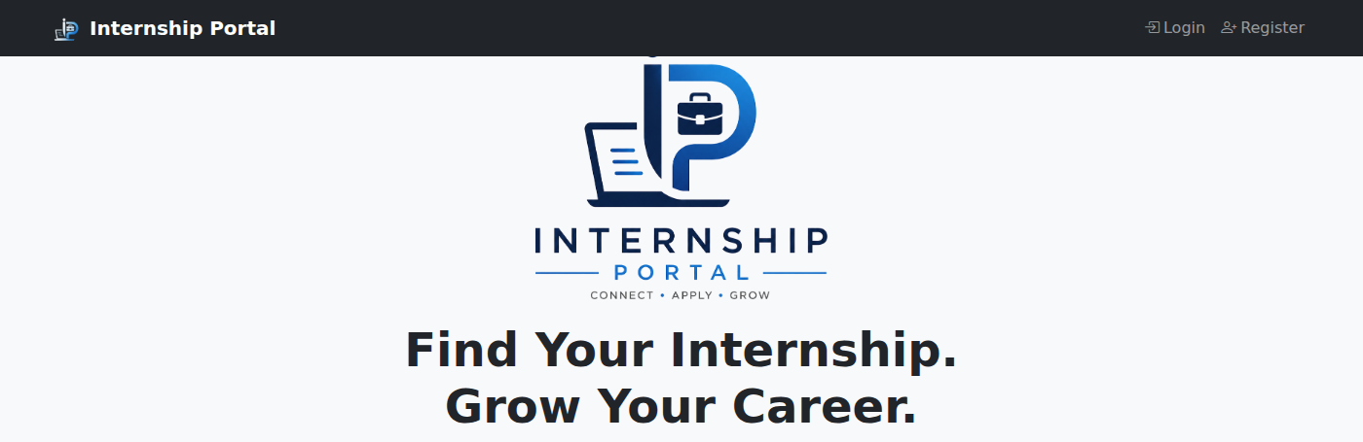
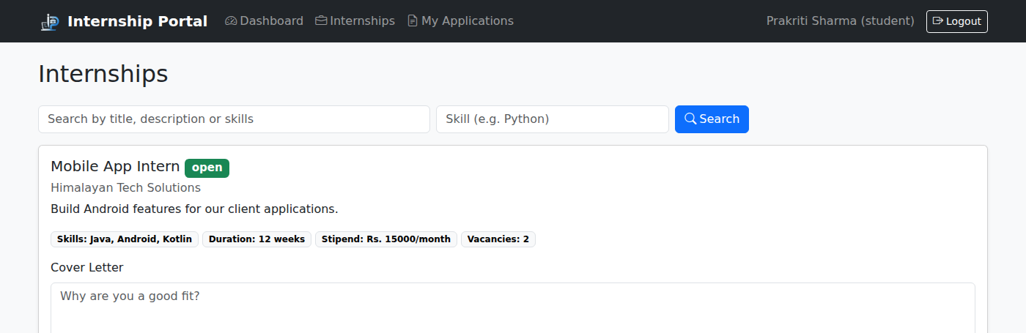
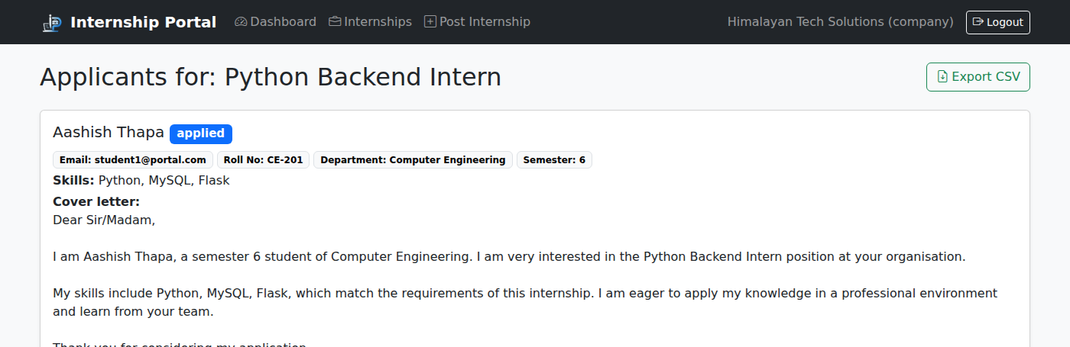
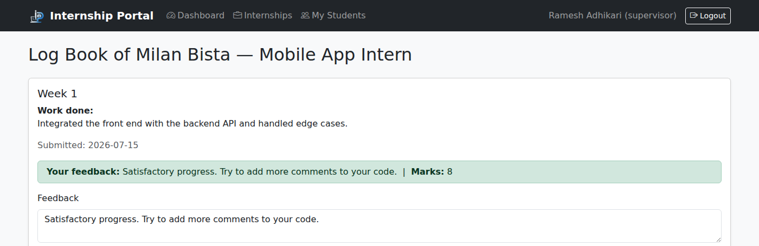
SCREENS FROM THE RUNNING SYSTEM
User Interface
Landing page
Internship list and search
Applicants with cover letter
Supervisor log review
Internship Portal · Final Project Defense
11
Notes:
These are real screenshots of the system with demonstration data loaded.

Slide 12
THE ORDER I WILL FOLLOW
System Demonstration
1
Open the portal
2
Register a student
Landing page shows live counts and the partner companies
One PDF with the NID, resume and other documents is uploaded
3
Admin approves
4
Company posts
The account sits in the verification queue until approved
A new internship with skills, duration, stipend and vacancies
5
Student applies
6
Company selects
Search by skill, then apply with a cover letter
The student is notified of the decision
7
Weekly log
8
Supervisor evaluates
The selected student records the work done that week
Feedback and marks; the student is notified
Internship Portal · Final Project Defense
12
Notes:
Keep two browser windows open so you are logged in as two roles at once and avoid repeated logging in and out.

Slide 13
HOW THE PARTS FIT TOGETHER
Implementation Highlights
ROUTING — app.py
Flask routing
app.add_url_rule('/apply/<int:internship_id>',
view_func=student.apply,
methods=['POST'])
app.py maps every URL to one function; <int:id> passes the record id as an argument
SQLAlchemy ORM
MODEL — models.py
Create = session.add, Read = Model.query, Update = change attribute, Delete = session.delete
class Application(db.Model):
student_id = db.Column(..., ForeignKey)
internship_id = db.Column(..., ForeignKey)
status = db.Column(db.String(20))
Jinja rendering
Templates loop over objects returned by the route; all pages extend one base layout
TEMPLATE — Jinja
{% for i in internships %}
<h5>{{ i.title }}</h5>
{% endfor %}
Security
Passwords stored as salted hashes; every value bound as a parameter, never pasted into SQL
Internship Portal · Final Project Defense
13
Notes:
Be ready to open any of these three files and point at the same lines in the editor.

Slide 14
33 AUTOMATED TESTS, ALL PASSING
Testing
Test case | Expected result | Actual | Status
Student registration | Rows created in users and students | Created | PASS
Duplicate email | Registration refused with a message | Refused | PASS
Wrong password | Login refused | Refused | PASS
Unverified company posts | Blocked until the admin approves | Blocked | PASS
Apply twice | Second application refused | Refused | PASS
Supervisor feedback | Marks stored and shown to the student | Stored | PASS
Delete a company | Its internships and applications removed | Removed | PASS
Student opens admin page | Redirected away | Redirected | PASS
Document is not a PDF | Registration refused, one PDF asked for | Refused | PASS
33
automated tests
Run in front of the examiner:
pytest tests/ -v
Unit tests of each route
Integration across all roles
Separate test database
Beta testing by classmates
Internship Portal · Final Project Defense
14
Notes:
The tests use a separate database called internship_db_test, so running them never touches the demonstration data.

Slide 15
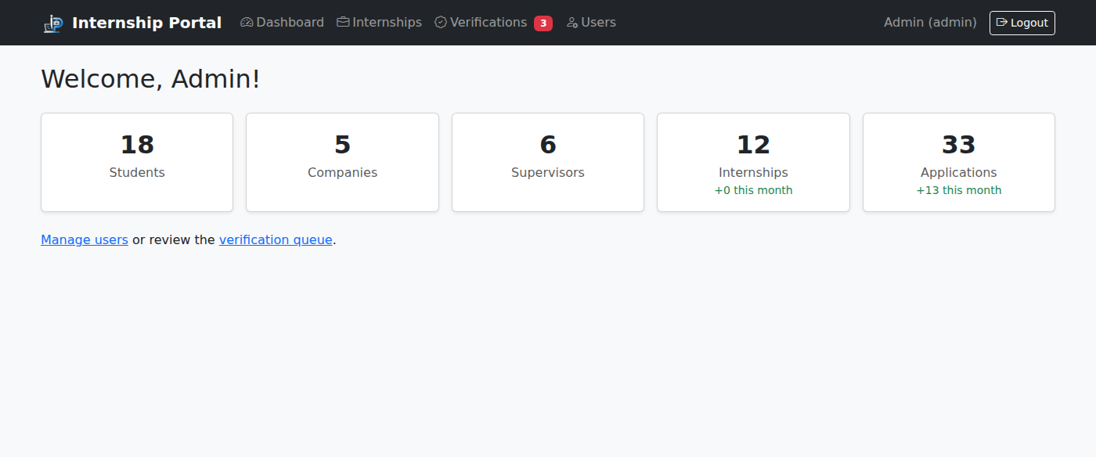

WHAT THE COMPLETED SYSTEM ACHIEVES
Results
9
4
30
33
Database tables
User roles
Working pages
Tests passing
Achieved
Complete workflow from posting to evaluation
Centralized, database backed information
Role based access verified by tests
Simple interface usable without training
Internship Portal · Final Project Defense
15
Notes:
The dashboard numbers come live from the database, not from hard coded values.

Slide 16
WHAT WAS DIFFICULT
Challenges and Solutions
Connecting Flask to MySQL
Kept the schema in database.sql as the single source, and re-ran it whenever the models changed
Errors such as unknown database and unknown column
Designing the relationships
Cascade where the data has no meaning alone; SET NULL where records must survive, as with logs
Deciding what should be deleted with a parent record
Keeping roles separate
Every route checks the session role and record ownership; tests now prove it
Users could reach pages belonging to other roles
Dates missing after ORM move
Added defaults to the model columns as well as the SQL, then re-tested
Timestamps were saved as empty and pages crashed
Internship Portal · Final Project Defense
16
Notes:
Examiners like a specific bug and a specific fix. The date default one is a good story.

Slide 17
HONEST SCOPE OF THIS VERSION
Limitations
No email or SMS
One combined file
Notifications are delivered inside the application only, because no mail server was available
NID, resume and certificates arrive as a single PDF; the system cannot index them separately
No CSRF protection
Basic search
Forms carry no anti forgery token; Flask-WTF would provide this before public use
Keyword and skill only; no filtering by duration, stipend or location
Development server
Single institution scale
Runs on the Flask development server; production needs a proper server and HTTPS
Designed and tested for college scale use, not for thousands of concurrent users
Internship Portal · Final Project Defense
17
Notes:
State these before the examiner finds them. Knowing your own limits reads as engineering maturity.

Slide 18

NOT IMPLEMENTED — PLANNED WORK
FUTURE WORK
Future Enhancements
Email delivery
Interview scheduling
Separate document fields
Send the notifications the system already generates by email
Companies propose slots and students confirm them
A parsed resume field and file attachments on the weekly logs
Completion certificate
Advanced filtering
Security hardening
Generated automatically at the end of an internship
Filter by duration, stipend and location as well as skill
CSRF tokens, HTTPS and a production server before deployment
Internship Portal · Final Project Defense
18
Notes:
Say clearly that none of these are in the current system.

Slide 19
SUMMARY
Conclusion
The Internship Portal brings students, companies, supervisors and an administrator onto one platform, and records the whole internship life cycle in a single relational database.
Educational value
Building this system required working through database design and normalization, request handling and routing, template inheritance, access control, and automated testing — the same concerns as a real web application, at a scale that could be fully understood and defended.
The complete workflow is implemented and tested, from account verification through to supervisor evaluation
Eleven normalized tables, accessed through an object relational mapper, with the schema kept under version control
Role based access and record ownership are enforced in every route and proven by automated tests
The design also leaves clear room for the enhancements listed as future work.
The project demonstrates practical use of Flask, Jinja templates, Bootstrap and MySQL together
Internship Portal · Final Project Defense
19
Notes:
Close on what was learned, not only on what was built.

Slide 20
THANK YOU
QUESTIONS & ANSWERS
[Your Name] · Roll No. [Your Roll Number] · [Your College Name]
github.com/RamSinghKarki/Internship_Portal
Notes:
Invite questions. If you do not know an answer, say what you do know and offer to show it in the code.

