Slide 1

Design and Implementation of Smart “Traffic Signalling System”
(Under the Guidance of Dr. S. Ravishankar Prof. ECE Dept.)
G. RAM SRIVATSAV ECE13054
G.V.V.S.S. KIRAN ECE13055
G.A. SAI CHARAN ECE13060

Slide 2
Abstract
Traffic congestion was recognized as major problems in modern urban areas for easy movement of vehicles.
The Traffic Density in cities like Bangalore is highly random in nature and is very difficult to predict. There is a need to deploy a smart signalling system to regulate and monitor the traffic.
This project aims to implement a smart traffic signalling system for seamless movement of vehicles on road in an optimal way.

Slide 3
Literature Survey(Md. Munir Hasan 2014 )[1]
In this paper[1], author proposed a method for determining trafﬁc congestion on roads using image processing techniques and a model for controlling trafﬁc signals based on information received from images of roads taken by video camera.
Author extracted trafﬁc density which corresponds to total area occupied by vehicles on the road in terms of total amount of pixels in a video frame instead of calculating number of vehicles.

Slide 4
Literature Survey(Md. Munir Hasan 2014 )[1]
Author set two parameters as output , trafﬁc cycle and weighted time for each road based on trafﬁc density.
Traffic Cycle is the total time required for one complete rotation of the signal lights at any traffic point.

Slide 5
Literature Survey(Md. Munir Hasan 2014 )[1]
The denser the traffic, longer is the traffic cycle. This method is applied for longer cycle duration when there is more traffic so that more vehicles can pass at a time.

Slide 6
Literature Survey(Anurag Kanungo 2014)[2]
This paper[2] presents the method to use live video feed from the cameras at traffic junctions for real time traffic density calculation using video and image processing.
It also focuses on the algorithm for switching the traffic lights according to vehicle density on road, there by aiming at reducing the traffic congestion on roads which will help lower the number of accidents.

Slide 7
Literature Survey(Anurag Kanungo 2014)[2]
This system consists of video cameras on the traffic junctions for each side as if it is a four way junction. Therefore four video cameras will be installed over the red lights facing the road.
Cameras would be capturing video and broadcasting it to the servers where using video and image processing techniques the vehicle density on every side of the road is calculated and an algorithm is employed to switch the traffic lights accordingly.

Slide 8
Literature Survey(Anurag Kanungo 2014)[2]
Hardware also includes connection of these cameras to the server to receive live feed and a server capable enough for handling the processing requirements.
Software used in the system includes MATLAB and image processing toolbox and C++ compiler to generate algorithmic results.

Slide 9
LITERATURE SURVEY(Bilal Ghazal 2016)[3]
This paper[3] proposes a system based on PIC microcontroller that evaluates the traffic density using IR sensors and accomplishes dynamic timing slots with different levels.
Moreover, a portable controller device is designed to solve the problem of emergency vehicles stuck in the overcrowded roads.

Slide 10
LITERATURE SURVEY(Bilal Ghazal 2016)[3]
The IR transmitter and the IR receiver are mounted on either sides of a road. When an automobile passes on the road between the IR sensors, the system is activated and the car counter is incremented.

Slide 11
LITERATURE SURVEY(Bilal Ghazal 2016)[3]
The collected information about the traffic density of the different roads of a junction is analysed in order to modify dynamically the delays of green light at the lane having the significant traffic volume. The whole system could be controlled by PIC microcontroller or even by PLC.

Slide 12
LITERATURE SURVEY(Vivek Tyagi 2012)[4]
This paper[4] considers the problem of vehicular trafﬁc density estimation, utilizing the information cues present in the cumulative acoustic signal acquired from a roadside-installed single microphone.
This cumulative signal comprises several noise signals such as tire noise, engine noise, engine-idling noise, occasional honks, and air turbulence noise of multiple vehicles.

Slide 13
LITERATURE SURVEY(Vivek Tyagi 2012)[4]
The occurrence and mixture weightings of these noise signals are determined by the prevalent trafﬁc density conditions on the road segment.
For instance, under a free-ﬂowing trafﬁc condition, the vehicles typically move with medium to high speeds and there by produce mainly tire noise and air turbulence noise and less engine-idling noise and honks.

Slide 14
LITERATURE SURVEY(Vivek Tyagi 2012)[4]
For slow-moving congested trafﬁc, the cumulative signal will largely be dominated by engine-idling noise and honks; air turbulence and tire noises will be inconspicuous.
Further more, these various noise signals have spectral content that are very different from each other and, hence, can be used to discriminate between the different trafﬁc density states that lead to them.

Slide 15
LITERATURE SURVEY(Ms.Pallavi Choudekar 2011)[5]
In this paper[5] they propose a system for controlling the traffic light by image processing. The system will detect vehicles through images instead of using electronic sensors embedded in the pavement.
A camera will be installed alongside the traffic light. It will capture image sequences. Setting image of an empty road as reference image, the captured images are sequentially matched using image matching.

Slide 16
LITERATURE SURVEY (Ms.Pallavi Choudekar 2011)[5]
For this purpose edge detection has been carried out using Prewitt edge detection operator and according to percentage of matching traffic light durations can be controlled.

Slide 17
LITERATURE SURVEY(Ms.Pallavi Choudekar 2011)[5]
Following are the steps involved
• Image acquisition
• RGB to gray conversion
• Image enhancement
• Image matching using edge detection

Slide 18
Literature Survey
Author(year) | Title | Features | Method used to Determine the Features
Md. Munir Hasan | Smart Trafﬁc Control System with Application of Image Processing Techniques | 1. traffic density 2. green light on time calculation | For Traffic Density they used Image Processing. (sobey edge detection ) we planned to use this method to detect the traffic density because this is more efficient when compared others.
Anurag Kanungo | Smart Traffic Lights Switching and Traffic Density Calculation using Video Processing | Traffic Density. | For traffic density they used video processing .

Slide 19
Literature Survey
Author(year) | Title | Features | Method used to Determine the Features
Bilal Ghazal | Smart Traffic Light Control System | 1.Traffic density | They uses IR sensors and PIC controller
Vivek Tyagi | Vehicular Trafﬁc Density State Estimation Based on Cumulative Road Acoustics | 1.Traffic density | This paper uses microphone on road sides ad records acoustics
Ms.Pallavi Choudekar | Implementation of Image Processing in Real Time Traffic Light Control | 1. Traffic Density | For Traffic Density they used Image Processing.(Prewitt edge detection )

Slide 20
Parameters That are Considered in Calculation of Green Light Time
Traffic Density
Driver Reaction Time

Slide 21
Traffic Density

Slide 22
Traffic Density
Traffic Density is one of the major factor that effects the seamless flow of ambulances, In metropolitan cities, traffic density plays an important role in navigation of emergency vehicles.

Slide 23
Literature Survey
Methods | Image Acquisit | Preprocess | Density Calculation
Background Subtraction technique | Uses cameras | Grayscale conversion, Binary conversion, Erosion, Dilation | Motion detection using Consecutive frame comparison based on histogram key region and Vehicle detection using background
Canny Edge Detection Technique | Uses cameras | Grayscale conversion, Background subtraction | Canny edge detection for vehicle edge detection, Moore neighborhood algorithm for object count

Slide 24
Methods | Image Acquisit | Preprocess | Density Calculation
Dual method technique | Uses cameras | Grayscale conversion | using a combination of gradient magnitude and direct subtraction techniques to detect vehicles. We use this way of detection.
Gradient Method | Uses cameras | Grayscale conversion | using canny edge detector and gradient based edge detection

Slide 25
Literature Survey
We can also use proximity sensors ,RFID sensors and IR sensors to estimate Traffic density, but all these methods are inaccurate when compared with Image Processing.

Slide 26
Methodology
To estimate traffic density we combine 2 methods
1-Gradient method and
2-Direct subtraction method
Then we combine both of the results for better detection of vehicles.

Slide 27

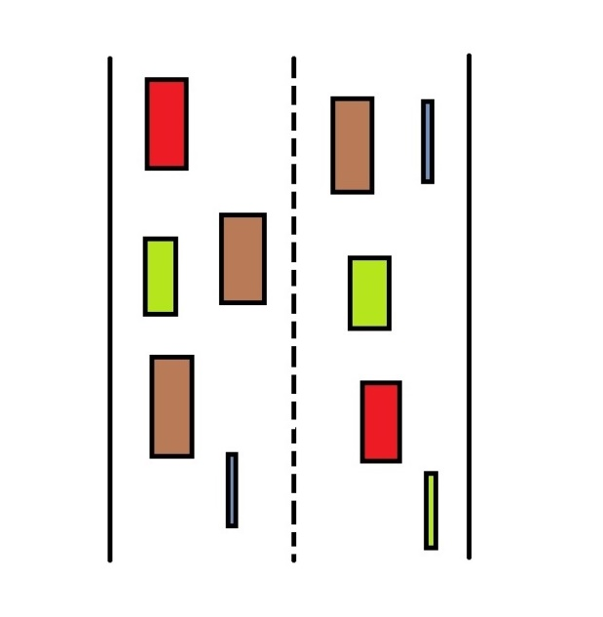
Gradient Method
At ﬁrst the RGB foreground image from camera video frame and the background images from the reference data base are converted into grey scale image.

Slide 28

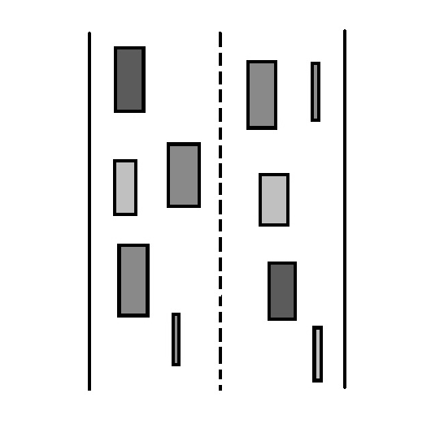
Gradient Method
Grey Scale images:

Slide 29
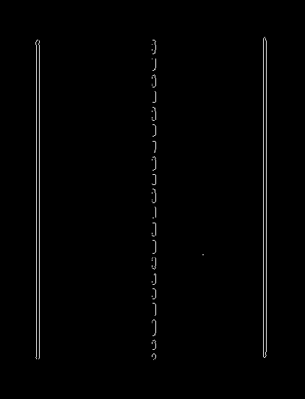
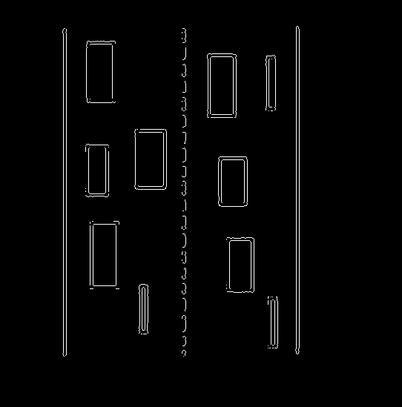
Gradient Method
Then we apply sobel edge detecting operation on the background and foreground image.

Slide 30
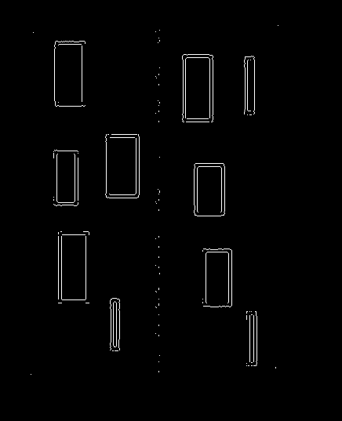
Gradient Method
Foreground and Background images are subtracted to obtain foreground objects.

Slide 31
Gradient Method
Now we need to do some noise removal to remove the noise introduced by subtraction. We choose wiener ﬁlter because of it’s ability remove the additive noise and invert the blurring simultaneously.
Gtuned = Gobj −0.009
Gtuned =Gtuned If pixelvalue ≥ 0
0 else

Slide 32
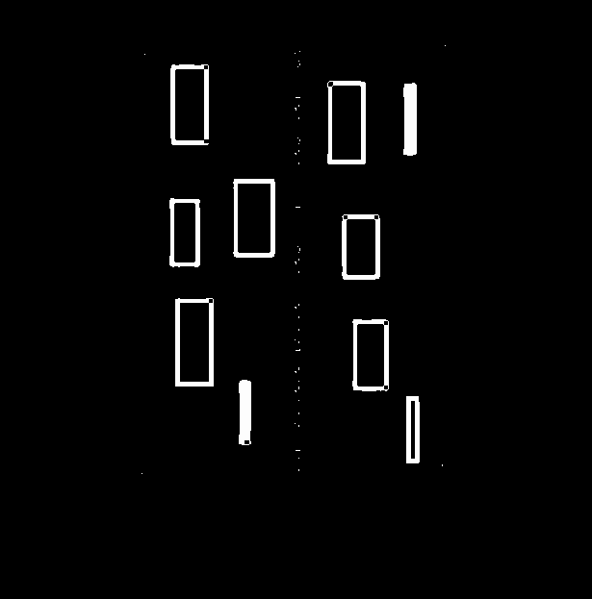
Gradient Method
Then we perform morphological image closing

Slide 33
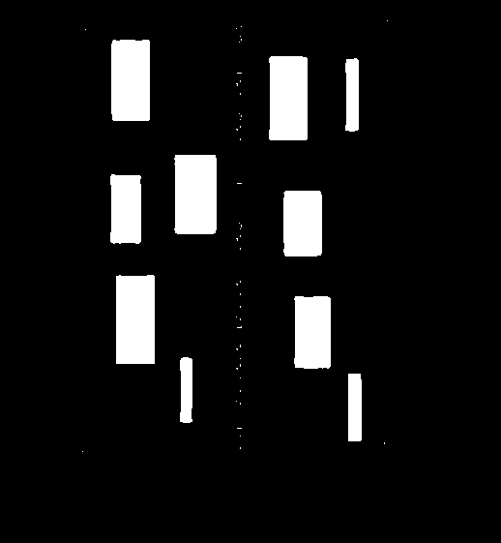
Gradient Method
After that we perform ﬂood ﬁll operation to ﬁll the holes in the objects with closed contours so that we get image with solid foreground objects.

Slide 34
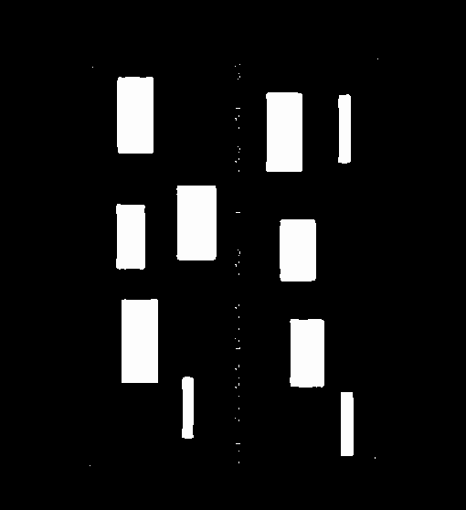
Gradient Method
Now we convert the filled image into a binary image to easily count the number of white pixels.

Slide 35
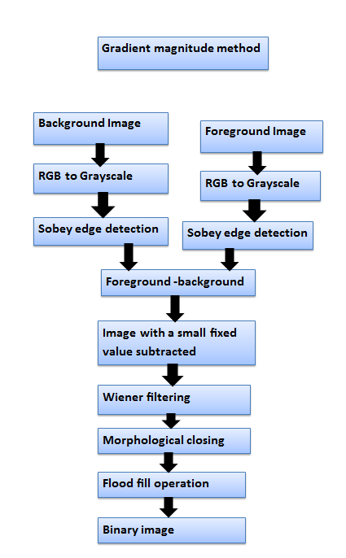
Flow chart(for finding traffic density)

Slide 36


Direct Subtraction Method
At ﬁrst the RGB foreground image from camera video frame and the background images are converted into grey scale image.

Slide 37
Grey Scale images:

Slide 38
Direct Subtraction Method
Foreground and Background images are subtracted using to obtain foreground objects as in gradient method.

Slide 39
Direct Subtraction Method
Now we need to do some noise removal to remove the noise introduced by subtraction. We choose wiener ﬁlter because of it’s ability remove the additive noise and invert the blurring simultaneously.
Dtuned = Dobj −0.009
Dtuned =Dtuned If pixelvalue ≥ 0
= 0 else

Slide 40
Direct Subtraction Method
Then we perform morphological image closing and ﬂood ﬁll operation to ﬁll the holes in the objects with closed contours as in gradient method, so that we get image with solid foreground objects.

Slide 41
Direct Subtraction Method
Then we convert filled image to a binary image to easily count the number of white pixels.

Slide 42
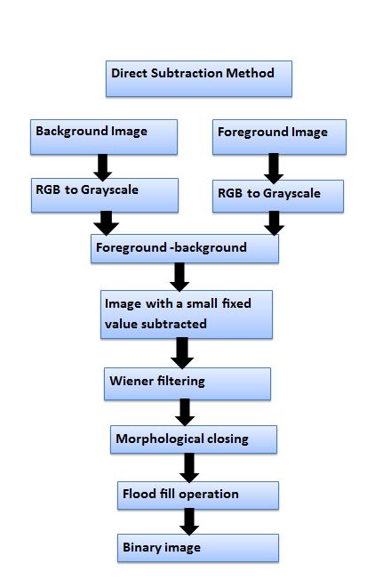
Flow chart(for finding traffic density)

Slide 43
After this we add direct subtraction method and gradient method images to get better detectable image for estimation.
Then we find count number of white pixels in the combined image which when divided with the area of the road gives, the traffic density value.

Slide 44
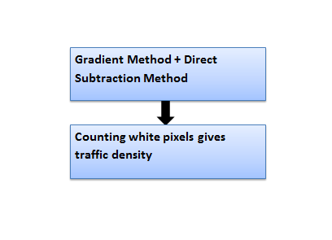
Flow chart(for finding traffic density)

Slide 45
Now we use fuzzy estimation, by mapping the traffic density value to a membership function(Fuzzification).

Slide 46
Weather
Sudden changes in weather causes increase in traffic congestion.
The main weather changes that effect the traffic congestion is Rainfall.

Slide 47
Rainfall
Rainfall is one of the major factor that effect the traffic congestion.
Rainfall causes slippery roads .So, the speed of the vehicles travelling on that road reduces, This in turn increases Traffic Congestion.
Highest recorded rainfall in India is 6 mm/min.

Slide 48
DRT(Driver Reaction Time)
DRT is the time that the driver takes in response to the change of traffic light to green.

Slide 49
Ton (Green Light On Time Calculation)
Now we calculate the time for which the green light should be on by the formulae.
Ton=Td*K+DRT
-Td-Fuzzy membership function Value.
-DRT-Driver Reaction Time.
-K-Weather Constant(varying from 1-2).

Slide 50
Prioritizing Emergency Vehicles

Slide 51
Prioritizing Emergency Vehicles
We had divided emergency vehicles into two categories.
Emergency vehicles (E1)
1-Ambulances.
2-Fire Engines.
Emergency vehicles (E2)
1-police vehicles.
2-government vehicles.

Slide 52
Emergency vehicles (E1)
In this category we considered all the emergency vehicles that involve in life saving activities.

Slide 53
Emergency vehicles (E2)
In this category we considered the remaining emergency vehicles including government transport vehicles.

Slide 54
Calculation of priority factor
Based on the values of the count of E1 and count of E2 we calculate this priority factor for every road that converge at the junction.
The road with maximum priority factor value will change first to green with the time calculated based on Traffic density, Weather factor and Driver reaction time.

Slide 55
Timeline | Work Plan
November 2016 | Literature survey
January 2017 | Literature survey and Simulating the base paper[1] identified during literature survey
February 2017 | Literature survey and Simulating the base paper[1] identified during literature survey
March 2017 | Design ,Implementation and Testing continued.
April 2017, May 2017 | Preparing a research paper for publishing the work and submitting for publication.Draft copy of Project report documentation.

Slide 56
References
[1] Md. Munir Hasan, “Smart Trafﬁc Control System with Application of Image Processing Techniques”, 3rd INTERNATIONAL CONFERENCE ON INFORMATICS, ELECTRONICS & VISION, 2014.
[2] Anurag Kanungo ,“Smart Traffic Lights Switching and Traffic Density Calculation using Video Processing”, Engineering and Computational Sciences (RAECS), 2014.
[3] Bilal Ghazal , “Smart Traffic Light Control System ”, Electrical, Electronics, Computer Engineering and their Applications (EECEA), Third International Conference ,2016.

Slide 57
References
[4] Vivek Tyagi, “Vehicular Trafﬁc Density State Estimation Based on Cumulative Road Acoustics”, Ieee Trasactions on Intelligent Transportation Systems, 2012.
[5] Ms.Pallavi Choudekar , “Implementation of Image Processing in Real Time Traffic Light Control ”, Electronics Computer Technology (ICECT), 2011.
[6] Amit Bhat, “Design and Implementation of a Dynamic Intelligent Traffic Control System,” IEEE Computer Society, 17th UKSIM-AMSS International Conference on Modeling and Simulation, 2015.

Slide 58
References
[7]Megha A. Tank , “ Review on Smart Traffic Control for Emergency Vehicles” ,International Journal of Computer Applications, Volume 112 – No. 7, February 2015.
[8]Mohit Jha, Shailja Shukla, “ Design Of Fuzzy Logic Traffic Controller For Isolated Intersections With Emergency Vehicle Priority System Using MATLAB Simulation”, CSIR Sponsored 10th Control Instrumentation System Conference 2013.
[9] K.ATHAVAN, N.DINESH, and G.BALASUBRAMANIAN, “AUTOMATIC AMBULANCE RESCUE SYSTEM,” Second International Conference on Advanced Computing & Communication Technologies, 2012.

Slide 59
References
[10] P. Arunmozhi, P. Joseph William, “Automatic Ambulance Rescue System Using Shortest Path Finding Algorithm”, International Journal of Science and Research (IJSR) ISSN (Online): 2319-7064 Impact Factor (2012): 3.358
[11] Ms. Avani.Joshi ,Dr. Dhirendra Mishra, “ Review of Traffic Density Analysis Techniques”, International Journal of Advanced Research in Computer and Communication Engineering Vol. 4, Issue 7, July 2015

Slide 60
References
[12] Geetha.E, V.Viswanadha, Kavitha.G, “Design of an Intelligent Auto Traffic Signal Controller with Emergency Override”, International Journal of Engineering Science and Innovative Technology (IJESIT) Volume 3, Issue 4, July 2014.
[13] D. Spandana , D. Subba Rao , M.Pushpalatha, “ Automatic Ambulance Rescue System ”, International Journal of Innovative Technology (IJITECH) Vol.03, Issue.07,August 2015.

Slide 61


