Slide 1


Serverless Document Processing and Analytics Platform on AWS
Submitted by
Ram Thokane (16010123249)
Shashwat Jain (16010123310)
Advanced Cloud Computing — Course Project
LY B.Tech Computer Engineering, Semester VII
Department of Computer Engineering, K J Somaiya School of Engineering
Faculty Guide: [Faculty guide name]
Academic Year 2026–27
1
Notes:
Title slide. Introduce the team and the project: a serverless platform on AWS that uploads TXT documents, analyses them automatically and shows the analytics in a web dashboard.

Slide 2
Abstract and Introduction
Abstract
Intended benefits
Reading text documents and counting words, paragraphs and recurring terms by hand is slow, error-prone and hard to repeat across many files.
This project builds a serverless platform on AWS: a browser dashboard uploads a TXT file to a private Amazon S3 bucket, an S3 event invokes an AWS Lambda function that analyses the text, and the results are stored in Amazon DynamoDB and served back through an Amazon API Gateway HTTP API.
The prototype was deployed in ap-southeast-2 (Sydney) and processed sample documents end to end, returning word, character and paragraph counts and the top 10 keywords.
1
No servers to manage
No EC2 instances to patch; AWS runs the compute.
2
Automated processing
Each upload triggers analysis with no manual step.
3
Scales with demand
Lambda runs one invocation per event, as needed.
4
Convenient analytics
Results are kept in DynamoDB and viewed in the dashboard.
Keywords: serverless, AWS Lambda, Amazon S3, DynamoDB, API Gateway, event-driven processing, text analytics
‹#›
Notes:
Problem: analysing text documents by hand is slow and inconsistent. Solution: an event-driven AWS pipeline. Stress that the benefits listed are design goals of a serverless approach, not measured benchmarks.

Slide 3
Problem Statement and Objectives
Limitations of manual analysis
Objectives
Slow
Counting words, paragraphs and keywords by hand takes time for every file.
O1
Automated TXT processing
Analyse every .txt file (≤ 1 MB) placed under incoming/ without manual action.
O2
Document analytics
Word, character and paragraph counts plus the top 10 keywords with frequencies.
Inconsistent
Different people count differently; results cannot be reproduced.
O3
Persistent storage
One DynamoDB item per document holding status and analytics.
Not stored
Results live in notes or spreadsheets, not in a searchable record.
O4
REST-style access
Three HTTP API routes: POST /uploads, GET /documents, GET /documents/{documentId}.
No single view
There is no one place to upload files and see their analytics.
O5
Dashboard access
Upload, list, view details and track status from a browser.
‹#›
Notes:
Left: why manual analysis is a problem. Right: what the platform had to achieve, stated as checkable targets.

Slide 4
Proposed Solution
1
2
3
4
5
Upload
Store
Analyse
Persist
Display
User selects a .txt file in the dashboard; the API returns a presigned upload URL.
Browser PUTs the file straight to the private S3 bucket under the incoming/ prefix.
The S3 ObjectCreated event invokes DocumentProcessor, which reads and analyses the text.
Analytics and status are written to the DocumentAnalyticsV3 table in DynamoDB.
The dashboard reads records through GET /documents and shows the analytics.
User-driven (synchronous)
Steps 1, 2, 5: request → response between the browser, API Gateway, DocumentApi and S3.
Event-driven (asynchronous)
Steps 3, 4: S3 invokes DocumentProcessor; no user action or polling server is needed.
One ID end to end
documentId links the API record, the S3 key incoming/<documentId>.txt and the DynamoDB item.
‹#›
Notes:
Walk through the five steps. Steps 1, 2 and 5 are driven by the user through the browser; steps 3 and 4 happen automatically, triggered by the S3 event.

Slide 5
AWS Architecture
1 POST /uploads
6 GET /documents
Amazon API Gateway
HTTP API
DocumentAnalyticsAPI
invoke
AWS Lambda
DocumentApi
routes · validation · presigning
PutItem (PENDING) · GetItem · Scan
Client
Browser frontend
HTML · CSS · JavaScript
signs a presigned PUT URL
for one S3 key
Amazon DynamoDB
DocumentAnalyticsV3
partition key: documentId
CloudWatch
Logs
3 ObjectCreated
(incoming/, .txt)
The browser never accesses
DynamoDB; reads go
through the API.
Amazon S3 (private)
Document bucket
incoming/<documentId>.txt
AWS Lambda
DocumentProcessor
read · analyse · update
2 PUT file via
presigned URL
5 UpdateItem: status +
analytics
4 GetObject
Synchronous request / response
Asynchronous, event-driven
Logs / signing (no data transfer)
‹#›
Notes:
Red solid arrows: synchronous request/response initiated by the browser. Navy dashed arrows: the asynchronous path started by the S3 event. The browser only talks to API Gateway and, with a presigned URL, to S3. It never reaches DynamoDB.

Slide 6
Technology Stack
Technology | Role in the project | Project resource
Amazon S3 | Private storage for uploaded TXT files; source of ObjectCreated events | serverless-doc-analytics-ram-2026-73921 (incoming/)
AWS Lambda | API request handling and document processing | DocumentApi, DocumentProcessor
Amazon API Gateway (HTTP API) | REST-style endpoints with built-in CORS | DocumentAnalyticsAPI: POST /uploads, GET /documents, GET /documents/{documentId}
Amazon DynamoDB | Document metadata, processing status and analytics | DocumentAnalyticsV3 (partition key documentId)
Amazon CloudWatch | Lambda execution logs and troubleshooting | /aws/lambda/DocumentProcessor log group
HTML, CSS, JavaScript | Dashboard: upload, list, details, status polling | index.html, style.css, app.js, config.js
Python + Boto3 | Lambda code; SDK calls to S3 and DynamoDB | lambda_function.py in each Lambda
Region: ap-southeast-2 (Sydney) · Supported input: .txt, maximum 1 MB (prototype limit)
‹#›
Notes:
Only services and languages actually used in the deployed prototype are listed. All AWS resources are in ap-southeast-2 (Sydney).

Slide 7
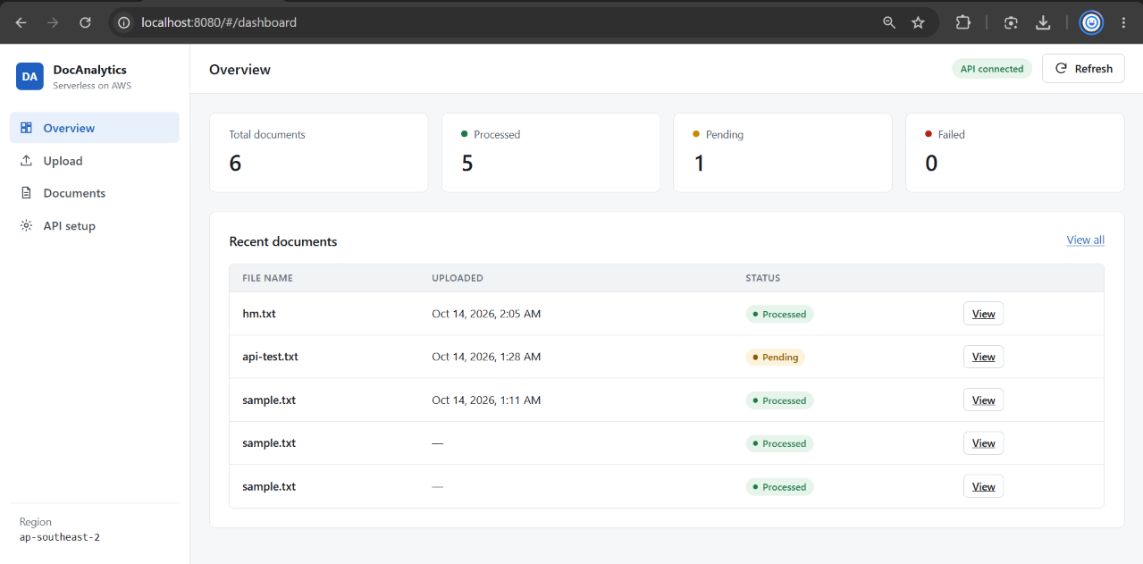
Implementation and Workflow
1
POST /uploads
Browser sends fileName, contentType, fileSize to DocumentAnalyticsAPI.
2
PENDING record
DocumentApi creates documentId (UUID) and writes a PENDING item.
3
Presigned URL
DocumentApi returns a short-lived PUT URL for incoming/<documentId>.txt.
4
Direct upload
Browser PUTs the file to S3; no AWS credentials in the browser.
5
Process
S3 event → DocumentProcessor reads the key, analyses text, updates the same item.
Figure: DocAnalytics dashboard reading DocumentAnalyticsV3 through DocumentAnalyticsAPI (ap-southeast-2), 14 Oct 2026, 02:08 IST: 6 documents, 5 processed, 1 pending, 0 failed.
Poll
Dashboard polls GET /documents/{documentId} until the status changes.
PENDING
COMPLETED
FAILED
6
Status lifecycle: PENDING → COMPLETED, or FAILED with an errorMessage if processing raises an error.
‹#›
Notes:
Explain the upload handshake and how documentId ties the three records together. The screenshot is the project dashboard reading live records from DynamoDB through the API.

Slide 8
Document Analytics
Word count
Total words in the document.
Character count
Length of the decoded text, including spaces and line breaks.
38
314
4
words
characters
paragraphs
Paragraph count
Blocks separated by one or more blank lines (regex split).
Top 10 keywords
Lower-cased word tokens from a regex, stop words removed, ranked by frequency.
Processing steps in DocumentProcessor
Decode UTF-8
(BOM removed)
Regex
tokenise
Drop stop
words
Count &
rank top 10
‹#›
Notes:
These are rule-based counts using Python regular expressions and frequency counting. There is no machine learning or NLP model. The numbers on the right are the verified results for sample.txt.

Slide 9
Results and Testing
# | Test (type) | Observed outcome | Status
1 | DocumentProcessor console test, sample.txt (direct Lambda) | Succeeded: 38 words, 314 characters, 4 paragraphs, 10 keywords | Verified
2 | Console upload of automatic-test.txt to incoming/ (S3 trigger) | Processed automatically: 24 words, 159 characters, 1 paragraph | Verified
3 | GET /documents (API) | JSON list of the existing DynamoDB records | Verified
4 | POST /uploads for api-test.txt (API) | PENDING item + presigned URL; no file was PUT, so it stays PENDING | As designed
5 | API CORS check (CloudShell + console) | GET/POST/OPTIONS allowed; origin http://localhost:8080 added | Verified
6 | Dashboard list, 02:03 IST (browser) | 5 records: 4 processed, 1 pending | Verified
7 | Upload of hm.txt, 32 KB, 02:05 IST (end to end) | Same-minute processing: 3,388 words, 32,746 characters, 156 paragraphs | Verified*
* Confirmed by the UUID-keyed DynamoDB record and the dashboard (6 total, 5 processed, 1 pending, 0 failed); its CloudWatch log was not captured. Not yet tested: oversized or non-TXT rejection on the deployed API, the FAILED path, and load or performance.
‹#›
Notes:
Be precise about test type. Tests 1-2 exercise the processor; 3-5 the API; 6-7 the browser. The api-test.txt record stays PENDING by design because only the presigned URL was requested and no file was uploaded.

Slide 10
Security, Reliability and Limitations
Implemented
Limitations → proposed improvements
Private bucket: Block Public Access left at its default; no public object URLs.
Presigned PUT URLs: short-lived and scoped to one key, incoming/<documentId>.txt.
CORS: API allows GET, POST, OPTIONS; API and S3 accept the http://localhost:8080 origin.
Input limits: TXT only, 1 MB maximum, checked in the browser and in DocumentApi.
Lambda execution roles with CloudWatch Logs for troubleshooting.
Status tracking: PENDING → COMPLETED or FAILED with an error message.
No authentication → Cognito JWT authorizer and API throttling.
Broad IAM role (PowerUserAccess seen in the console) → attach the scoped policies drafted in backend/iam/.
Scan-based listing → Query with an index and paginated GET /documents.
TXT ≤ 1 MB only → larger files and PDF text extraction.
Local frontend, no alarms → hosted site, CloudWatch alarms, failed-event destination.
Reliability: S3 invokes DocumentProcessor asynchronously, so Lambda retries failed invocations; every document keeps a visible status, and both functions write logs to CloudWatch.
‹#›
Notes:
Left column is what is configured now. Right column is what is missing and how it would be fixed. Be open that the execution role seen in the console is broader than least privilege.

Slide 11
Conclusion and Future Scope
What was implemented
Future scope
✓
Private S3 bucket with an ObjectCreated trigger (incoming/, .txt)
PDF extraction
Extract text from PDFs before analysis.
Authentication
User sign-in and per-user documents.
✓
DocumentProcessor Lambda computing four analytics
✓
DocumentAnalyticsV3 table holding status and results
Error reporting
Show FAILED reasons and retry in the UI.
Larger documents
Raise the 1 MB limit; stream large files.
✓
DocumentApi behind an HTTP API with three routes and CORS
✓
HTML/CSS/JS dashboard: upload, list, details, polling
Richer analytics
Sentence counts and reading time.
Monitoring
Alarms, dashboards and tracing.
✓
Verified runs: direct test, S3-triggered upload, API list, end-to-end upload
‹#›
Notes:
Summarise what works today, then the most valuable extensions.

Slide 12
References
[1] AWS, “What is AWS Lambda?” https://docs.aws.amazon.com/lambda/latest/dg/welcome.html
[2] AWS, “Tutorial: Using an Amazon S3 trigger to invoke a Lambda function,” https://docs.aws.amazon.com/lambda/latest/dg/with-s3-example.html
[3] AWS, “Amazon S3 Event Notifications,” https://docs.aws.amazon.com/AmazonS3/latest/userguide/EventNotifications.html
[4] AWS, “Uploading objects with presigned URLs,” https://docs.aws.amazon.com/AmazonS3/latest/userguide/PresignedUrlUploadObject.html
[5] AWS, “Blocking public access to your Amazon S3 storage,” https://docs.aws.amazon.com/AmazonS3/latest/userguide/access-control-block-public-access.html
[6] AWS, “API Gateway HTTP APIs,” https://docs.aws.amazon.com/apigateway/latest/developerguide/http-api.html
[7] AWS, “Configure CORS for HTTP APIs in API Gateway,” https://docs.aws.amazon.com/apigateway/latest/developerguide/http-api-cors.html
[8] AWS, “What is Amazon DynamoDB?” https://docs.aws.amazon.com/amazondynamodb/latest/developerguide/Introduction.html
[9] AWS, “Defining Lambda function permissions with an execution role,” https://docs.aws.amazon.com/lambda/latest/dg/lambda-intro-execution-role.html
[10] AWS, “Security best practices in IAM,” https://docs.aws.amazon.com/IAM/latest/UserGuide/best-practices.html
[11] AWS, “Sending Lambda function logs to CloudWatch Logs,” https://docs.aws.amazon.com/lambda/latest/dg/monitoring-cloudwatchlogs.html
[12] AWS, “Boto3 documentation,” https://boto3.amazonaws.com/v1/documentation/api/latest/index.html
[13] Python Software Foundation, “re — Regular expression operations,” https://docs.python.org/3/library/re.html
‹#›
Notes:
Official AWS and Python documentation used for the design.

Slide 13
Thank You
‹#›
Notes:
Thank you. Invite questions.

