Slide 1

MSME Cloud
B2B E-Commerce Portal for IT Products and Services

Slide 2
SSAD 46 (Team 7)
Team Members: Madhur Aggarwal, Saumya Srivastava, T. Revanth, D. Vamshi Krishna, Rama Rohit Reddy.
Client
Rama Mohan (MSME Cloud)

Slide 3
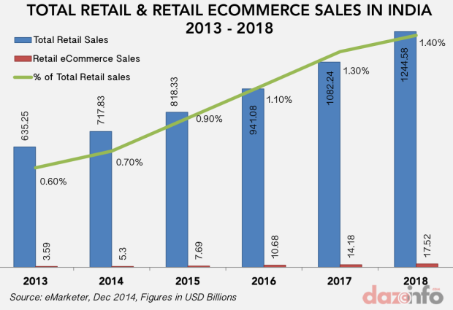
Problem Statement
In the current era, setting up IT infrastructure in micro, small and medium enterprises has become a serious issue due to inability to make right decisions. Generally, the challenges faced by such companies are delayed technical support, inefficient consulting, high maintenance and heavy budgeting.

Slide 4
Solution
To overcome this hurdle, MSME CLOUD has come up with an efficient way to handle the IT procurement. It uses house of art (B2B) ecommerce solution to handle the issues quickly by saving the client’s time with a click away service model. This model ensures there is no latency in providing technical support with a end­-end expert consulting for making efficient decisions which would eventually eliminate the budgeting, as they are offered support through online mode.

Slide 5
About The Project
Breaking it Down
B2B E-Commerce: Business-to-business (B2B) refers to a situation where one business makes a commercial transaction with another. We provide IT Products and Services to other retailers.
Provision of IT Products and Services: The website will not only offer IT products (Hardware), but services too. We would collaborate with service centers and technicians, and act as the mediator between the customer and the service provider.

Slide 6

About the Framework
Framework Used: Magento 2.0
Magento is an open-source e-commerce platform written in PHP.

Slide 7
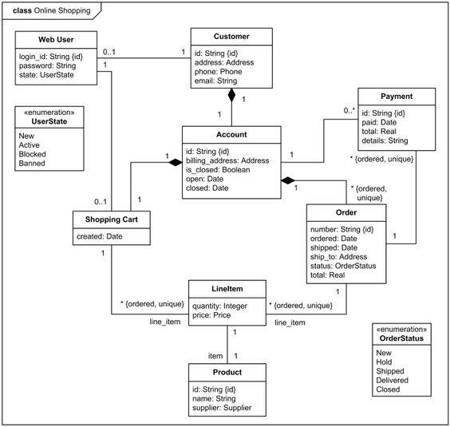
Design

Slide 8
Target User-Profile
As a B2B portal, this website mainly targets on vending IT products and services to :
Medium and Small Enterprises, because these firms generally cannot afford to have a technical department to themselves so there is more scope for business, which is beneficial to both the enterprise and the provider.

Slide 9
Analysis of Requirments
Design
Basic Functionalities
Advance Features and Testing
Work Flow
24 Aug-12sept
13 sept-20 sept
21 Sept – 6 Oct
7 Oct-15 Nov

Slide 10
Feature Requirements
User can view, browse, and search for items.
Items can be added to shopping cart and wish list.
User can register, sign in, check out and use the remember me feature.
Shopping cart can be viewed and updated.
The total can be calculated, including the taxes and shipment prices.
Payment can be made offline.
PDF generation of the products present in cart.
Changing the theme in Magento 2.0

Slide 11
Authorization (using CIN number), to check if a company exists or not. Distinguishing feature between B2B and B2C.
Fraud Detection: to prevent transactions with suspicious and fake users.
Void: Cancel order as per customer request, by the moderator, via email.
Status and Shipment

Slide 12
Time Line
Understanding The Project: Understanding the idea behind the project, and the vision behind a B2B e-commerce website that caters to small and medium scale IT companies.
Requirements: Talking to the client about the product they have in mind, and coming up with the project requirements accordingly
Working on the design of the project.
Installing and Understanding the framework, Magento 2.0

Slide 13
Basic features like view, browse, and search for products are added, add item to cart/wish-list are added
Billing feature is included, and offline payment can be done
Customization of Magento 2.0 by changing the theme/skin
User profile related features like Registration, sign in, check out and remember me features are added
PDF generation of the product present in the cart can be successfully done.
Release 1

Slide 14
Authorization: This feature is added to verify the existence of a company using CNI number. Distinguishing feature between B2B and B2
A customer can request cancelation of order, via email, and the moderator can delete the order.
The website can detect fraud, by analyzing past transactions
Release 2

Slide 15
How well have we conformed to
the project requirements ?

Slide 16
Questions

Slide 17
Thank You

