Slide 1

Stock Price Prediction
using LSTM
A Deep Learning Approach
Rama Krishna Reddy(123ad0043)

Slide 2
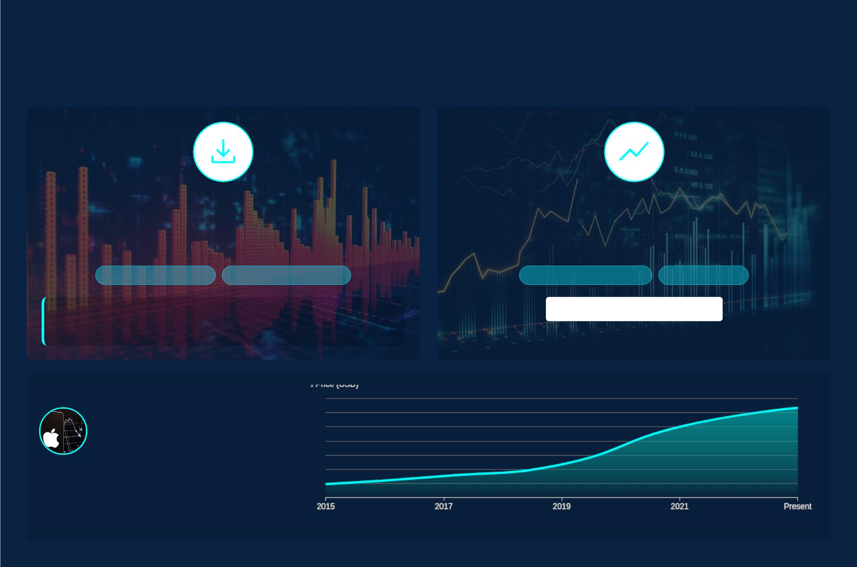
Data Acquisition
Foundation for Robust Stock Prediction Models
Efficient Data Sourcing with `yfinance`
Prioritizing 'Close' Prices
Leverage `yfinance` for seamless access to comprehensive
historical stock data.
Focus on daily closing prices to capture primary market sentiment
and minimize noise.
Seamless API Integration
Reliable Historical Datasets
Standard Time Series Metric
Reduced Volatility
import yfinance as yf
Crucial for LSTM Accuracy
data = yf.download('AAPL', start='2015-01-01')
Case Study: Apple Inc.
(AAPL)
Utilizing `AAPL` historical 'Close' price data from
January 2015 to the present to train our predictive
model.
Source: Stock_Price_Prediction.pdf

Slide 3
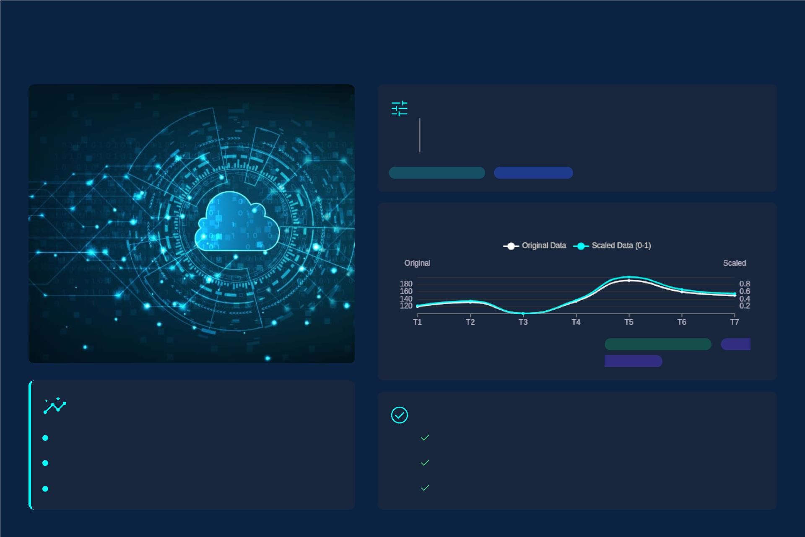
Preparing Data for LSTM
`MinMaxScaler`
Scales values to a deﬁned range, typically (0, 1),
maintaining the original distribution shape.
Data Preprocessing
Feature Scaling
Normalizing Price Ranges to (0, 1)
Transforms arbitrary price values into a
consistent range.
Range Transformation
LSTM
Input Ready
Why Scale Data?
Creating Scaled Datasets
Optimizes Model Performance
Normalizes Feature Contributions
Enhances Training Stability
Apply scaler to training data, ﬁt once.
Transform validation/test sets with the same scaler.
Inverse transform predictions for real-world values.
Source: Stock_Price_Prediction.pdf

Slide 4

Building Sequential
04
Training Data
Deﬁning the Prediction
Window
Sequence Generation for
Learning
• Prediction Days
• X_train & y_train
Determines future steps the model forecasts.
E.g., 60 days for a mid-term outlook.
Inputs (`X_train`): Historical data sequence.
Outputs (`y_train`): Future value(s) to predict.
A critical hyperparameter for performance.
Historical Window
(X_train)
Future Prediction
(y_train)
→
[ t-N, ..., t-1 ]
[ t, ..., t+P-1 ]
Overlapping windows capture temporal patterns.
Forecast Scope
Time Horizon
Feature Set
Target Value
The 3D Tensor: LSTM Input Requirements
LSTMs require a 3-dimensional input format to
eﬀectively process sequences and understand
temporal dependencies.
Samples
(batch size)
Timesteps
Features
Shaping data correctly is paramount for deep learning
models to understand time-series dependencies.
(sequence length)
(# of variables)
Data Prep
Tensor Flow
Deep Learning
Sources
LSTM Time Series Forecasting with TensorFlow & Python - YouTube
Predicting Stock Prices with Deep Learning - GitHub

Slide 5
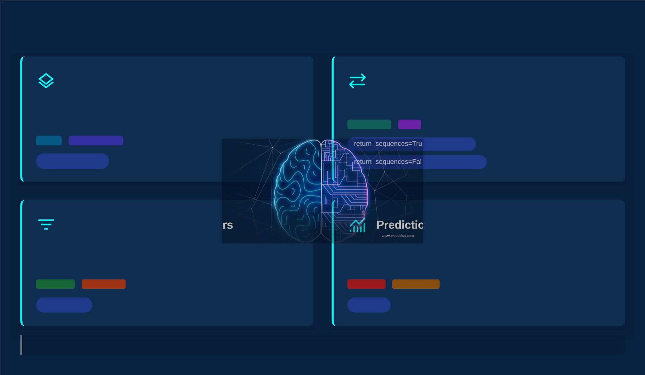
LSTM Model Architecture
Sequential Model Foundation
Recurrent Memory: LSTM Layers
Linear stack for intuitive model construction.
Processes sequences, capturing long-term dependencies.
Time Series
RNN
Keras
Model Stacking
e (for stacking)
tf.keras.Sequential
se (for final output)
Regularization: Dropout Laye
n: Dense Output
Prevents overfitting by randomly setting inputs to zero.
A single-unit `Dense` layer for final price prediction.
Overfitting
Robustness
Prediction
Dense(1)
Output Layer
Dropout(rate)
"This carefully layered architecture allows the LSTM model to effectively learn from complex sequential data, crucial for accurate time series forecasting."
Source: LSTM Time Series Forecasting with TensorFlow & Python - YouTube; How to Develop LSTM Models for Time Series Forecasting

Slide 6
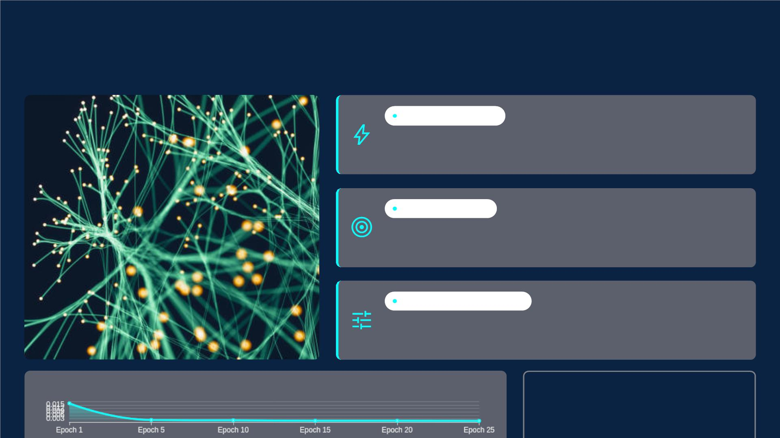
Model Compilation and Training
Deep Learning for Financial Forecasting
ADAM OPTIMIZER
Choosing `adam` optimizer for eﬃcient and adaptive learning
rate optimization during training.
LOSS FUNCTION
Setting `mean_squared_error` to quantify prediction accuracy by
measuring the average squared diﬀerence.
EPOCHS & BATCH SIZE
Deﬁning training iterations (`epochs`) and samples per update
(`batch_size`) to control the learning process.
Training Loss Progression Over Epochs
Continuous monitoring of training
loss is critical for model optimization
and detecting convergence.
Source: Stock_Price_Prediction.pdf

Slide 7
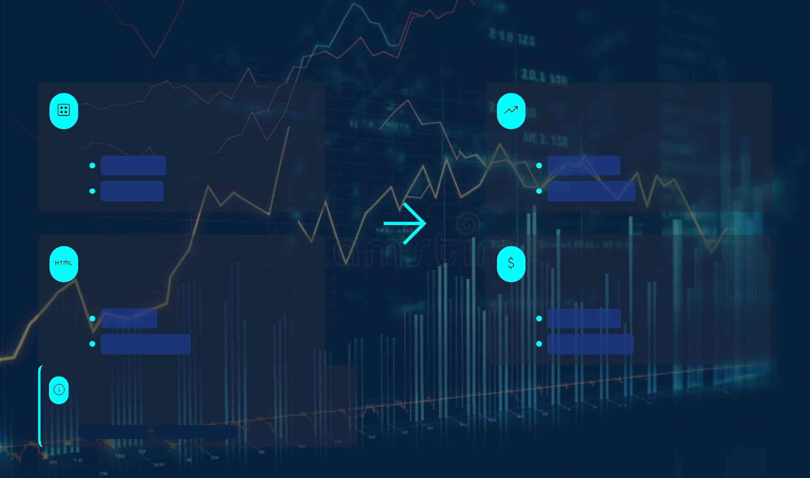
Generating Predictions
Test Data Construction
Model Forecasting
Create `X_test` using the pre-scaled historical
data, crucial for consistent model input.
Utilize `model.predict()` to generate future price
predictions based on learned historical patterns.
Scaled Data
Feature Set
Future Values
Prediction Output
Input Reshaping
De-scaling Predictions
Reshape `X_test` into the necessary 3D tensor
format for LSTM network compatibility.
Convert the scaled forecast values back to their
original price scale for practical interpretation.
3D Tensor
Original Scale
Sequence Format
Real-world Value
Understanding Prediction Limitations
LSTM models cannot guarantee accuracy due to market volatility and
external factors.
Market Volatility
External Influences
Source: Stock Market Predictions with LSTM in Python - DataCamp

Slide 8
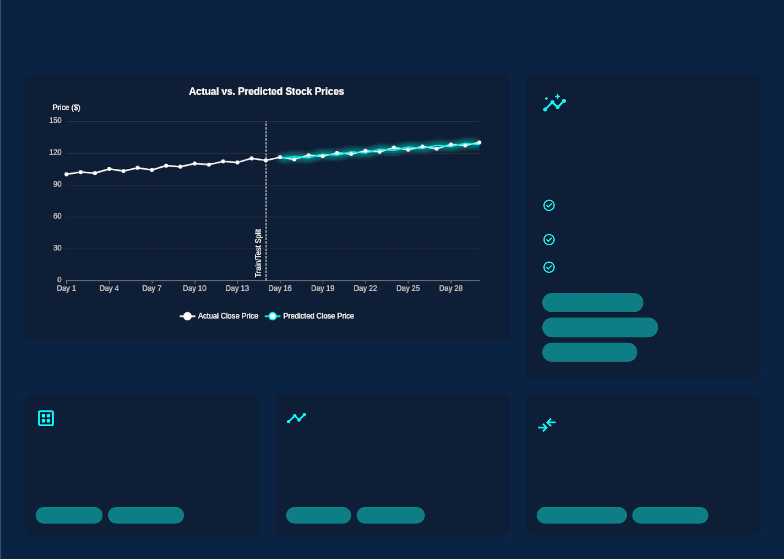
Model Performance Visualization
Visualizing performance
provides critical insights
into model accuracy and
reliability.
Close alignment means high
accuracy.
Gaps indicate prediction error.
Observe trends, not just points.
Model Accuracy
Prediction Fidelity
Trend Analysis
Data Segregation
Historical Context
Performance
Assessment
Splitting data into training for learning
and validation for unbiased
evaluation.
Plotting historical prices establishes
baseline patterns and market
behavior.
Overlaying actual vs. predicted values
helps quantify model ﬁt and identify
deviations.
Training Set
Validation Set
Past Trends
Market Data
Accuracy Metrics
Error Analysis

Slide 9
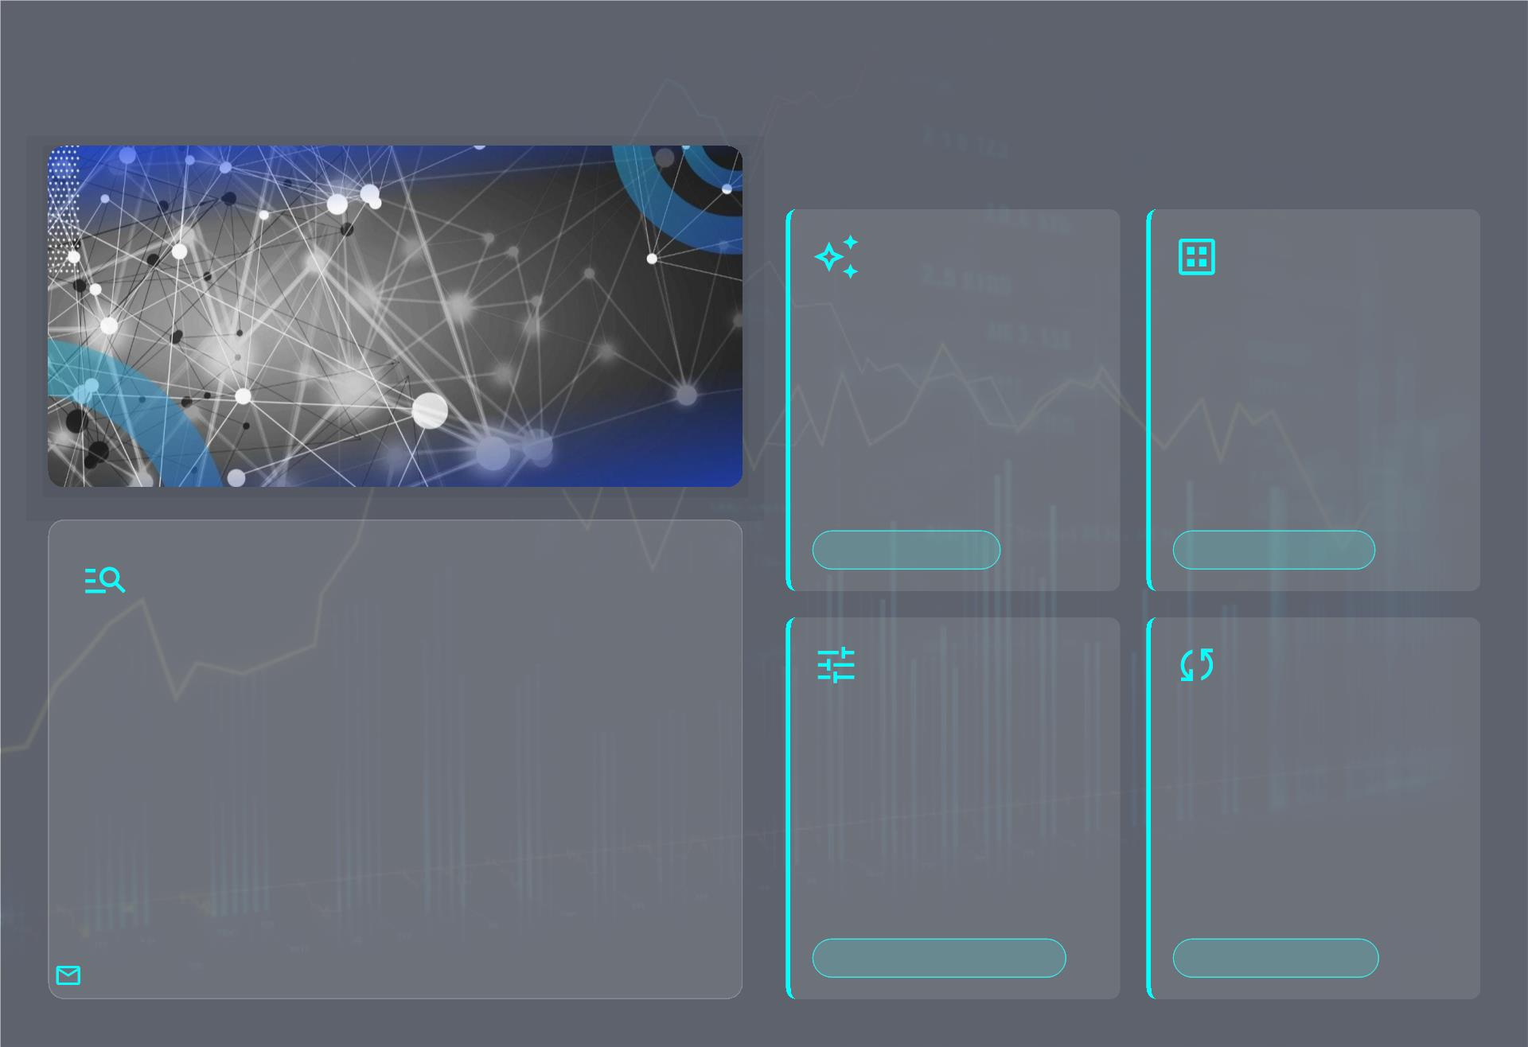
Summary and Future Enhancements
Next-Gen Prediction Capabilities
Explore advanced deep
learning architectures for
enhanced predictive
power.
Integrate volume,
indicators, and sentiment
for comprehensive market
insights.
Complex Models
Enriched Features
LSTM Prediction Journey
•
•
Leveraged LSTM networks for time-series
forecasting.
Modeled historical stock data, learning key
patterns.
Systematic tuning of
model parameters to
achieve peak prediction
accuracy.
Connect to real-time data
feeds for instantaneous,
dynamic forecasts.
•
•
Ensured data normalization for model accuracy.
Focused on predicting future stock price
movements.
"LSTM models cannot guarantee accurate predictions; the stock market is highly volatile and inﬂuenced by factors beyond historical data."
Optimized Performance
Live Data Streams

Slide 10
Thank You & Any Q/A
😊

