Slide 1
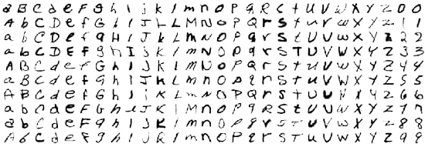
EMNIST DATA SET

Slide 2
Introduction
The Task for the AI
Our goal is to construct and train an artificial neural network on thousands of images of handwritten digits and letters so that it may successfully identify others when presented. The data that will be do the project on it is the EMNIST database which contains 112,800 images for training and 10,000 test.

Slide 3
CONTENTS
01. Get The Data
02. Plotting the images
03. Preprocessing the images
04.Bulid and train the model ?

Slide 4
01. Get The Data

Slide 5
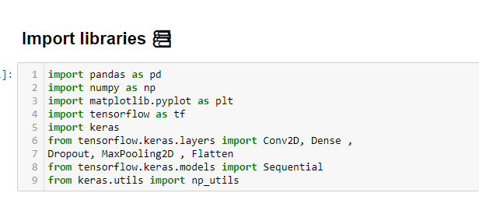
Importing the required libraries

Slide 6
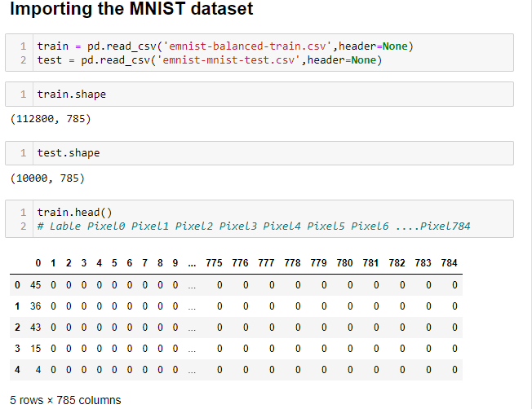
Read The Data

Slide 7
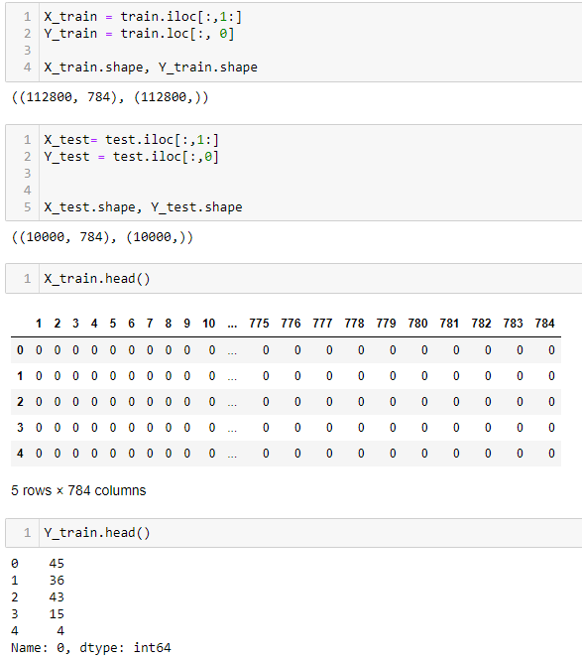
Separating the data
let’s separate the
Train and test data ( Labels (dependent variable [Y_train][Y_test]))
Train and test data( Pixels (independent variable [ X_train ][X_test])

Slide 8
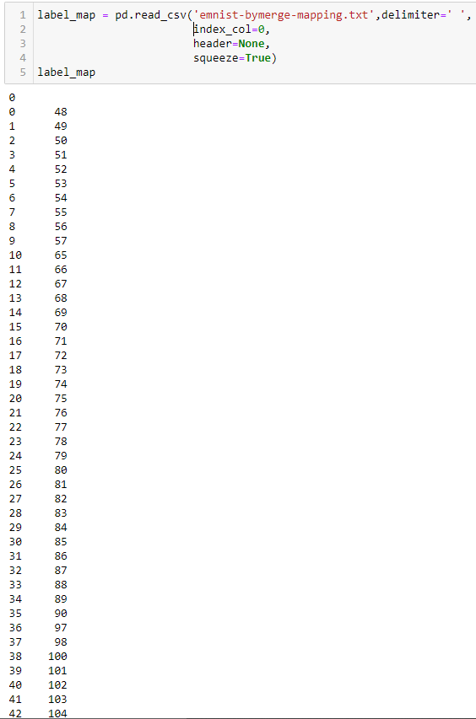
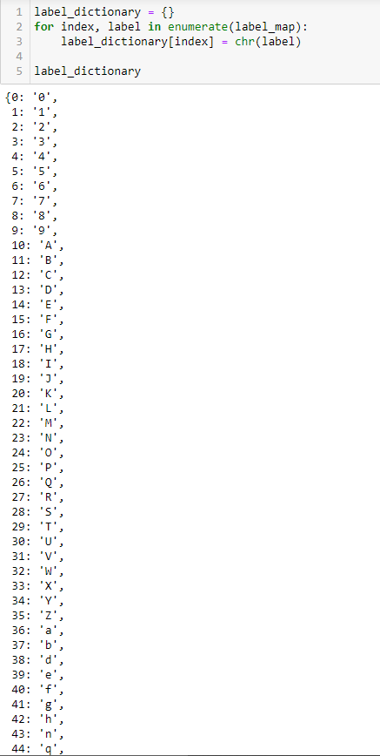
labels
Before
After

Slide 9
02. Plotting the images

Slide 10
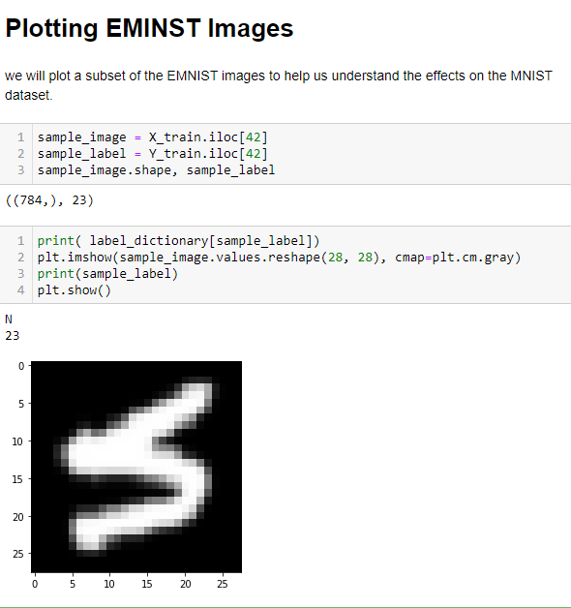
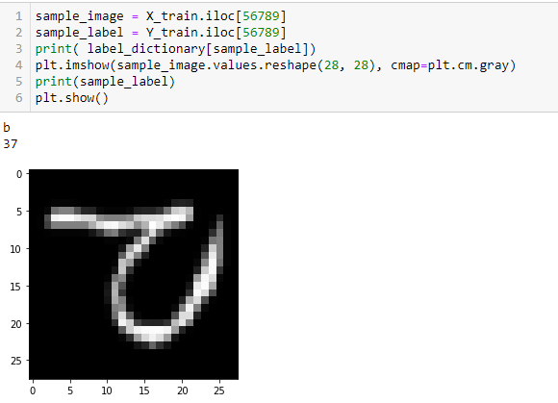
Plotting EMNIST images
we will plot a subset of the EMNIST images to help us understand the effects on the MNIST dataset.
We observesd that the EMNIST dataset was rotated and flipped
we need fix that.

Slide 11
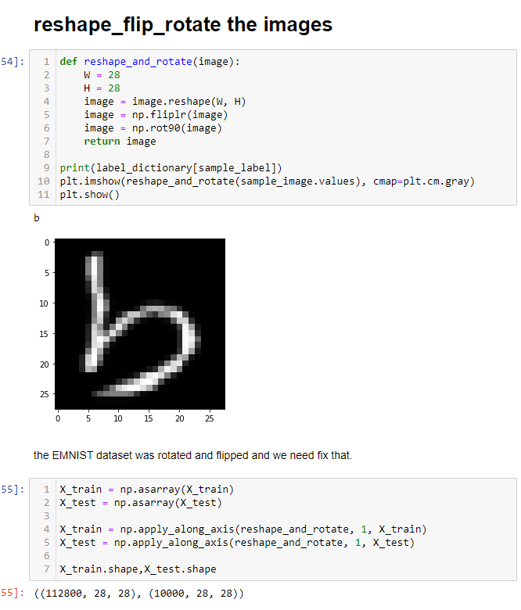
Rotate ,flip and reshape the images

Slide 12
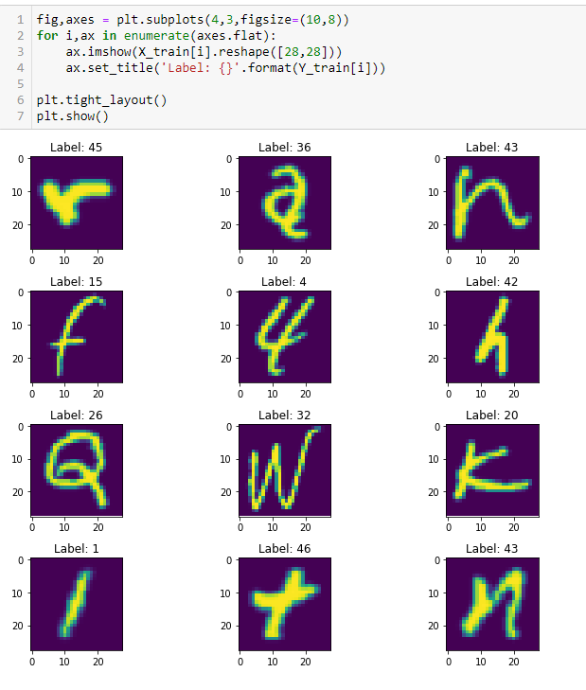
Plotting randomly images after edit it

Slide 13
03. Preprocessing the images

Slide 14
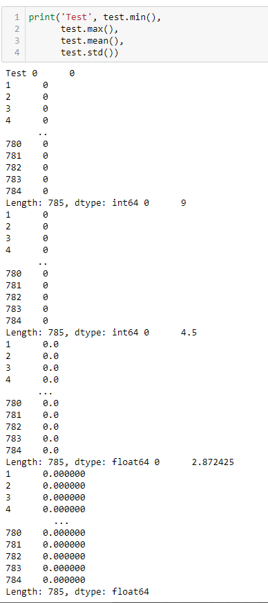
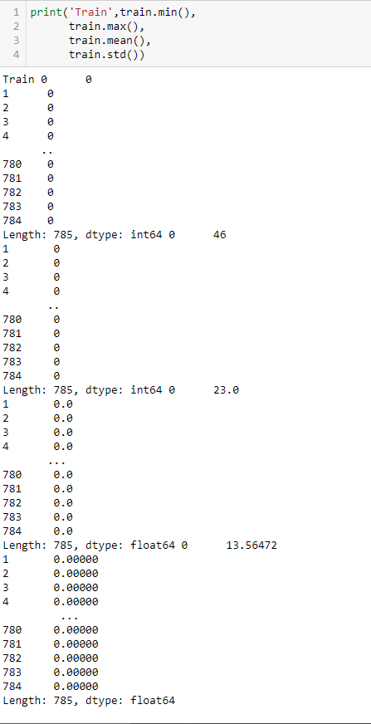
Normalization
Here we got the min,max,
Mean and std for the train
And test data to see the
Values and determine what
We have to do .

Slide 15

Normalization
We perform a grayscale normalization to reduce the effect of illumination’s differences.
Moreover the NN it will be faster on [0..1] data

Slide 16
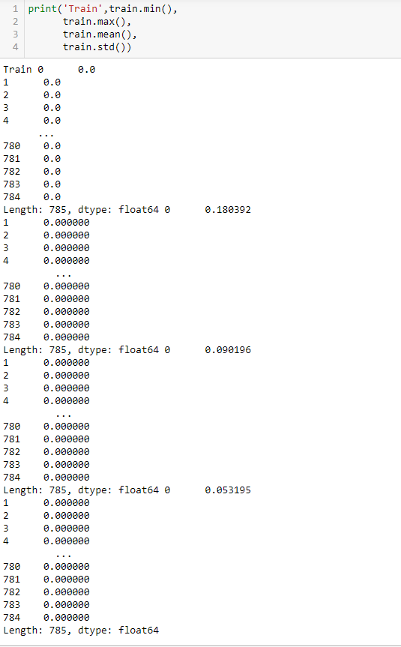
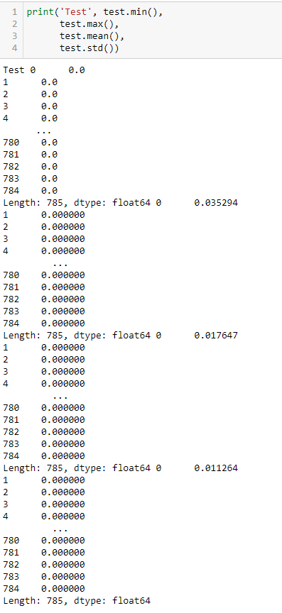
Result of norm

Slide 17
Reshape
Train and test images (28px x 28px) has been stock into pandas.Dataframe as 1D vectors of 784 values. We reshape all data to 28x28x1 3D matrices.
Keras requires an extra dimension in the end which correspond to channels. MNIST images are gray scaled so it use only one channel. For RGB images, there is 3 channels, we would have reshaped 784px vectors to 28x28x1 3D matrices.

Slide 18
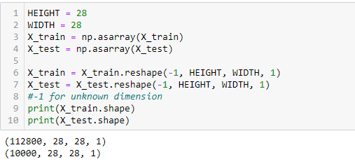
Reshape

Slide 19
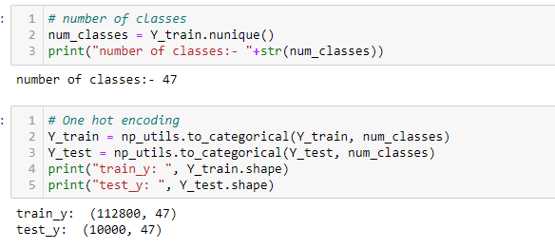
One hot encoding

Slide 20
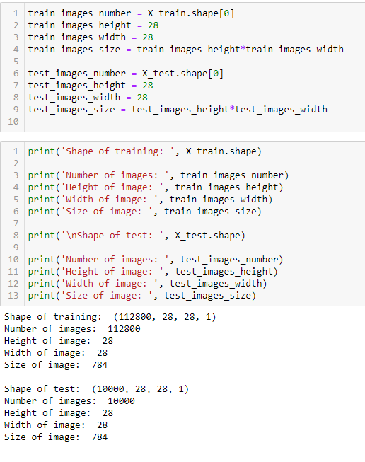
Info about data

Slide 21
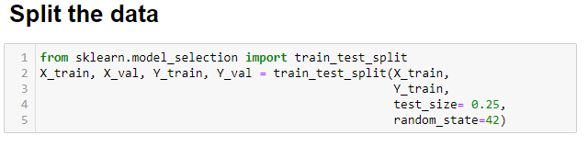
Splitting the data

Slide 22
04.Bulid and train the model ?

Slide 23
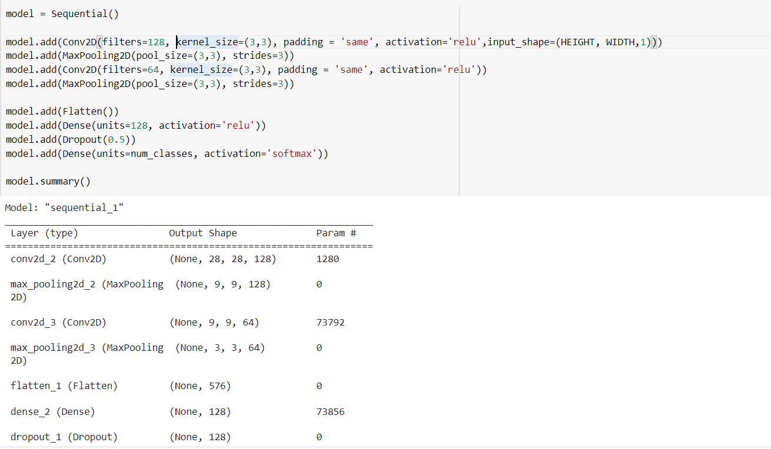
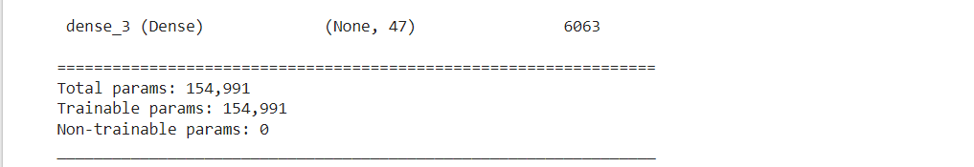
Build CNN model:

Slide 24
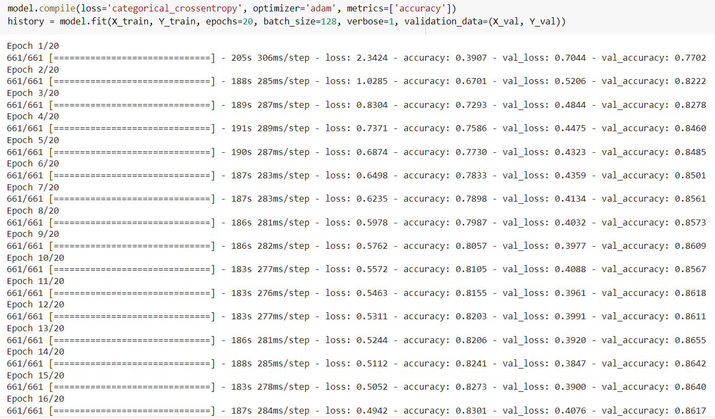
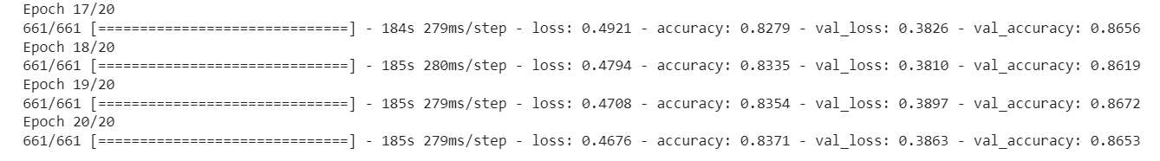
Train the model:

Slide 25
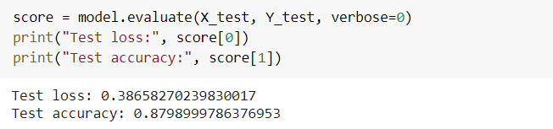
Evaluate the model:

Slide 26
MLPClassifier:

Slide 27
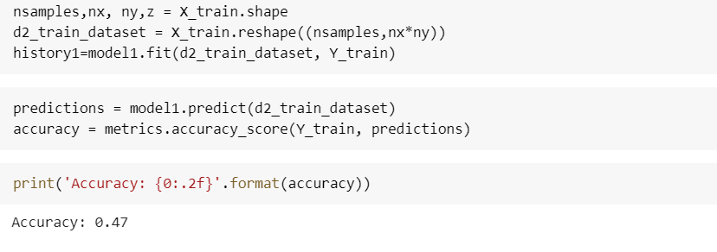
Train MLPClassifier:

Slide 28
Thank you !

