Slide 1

SRI HRSM COLLEGE GANGAVATHI
PROJECT PRESENTATION
AI SIEM
PLATFORM
SOC Dashboard
Critical
0
SOC Operations for Real-Time Threat Monitoring
A web-based security operations platform for monitoring logs, detecting alerts, managing incidents, and supporting AI-assisted investigation.
Open Alerts
15
Blocked
1
Frontend: React, Vite, Tailwind CSS
Backend: Node.js, Express
Database: PostgreSQL, Redis
GUIDE:
PRESENTED BY :
MISS POOJA G M
LECTURER
Fayaz
U32ZC23S0011
SRI H.R. SRIRAMULU MEMORIAL COLLEGE, SARASWATHIGIRI, GANGAVATHI

Slide 2
ABSTRACT
02 / 35
ABSTRACT
Project summary and expected outcome.
KEY POINTS
AI SIEM Platform centralizes log monitoring, alert detection, incident handling, and AI-based investigation support.
Central SOC view
It gives SOC users one portal to observe live security status, review alerts, inspect logs, and track response actions.
Threat visibility
The system is built as a full-stack web application using React, Node.js, PostgreSQL, Redis, and Docker.
Its final outcome is a practical SOC lab platform for real-time threat monitoring and demonstration.
Response support
SRI H.R. SRIRAMULU MEMORIAL COLLEGE, SARASWATHIGIRI, GANGAVATHI

Slide 3
INTRODUCTION
03 / 35
INTRODUCTION
Why SOC operations need a connected monitoring workflow.
KEY POINTS
Security teams need continuous visibility into logs, alerts, incidents, and asset health.
SOC users
Manual checking of logs is slow and can miss repeated authentication failures or credential dumping indicators.
Security admin
A SIEM collects events, correlates activity, and helps analysts prioritize suspicious behavior.
This project demonstrates those SOC concepts through a working academic web platform.
Incident analyst
SRI H.R. SRIRAMULU MEMORIAL COLLEGE, SARASWATHIGIRI, GANGAVATHI

Slide 4
PROBLEM STATEMENT
04 / 35
PROBLEM STATEMENT
Operational gaps found in manual security monitoring.
KEY POINTS
Logs may be stored separately from alerts, making investigation time-consuming.
Scattered logs
Repeated failed logon events or credential dumping indicators can be missed without correlation rules.
Slow triage
Manual incident tracking makes it difficult to prove what was acknowledged, resolved, or blocked.
Students need a clear platform to demonstrate SIEM concepts with live screens and database-backed records.
Weak evidence
SRI H.R. SRIRAMULU MEMORIAL COLLEGE, SARASWATHIGIRI, GANGAVATHI

Slide 5
OBJECTIVES
05 / 35
OBJECTIVES OF THE PROJECT
Key goals that shape the SOC platform scope.
KEY POINTS
Provide secure login/logout and role-based access for SOC users.
Monitor
Display dashboard metrics for critical threats, open alerts, events per second, and blocked threats.
Detect
Support log filtering, alert acknowledgement, alert resolution, and incident creation.
Provide AI-assisted runbook actions such as triage, anomaly review, forensics, threat hunt, and IOC extraction.
Respond
Run the full lab stack consistently using Docker services.
SRI H.R. SRIRAMULU MEMORIAL COLLEGE, SARASWATHIGIRI, GANGAVATHI

Slide 6
PROJECT SCOPE
06 / 35
SCOPE OF THE PROJECT
Coverage boundaries for monitoring, triage, and demonstration.
KEY POINTS
Covers dashboard, logs, alerts, incidents, AI analysis, rules, settings, and database visibility.
Dashboard
Supports real-world collector style event input and SOC-style alert review.
Triage
Designed for academic lab demonstration rather than production enterprise deployment.
Can be extended with Wazuh, Elastic, syslog collectors, role policies, and report export.
AI runbook
SRI H.R. SRIRAMULU MEMORIAL COLLEGE, SARASWATHIGIRI, GANGAVATHI

Slide 7
PROPOSED SOLUTION
07 / 35
PROPOSED SOLUTION
Integrated SOC portal for real-time threat monitoring.
KEY POINTS
Frontend dashboard presents live security status and analyst workflows.
Unified portal
Backend APIs handle authentication, logs, alerts, incidents, rules, settings, and analysis requests.
REST APIs
PostgreSQL stores users, logs, alerts, incidents, rules, audit records, and analysis history.
Docker Compose runs the complete application stack for repeatable demonstration.
Database records
SRI H.R. SRIRAMULU MEMORIAL COLLEGE, SARASWATHIGIRI, GANGAVATHI

Slide 8
DOMAIN SURVEY
08 / 35
DOMAIN SURVEY
Current security operations practices behind SIEM platform design.
KEY POINTS
SIEM tools such as Wazuh, Splunk, Elastic Security, and QRadar centralize logs and raise alerts.
SIEM tools
SOC teams follow triage workflows: detect, acknowledge, investigate, contain, resolve, and document.
SOC lifecycle
Common attack signals include failed logon bursts, credential dumping, suspicious tools, and unusual source activity.
Dashboards, severity labels, and runbooks help analysts prioritize work quickly.
Runbooks
SRI H.R. SRIRAMULU MEMORIAL COLLEGE, SARASWATHIGIRI, GANGAVATHI

Slide 9
EXISTING SYSTEM
09 / 35
EXISTING SYSTEM
Typical limitations in manual or disconnected monitoring.
KEY POINTS
Logs are often reviewed only after an incident is suspected.
Manual review
Alerts, raw events, and incident notes may be stored in separate tools.
Separate tools
Database evidence may require command-line access, which is difficult during a lab demo.
No single screen explains threat status, affected assets, and response actions together.
Low visibility
SRI H.R. SRIRAMULU MEMORIAL COLLEGE, SARASWATHIGIRI, GANGAVATHI

Slide 10
PROPOSED SYSTEM
10 / 35
PROPOSED SYSTEM
Improved workflow centered on visibility and response speed.
KEY POINTS
Dashboard summarizes operational SOC status in one view.
Faster triage
Logs page supports filtering by severity, source, and time range.
Clear evidence
Alerts page provides acknowledgement and resolution actions.
Incidents page records response cases, and AI Analysis supports guided investigation workflows.
Guided action
SRI H.R. SRIRAMULU MEMORIAL COLLEGE, SARASWATHIGIRI, GANGAVATHI

Slide 11
PROJECT MODULES
11 / 35
MODULES OF THE PROJECT
Major functional areas that support SOC operations.
KEY POINTS
Authentication and secure access management.
Auth
Dashboard metrics and asset health monitoring.
Logs
Log ingestion, search, filtering, and raw event review.
Alert triage, acknowledgement, resolution, and blocked-threat clearing.
Alerts
Incident management, rules management, AI analysis, settings, and database administration.
SRI H.R. SRIRAMULU MEMORIAL COLLEGE, SARASWATHIGIRI, GANGAVATHI

Slide 12
REQUIREMENT SPECIFICATION
12 / 35
HARDWARE REQUIREMENT
Balanced hardware support for student systems and lab execution.
KEY POINTS
Laptop or desktop with modern 64-bit processor.
8 GB RAM
Minimum 8 GB RAM recommended for containers and browser testing.
64-bit CPU
At least 10 GB free disk space for Docker images, database volumes, and logs.
Stable local browser environment for frontend, backend, and database GUI access.
10 GB disk
SRI H.R. SRIRAMULU MEMORIAL COLLEGE, SARASWATHIGIRI, GANGAVATHI

Slide 13
SOFTWARE REQUIREMENT
13 / 35
SOFTWARE REQUIREMENT
Core software stack for SOC portal execution.
KEY POINTS
Docker Desktop and Docker Compose for running the multi-container stack.
Docker
React with Vite and Tailwind CSS for the frontend user interface.
React
Node.js and Express for backend REST API services.
PostgreSQL for persistent records and Redis for fast supporting state/cache operations.
Postgres
SRI H.R. SRIRAMULU MEMORIAL COLLEGE, SARASWATHIGIRI, GANGAVATHI

Slide 14
TECHNOLOGY
14 / 35
INTRODUCTION TO REACT
Frontend framework for the SOC user interface.
KEY POINTS
React builds reusable pages for dashboard, logs, alerts, incidents, AI analysis, rules, and settings.
Components
Component-based structure keeps navigation and SOC panels consistent.
Pages
State management supports authentication, profile details, and current UI data.
The browser interface makes the lab easier to demonstrate to examiners.
State
SRI H.R. SRIRAMULU MEMORIAL COLLEGE, SARASWATHIGIRI, GANGAVATHI

Slide 15
TECHNOLOGY
15 / 35
INTRODUCTION TO NODE.JS
Backend runtime for APIs and SOC workflow logic.
KEY POINTS
Node.js with Express exposes REST endpoints for login, logs, alerts, incidents, rules, and settings.
Express
Controllers separate request handling from services and database models.
REST API
Middleware supports authentication, rate limits, and security checks.
The API layer connects the frontend experience to PostgreSQL records.
Middleware
SRI H.R. SRIRAMULU MEMORIAL COLLEGE, SARASWATHIGIRI, GANGAVATHI

Slide 16
TECHNOLOGY
16 / 35
INTRODUCTION TO TAILWIND CSS
Visual styling for a dark SOC operations interface.
KEY POINTS
Tailwind CSS provides utility classes for layout, spacing, typography, and responsive behavior.
Dark UI
Dark panels, severity colors, and compact controls match the security dashboard use case.
Responsive
Consistent UI patterns make logs, alerts, and incident screens easy to scan.
The interface is suitable for repeated live demonstration.
Severity colors
SRI H.R. SRIRAMULU MEMORIAL COLLEGE, SARASWATHIGIRI, GANGAVATHI

Slide 17
TECHNOLOGY
17 / 35
INTRODUCTION TO POSTGRESQL AND REDIS
Data storage and fast state support.
KEY POINTS
PostgreSQL stores users, logs, alerts, incidents, rules, AI analyses, audit logs, and source records.
SQL records
Relational tables make it easy to verify evidence during project evaluation.
Evidence
Redis supports fast temporary state and future real-time workflow expansion.
Adminer or database tools can be used to inspect records directly.
Cache
SRI H.R. SRIRAMULU MEMORIAL COLLEGE, SARASWATHIGIRI, GANGAVATHI

Slide 18
SYSTEM ARCHITECTURE
18 / 35
ARCHITECTURAL DIAGRAM
Layered flow from event collection to dashboard and analyst response.
React UI
SOC FLOW
Collect
Event Sources
Collector
Backend API
PostgreSQL
Normalize
Redis
Store
Display
SRI H.R. SRIRAMULU MEMORIAL COLLEGE, SARASWATHIGIRI, GANGAVATHI

Slide 19
ARCHITECTURE EXPLANATION
19 / 35
ARCHITECTURE EXPLANATION
How the platform layers collaborate during monitoring and response.
KEY POINTS
Event sources generate security activity such as failed logons and suspicious endpoint behavior.
Source
The collector normalizes events and passes them to backend services.
API
Rules evaluate logs and create alerts when suspicious patterns are detected.
The frontend displays dashboards, log streams, alerts, incidents, and AI runbooks for SOC users.
Frontend
SRI H.R. SRIRAMULU MEMORIAL COLLEGE, SARASWATHIGIRI, GANGAVATHI

Slide 20
PROCESS FLOW
20 / 35
PROCESS FLOW DIAGRAM
SOC operation journey from event capture to response closure.
SOC FLOW
Detect
Login
Monitor
Review Logs
Triage Alert
Create Incident
Resolve
Investigate
Contain
Resolve
SRI H.R. SRIRAMULU MEMORIAL COLLEGE, SARASWATHIGIRI, GANGAVATHI

Slide 21
PROCESS EXPLANATION
21 / 35
PROCESS FLOW EXPLANATION
Sequential logic followed during a standard SOC session.
KEY POINTS
The SOC admin logs in and checks dashboard status.
Login
The analyst reviews event volume, source activity, asset health, and severity distribution.
Triage
Suspicious logs are filtered and selected for deeper investigation.
Open alerts are acknowledged, resolved, or escalated into incidents with supporting evidence.
Document
SRI H.R. SRIRAMULU MEMORIAL COLLEGE, SARASWATHIGIRI, GANGAVATHI

Slide 22
USE CASE DIAGRAM
22 / 35
USE CASE DIAGRAM
Main user and admin interactions supported by the platform.
View Dashboard
Filter Logs
SOC FLOW
Admin
Manage Alerts
Create Incident
SOC Admin
Monitor
Run AI Analysis
Manage Rules
Analyze
Respond
SRI H.R. SRIRAMULU MEMORIAL COLLEGE, SARASWATHIGIRI, GANGAVATHI

Slide 23
USE CASE EXPLANATION
23 / 35
USE CASE EXPLANATION
Responsibilities divided across SOC monitoring and response actions.
KEY POINTS
The SOC admin is the primary actor for the academic demonstration.
Access
The user can log in, view security status, filter logs, and inspect raw event details.
Actions
Alerts can be acknowledged when investigation begins and resolved when action is complete.
Incidents and AI analysis provide structured support for documenting investigation steps.
Evidence
SRI H.R. SRIRAMULU MEMORIAL COLLEGE, SARASWATHIGIRI, GANGAVATHI

Slide 24
DATABASE DESIGN
24 / 35
CORE DATABASE DESIGN
Primary entities used to store SOC records and platform activity.
users
logs
alerts
incidents
SOC FLOW
Users
rules
ai_analyses
audit_log
log_sources
Events
Alerts
Incidents
SRI H.R. SRIRAMULU MEMORIAL COLLEGE, SARASWATHIGIRI, GANGAVATHI

Slide 25
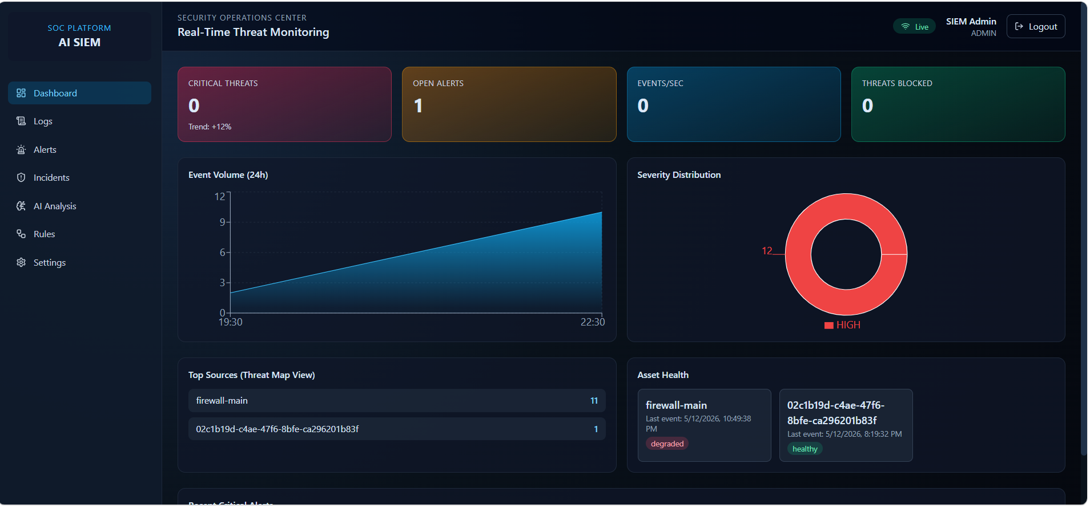
SCREENSHOTS
25 / 35
Dashboard Overview
Live SOC dashboard showing critical threats, open alerts, event volume, severity distribution, sources, and asset health.
Screenshot evidence from the running AI SIEM SOC platform
SRI H.R. SRIRAMULU MEMORIAL COLLEGE, SARASWATHIGIRI, GANGAVATHI

Slide 26
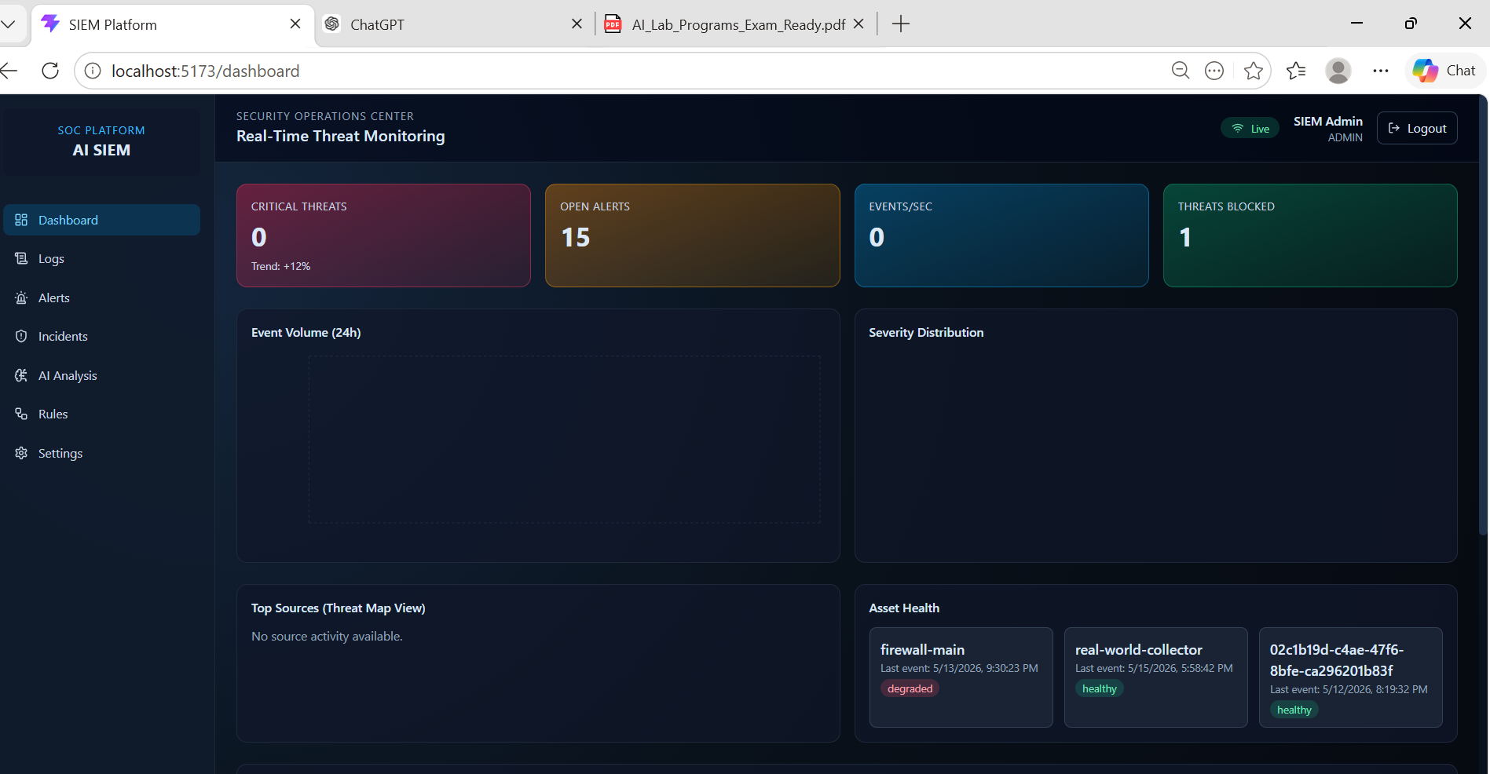
SCREENSHOTS
26 / 35
Real-Time Monitoring Dashboard
Browser view of the dashboard with open alerts, blocked threats, and monitored assets.
Screenshot evidence from the running AI SIEM SOC platform
SRI H.R. SRIRAMULU MEMORIAL COLLEGE, SARASWATHIGIRI, GANGAVATHI

Slide 27
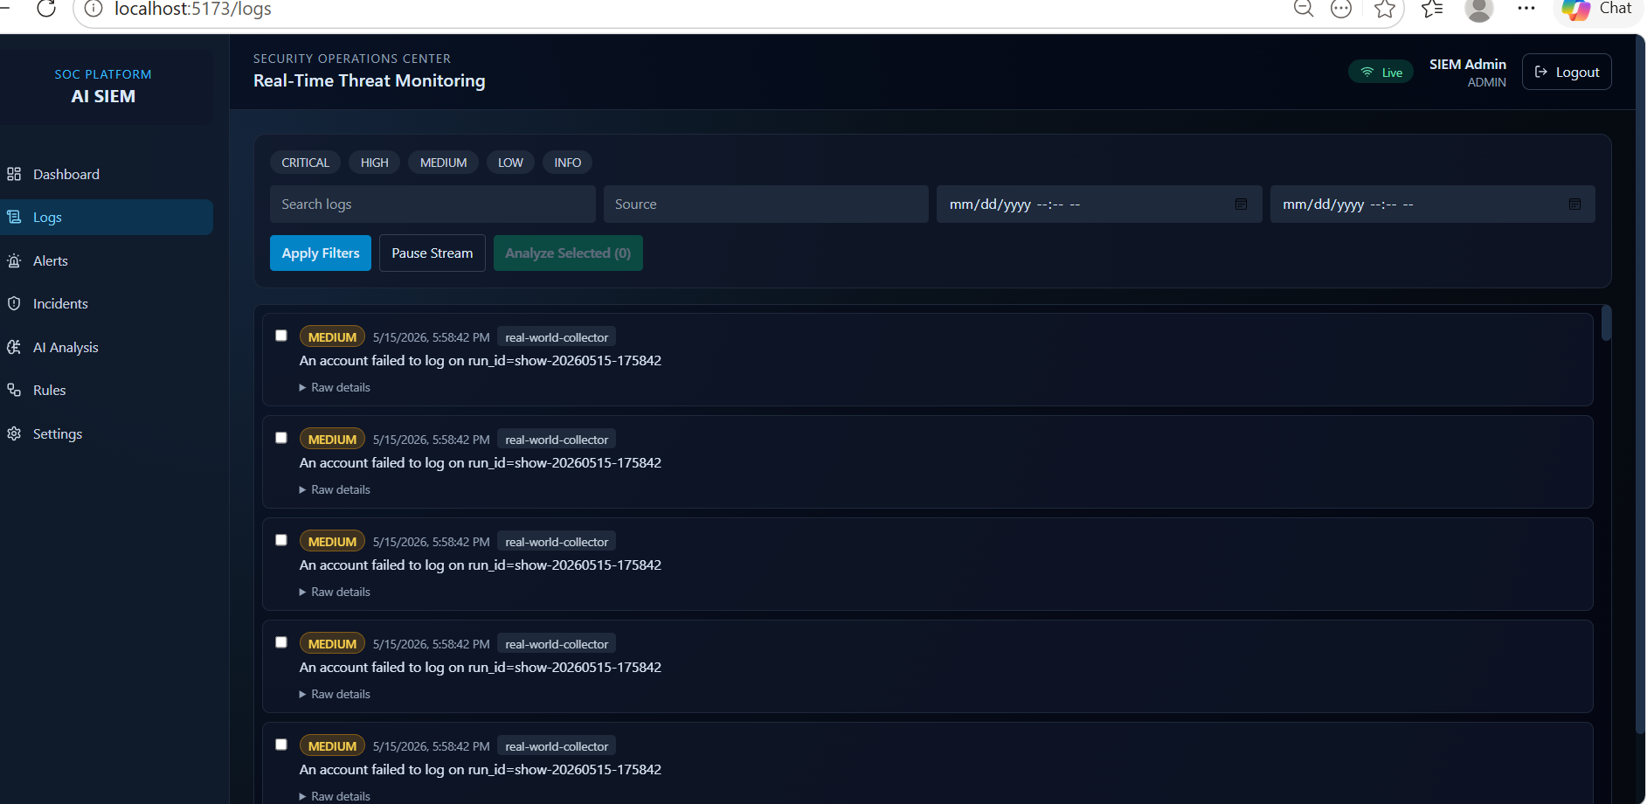
SCREENSHOTS
28 / 35
Live Logs Stream
Collected events appear in a searchable SOC log stream with severity badges and raw-detail expansion.
Screenshot evidence from the running AI SIEM SOC platform
SRI H.R. SRIRAMULU MEMORIAL COLLEGE, SARASWATHIGIRI, GANGAVATHI

Slide 28
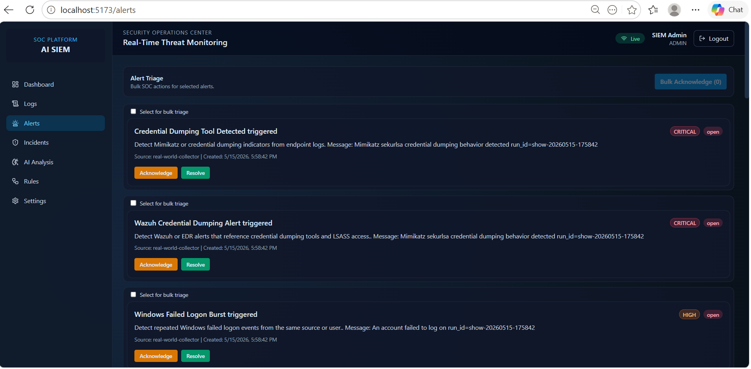
SCREENSHOTS
29 / 35
Alert Triage
Credential dumping and failed-logon alerts can be acknowledged or resolved from the triage queue.
Screenshot evidence from the running AI SIEM SOC platform
SRI H.R. SRIRAMULU MEMORIAL COLLEGE, SARASWATHIGIRI, GANGAVATHI

Slide 29
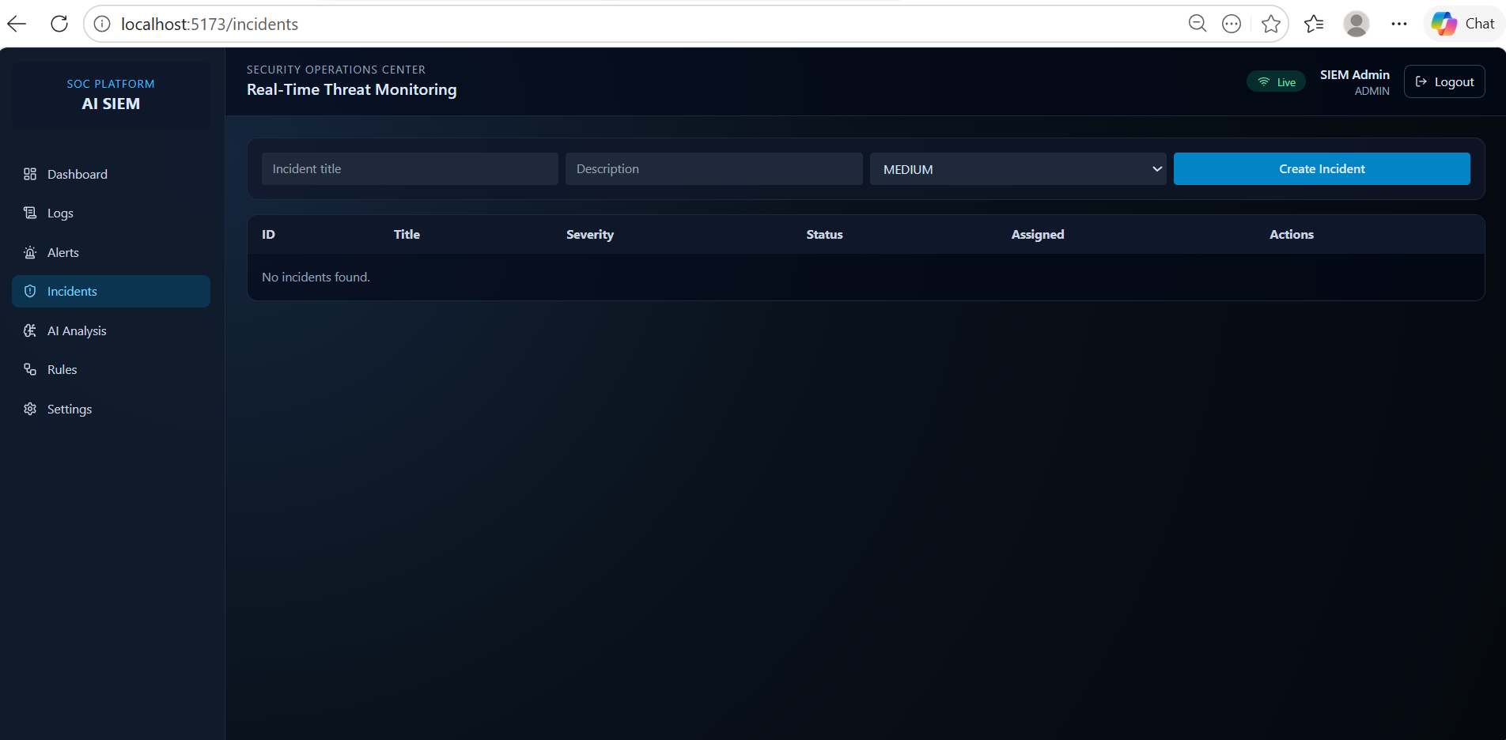
SCREENSHOTS
30 / 35
Incident Management
Incident creation form converts investigation context into a managed response record.
Screenshot evidence from the running AI SIEM SOC platform
SRI H.R. SRIRAMULU MEMORIAL COLLEGE, SARASWATHIGIRI, GANGAVATHI

Slide 30
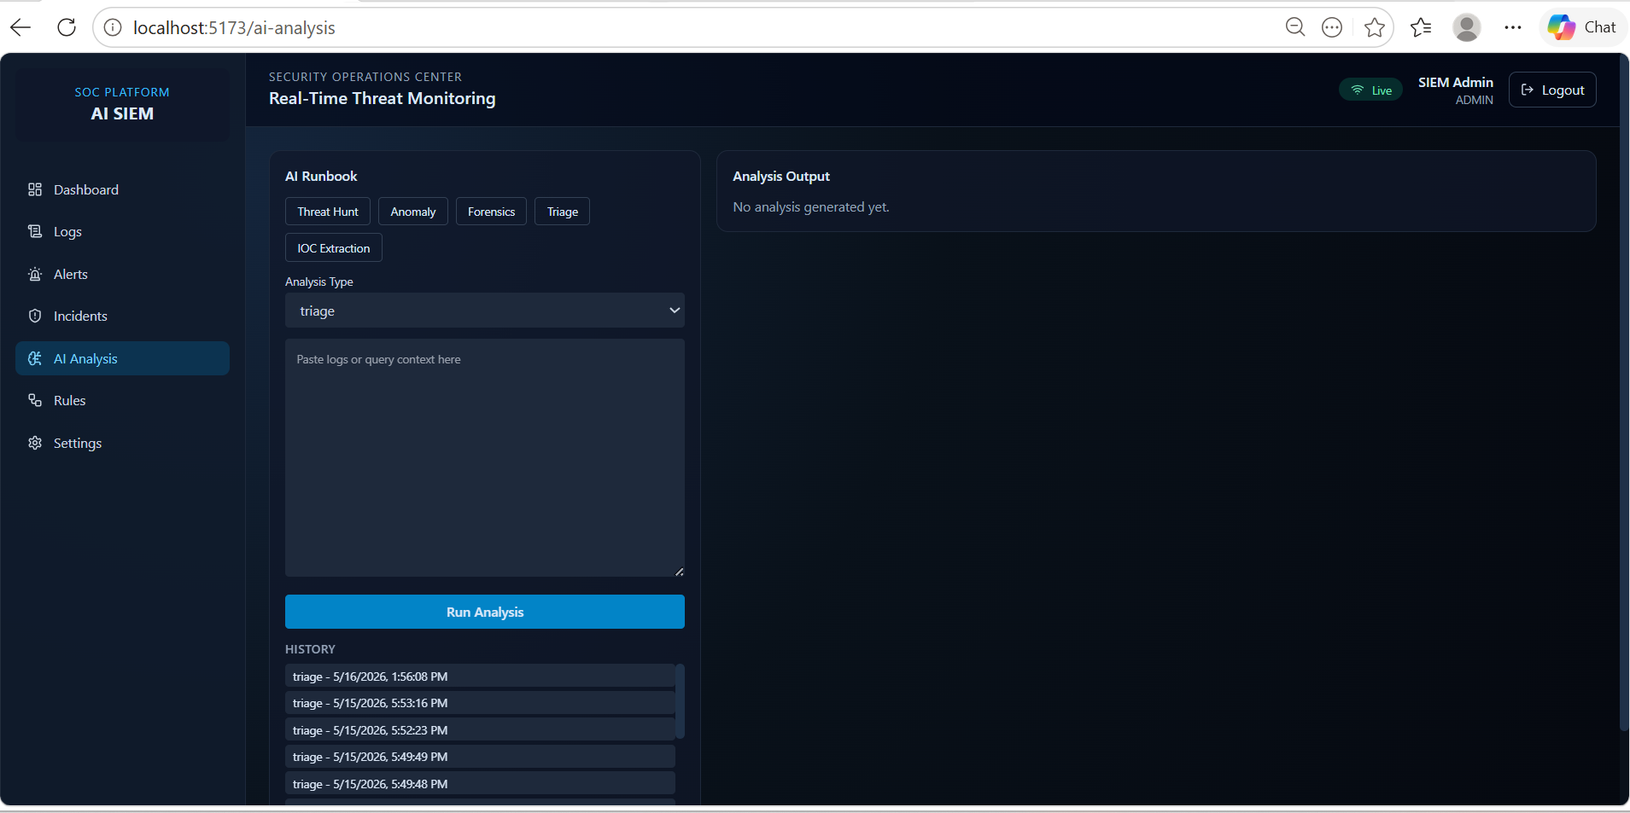
SCREENSHOTS
31 / 35
AI Analysis Runbook
AI runbook area supports threat hunt, anomaly, forensics, triage, and IOC extraction workflows.
Screenshot evidence from the running AI SIEM SOC platform
SRI H.R. SRIRAMULU MEMORIAL COLLEGE, SARASWATHIGIRI, GANGAVATHI

Slide 31
FUTURE ENHANCEMENTS
32 / 35
FUTURE ENHANCEMENTS
Possible extensions that can improve the SOC platform.
KEY POINTS
Integrate real Wazuh or Elastic Security event ingestion.
Wazuh
Add syslog and endpoint collectors for live multi-machine monitoring.
Reports
Improve AI analysis with provider configuration, usage controls, and saved playbooks.
Add report export, role-based permissions, richer incident timelines, and notification workflows.
Roles
SRI H.R. SRIRAMULU MEMORIAL COLLEGE, SARASWATHIGIRI, GANGAVATHI

Slide 32
CONCLUSION
33 / 35
CONCLUSION
The proposed solution improves real-time SOC monitoring and response.
KEY POINTS
AI SIEM Platform demonstrates a working SOC-style monitoring workflow.
Working demo
The system combines dashboard metrics, log review, alert triage, incident tracking, and AI-assisted analysis.
Evidence
Docker-based deployment makes the project repeatable for lab demonstration.
The final platform gives clear evidence of security monitoring, investigation, and response operations.
SOC ready
SRI H.R. SRIRAMULU MEMORIAL COLLEGE, SARASWATHIGIRI, GANGAVATHI

Slide 33
BIBLIOGRAPHY
34 / 35
BIBLIOGRAPHY
Reference materials used for the technology stack and system planning.
KEY POINTS
React and Vite documentation.
Docs
Node.js and Express documentation.
SIEM
PostgreSQL, Redis, Docker, and Docker Compose documentation.
Wazuh, SIEM concepts, SOC triage workflow references, and project source code.
Source code
SRI H.R. SRIRAMULU MEMORIAL COLLEGE, SARASWATHIGIRI, GANGAVATHI

Slide 34
THANK YOU
Questions and Demonstration
AI SIEM Platform - SOC Operations
SRI H.R. SRIRAMULU MEMORIAL COLLEGE, SARASWATHIGIRI, GANGAVATHI

