Slide 1


Slide 2

Introduction
Email is a major communication channel.
Phishing and malware attacks are increasing.
Shield Gate provides intelligent email protection.

Slide 3

Problem Statement
Phishing Emails
Malicious Attachments
Social Engineering
Credential Theft
Traditional Firewalls Limitations

Slide 4

Project Objectives
Protect incoming emails before delivery.
Detect phishing using AI and NLP.
Analyze headers, body, and attachments.
Sandbox suspicious files safely.
Ensure email availability through spooling.
Integrate open-source mail technologies.

Slide 5
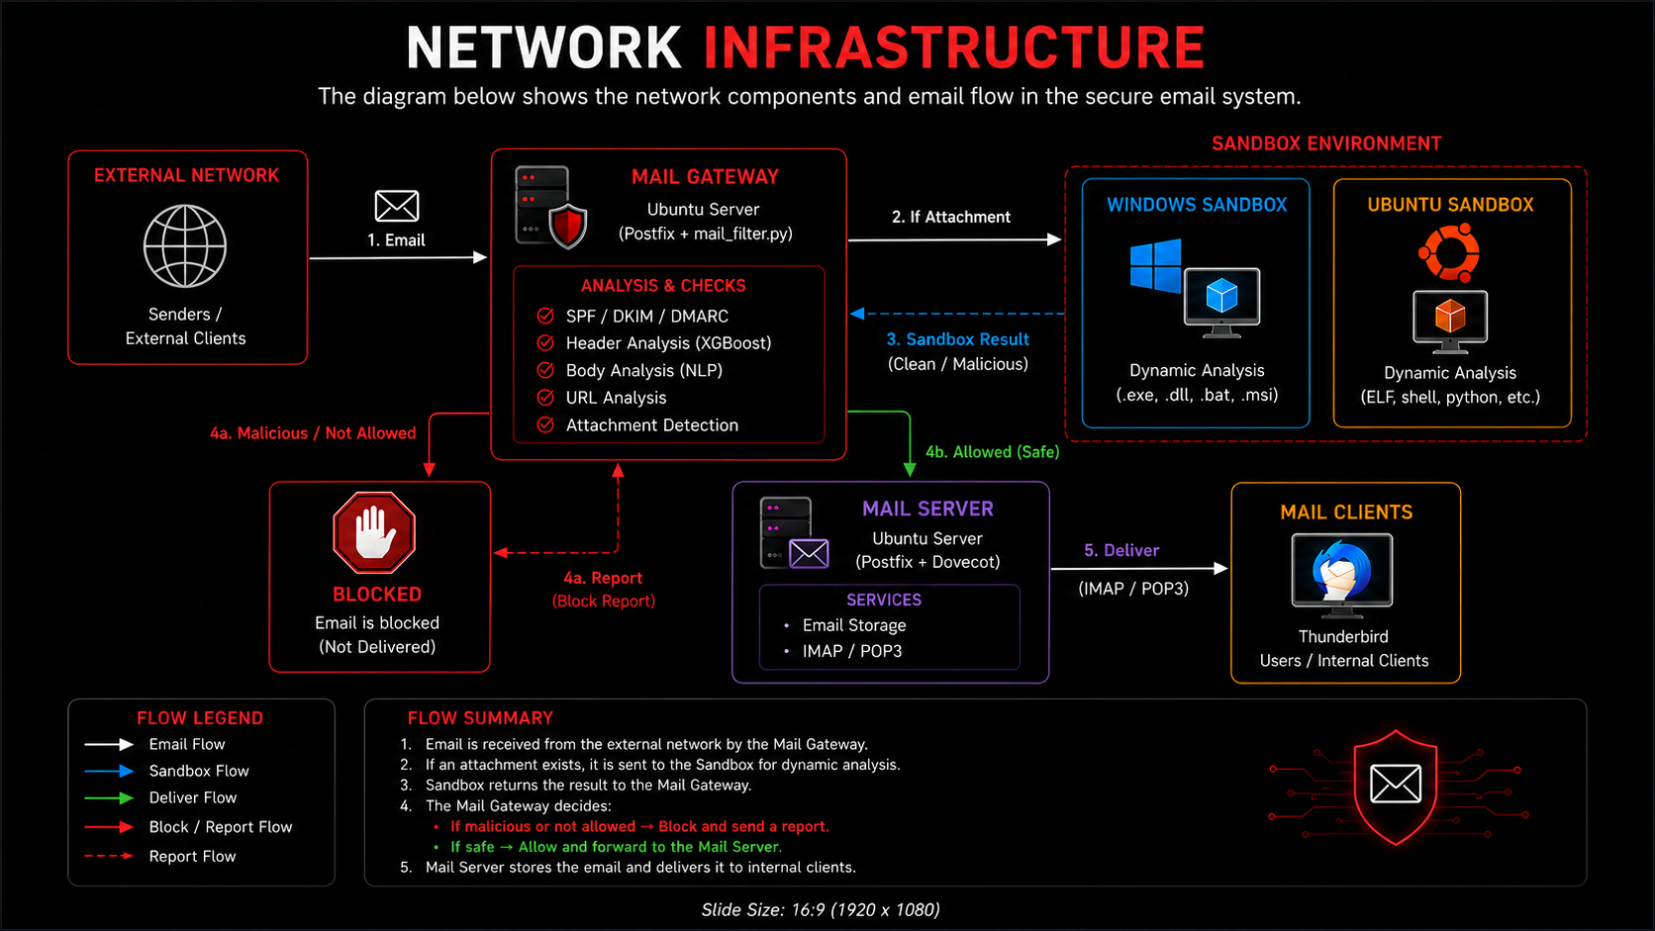

Slide 6
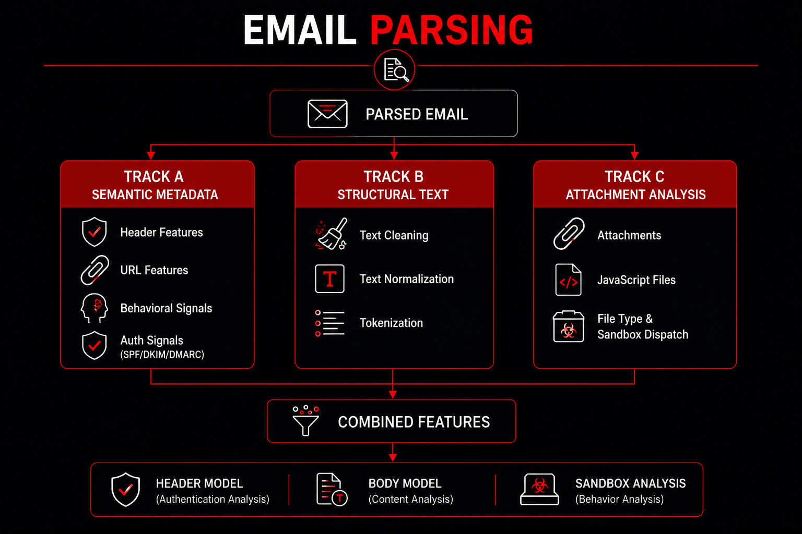

Slide 7
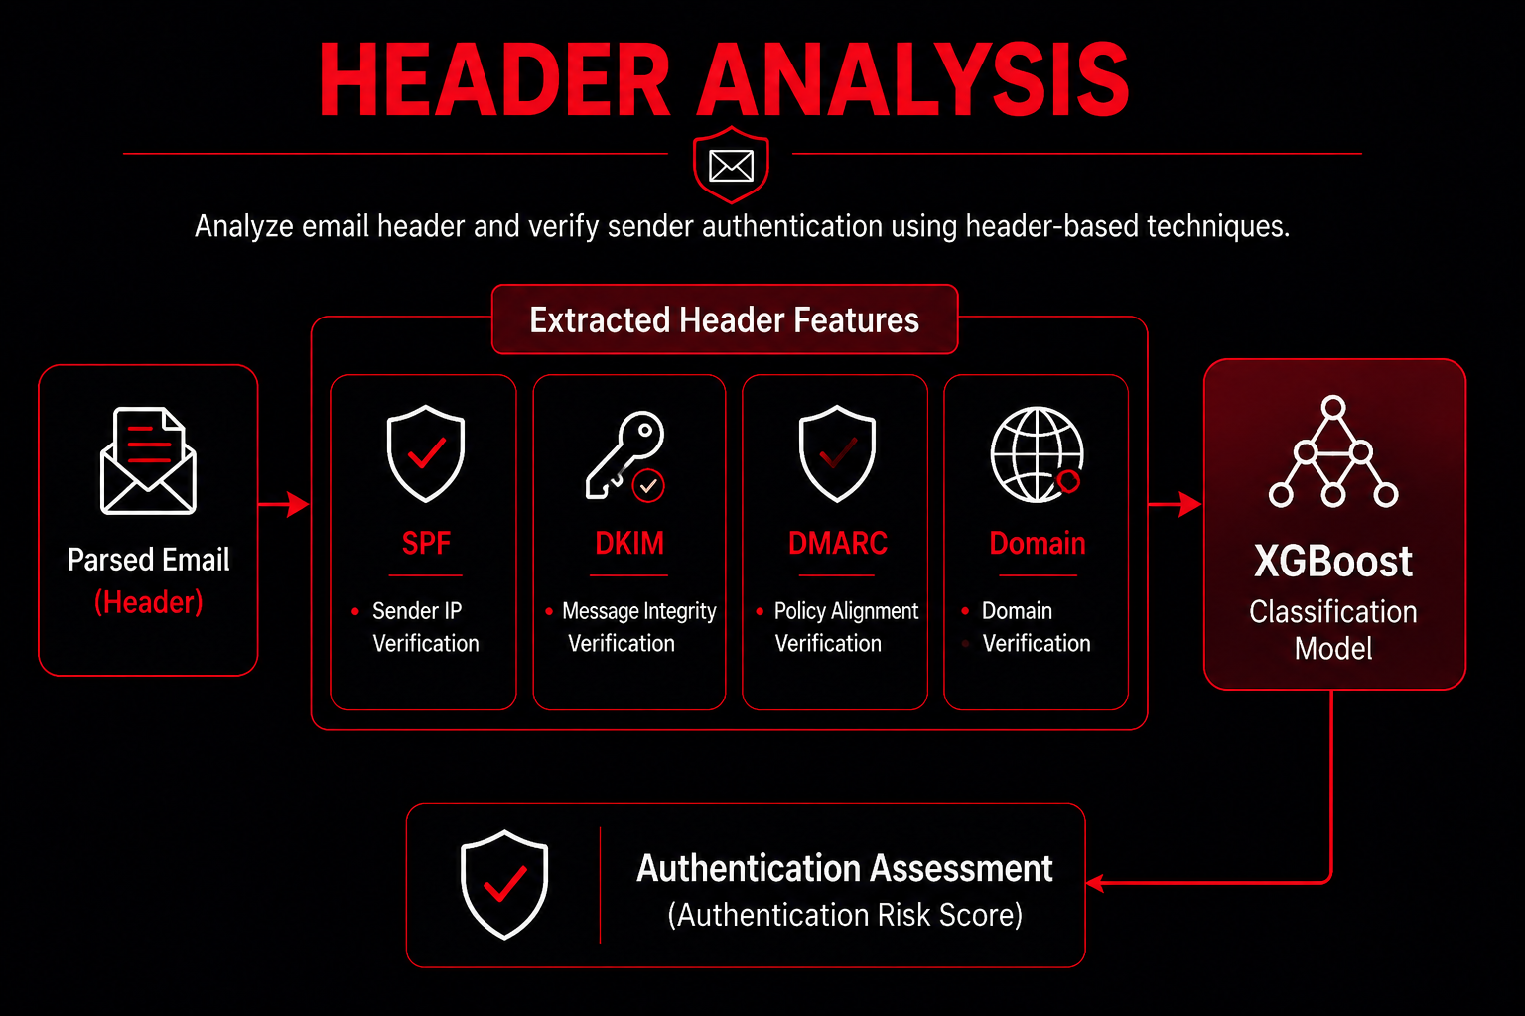

Slide 8
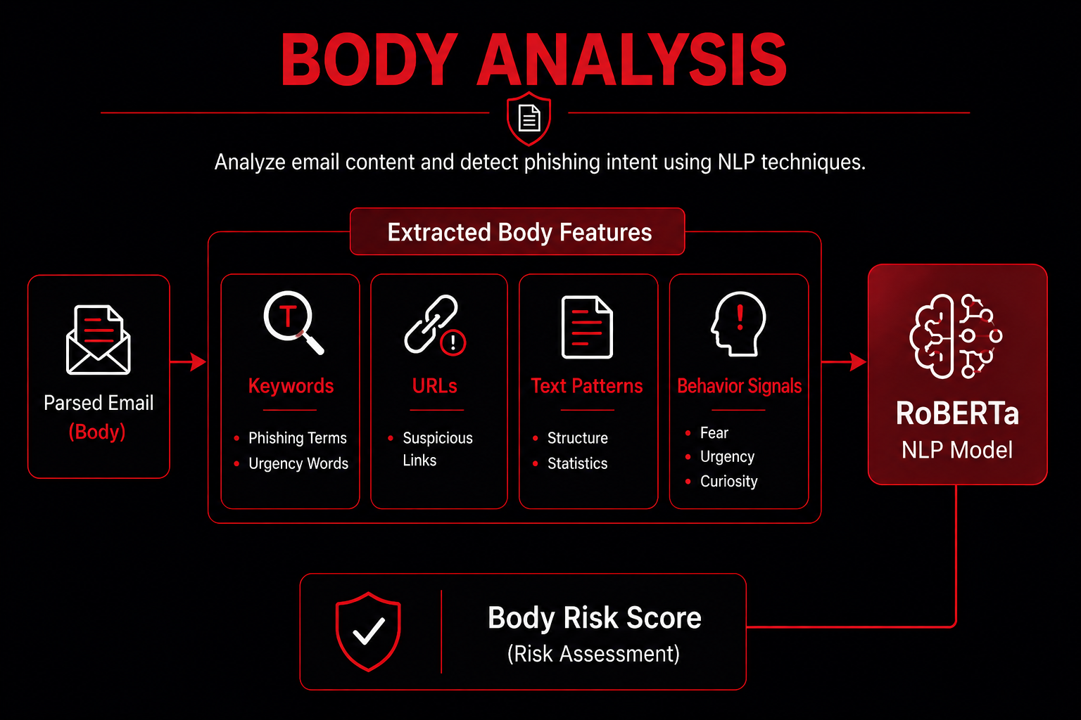

Slide 9
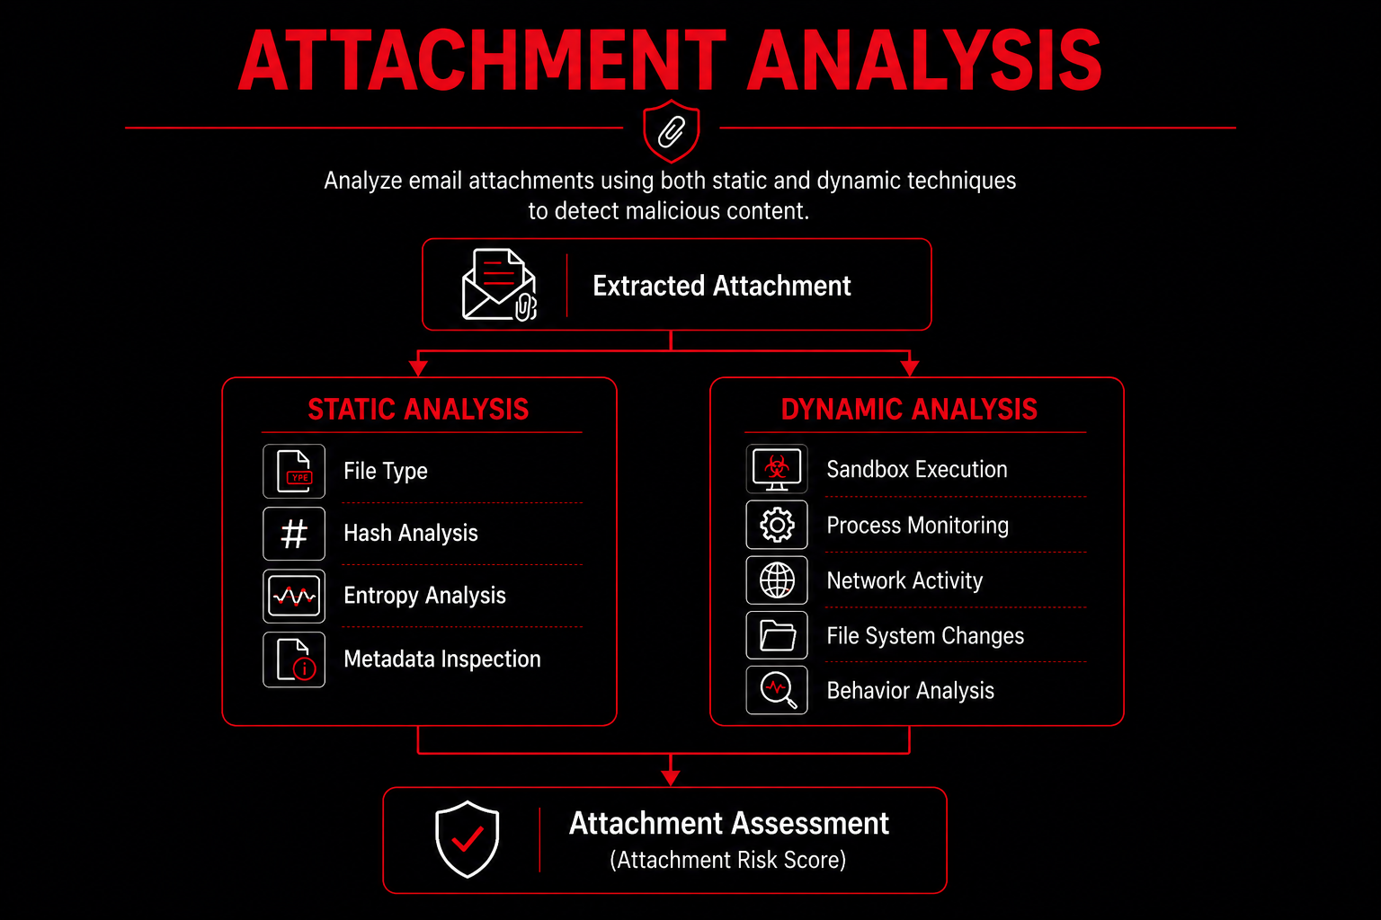

Slide 10
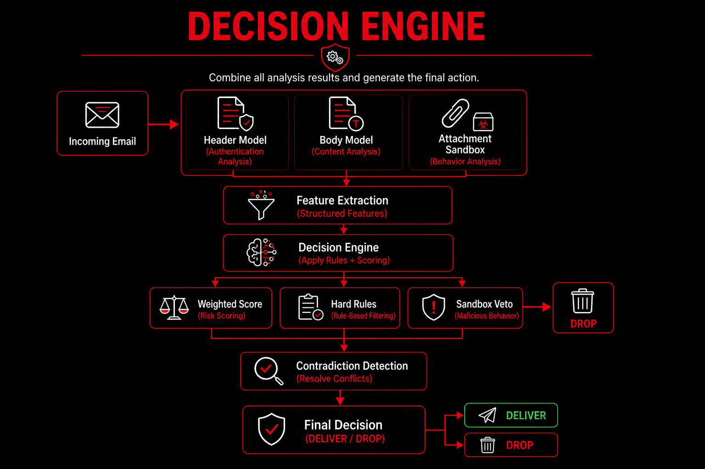

Slide 11
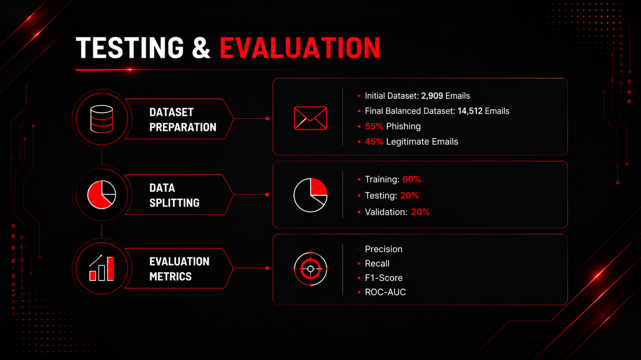

Slide 12
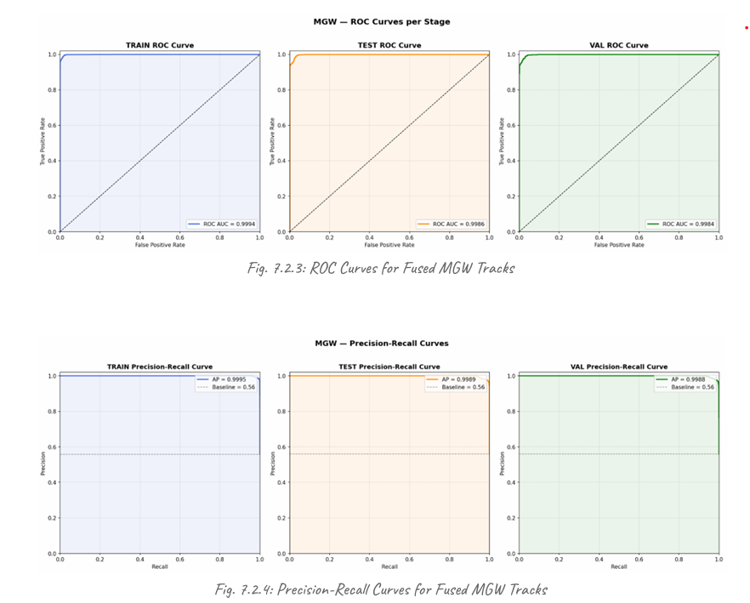
ROC & Precision-Recall Analysis
ROC-AUC = 99.84%
Average Precision = 99.88%
Excellent discrimination between phishing and legitimate emails

Slide 13
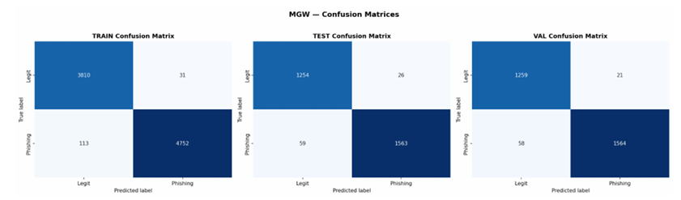
Confusion Matrix Results
Validation Results
True Positives: 1564
False Negatives: 58
True Negatives: 1259
False Positives: 21
Performance
Recall = 96.42%
Precision = 98.68%
False Positive Rate = 1.64%

Slide 14
Project Conclusion
Multi-layer phishing detection gateway
AI-powered email analysis (XGBoost + NLP)
Secure attachment sandboxing (CAPEv2)
96.42% phishing detection rate
1.64% false positive rate
Successful real-time email blocking before delivery

