Slide 1
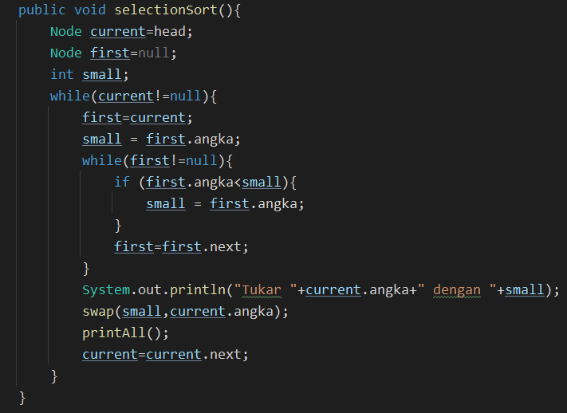
2
8
5
3
9
4
1
NULL
NULL
head
tail

Slide 2
current
2
8
5
3
9
4
1
NULL
NULL
head
tail

Slide 3
current
first
2
8
5
3
9
4
1
NULL
NULL
head
tail

Slide 4
small
current
first
2
8
5
3
9
4
1
NULL
NULL
head
tail

Slide 5
small
Current!=null
current
first
2
8
5
3
9
4
1
NULL
NULL
head
tail

Slide 6
small
Current!=null
current
first
2
8
5
3
9
4
1
NULL
NULL
head
tail

Slide 7
small
2
Current!=null
current
first
2
8
5
3
9
4
1
NULL
NULL
head
tail

Slide 8
small
2
Current!=null
current
First!=null
first
2
8
5
3
9
4
1
NULL
NULL
head
tail

Slide 9
First < small ?
small
2
Current!=null
current
First!=null
first
2
8
5
3
9
4
1
NULL
NULL
head
tail

Slide 10
First < small ?
small
2
Current!=null
current
First!=null
first
2
8
5
3
9
4
1
NULL
NULL
head
tail

Slide 11
First < small ?
small
2
Current!=null
current
First!=null
first
2
8
5
3
9
4
1
NULL
NULL
head
tail

Slide 12
First < small ?
small
2
Current!=null
current
First!=null
first
2
8
5
3
9
4
1
NULL
NULL
head
tail

Slide 13
First < small ?
small
2
Current!=null
current
First!=null
first
2
8
5
3
9
4
1
NULL
NULL
head
tail

Slide 14
First < small ?
small
2
Current!=null
current
First!=null
first
2
8
5
3
9
4
1
NULL
NULL
head
tail

Slide 15

First < small ?
small
2
Current!=null
current
First!=null
first
2
8
5
3
9
4
1
NULL
NULL
head
tail

Slide 16
First < small ?
small
1
Current!=null
current
First!=null
first
2
8
5
3
9
4
1
NULL
NULL
head
tail

Slide 17
small
1
Current!=null
current
First!=null
first
2
8
5
3
9
4
1
NULL
NULL
head
tail

Slide 18
small
1
Current!=null
current
First!=null
first
2
8
5
3
9
4
1
NULL
NULL
head
tail

Slide 19
small
1
Current!=null
current
First!=null
first
2
8
5
3
9
4
1
NULL
NULL
head
tail

Slide 20
small
1
Current!=null
current
First!=null
first
1
8
5
3
9
4
2
NULL
NULL
head
tail

Slide 21
small
1
Current!=null
current
First!=null
first
1
8
5
3
9
4
2
NULL
NULL
head
tail

Slide 22
small
1
Current!=null
current
First!=null
first
1
8
5
3
9
4
2
NULL
NULL
head
tail

Slide 23
small
8
Current!=null
current
First!=null
first
1
8
5
3
9
4
2
NULL
NULL
head
tail

Slide 24
First < small ?
small
8
Current!=null
current
First!=null
first
1
8
5
3
9
4
2
NULL
NULL
head
tail

Slide 25
First < small ?
small
5
Current!=null
current
First!=null
first
1
8
5
3
9
4
2
NULL
NULL
head
tail

Slide 26
First < small ?
small
3
Current!=null
current
First!=null
first
1
8
5
3
9
4
2
NULL
NULL
head
tail

Slide 27
First < small ?
small
3
Current!=null
current
First!=null
first
1
8
5
3
9
4
2
NULL
NULL
head
tail

Slide 28
First < small ?
small
3
Current!=null
current
First!=null
first
1
8
5
3
9
4
2
NULL
NULL
head
tail

Slide 29
First < small ?
small
2
Current!=null
current
First!=null
first
1
8
5
3
9
4
2
NULL
NULL
head
tail

Slide 30
First < small ?
small
2
Current!=null
current
First!=null
first
1
8
5
3
9
4
2
NULL
NULL
head
tail

Slide 31
small
2
Current!=null
current
First!=null
first
1
2
5
3
9
4
8
NULL
NULL
head
tail

Slide 32
small
2
Current!=null
current
First!=null
first
1
2
5
3
9
4
8
NULL
NULL
head
tail

Slide 33
small
2
Current!=null
current
First!=null
first
1
2
5
3
9
4
8
NULL
NULL
head
tail

Slide 34
small
5
Current!=null
current
First!=null
first
1
2
5
3
9
4
8
NULL
NULL
head
tail

Slide 35
First < small ?
small
5
Current!=null
current
First!=null
first
1
2
5
3
9
4
8
NULL
NULL
head
tail

Slide 36
First < small ?
small
3
Current!=null
current
First!=null
first
1
2
5
3
9
4
8
NULL
NULL
head
tail

Slide 37
First < small ?
small
3
Current!=null
current
First!=null
first
1
2
5
3
9
4
8
NULL
NULL
head
tail

Slide 38
First < small ?
small
3
Current!=null
current
First!=null
first
1
2
5
3
9
4
8
NULL
NULL
head
tail

Slide 39
First < small ?
small
3
Current!=null
current
First!=null
first
1
2
5
3
9
4
8
NULL
NULL
head
tail

Slide 40
small
3
Current!=null
current
First!=null
first
1
2
5
3
9
4
8
NULL
NULL
head
tail

Slide 41
small
3
Current!=null
current
First!=null
first
1
2
3
5
9
4
8
NULL
NULL
head
tail

Slide 42
small
3
Current!=null
current
First!=null
first
1
2
3
5
9
4
8
NULL
NULL
head
tail

Slide 43
small
3
Current!=null
current
First!=null
first
1
2
3
5
9
4
8
NULL
NULL
head
tail

Slide 44
small
5
Current!=null
current
First!=null
first
1
2
3
5
9
4
8
NULL
NULL
head
tail

Slide 45
First < small ?
small
5
Current!=null
current
First!=null
first
1
2
3
5
9
4
8
NULL
NULL
head
tail

Slide 46
First < small ?
small
5
Current!=null
current
First!=null
first
1
2
3
5
9
4
8
NULL
NULL
head
tail

Slide 47
First < small ?
small
4
Current!=null
current
First!=null
first
1
2
3
5
9
4
8
NULL
NULL
head
tail

Slide 48
First < small ?
small
4
Current!=null
current
First!=null
first
1
2
3
5
9
4
8
NULL
NULL
head
tail

Slide 49
small
4
Current!=null
current
First!=null
first
1
2
3
5
9
4
8
NULL
NULL
head
tail

Slide 50
small
4
Current!=null
current
First!=null
first
1
2
3
4
9
5
8
NULL
NULL
head
tail

Slide 51
small
4
Current!=null
current
First!=null
first
1
2
3
4
9
5
8
NULL
NULL
head
tail

Slide 52
small
4
Current!=null
current
First!=null
first
1
2
3
4
9
5
8
NULL
NULL
head
tail

Slide 53
small
9
Current!=null
current
First!=null
first
1
2
3
4
9
5
8
NULL
NULL
head
tail

Slide 54
First < small ?
small
9
Current!=null
current
First!=null
first
1
2
3
4
9
5
8
NULL
NULL
head
tail

Slide 55
First < small ?
small
5
Current!=null
current
First!=null
first
1
2
3
4
9
5
8
NULL
NULL
head
tail

Slide 56
First < small ?
small
5
Current!=null
current
First!=null
first
1
2
3
4
9
5
8
NULL
NULL
head
tail

Slide 57
First < small ?
small
5
Current!=null
current
First!=null
first
1
2
3
4
9
5
8
NULL
NULL
head
tail

Slide 58
small
5
Current!=null
current
First!=null
first
1
2
3
4
5
9
8
NULL
NULL
head
tail

Slide 59
small
5
Current!=null
current
First!=null
first
1
2
3
4
5
9
8
NULL
NULL
head
tail

Slide 60
small
5
Current!=null
current
First!=null
first
1
2
3
4
5
9
8
NULL
NULL
head
tail

Slide 61
small
9
Current!=null
current
First!=null
first
1
2
3
4
5
9
8
NULL
NULL
head
tail

Slide 62
First < small ?
small
9
Current!=null
current
First!=null
first
1
2
3
4
5
9
8
NULL
NULL
head
tail

Slide 63
First < small ?
small
8
Current!=null
current
First!=null
first
1
2
3
4
5
9
8
NULL
NULL
head
tail

Slide 64
First < small ?
small
8
Current!=null
current
First!=null
first
1
2
3
4
5
9
8
NULL
NULL
head
tail

Slide 65
small
8
Current!=null
current
First!=null
first
1
2
3
4
5
8
9
NULL
NULL
head
tail

Slide 66
small
8
Current!=null
current
First!=null
first
1
2
3
4
5
8
9
NULL
NULL
head
tail

Slide 67
small
8
Current!=null
current
First!=null
first
1
2
3
4
5
8
9
NULL
NULL
head
tail

Slide 68
small
9
Current!=null
current
First!=null
first
1
2
3
4
5
8
9
NULL
NULL
head
tail

Slide 69
First < small ?
small
9
Current!=null
current
First!=null
first
1
2
3
4
5
8
9
NULL
NULL
head
tail

Slide 70
First < small ?
small
9
Current!=null
current
First!=null
first
1
2
3
4
5
8
9
NULL
NULL
head
tail

Slide 71
small
9
Current!=null
current
First!=null
first
1
2
3
4
5
8
9
NULL
NULL
head
tail

Slide 72
small
9
Current!=null
current
First!=null
first
1
2
3
4
5
8
9
NULL
NULL
head
tail

Slide 73
1
2
3
4
5
8
9
NULL
NULL
head
tail

