Slide 1
PROJECT TITLE
CAPSTONE PROJECT
Presented By:
Ghantasala RamaKousalya – Vignan Institute of technology and science – CSE

Slide 2
Problem Statement
Challenge - Create a robust network intrusion detection system (NIDS) using machine learning. The system should be capable of analyzing network traffic data to identify and classify various types of cyber-attacks (e.g., DoS, Probe, R2L, U2R) and distinguish them from normal network activity. The goal is to build a model that can effectively secure communication networks by providing an early warning of malicious activities.

Slide 3
Proposed Solution
The proposed system aims to address the challenge of network intrusion detection. This involves leveraging data analytics and machine learning techniques to forecast demand patterns accurately. The solution will consist of the following components:
Data Collection:
Gather data on network which includes type of network and service.
Data Preprocessing:
Clean and preprocess the collected data to handle missing values, outliers, and holding out data.
Extract relevant features from the data.
Machine Learning Algorithm:
Implement a machine learning algorithm, such as a time-series forecasting model to predict bike counts based on historical patterns.
Deployment:
Deploy the solution on a scalable and reliable platform, considering factors like server infrastructure, response time, and user accessibility.
Evaluation:
Assess the model's performance using appropriate metrics such as Mean Absolute Error (MAE), Root Mean Squared Error (RMSE), or other relevant metrics.

Slide 4
Algorithm & Deployment
Data Input:
Input features- Input data consists of network type, duration, service, service count and protocol type.
Training Process:
Data is trained and it shows proportion of training data and holding data. Training data is considered and preprocess it and selects the model.
Prediction Process:
There are two types of classifiers: Decision Tree, Snap Random Forest. They contain 3 stages: Hyperparameter optimization, Feature engineering and Hyperparameter optimization and pipelines are generated.

Slide 5
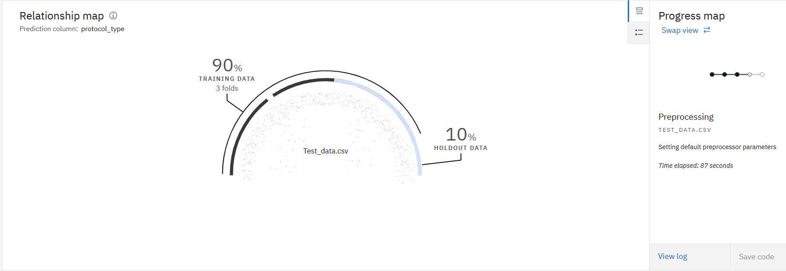
Result

Slide 6
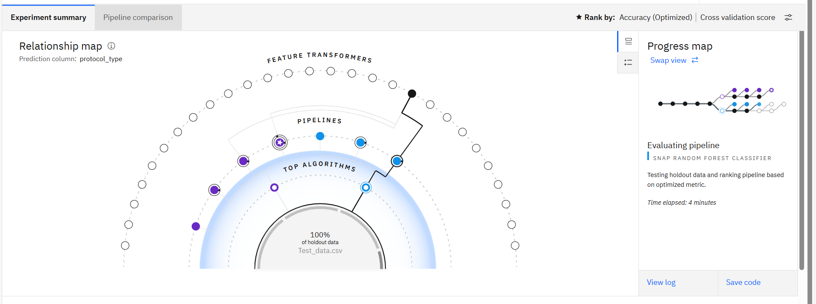
Result

Slide 7
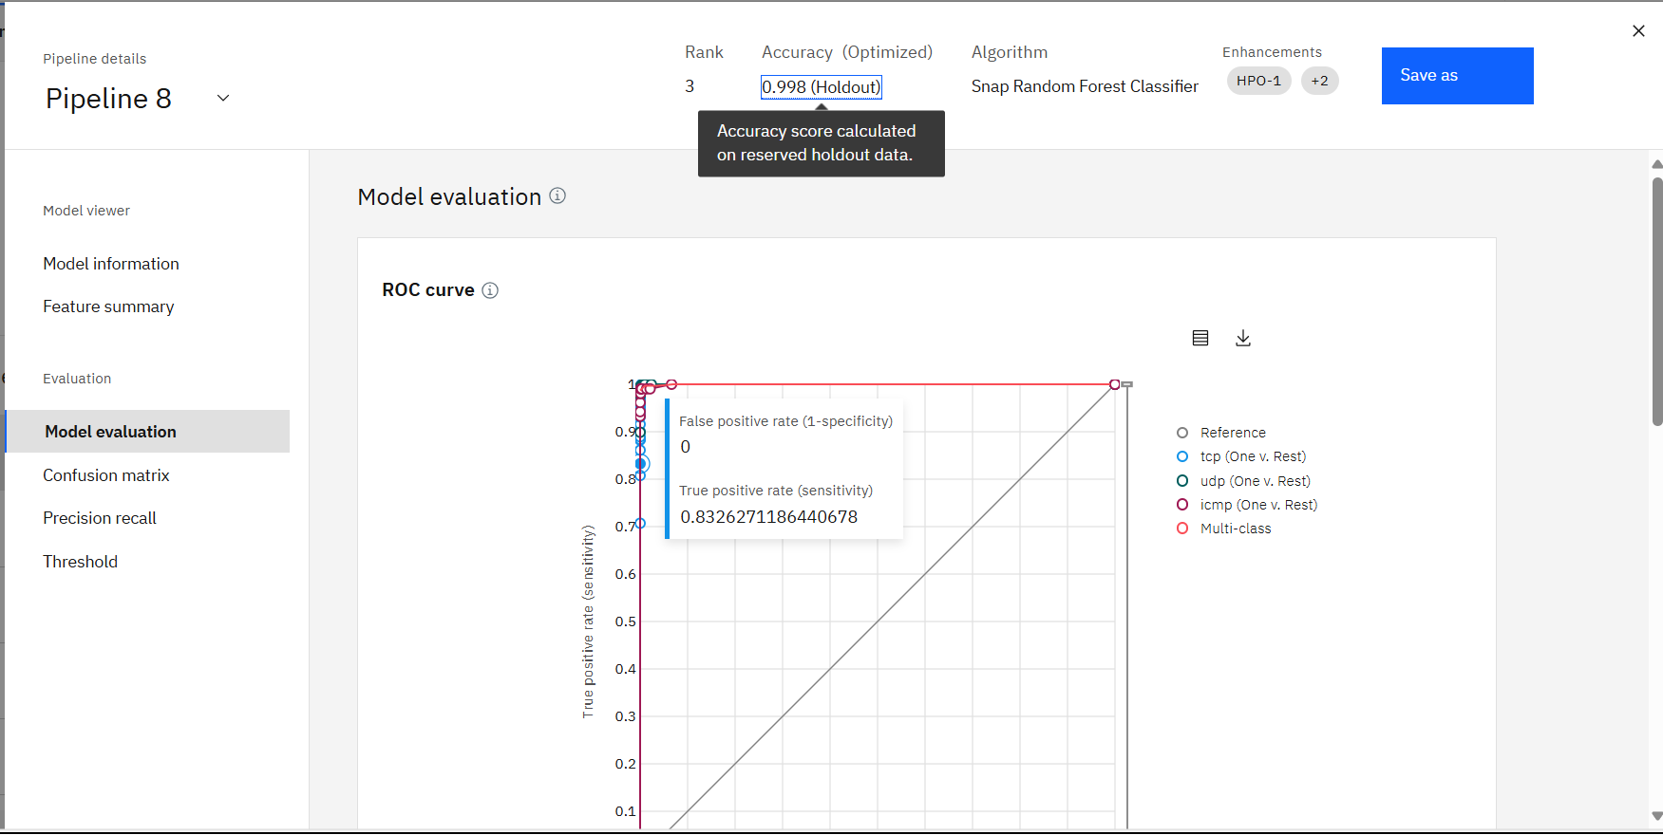
Result

Slide 8
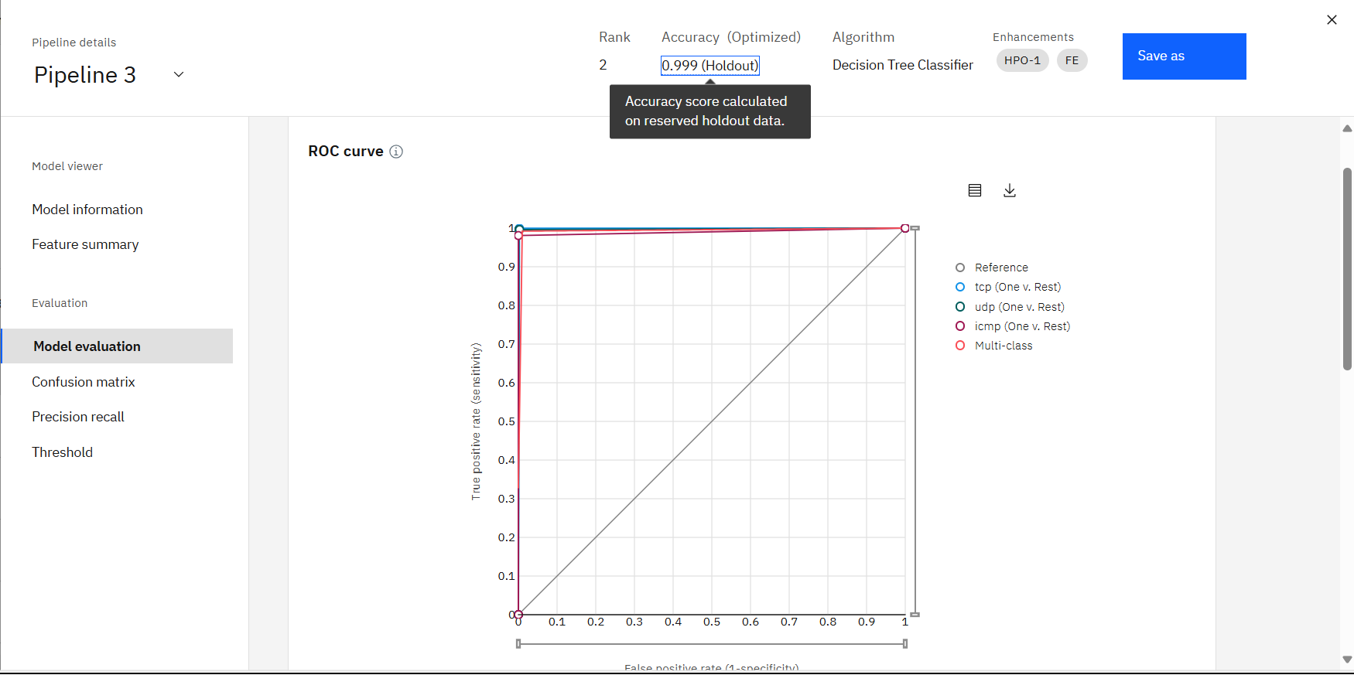
Result

Slide 9
Conclusion
Network intrusion detection plays a vital role in modern cybersecurity by actively monitoring network traffic to identify suspicious activities, policy violations, or potential threats. NIDS can face challenges such as false positives, encrypted traffic, and evasion techniques—but continual tuning and advanced analytics help improve accuracy.

Slide 10


IBM CERTIFICATIONS

Slide 11

IBM Certifications

Slide 12

IBM CERTIFICATIONS

Slide 13
THANK YOU

