Slide 1
Energy Consumption and Prediction
Presented by
Rama Lingeswara Rao Sivakavi
Mentored by
Aswin Vellaichamy Sir

Slide 2
Contents
Project Objective and Overview | The project aims to analyze household energy consumption patterns and forecast future demand using data exploration, visualization, and predictive modeling.
Mile Stone - 1 | Data Exploration
Mile Stone - 2 | Data Encoding and Visualization
Mile Stone - 3 | Model Creation and Comparison
Mile Stone - 4 | Time series forecasting with ARIMA and Prophet models
Model Evaluation | Model evaluation using metrics to assess accuracy and performance of predictive models
Conclusion | Summarizing Insights and Recommendations For Optimizing Household Energy Consumption.

Slide 3
Project Objective
The primary objective of this project is to analyze household power consumption data to :--
Identify consumption patterns :--
Understand how energy usage varies over time and across different appliances.
Discover peak usage times :--
Pinpoint the times when energy demand is at its highest.
Handle data challenges :--
Address missing values and fluctuations to ensure accurate analysis.
Forecast future demand :-
Use advanced time-series models to predict household energy requirements.
Derive actionable insights :--
Provide recommendations for optimizing energy consumption and improving energy efficiency in households.

Slide 4
Project Overview
The project analyses household energy usage using a dataset with minute-level data on power consumption, voltage, intensity, and appliance usage.
Mile Stones :--
Data Exploration : Examined dataset structure and handled missing data.
2. Data Encoding & Visualization : Visualized trends and encoded time-based features.
3. Model Creation & Comparison : Developed regression models to analyse consumption.
4. Time series forecasting with ARIMA & Prophet : Predicted future energy usage with ARIMA & Prophet.
Outcome : Insights into energy patterns and models for forecasting consumption.

Slide 5
Mile Stone - 1
(DATA EXPLORATION)

Slide 6
Dataset Description
1. Key Features :--
Global Active Power : Total active power consumption.
Global Reactive Power : Power used for maintaining electric and magnetic fields.
Voltage : Power supply voltage.
Global Intensity : Total current intensity for the household.
Sub-metering 1, 2, 3 : Energy consumption by specific appliances (ex : kitchen, laundry, climate control).
2. Dataset Size :--
Rows : 2, 075, 261
Columns : 9

Slide 7
Initial Data Inspection
df.head( ) : Displays sample of the first 5 rows.
df.shape : The dataset has over 2 million rows and 9 columns.
df.info( ) : Revealed that most features are of type 'object', except for 'Sub_metering_3' which is numeric.
The functions df.head( ), df.shape, and df.info( ) are essential for initial data exploration. df.head( ) displays the first five rows of the dataset, providing a quick glance at its structure and variable types. df.shape returns the dimensions of the dataset, indicating the number of rows and columns, which helps assess its size. df.info( ) offers a concise summary, including the data types of each column and the count of non-null values, helping identify missing data and potential type conversion needs. Together, these functions help in understanding the dataset’s structure, size, and quality before further analysis or cleaning.

Slide 8
Missing Data Analysis and Handling
Missing data was identified and addressed using several methods. The dataset contained missing values in certain columns, which were handled by filling the gaps with default values such as zero, the mean, or the median of the respective column. Alternatively, rows containing missing data were removed to ensure that the dataset remained as clean and accurate as possible for analysis. These steps were essential in preparing the data for further exploration and model building.

Slide 9
Data Visualization & Insights
Visualizations : Histogram and boxplot for power consumption, correlation heatmap to identify relationships (plot(), sns.heatmap()).
Added time-based features by converting 'Date' and 'Time' to datetime and extracting hour, day, and month for deeper analysis (pd.to_datetime()).
In Milestone 1, the dataset was explored, revealing that 'Sub_metering_3' had the most missing values, which were handled using mean, median, or zero. Data types were reviewed, and 'object' columns like 'Global_active_power' need conversion to numeric for analysis. Various strategies were applied to handle missing values, resulting in a cleaner dataset. Visual analysis showed patterns in power consumption linked to specific times or seasons. Recommendations include using time-series models with newly created datetime features for better forecasting and further cleaning outliers and noise for more accurate predictions.

Slide 10
Analysis
Functions | Use case | Observations
df.head() | Displays the first 5 rows of the dataset to preview its structure and values. | We can see the first 5 rows of our dataset
df.tail() | Displays the last 5 rows of the dataset to inspect the end of the data. | We can see the last 5 rows of our dataset
df.shape | Returns the number of rows and columns in the dataset. | The number of rows and columns are displayed(2075259, 9)
df.info() | Provides a summary of the dataset, including data types and non-null counts. | We can see that only sub_metering3 is of float type all others are object type.
df.describe() | Generates summary statistics (mean, std, min, max, etc.) for numeric columns. | The respective values are displayed
df.isnull().sum() | Identifies the number of missing values in each column. | Sub_metering3 has 25979 null values
df.fillna(0) | Fill the null value with 0’s. | After filling it shows some rows of our data.
df.fillna(df['Sub_metering_3'].mean()) | Fills the null values with the mean of the column. | After filling with the mean it outputs some sample of data.
df.fillna(df['Sub_metering_3'].median()) | Fills the null values with the median of the column. | After filling with the median it outputs some sample of data.
df.unique() | Lists the unique values in a column. | It displays number of unique values in each column

Slide 11
Mile Stone - 2
(DATA ENCODING & VISUALISATION)

Slide 12
Process
Objective :--
Analyze and preprocess the dataset for power consumption forecasting.
Key Steps :--
Loaded household_power_consumption.txt (133MB).
2,075,259 rows, 9 columns.
Missing values and non-numeric data identified.
Handled missing values:
Converted non-numeric to NaN.
Filled missing values with 0.
Outcome :--
Cleaned dataset, ready for analysis and feature engineering.

Slide 13
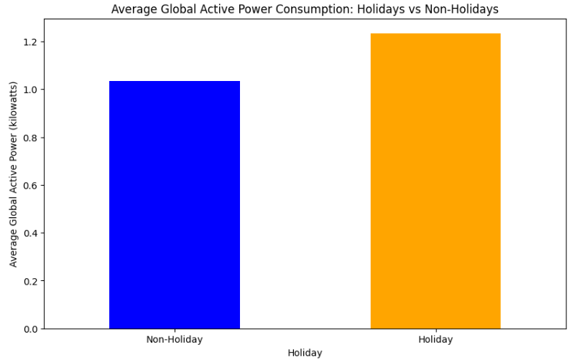
Feature Engineering - Holiday
Objective :--
Identify if the day is a holiday or not.
Method :--
Created a function is_holiday(date_str) to check if the day falls on a weekend.
Added a 'Holiday' column (binary : 1 for holiday, 0 for non-holiday).
Observations :--
All data points in the dataset are marked as holidays (value 1). Need additional non-holiday data for comparison.

Slide 14
Feature Engineering - DateTime
Objective :--
Convert Date and Time columns into a single DateTime column.
Method :--
Combined 'Date' and 'Time' into 'DateTime' using pd.to_datetime().
Outcome :--
The 'DateTime' column is now in the standard format (YYYY-MM- DD HH:MM:SS) for time-based analysis.

Slide 15
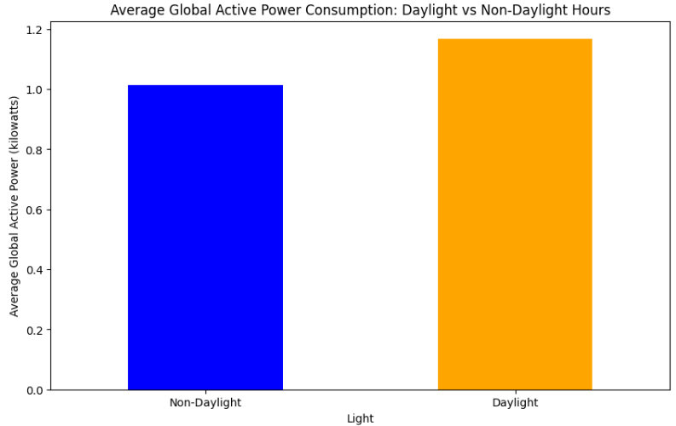
Feature Engineering - Sunlight
Objective :--
Identify whether it is daylight or not (from 06:00 AM to 06:00 PM).
Method :--
Created a function is_light(hour) to check if the hour falls within daylight hours (6 AM to 6 PM).
Added a 'light' column to represent daylight status (1 for daylight, 0 for non-daylight).
Outcome :--
All records in the sample fall within daylight hours, so the 'light' column is marked as 1.

Slide 16
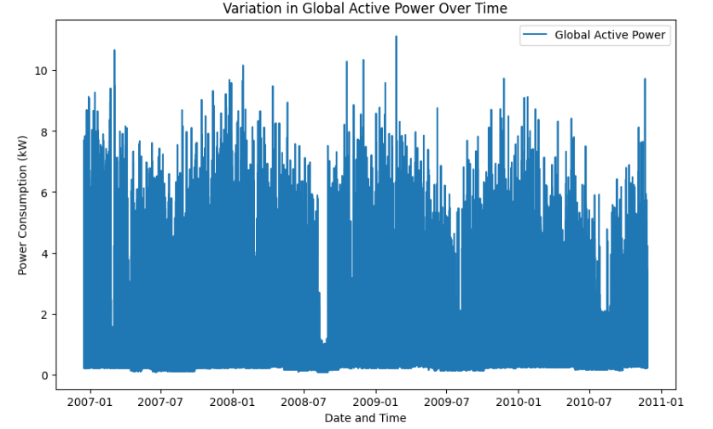
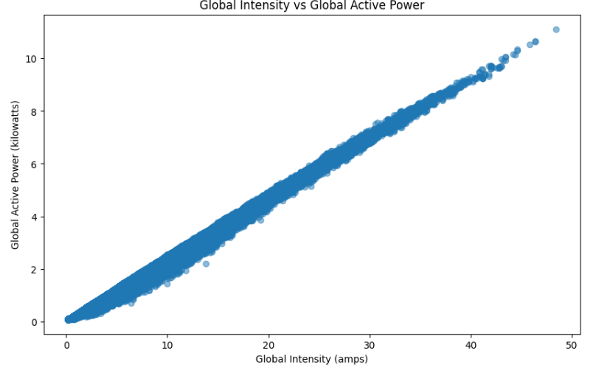
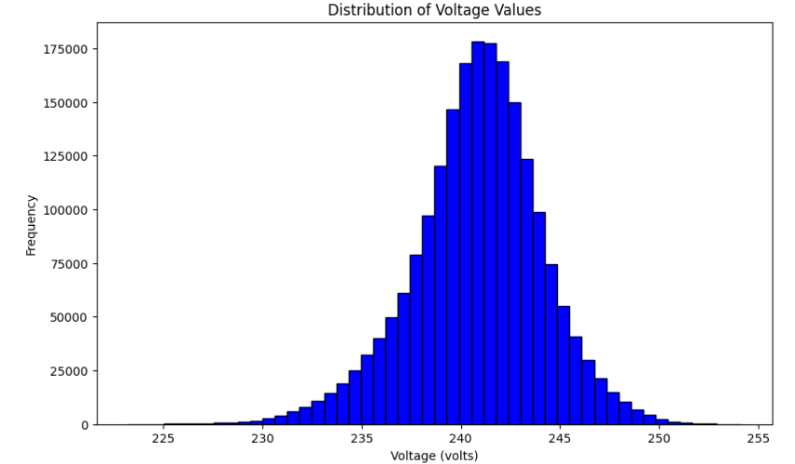
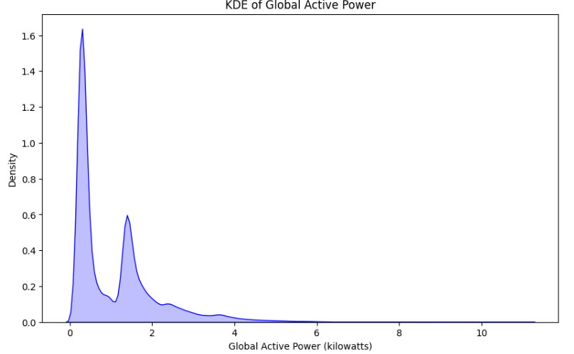
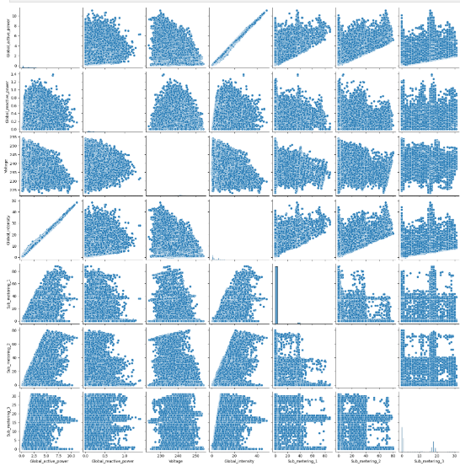
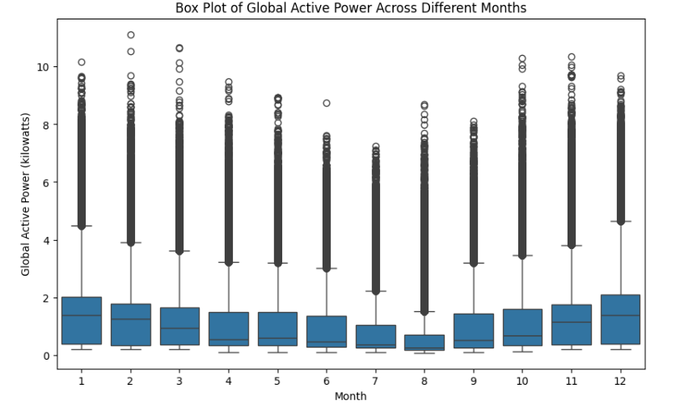
Plots

Slide 17
Graphical Insights into Power Consumption
Global_Active_Power Over Time: --
Graph :-- Line plot of Global_active_power vs. DateTime.
Insight :-- Power consumption varies significantly over time, reflecting changing usage trends.
Global_Intensity vs Global_Active_Power :--
Graph :-- Scatter plot of Global_intensity vs. Global_active_power.
Insight :-- Positive correlation—higher intensity leads to increased power consumption.
Distribution of Voltage :--
Graph :-- Histogram of Voltage.
Insight :-- Voltage follows a roughly normal distribution, centered around 235–245 volts, with occasional anomalies.

Slide 18
Analysis and Recommendations
Average Power Consumption Insights :--
Holiday vs Non-Holiday :--
Graph :-- Bar plot of average Global_active_power.
Insight :-- Higher power consumption observed on holidays.
Daylight vs Non-Daylight:
Graph :-- Bar plot of average Global_active_power.
Insight :-- Power consumption peaks during daylight hours (06:00 AM to 06:00 PM).
Conclusions and Recommendations :--
Summary :--
Addressed missing data and converted data types.
Engineered features like 'Holiday', 'DateTime', and 'Light' for enhanced analysis.
Recommendations :--
Perform in-depth analysis of time-based trends using engineered features.
Leverage time-series models for forecasting power usage.
Handle outliers to improve prediction accuracy.

Slide 19
Mile Stone - 3
(MODEL CREATION & COMPARISON)

Slide 20
Regression Models Overview
Linear Regression :--
Linear Regression fits a straight line to the data by minimizing the error between predicted and actual values. It works well for data with strong linear relationships but struggles with overfitting. Use it for simple, interpretable models without regularization.
Lasso Regression :--
Lasso Regression adds a penalty to shrink coefficients, with some becoming zero, effectively performing feature selection. It reduces model complexity and is useful for identifying the most important predictors. However, it may sacrifice some accuracy compared to Ridge or Linear Regression.
Ridge Regression :--
Ridge Regression penalizes the square of coefficients, shrinking them toward zero but retaining all features. It prevents overfitting and is effective for datasets with multicollinearity. Use it for a balance between accuracy and complexity when all features are relevant.

Slide 21
Training and Testing
The data is split into training (80%) and testing (20%) sets to evaluate model performance. The models (Linear, Lasso, and Ridge Regression) are trained on the training set and then tested on the unseen testing set to check generalization ability. Metrics like Mean Squared Error (MSE) are used for evaluation.
Who performs better :--
Ridge Regression usually performs better in complex datasets with many correlated features because it regularizes without eliminating any variables.
Lasso Regression works well if feature selection is needed, but can sometimes lose accuracy by removing too many features.
Linear Regression is simpler but may overfit with noisy or complex data, often outperformed by Ridge and Lasso.

Slide 22
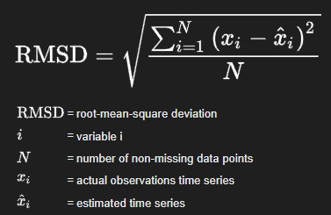

Performance Metrics
Root Mean Squared Error (RMSE) :--
Definition :-- Measures the average magnitude of the prediction error. It gives an idea of how much error is in the model’s predictions. The lower the RMSE, the better the model.
Use Case :-- Used to evaluate the accuracy of regression models by measuring the difference between predicted and actual values.
R² Score :--
Definition :-- Measures how well the model explains the variance in the data. A score of 1 indicates perfect fit, while 0 indicates no explanatory power.
Use Case :-- Used to determine the goodness of fit for regression models.

Slide 23
Mile Stone - 4
(TIME SERIES FORECASTING WITH ARIMA AND PROPHET MODELS)

Slide 24
Introduction to Time Series Forecasting
Time series forecasting is used to predict future values based on past observations.
Common applications :-- sales predictions, stock prices, energy consumption.
In this presentation, we will forecast energy consumption using two popular models :-- ARIMA and Prophet.

Slide 25
ARIMA (Auto Regressive Integrated Moving Average) Model
ARIMA is a widely used statistical model for time series forecasting.
It combines :--
AR (Auto-Regressive): The relationship between an observation and a number of lagged observations.
I (Integrated): Differencing the series to make it stationary.
MA (Moving Average): The relationship between an observation and a residual error from a moving average model.
ARIMA is used when data shows trends but not seasonal patterns.
ARIMA is used in finance, retail, healthcare, weather forecasting, transportation, energy, agriculture, telecommunications, and manufacturing for predicting trends, sales, stock prices, demand, traffic, and resource management based on historical data.

Slide 26
Steps to implement ARIMA
1. Data Preprocessing :--
Load dataset, clean data, and handle missing values.
2. Splitting Data :--
Split data into training and testing sets.
3. Model Creation :--
Fit ARIMA model with selected order (p, d, q).
4. Model Evaluation :--
Calculate performance metrics like RMSE to assess prediction accuracy.

Slide 27
Prophet Model
Prophet is a forecasting tool designed to handle time series with daily observations that display patterns on different time scales.
Advantages :--
Handles missing data well.
Can model holidays and seasonality.
Does not require stationarity of the data.
The Prophet model is used in forecasting demand, sales, website traffic, energy consumption, financial trends, and inventory management, as well as predicting seasonal patterns in various industries like retail and logistics.

Slide 28
Steps to Implement Prophet
Data Preprocessing :--
Convert the dataset into the format that Prophet requires.
Model Creation :--
Fit Prophet model on training data.
Forecasting :--
Predict future data points.
Model Evaluation :--
Evaluate the forecast accuracy using RMSE or other metrics.

Slide 29
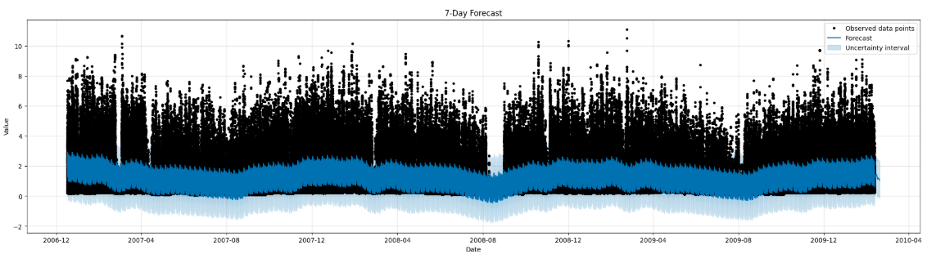
Plots from Prophet Model
Data forecasting means predicting the future based on past information. It's like making an educated guess about what might happen next using data that has already been collected.
In Energy Consumption Prediction, data forecasting is used to predict how much energy people will use in the future. This helps energy companies plan better and make sure there is enough electricity or gas available when needed.

Slide 30
Overall trend :-- Observe if the forecast shows an increasing, decreasing, or stable trend in global active power over the next 7 days.
Peaks and troughs :-- Identify any significant peaks or dips in the predicted power usage.
Confidence intervals :-- Pay attention to the shaded areas around the forecast line. These represent confidence intervals, showing the range of uncertainty in the predictions. Wider intervals suggest lower confidence in the forecast.
Comparison to past data :-- (if available in the plot) Compare the forecast to the observed historical data to understand how the forecast deviates from past patterns.
External factors :-- Consider any known external events (holidays, weather patterns, etc.) that might affect energy consumption and compare them to the predictions.

Slide 31
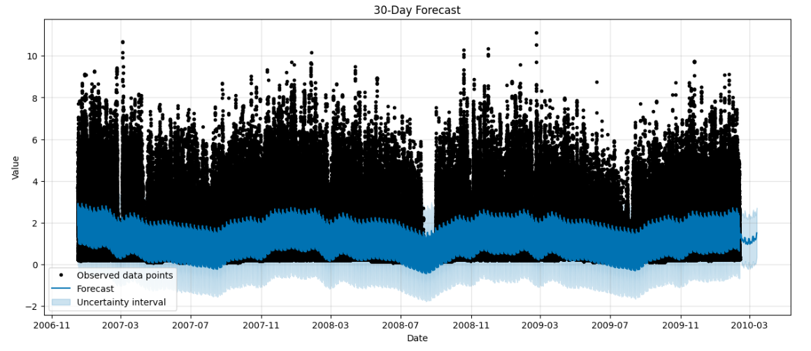
The predicted values (yhat) show a general increasing trend over the next 30 days, with some fluctuations.
The uncertainty intervals (yhat_lower and yhat_upper) appear to be relatively narrow, suggesting moderate confidence in the predictions, especially towards the end of the forecast period.
There is a potential peak in the predictions around the 15th day of the forecast, which could be further investigated.

Slide 32
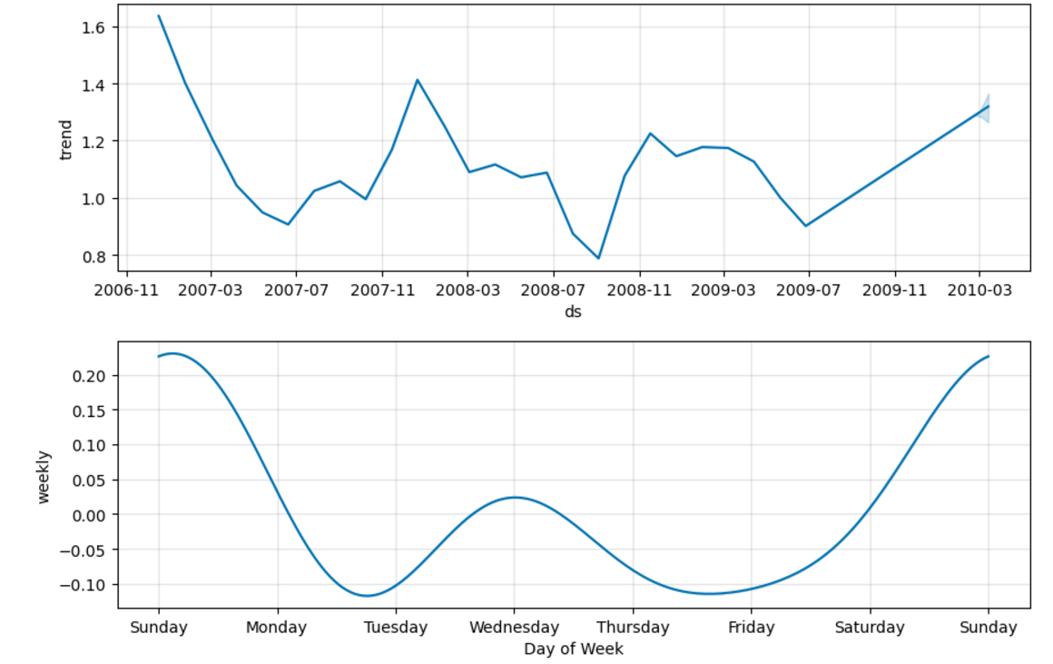
Component Analysis from Prophet Model

Slide 33
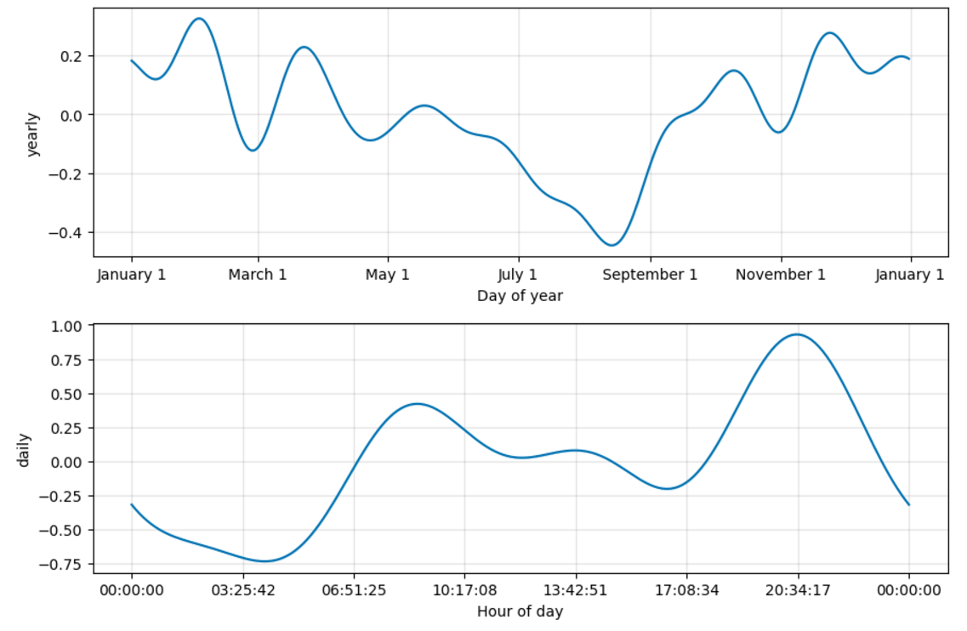

Slide 34
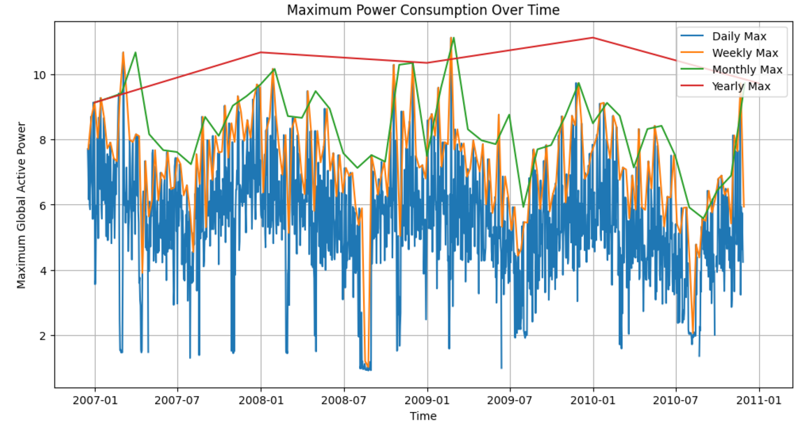

Slide 35
Daily Maximum Power Consumption :--
Observation: The maximum daily power consumption varies significantly, ranging from approximately 4.242 kW to 11.122 kW.
Time of Peak Consumption: Daily peaks are likely to occur during times of high household or industrial activity, such as:
Morning (6–9 AM): High power use for cooking, heating, or preparing for the day.
Evening (5–9 PM): Peak usage due to lighting, entertainment, and household chores.
Why? *These peaks align with human activity patterns, where demand increases during morning preparation and evening relaxation after work.
Weekly Maximum Power Consumption :--
Observation: Weekly peaks show significant variation, with some weeks reaching values as high as 9.724 kW.
Time of Peak Consumption:
Likely during weekdays (Monday-Friday) when industrial and commercial activity is at its peak.
Weekends may also show peaks depending on household activity patterns.
Why?
Weekly peaks often correlate with work schedules, industrial processes, and household routines.
Specific events (e.g., festivals or holiday preparations) may also drive consumption spikes in certain weeks.

Slide 36
Monthly Maximum Power Consumption :--
Observation: Monthly peaks show patterns tied to seasonal variations. For example:
The highest monthly consumption (10.670 kW) occurs in March 2007, and other high peaks occur in winter months like November or February. *Why? *Winter Months: Increased heating demands in colder months (November–February). *Summer Months: Possible spikes in regions requiring cooling (air conditioners, fans). *Seasonal Factors: Holidays, industrial cycles, and agricultural demands can also influence monthly consumption.
Yearly Maximum Power Consumption :--
Observation :--
The highest annual peak (11.122 kW) occurs in 2009, with a declining trend in 2010.
Why 2009 Was the Highest?
Economic or industrial growth during 2009 may have driven higher consumption.
Specific events or seasonal extremes could have increased heating or cooling needs.
In 2010, the decline might be attributed to:
Increased energy efficiency measures.
Reduced industrial output or economic slowdowns.
Shifts to alternative energy sources or better power management.

Slide 37
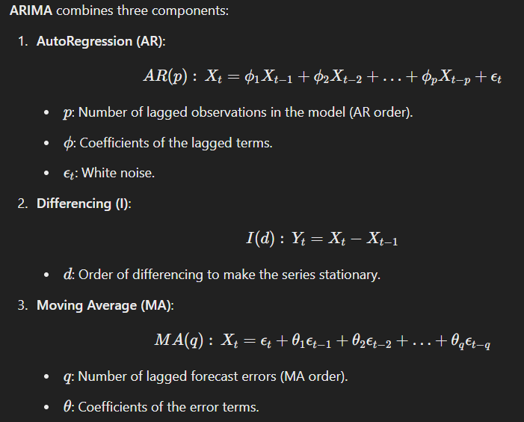
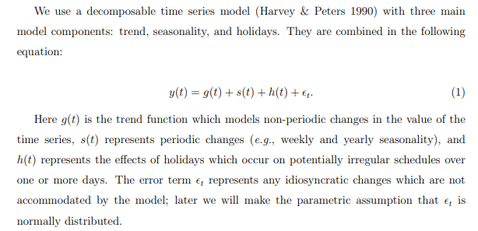
Mathematical Skeleton of the Models
Prophet Model :--

Slide 38
Model Evaluation

Slide 39


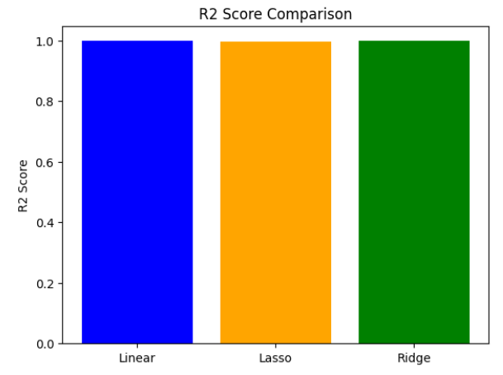
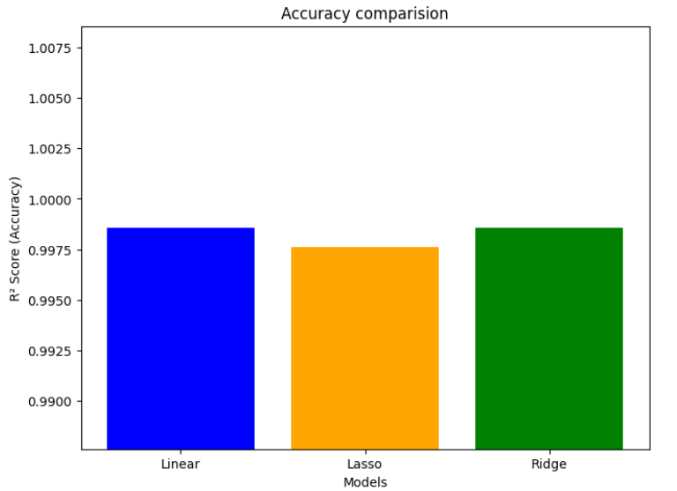
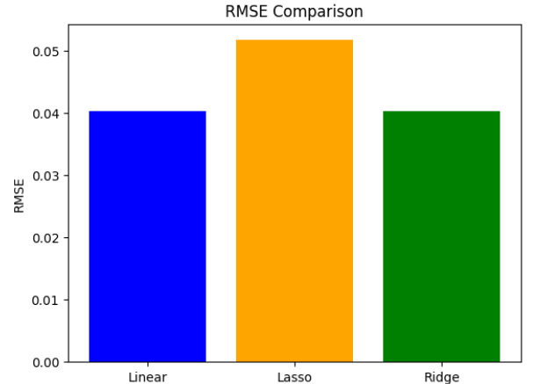
Regression Models
Outputs :--
1. RMSE values :--
2. Accuracy values :--
3. Comparision :--

Slide 40
Insights-Regression Models
Linear & Ridge Regression :--
perform equally well with high R² and low RMSE.
Lasso Regression :-
sacrifices some accuracy for simplicity by shrinking some coefficients to zero.
RMSE Comparison :--
This shows that Lasso has the highest RMSE, indicating a slightly higher prediction error.
R² Score Comparison :--
Linear and Ridge Regression have nearly identical R² scores, indicating they explain the variance in the data similarly.
Summary :--
i) Linear and Ridge are the most effective models for this dataset, with similar performance.
ii) Lasso provides a more simplified model by shrinking some coefficients but sacrifices a slight bit of accuracy in doing so.

Slide 41
Results & Comparison (ARIMA & Prophet)
The ARIMA model (Order: 5,1,0) was evaluated using RMSE to predict energy consumption, revealing key patterns. The Prophet model, designed for seasonal time series, was compared to ARIMA, highlighting seasonal trends and holidays. Both models' forecast accuracy, including RMSE, was assessed through visual plots of forecasted vs. actual data.
ARIMA :--
a) Best for stationary data.
b) Requires careful parameter selection (p, d, q).
c) Does not handle holidays or special events well.
Prophet :--
a) Handles holidays and seasonal trends effectively.
b) Less sensitive to parameter tuning.
c) Works well with missing data.

Slide 42
Streamlit App
This script is a Streamlit-based web application designed to predict energy consumption using pre-trained machine learning models.
The application offers an interactive interface where users can input features like voltage, global intensity, sub-metering values, and date-time through sliders and pickers.
It uses these inputs to create a DataFrame that aligns with the models' expected features.
The predictions are made using Linear and Ridge Regression models, loaded via joblib, and displayed dynamically with st.metric.
The app also incorporates custom styling, allowing users to select background colors and enjoy a visually appealing layout with styled headers and input sections.

Slide 43
The application handles errors gracefully, ensuring a smooth user experience even if resources fail to load or predictions encounter issues.
A disclaimer emphasizes the tool's purpose as an exploratory tool rather than one for critical energy management.
By integrating robust functionality with a user-friendly interface, this script is an excellent example of how data science models can be deployed as web applications for real-world usability.

Slide 44
Conclusion
In this analysis, we have successfully cleaned and visualized energy consumption data to uncover key insights about usage patterns. By exploring hourly, daily, and seasonal trends, we identified significant consumption peaks, particularly in the evening hours, and highlighted the influence of factors like sunlight and holidays. Through robust model building, including Linear, Lasso, and Ridge regression, we evaluated the accuracy of predictions using metrics like RMSE and R², with Ridge regression offering a stable performance under multi-collinearity.
forecasting techniques like ARIMA and Prophet, which allowed us to predict future energy consumption trends across weekly, monthly, and yearly intervals, enhancing our understanding of long-term energy demand. These insights can guide better energy management, helping utilities optimize grid operations and improve demand-side management strategies

Slide 45
Thank you
~Rama Lingeswara Rao Sivakavi

