Slide 1
Time Tracking App Using Pomodoro Technique
Group 2
Sefa Sahan Rama Nahawandi
Saffet Senih Çilesiz
Nancy Alomari
Mentor:
Irfan Karadeniz

Slide 2
outlines
Introduction​
Primary Goals
Resources
Timeline
UML Diagrams
Problems Encountered
​Summary​

Slide 3
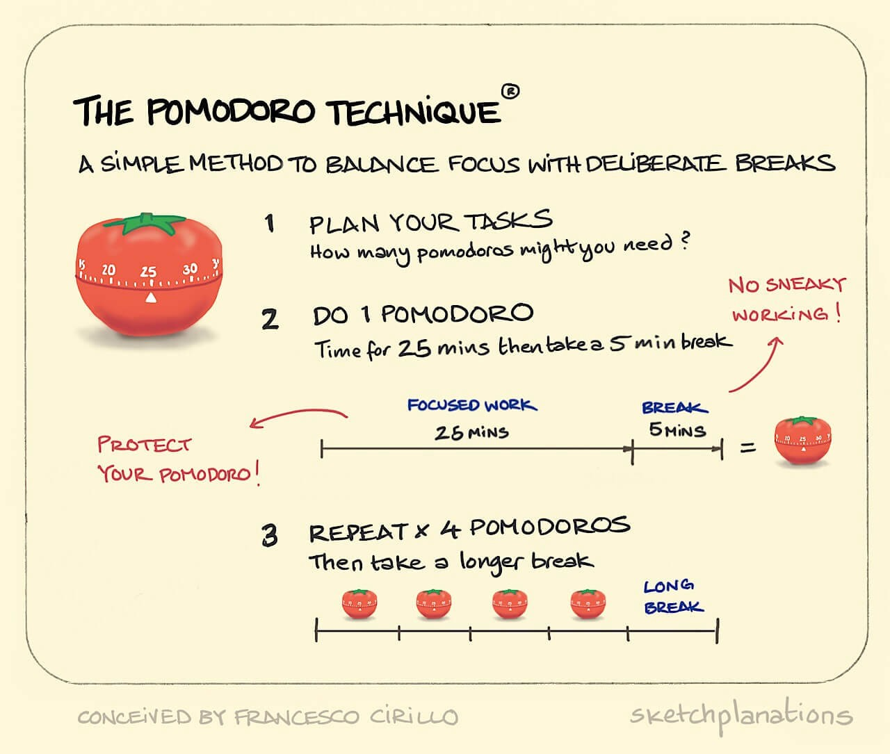
Introduction
The App helps the people who are struggling to focus on their studies or complete assignments to do it with Pomdoro technique, developed in the late 1980s Francesco Cirillo.
Which uses a cycle of 25 minutes of focused work followed by a 5 minutes break

Slide 4
PRIMARY GOALS
Time Tracking App using Python and PyQt5
- Implementation of previous Python lessons
- learning how to work as a team
- Enriching teams' members portfolio

Slide 5
Libraries Used
Datetime
built-in library
Passlib
SYS
Json
BUILT-IN LIBRARY
Email-validator
commonly used to manipulate date and time object data. You can create date and
datetime objects, loop through a range of dates, parse and format date strings, and more.
Password hashing library for Python 2 & 3, which provides cross-platform implementations of over 30 password hashing algorithms, as well as a framework for managing existing password hashes.
The sys library allows the programmer to get information about the Python interpreter and the operating system, work with input and output
Contains functions for turning json encoded data into Python objects and vise-versa.
Is a robust Python library hat validates email addresses.
It performs two types of validation - syntax validation and deliverability
validation.

Slide 6
TIMELINE
24 Oct – 29 Oct
29 OCT – 6 Nov
UML Diagrams
Coding

Slide 7
UML Diagram
Structural
class
Behavioral
activity
Usecase

Slide 8
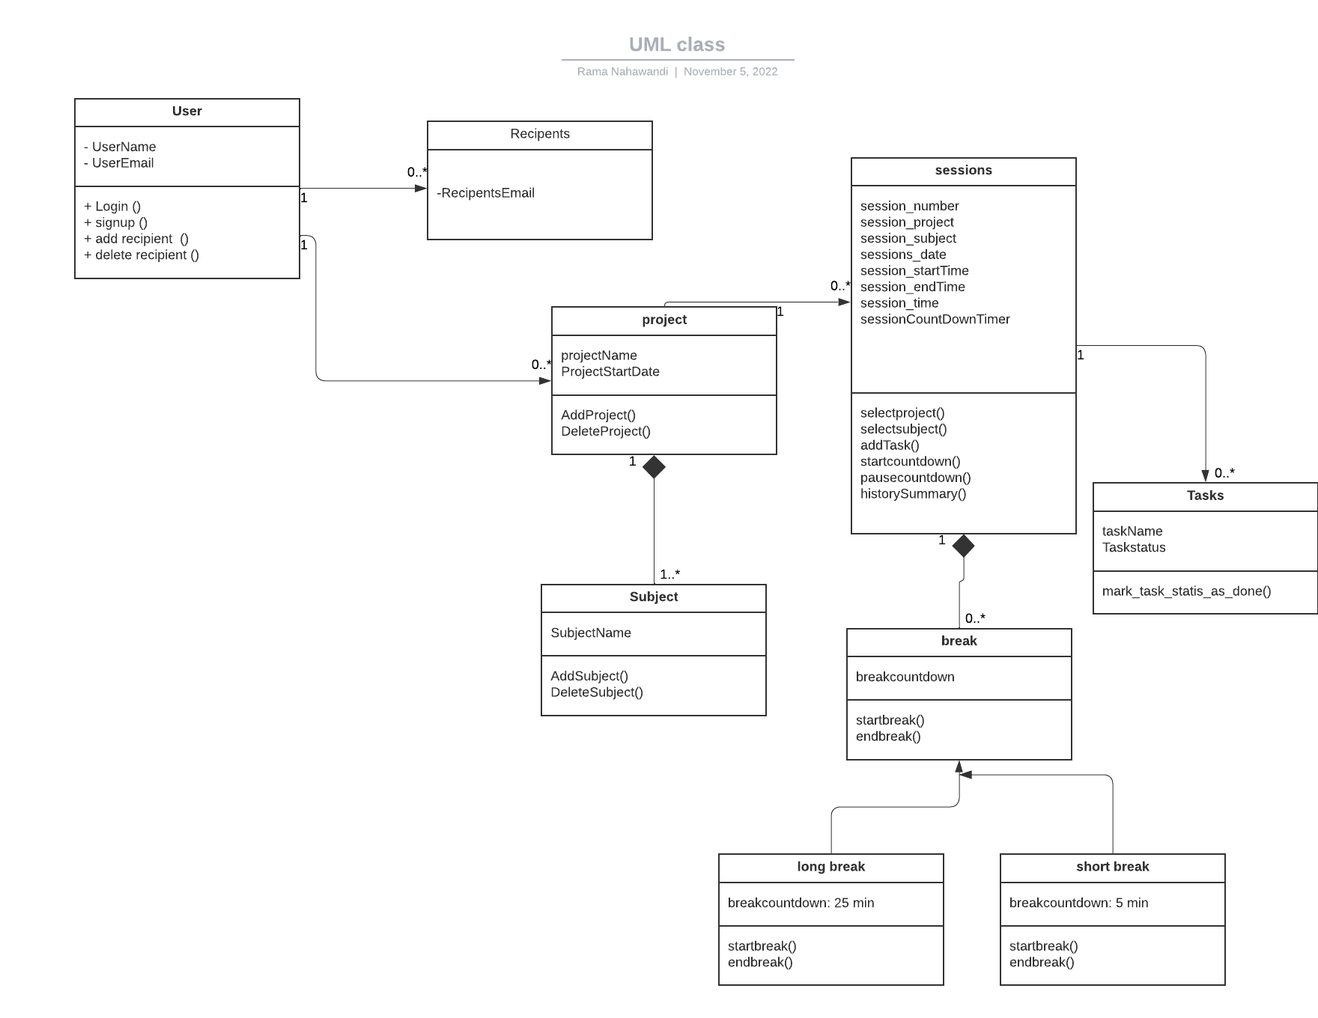
UML Class Diagram

Slide 9
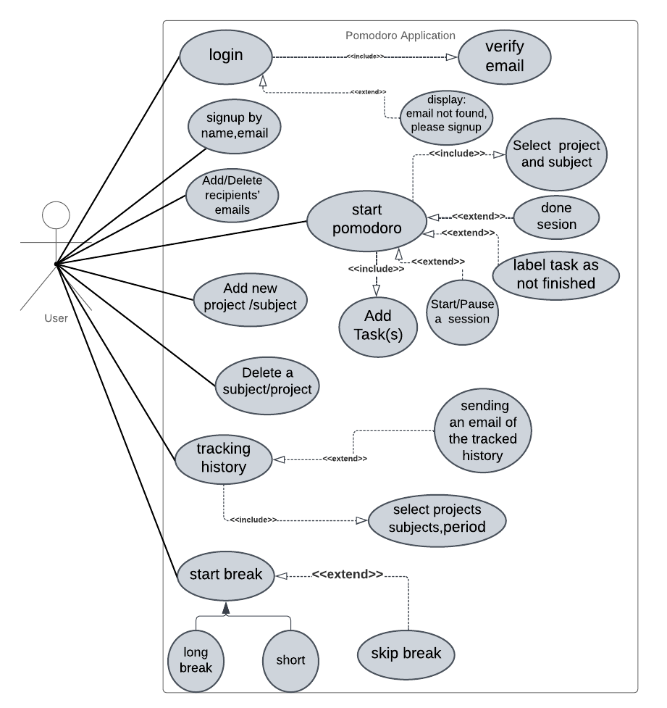
UML usecase Diagram

Slide 10
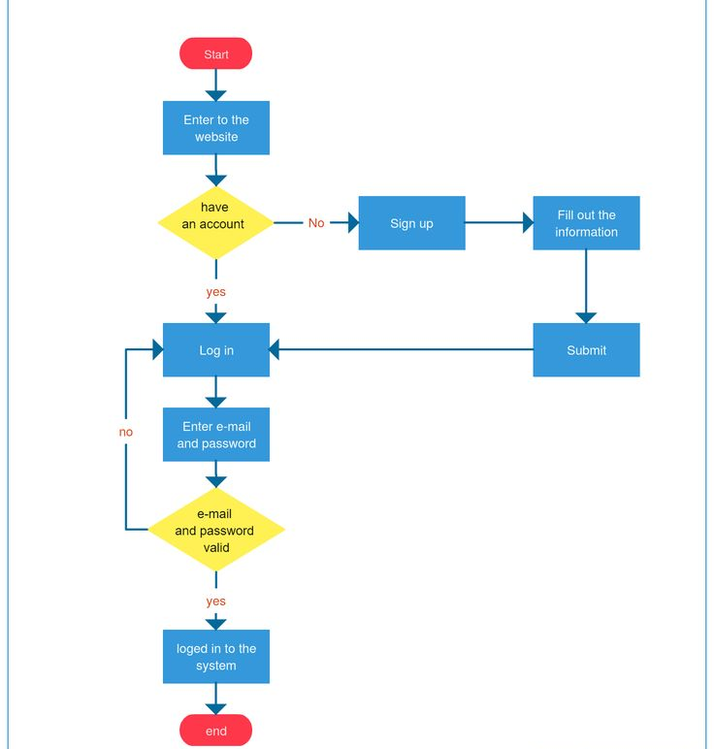
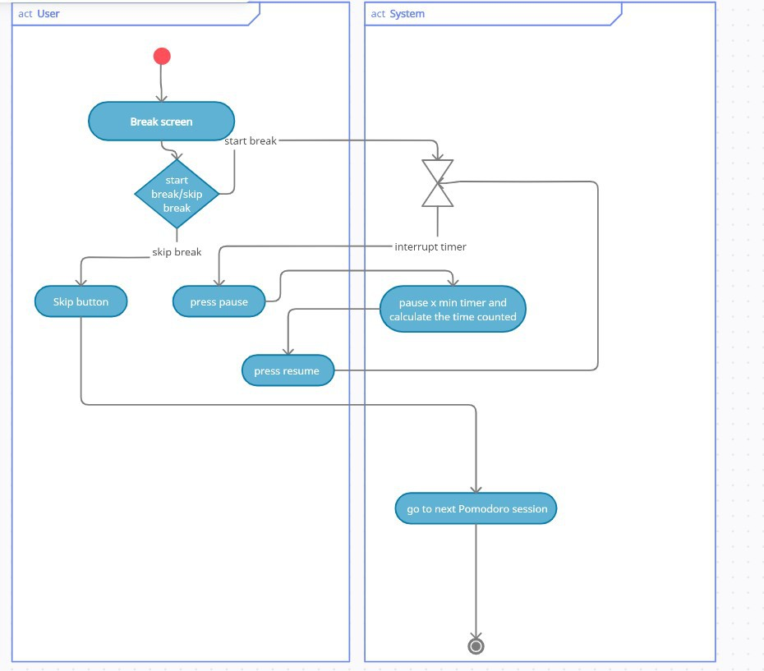
UML activity Diagram
Log in
Break screen

Slide 11
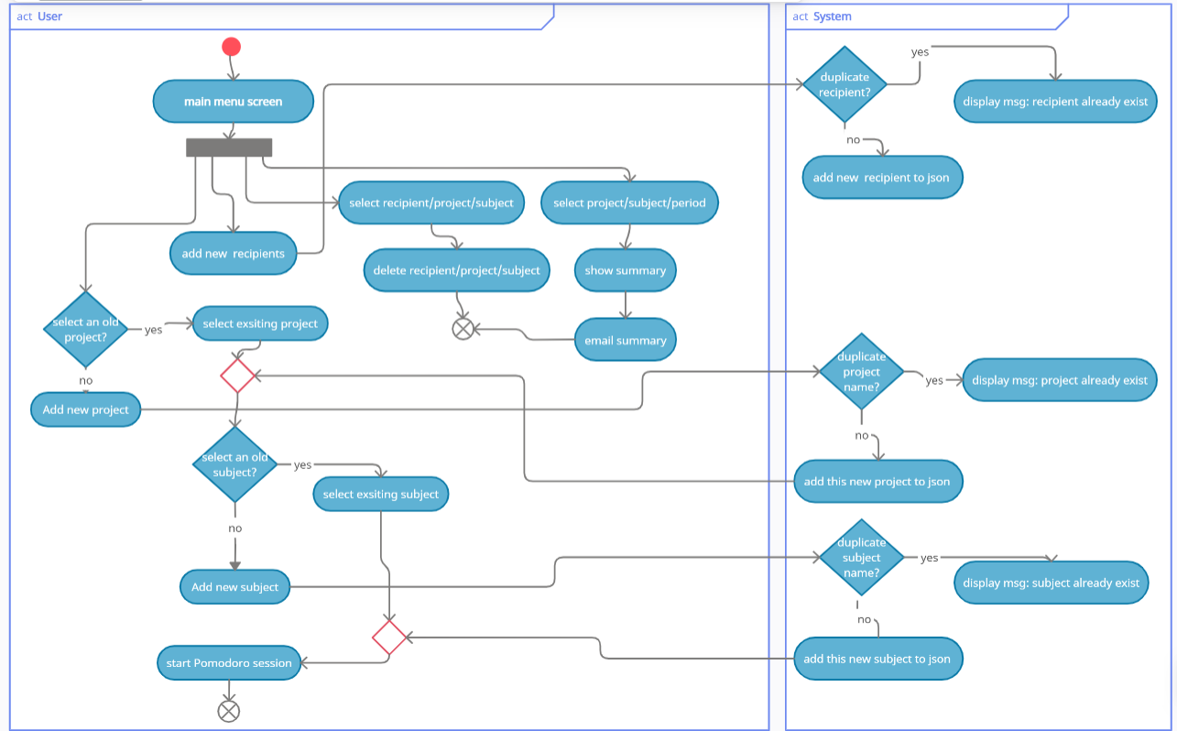
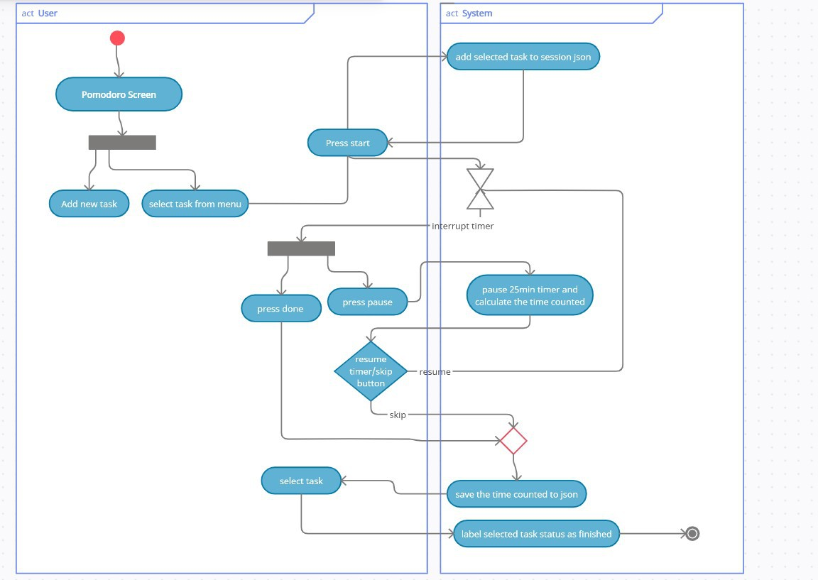
UML activity Diagram
Main menu logic
Pomdoro screen

Slide 12



Problems Encountered
UI
Team work
UML Diagrams
Sign up needed more fields
Adding subjects to projects in the UI was not logical.
In general the team felt the need to change or edit couple of screens.
It was the first time working as a team and on a platform like Trello, so next time we can improve on that!
Due to lack of experience and first encounter, this task was hard for all team members and was solely executed by Rama

Slide 13
SUMMARY
The project is functional yet needs some further enhancement!
The UI colors (look and feel)!
Dividing the code and using the main to call all functions together.

Slide 14
THANK YOU!

