Slide 1
Gauge Chart Using Qlik View & Symbol map using Tableau
Presented by
Rama Naveen Kommuri
44599: Introduction to Data Visualization
April 06,2017

Slide 2
Outline
What is Gauge ?
Gauge Chart
QlikView
Symbol map using pie chart
Data
Goals
Demonstration

Slide 3
What is gauge ?

Slide 4
Example of Gauge
Figure 1: GIF of speedometer

Slide 5
Gauge Chart
Gauge is a device that is used in measurement
Examples:
Speedometer
Thermometer
Gauge chart is similar to speedometer
A pointer is used to show information on Gauge chart
Gauge chart compares the current value with minimum and maximum value

Slide 6
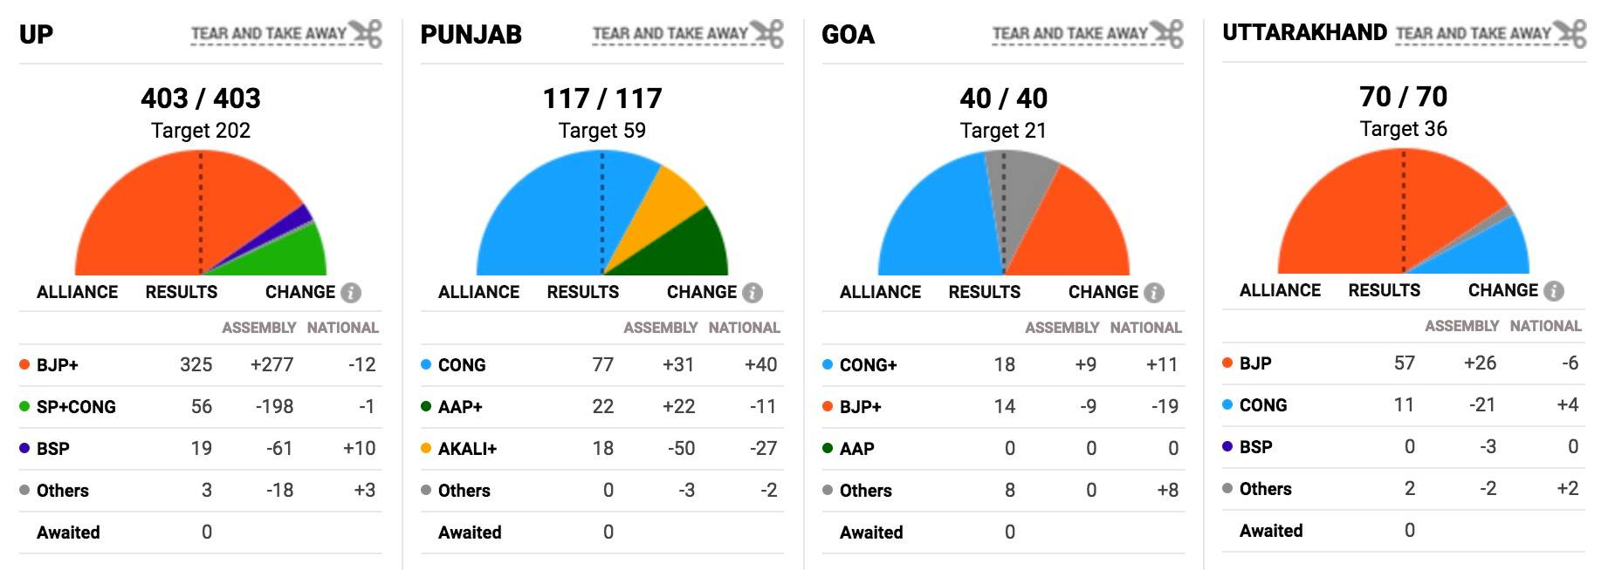
Gauge Chart (example)
Figure 2: Example for gauge chart

Slide 7
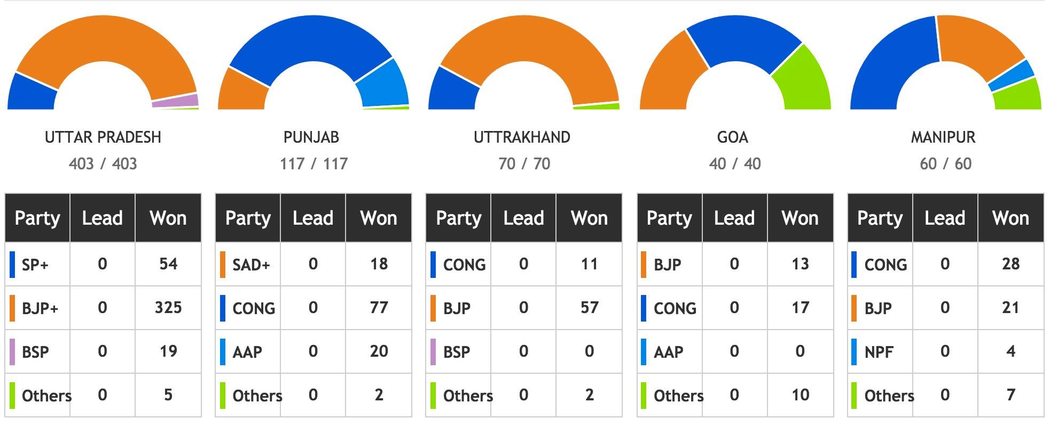
Gauge Chart (example)
Figure 3: Example for gauge chart

Slide 8
QlikView
QlikView is a business intelligence tool used to analyze data and support decision making
It is the most flexible tool for turning data into knowledge
Is placed 3rd in Gartner magic quadrant for BI 2017

Slide 9
Symbol map using pie chart
Symbol Maps are simply maps that have a mark displayed over a given Longitude and Latitude
It uses Marks card in tableau to build powerful visualization

Slide 10
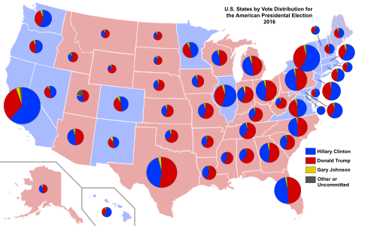
Symbol map (example)
Figure 4: Example of Symbol map using pie chart

Slide 11
Data
Crime rates in USA of the year 2014
Data Source:
https://www.infoplease.com/us/crime/crime-rate-state-2014

Slide 12
Sample Data
Data
There are 50 records in the data
Table 1: Sample data of USA crime rate

Slide 13
Goals
Goal 1:
To visualize the crime rate of 50 different states in USA of the year 2014 using Gauge chart in QikView
Goal 2:
To visualize the different categories of crimes (rape, murder, robbery) of 50 different states in USA of the year 2014 using Symbol map in Tableau

Slide 14
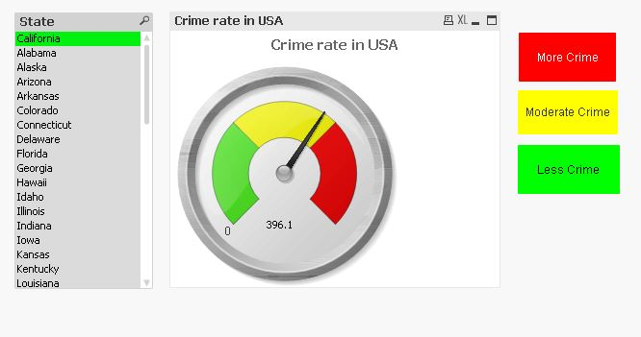
Goal 1
Figure 5: Gauge chart using QlikView

Slide 15
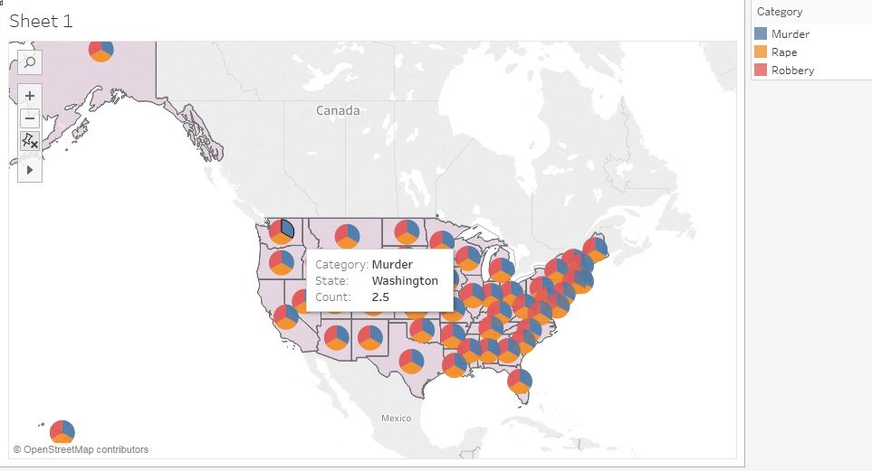
Goal 2
Figure 6: Symbol map using Tableau

Slide 16

DEMO

Slide 17
Lessons Learned
Explored various tools for data visualization and their significance
Choosing appropriate data for visualization
How to organize the data to get an appropriate chart
I have learnt analyzing the data to choose an appropriate chart for it

Slide 18


