Slide 1
SignalR Hubs
Enabling Real-Time updates for multiple users
Dhanuka Ramanayake

Slide 2
Why we need real-time communication
For apps that require frequent updates : Maps, Social networks, Stock market, Voting, Auction apps
Collaborative apps: Whiteboard apps
Multiple users editing the same data
Ensuring consistency and immediate updates in client side

Slide 4
Different ways to achieve real-time communication
Polling
Pros: Simple to implement.
Cons: Inefficient, high server load, and delayed updates.
Example: Periodically check for blog post updates
WebSockets
Pros: Full-duplex communication, low latency, efficient.
Cons: Requires WebSocket support in clients, more complex to implement.
Example: Online gaming
Server-Sent Events
Pros: Simple to implement, good for unidirectional(server to client) updates.
Cons: Not suitable for bidirectional communication, limited browser support.
Example: Real-time news updates apps
Long Polling
Pros: Works with older browsers, more reliable.
Cons: High latency, inefficient, higher server load.
Example: Chat app for old browsers
SignalR
Pros: Abstracts complexities, easy to implement.
Cons: Additional library to manage, potential overkill for simple applications.
Example: Real-time document editing apps
Notes:
Polling : Sends periodic GET requests to server
Long Polling : Sends a GET request and holds it open until new data is available or time out occur.
WebSockets provide full-duplex communication channels over a single TCP connection.
Server-sent events allow servers to push updates to the client

Slide 5
What is SignalR?
Available since early 2013 on .NET Framework
Re-architected version introduced with ASP.NET Core 2.1
Enables server-side code to push content to clients instantly
Overall framework that facilitates real-time web communication
Underlying transport protocols
WebSockets
Server-Sent Events
Long Polling
Features
Automatic fallback
Manages connections, groups, and messaging
SignalR Hub protocol
Notes:
Server-Sent Events: Client makes a HTTP POST request to server, then server pushes the message to other clients in hub

Slide 6


Communication via REST
Request
Response
Communication via SignalR
Handshake
Persistent, Bidirectional Channel
Reference: https://medium.com/@dwivedi.gourav/asp-net-core-signalr-signalr-debugging-tool-a82dc5230035

Slide 7

What is a SignalR Hub?
Specific part of SignalR library
Allows to define methods and logic for real-time interaction between clients and server
Central point for real-time communication
Server-side component
Method invocation
Stateless
Client A
Client B
Client C
SignalR Hub
Client D
Server
Notes:
Method invocation - clients can invoke methods on the server and vice versa Stateless nature of SignalR hubs means they do not retain information between client connections, method calls, message contents(chat history). Use a DB, cache for statefulness

Slide 8
Demo

Slide 9
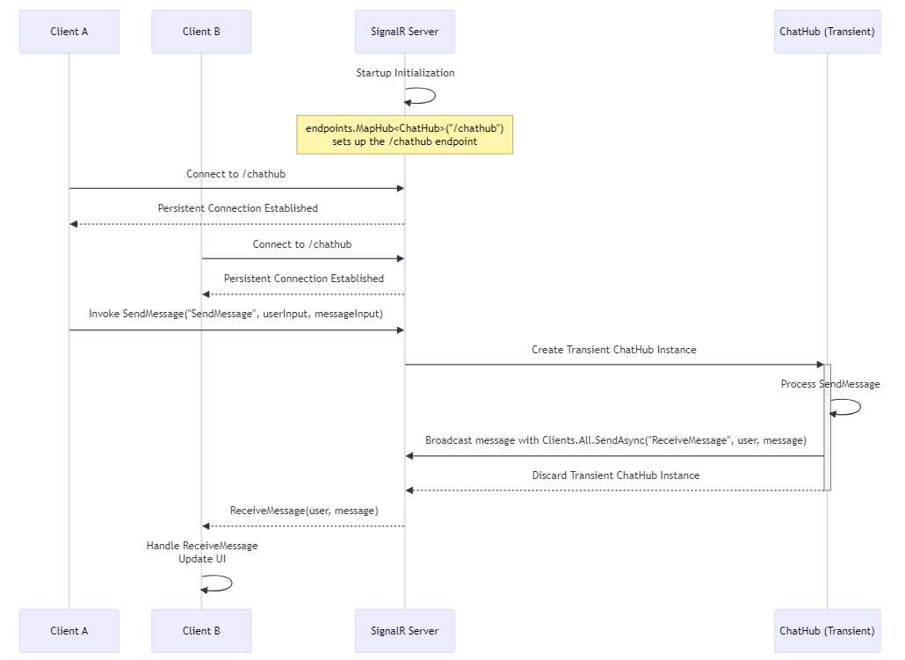

Slide 10
Scaling Out
Backplane
Separate entity
Shared resources among server instances
Technologies that can be used
Redis
As a standalone Redis server or cluster accessible
by all SignalR server instances.
Azure SignalR Service
As a managed cloud service in Azure,
abstracting the backplane implementation.
SQL Server
As a database instance that the SignalR server
instances read from and write to.
Backplane

Slide 11
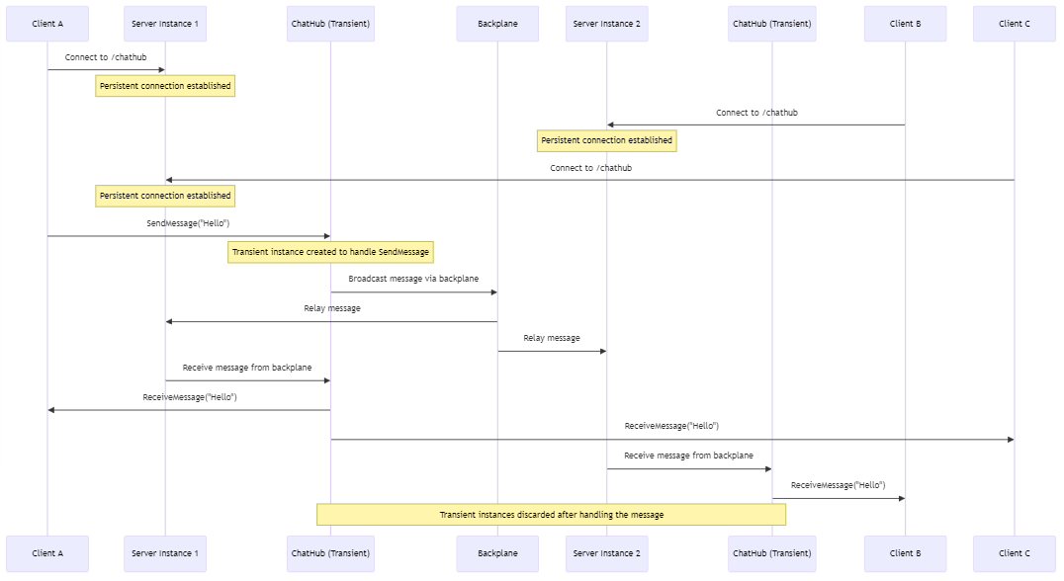

Slide 12
Questions

Slide 13
Thank You!

Slide 14
SignalR
https://learn.microsoft.com/en-us/aspnet/core/signalr/introduction?view=aspnetcore-8.0
SignalR hub
https://learn.microsoft.com/en-us/aspnet/core/signalr/hubs?view=aspnetcore-8.0
Scale out
https://learn.microsoft.com/en-us/aspnet/signalr/overview/performance/scaleout-in-signalr
WebAssembly example
https://github.com/dotnet/blazor-samples/tree/main/6.0/BlazorWebAssemblySignalRApp
ASP.NET Core SignalR & SignalR Debugging Tool
https://medium.com/@dwivedi.gourav/asp-net-core-signalr-signalr-debugging-tool-a82dc5230035

