Slide 1

Batchu Venkata Dharma Rama Teja
Keylogger & Security
Final Project

Slide 2
Keylogger & Security
Keylogging is a powerful cybersecurity tool that records every keystroke on a target device, providing valuable insights into user activity and potential security breaches.

Slide 3
Agenda
1
Problem Statement
2
Project Overview
3
Who Are The End Users
4
Solution and Value Proposition
5
The "Wow" Factor in Our Solution
6
Modelling
7
Results

Slide 4
Problem Statement
Security Vulnerabilities
Insider Threats
Compliance Concerns
Keylogging can expose sensitive information, such as login credentials and financial data, putting systems and users at risk.
Rogue employees or malicious actors can use keylogging to gain unauthorized access and gather intelligence.
The use of keylogging must be carefully managed to ensure compliance with privacy laws and ethical guidelines.

Slide 5
Project Overview
1
Understand the Risks
Conduct a thorough risk assessment to identify vulnerabilities and potential threats.
2
Evaluate Keylogging Solutions
Research and compare different keylogging technologies, considering their features, capabilities, and privacy implications.
3
Develop a Deployment Strategy
Create a plan to securely implement keylogging, ensuring it aligns with organizational policies and legal requirements.

Slide 6
Who Are The End Users
IT Administrators
Security Analysts
Use keylogging to monitor system activity, detect suspicious behavior, and respond to security incidents.
Leverage keylogging data to investigate potential breaches, conduct forensic analysis, and enhance security protocols.
Compliance Officers
Researchers
Utilize keylogging to ensure adherence to regulatory requirements and industry best practices.
Analyze keylogging data to uncover patterns, trends, and vulnerabilities, informing ongoing security improvements.

Slide 7
Solution and Value Proposition
Comprehensive Monitoring
Advanced Analytics
Robust Security
Our keylogging solution provides a complete record of user activity, including keystroke logs, screenshot captures, and network traffic monitoring.
Sophisticated algorithms analyze the collected data to detect anomalies, identify threats, and generate actionable insights.
Military-grade encryption and secure storage ensure the confidentiality and integrity of sensitive keylogging data.

Slide 8
The Wow Factor In Our Solution
Innovative Approach
Remote Deployment
Automated Reporting
Combining technical measures with user education for comprehensive protection.
Deploy keylogging capabilities across distributed networks with minimal user impact.
Customizable reports and dashboards provide comprehensive visibility into system health and security posture.

Slide 9
Modelling
Pilot Implementation
Customization
Test the keylogging solution in a controlled environment to validate functionality and identify any issues.
Tailor the solution to meet the specific requirements and policies of the organization.
Ongoing Monitoring
Enterprise-Wide Rollout
Continuously monitor the performance and effectiveness of the keylogging solution, making iterative improvements as needed.
Deploy the keylogging solution across the organization, providing training and support to end users.

Slide 10
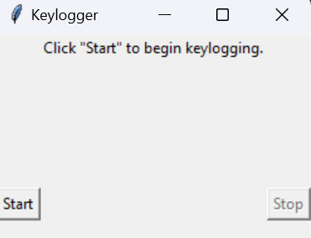
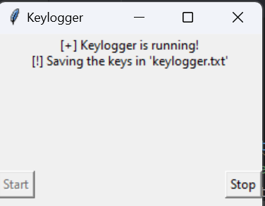
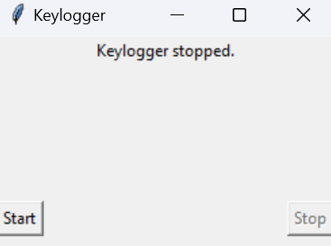
Results
1. Successfully implemented a keylogger that captures keystrokes and records them into both text and JSON files.
2. Real-time keylogging with start and stop functionality controlled via a simple GUI.

Slide 11
Project Link
https://github.com/RamaTeja99/Keylogger_Project.git

