Slide 1
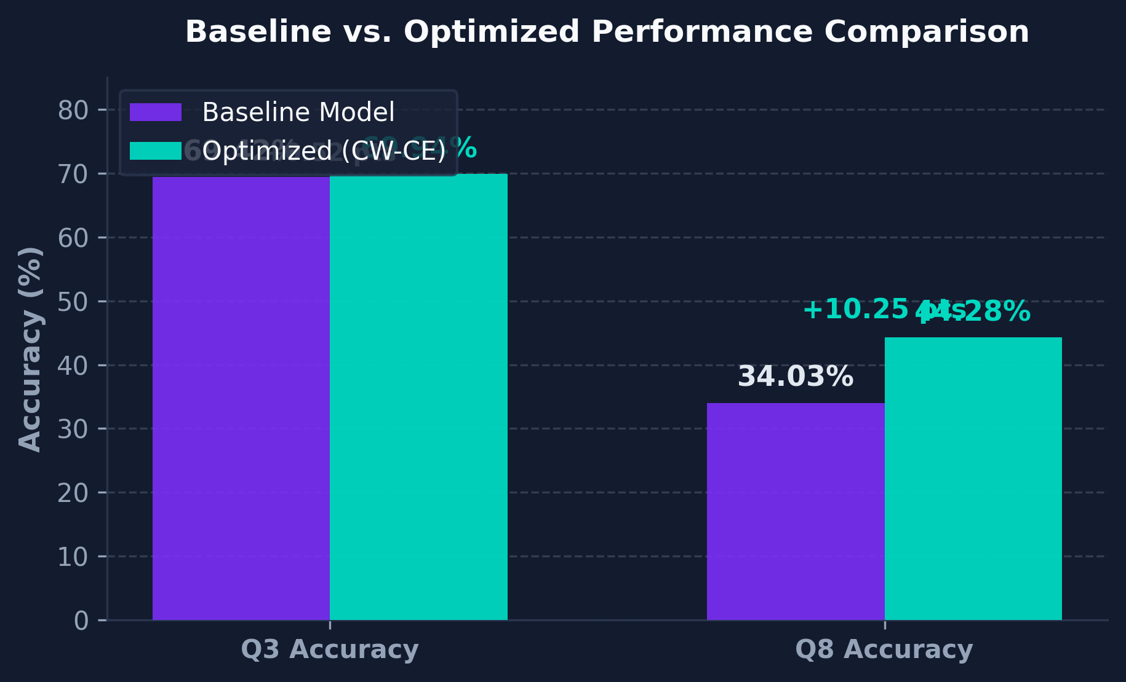
PROTINTEL EVALUATION BENCHMARK
Model Performance — CB513 Benchmark
Independently verified via fresh evaluation on the CB513 held-out test set — 514 proteins never seen during training.
QUANTITATIVE METRIC COMPARISON
Metric | Baseline | Optimized | Improvement
Q3 Accuracy | 69.42% | 69.94% | +0.52 pts
Q8 Accuracy | 34.03% | 44.28% | +10.25 pts
Q3 MCC | 0.527 | 0.539 | +0.012
Q8 Macro F1 | — | 30.77% | N/A
KEY ARCHITECTURAL HIGHLIGHT
+10.25 point improvement in Q8 (8-class) accuracy through class-weighted loss addressing severe data imbalance.

