Slide 1

JARIR
DATABASE
Database Principles Project
Rama Alomair
Alanoud Alshayea
Sara Aloqiel
Layan Alhaider

Slide 2

PROJECT
DESCRIPTION
Jarir bookstore is an offline and online retail store that offers electronics, books, office supplies and more. The project aspires to design a database for Jarir to manage and sustain data for online orders.

Slide 3
VIEW
DESCRIPTION
The database is insightful for customers as it permits:
Saving personal information
View product details
View and track orders
Contact courier driver

Slide 4
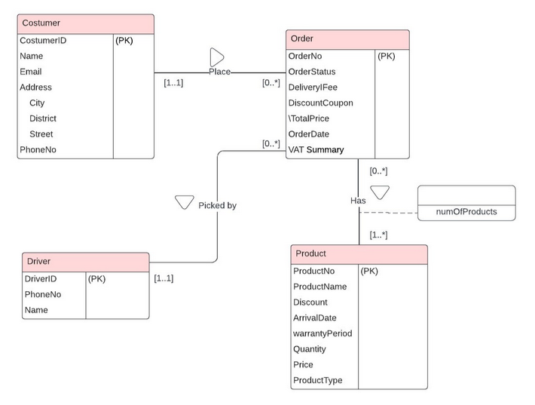
EER
MODEL
Global enhanced entity relationship diagram

Slide 5
DATA
DICTIONARY
Data Dictionary showing description of all entities:
Entity Name | Description | Occurrence
Customer | The customer is the person that places an order. | A customer can place one, none or many orders
Order | An Order refers to a customer’s request made through the online shop. | An order is placed by one and only one customer, has one or more products, and is picked by one and only one driver.
Product | Products are of many types, selected by the customer and added to an order. | Each product is in one, none or many orders.
Driver | The driver is the individual responsible for picking up an order and delivering it to a customer. | A driver picks one, none or many orders.

Slide 6
DATA
DICTIONARY
Data Dictionary showing description of all relationships:
Entity Name | Multiplicity | Relationship | Entity Name | Multiplicity
Customer | 1..1 | Place | Order | 0.. *
Order | 0.. * | Has | Product | 1.. *
Order | 0.. * | Picked by | Driver | 1..1

Slide 7
DATA
QUERIES
DATA QUERIES LIST:
List products within specific type and price range.
Sort products from highest price to lowest and vice versa.
Retrieve customer’s information.
Display discounted products.
Sort products from newest arrivals to oldest.
Display a specific order status
Display max and min product price within specific type

Slide 8
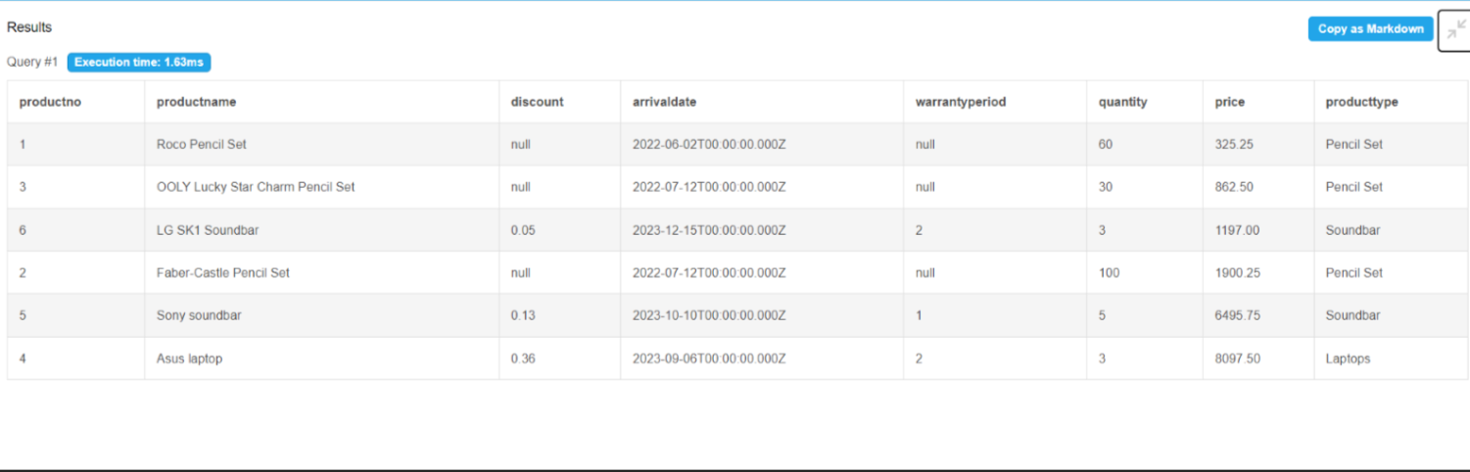
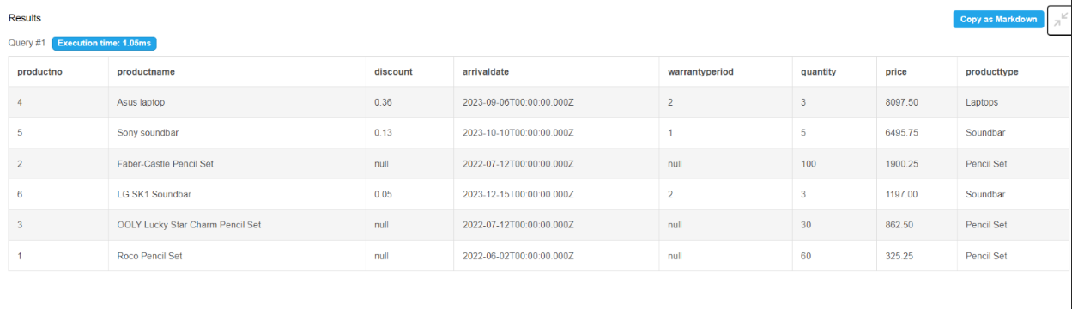
DATA
OUTPUT
QUERIES
SELECT *
FROM Product
Order by Price;
COMMAND
Sort products from highest price to lowest and vice versa.
SELECT *
FROM Product
Order by Price DESC;

Slide 9
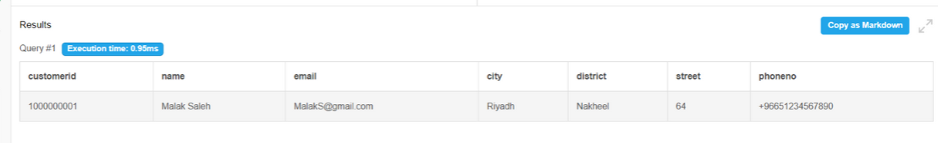
DATA
QUERIES
COMMAND
Retrieve customer’s information.
SELECT *
FROM Customer
WHERE CustomerID = '1000000001';
OUTPUT

Slide 10
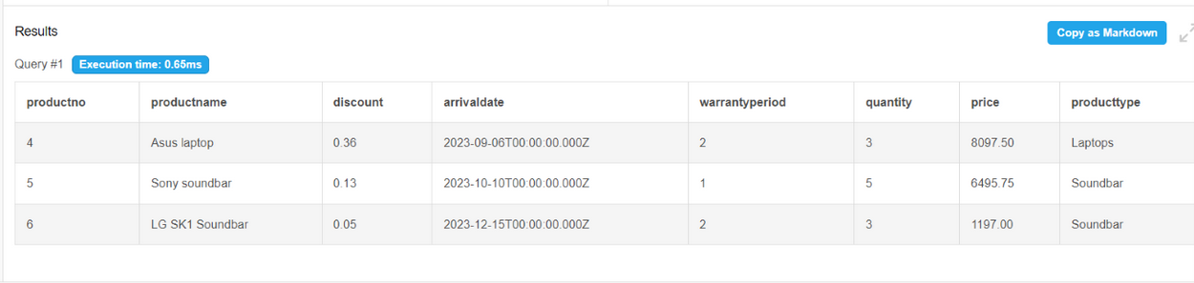
DATA
QUERIES
COMMAND
Display discounted products.
SELECT *
FROM Product
WHERE Discount IS NOT NULL;
OUTPUT

Slide 11
THANK YOU
Q&A Session: we welcome any questions or further discussion

