Slide 1



LINKEDIN JOB
JOB MARKET INTELLIGANCE
Group # 1
Rama Alomair 444200662
Walaa Saifaleslam 444200088
Mona Alnajjar 444200091
Alya Althobiani 444200973
IT462 - Big Data Systems 1447 2'nd Semester
Dr. Afshan Jafari
Mon 11 May 2026
1

Slide 2

Problem & Motivation
Problem Statement
How can distributed big data processing be leveraged to extract meaningful insights — including job demand patterns, required skills, and salary predictions — from large-scale LinkedIn job postings?
Context
Stakeholders
Job Seekers · Recruiters
HR Teams · Researchers
Career Counselors
Millions of job postings generated daily — hard to analyze at scale
2

Slide 3
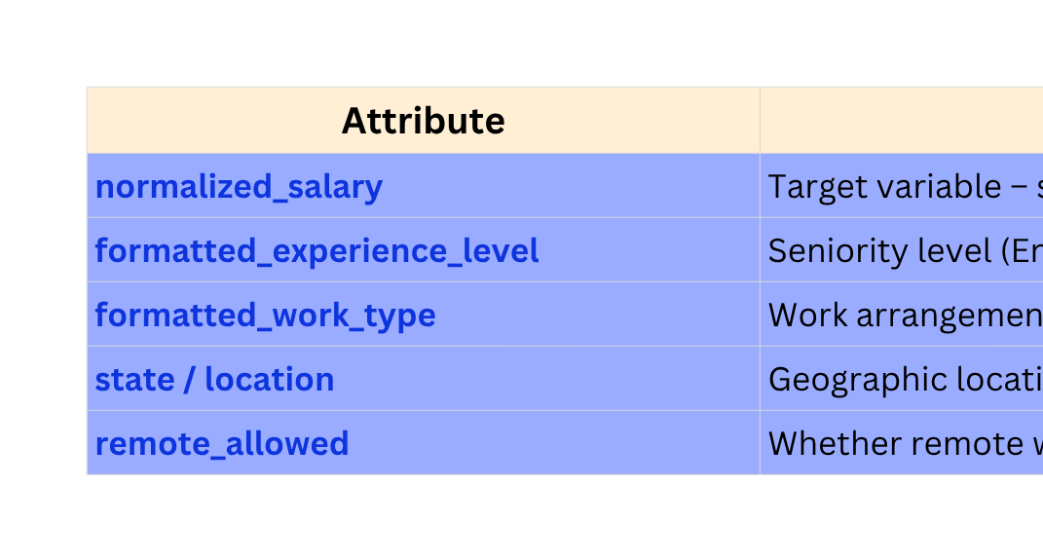
Dataset Overview
Source: LinkedIn Job Listings — Hugging Face
URL: huggingface.co/datasets/Moheez2611/linkedin_job_listings
Domain: Human Resources & Labor Market Analytics
~123K
Row
34
Column
3 – 4 / 2024
Time span
3

Slide 4

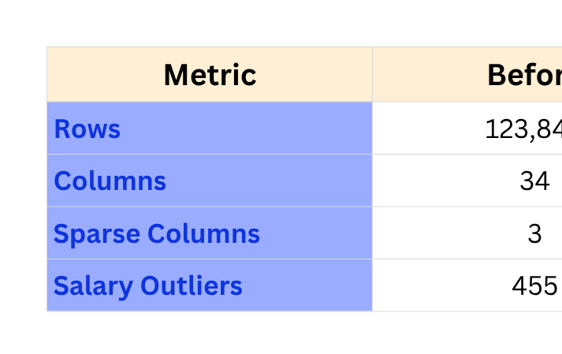

Data Quality & Prepsocessing
MAIN DATA QUALITY ISSUES
KEY PREPROCESSING STEPS
Dropped highly sparse columns
Imputed missing values:
categorical → "Unknown"
numeric → 0.0
salary → median values
Reduced dimensionality by:
extracting state
removing redundant features
Applied:
StringIndexer
OneHotEncoder
StandardScaler
High missingness in:
closed_time (99.13%)
skills_desc (98.03%)
med_salary (94.93%)
Salary inconsistencies and extreme outliers
High-cardinality categorical fields
(title, location)
4

Slide 5
RDD EXPLORATION
Filter
Scala Snippet
Isolate remote jobs from the dataset to analyze flexible work opportunities
val stateTotalsRDD =
stateSalaryRDD.reduceByKey((a, b) =>
(a._1 + b._1, a._2 + b._2)
)
val sortedRDD = stateAvgRDD
.map { case (state, avg) => (avg, state) }
.sortByKey(false)
reduceByKey
Compute average salary per state for geographic salary analysis
sortByKey
Rank states by average salary to identify highest-paying regions
Result Summary
STRONG ONLINE PRESENCE
State | Avg Salary
San Francisco Bay Area | $119,270
New York City Metro Area | $106,076
Greater Seattle Area | $105,693
Interpretation
Remote jobs represented only 12.3% of total postings
Geographic location strongly influenced salary levels
Metropolitan regions consistently showed the highest compensation
Results helped identify important salary prediction features such as location and work type
5

Slide 6
SQL ANALYTICS HIGHLIGHTS
Average salary by experience level
Result Summary
Executive and Director roles had the highest average salaries
Experience Level | Avg Salary
Executive | $119,888
Director | $113,012
Mid-Senior Level | $92,309
Top states by average salary
San Francisco Bay Area and New York City ranked highest
Salary ranking within experience levels
Revealed extreme salary outliers and large salary variation within the same seniority group
STRONG ONLINE PRESENCE
Interpretation
Experience level and geographic location were major salary predictors
SQL analytics revealed salary outliers exceeding regional averages
Findings directly supported the ML task of salary prediction by identifying the most influential features
6

Slide 7

ML Approach
PROBLEM TYPE
MODEL CHOSEN
Supervised Regression (Predicting Continuous Salary)
Random Forest (Ensemble) & Gradient Boosted Trees (GBT)
KEY FEATURE
TRAIN/TEST SPLIT
Job Title, State, Work Type, Experience Level, Remote Allowed
80% Training / 20% Testing | Seed: 42
7

Slide 8
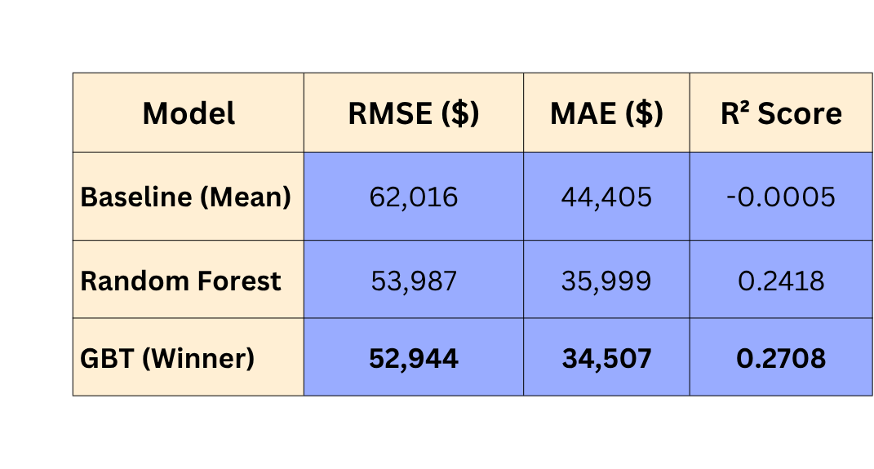
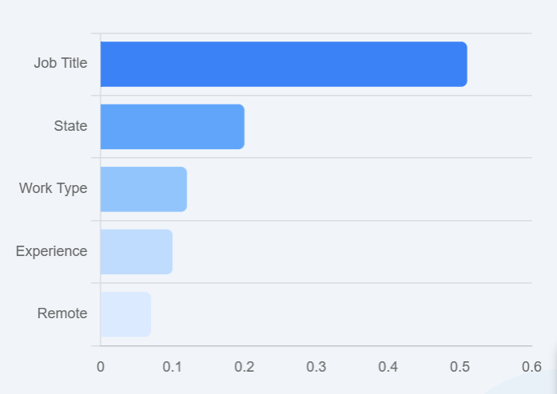
Results & Model Performance
Interpretation: GBT outperformed the baseline by 14.6%. R² of 0.27 is a solid indicator for real-world salary data.
8

Slide 9


INTERPRETATION & INSIGHTS
Top 3 important features: Job Title, followed by State and Work Type.
Where the model performs well: Estimating salaries for common job titles.
Where it struggles: Predicting salary for rare roles with low data frequency.
Practical implications: Recruiters can benchmark competitive salary ranges; job seekers can identify location-based pay disparities.
9

Slide 10

LIMITATIONS & FUTURE WORK
Limitations
Future Work
Missing skills data (98% nulls)
Spark NLP for skill extraction
Limited temporal window (2 months)
Real-time streaming integration
No company revenue data
Hyperparameter Grid Search
10

Slide 11

CONCLUSION
Main Achievements
Built end-to-end Spark pipeline for 123k+ records.
GBT model improved salary prediction accuracy by 14.6%.
Key Takeaway
Data transparency enables informed pay decisions for job seekers and recruiters alike.
11

Slide 12

THANK
You
Any Questions?
12

