Slide 1
Making Medical Abstracts Easier to Read
Sequential Sentence Classification — PubMed 20k RCT Capstone Project
Ramachandra Udupa | Employee ID: 290997
Notes:
Quick intro: who I am and what this project is. The one-line version — abstracts are hard to skim,
so I built a model that automatically restructures them into something scannable. I'll walk through
the problem, the five approaches I tried, the results, a live example, and what I'd recommend we do
with it.

Slide 2
The Problem
• Medical research abstracts pack Background, Objective, Methods, Results, and Conclusions into one dense, unlabeled paragraph — typically 200 to 300 words with zero visual separation between sections.
• Anyone reviewing a paper — a clinician, a researcher, anyone doing a literature review — has to read the whole thing just to find the one part they actually need.
• That's a real bottleneck for systematic reviews and meta-analyses, where someone might need to scan hundreds or thousands of abstracts in one pass.
• A handful of journals format their abstracts with section headers already, but most don't, and there's no practical way to retrofit the existing literature by hand.
1
Notes:
This is the business case in plain terms: nobody wants to read a full paragraph just to find one
sentence. It's not a one-off annoyance either — it's a time cost that repeats every single time
anyone on the research or clinical side does a literature review. I'll show a live example of exactly
this problem in a few slides, using a real abstract.

Slide 3
The Idea
• Build a model that reads an abstract one sentence at a time and tags each one: Background, Objective, Methods, Results, or Conclusions.
• Once every sentence is tagged, we can automatically reformat the abstract into a clean, scannable structure — no manual editing needed.
• This is what's called sequential sentence classification: each sentence gets its own label, but the model still gets to consider it in the context of the sentences around it.
• The end output isn't just a set of labels — it's a genuinely more readable document, ready to hand to anyone who needs to skim it fast.
2
Notes:
The core idea is simple even though the models behind it aren't: read a sentence, decide which of
five buckets it belongs in, repeat for every sentence in the abstract. Once we have those labels,
laying the abstract out nicely is just formatting — the hard part, and the bulk of this project, was
getting those labels right.

Slide 4
The Data
• PubMed 20k RCT: a public dataset of real randomized controlled trial abstracts pulled from PubMed.
• About 20,000 abstracts in total, already broken down sentence by sentence, with every sentence hand-labeled into one of our five categories.
• Split three ways, on purpose:
– Training set — 180,040 sentences the models actually learn from.
– Validation set — 30,212 sentences used to tune and compare models along the way.
– Test set — 30,135 sentences, held back and checked only once, at the very end.
• The five labels — Background, Objective, Methods, Results, Conclusions — and nothing else, so every sentence has to fit one of these.
3
Notes:
None of this is synthetic — it's about 240,000 real sentences from real trial abstracts. The reason
we split it three ways is discipline: we tune models against the validation set as much as we like,
but the test numbers only get looked at once, right at the end, so we're not fooling ourselves about
how well this actually generalizes to abstracts the model has never seen.

Slide 5
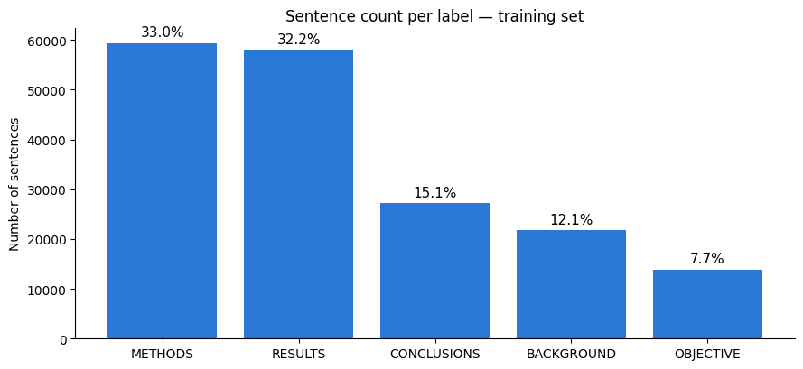
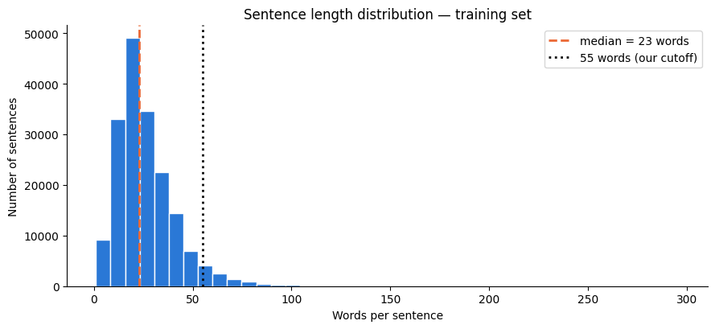
What the Data Told Us
Methods and Results make up nearly two-thirds of all sentences while Objective is under 8% — this imbalance is exactly why we later weighted the loss function during tuning. Sentence length also directly set the 55-word cutoff used by the token-level model.

Slide 6
Five Approaches, Simple to Advanced
• Model 0 — Naive Bayes + TF-IDF: a simple keyword-based baseline.
• Model 1 — Custom Neural Network (word-level): learns word patterns from our own data.
• Model 2 — Pretrained Sentence Encoder (Google USE): borrows a ready-made, general-purpose model.
• Model 3 — Custom Neural Network (character-level): learns from raw letter and word-shape patterns.
• Model 4 — Fine-Tuned Language Model (DistilBERT): adapts a pretrained language model to our exact task.
Every approach got the same treatment: a quick, mostly-default first pass to get a baseline, then a properly tuned version — each one scored on both the validation set and the untouched test set, so the comparison on the results slide is apples to apples.
4
Notes:
We didn't jump straight to the fanciest option. Each of these five got the same fair process: build
it, run a naive version to get a baseline, then tune it, then measure it the same way every time —
validation and test — so the comparison on the next few slides is a genuinely fair one.

Slide 7
Results: Validation Accuracy
DistilBERT, fully fine-tuned: 87.1% validation, 86.0% test — our best result, every model improved after tuning, and the winner's test score barely moved from its validation score.
5
Notes:
Every bar pair here shows the tuned version beating the naive version — that alone tells us tuning
was worth doing across the board, not just for one lucky model. And DistilBERT's test score, 86.5%,
tracks right alongside its validation score of 87.5%, which is a good sign we're not just seeing
something that happened to get lucky on the validation set.

Slide 8
Key Takeaways
• Tuning improved every single model we tried — the extra effort consistently paid off, no exceptions.
• A ready-made, general-purpose sentence embedding (Google USE) actually underperformed our own custom-trained model. Off-the-shelf isn't automatically better for a specialized task.
• The character-level model started out weakest of all (58.3%) but became one of our strongest after tuning (80.8%) — architecture tuning mattered as much as the underlying approach.
• Fully fine-tuning an actual pretrained language model gave the best result by a clear margin (87.1%), well ahead of the next-best approach.
• The winning model's test score (86.0%) landed almost exactly where its validation score did (87.1%) — a good sign it'll hold up on abstracts it hasn't seen before.
6
Notes:
Five things worth remembering: tuning always helped, an off-the-shelf embedding actually lost to our
own custom model, the character-level model had the single biggest turnaround from tuning, DistilBERT
won outright, and its test-set score barely dropped from validation — so we're not looking at a model
that just memorized the validation set.

Slide 9
From Dense Text to Structured Text
BEFORE
AFTER — auto-segmented by our model
Investigate the efficacy of several weeks of daily low-dose oral prednisolone in improving pain, mobility, and systemic low-grade inflammation in the short term, and whether the effect is sustained in older adults with moderate to severe knee osteoarthritis (OA). A total of a specified number of patients with primary knee OA were randomized into two groups; one group received a daily dose of prednisolone while the other received a placebo. Outcome measures included pain reduction, improvement in function scores, and systemic inflammation markers. Pain was assessed using the visual analog pain scale. Secondary outcome measures included the Western Ontario and McMaster Universities Osteoarthritis Index scores, patient global assessment of knee OA severity, and walk distance. Serum levels of various biomarkers were measured. There was a clinically relevant reduction in the intervention group compared to the placebo group for knee pain, physical function, and other measures at different time points.
Objective: Investigate the efficacy of several weeks of daily low-dose oral prednisolone in improving pain, mobility, and systemic low-grade inflammation in the short term, and whether the effect is sustained in older adults with moderate to severe knee osteoarthritis (OA).
Methods: A total of a specified number of patients with primary knee OA were randomized into two groups; one group received a daily dose of prednisolone while the other received a placebo. Outcome measures included pain reduction, improvement in function scores, and systemic inflammation markers. Pain was assessed using the visual analog pain scale. Secondary outcome measures included the Western Ontario and McMaster Universities Osteoarthritis Index scores, patient global assessment of knee OA severity, and walk distance. Serum levels of various biomarkers were measured.
Results: There was a clinically relevant reduction in the intervention group compared to the placebo group for knee pain, physical function, and other measures at different time points.
This is a real abstract run through our actual trained model — nothing staged.
7
Notes:
This is not a mockup — this is the real trained model, run against a real abstract it had never seen,
live in the notebook. Left side is exactly what you'd get pasted from a paper. Right side is what the
model produced automatically: Objective, then all five Methods sentences grouped together, then
Results — no manual work, no hints about where the boundaries were. That's the entire value
proposition of this project in one slide.

Slide 10
Recommendation
• Deploy the fine-tuned DistilBERT model. Best accuracy overall — 87.1% validation / 86.0% test — and it reliably separates all five sections.
• Start with a pilot, not a full rollout: run it against one team's incoming literature reviews first, collect feedback on any obviously wrong labels, then expand from there.
• If speed or compute cost matters more than a few points of accuracy: the tuned word-level or character-level neural networks (~78-81%) are far cheaper to run and still solid performers.
• Either way, keep a human in the loop early on — this speeds up reading, it doesn't replace judgment.
8
Notes:
My recommendation is the fine-tuned DistilBERT model, but I'd stage the rollout rather than flipping
it on everywhere at once — start with one team, see where it actually gets things wrong on real
incoming abstracts, and use that feedback before expanding further. And if there's ever a reason to
care more about speed or running cost than the last few points of accuracy, the tuned Conv1D models
are a genuinely solid fallback, not just a consolation prize.

Slide 11
What This Means Day to Day
• Turns a full read-through of an abstract into a five-second scan — the reader goes straight to the section they actually need.
• Multiply that across every abstract someone reviews in a week, and the time saved adds up fast — especially for anyone doing large-scale literature reviews.
• The winning model is lightweight enough (roughly 260MB) to run as a simple internal service, on hardware we already use for other internal tools — no special infrastructure required.
• Trained once, on our own data — no per-use licensing cost, and it's ours to run as much as we want.
9
Notes:
This slide is really about translating the accuracy numbers into something that matters day to day:
less time spent hunting through paragraphs, and a model that's cheap enough to actually deploy without
standing up new infrastructure. It's a one-time training cost, then it's just ours to use.

Slide 12
Next Steps
• Short term: wrap the winning model in a simple internal tool so any team can paste in an abstract and get back a structured version.
• Medium term: pilot it with a real team, collect feedback on where it gets things wrong, and use that to decide whether more tuning is needed.
• Longer term: test the approach on other types of documents beyond clinical trial abstracts, and explore larger pretrained models if we need to push accuracy further.
• Ongoing: keep an eye on accuracy as new literature comes in — language and topics shift over time, so the model should be revisited periodically, not deployed and forgotten.
10
Notes:
Roughly in order: ship a simple internal tool first, pilot it with one real team and actually listen
to where it's wrong, then think bigger — other document types, bigger models — once we trust it.
And this isn't a train-once-and-forget situation; language in the literature shifts over time, so
whoever owns this should plan to periodically check it's still performing well.

Slide 13
Thank You
Questions?
Ramachandra Udupa | Employee ID: 290997
Notes:
Wrap up: five approaches tried, fine-tuned DistilBERT came out on top at 87.5%/86.5%, and we have a
working live example to prove it isn't just a number on a slide. Open it up for questions from here.

