Slide 1
RAG - Production Grade Architecture (PoC)
Ramachandra – Software Architect

Slide 2
Overview
Purpose
Problem Statement
Solution
RAG High-Level Architecture – PoC
Why This Architecture Is Strong
Component and Layer Responsibilities
Replaceability & Evolution
Why This Architecture Is Enterprise‑Ready
PoC– Software Stack
Demo
Key Achievements
Recap

Slide 3
Purpose
This Proof of Concept demonstrates:
How Large Language Models (LLMs) can be grounded using enterprise or private data
A clean separation of concerns across API, retrieval, and generation layers
A model‑agnostic and storage‑agnostic RAG architecture suitable for future production evolution

Slide 4
Problem Statement
Challenges with LLMs
LLMs are trained on general, public data
They cannot access proprietary or domain‑specific content
They may hallucinate when answering factual questions outside their training data
They provide no inherent guarantees of grounding, traceability, or source attribution
Solution: Retrieval‑Augmented Generation (RAG)
RAG addresses these challenges by:
Retrieving relevant knowledge at query time
Injecting that knowledge into the LLM prompt
Generating responses grounded in real, verifiable data

Slide 5
Solution
Solution: Retrieval‑Augmented Generation (RAG)
RAG addresses these challenges by:
Retrieving relevant knowledge at query time
Injecting that knowledge into the LLM prompt
Generating responses grounded in real, verifiable data
Result:
Accurate, explainable, and enterprise‑ready GenAI responses

Slide 6
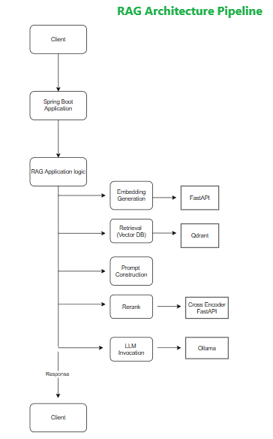
RAG High-Level Architecture (PoC)
The PoC currently focuses on:
Document-based question answering
Contextual response generation using enterprise content
Modular and cloud-ready architecture design
Model-agnostic and data-source-agnostic approach
Conceptual Flow
Client sends query
Enterprise API routes request
RAG layer orchestrates retrieval and generation
LLM responds with grounded answer
Key Layers
Enterprise API Layer (Spring Boot)
RAG Orchestration Layer (FastAPI)
Vector Database (Qdrant)
Cross Encoder For Reranker (FastAPI)
LLM Runtime (Ollama)

Slide 7
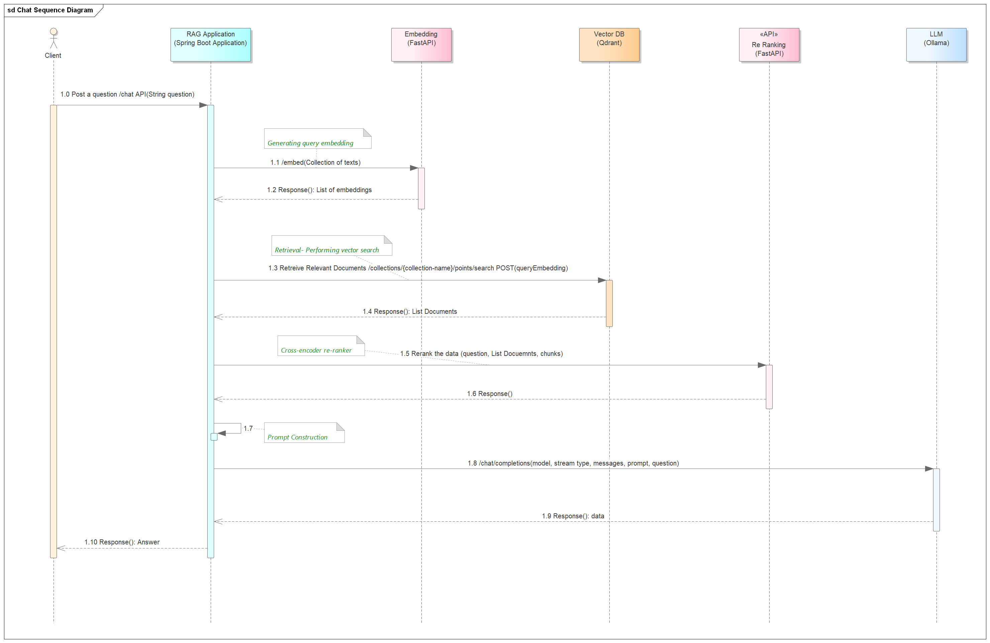
RAG High-Level Architecture (PoC) Contd..
Sequence: Client to RAG system

Slide 8
Architectural Principles (PoC) Contd..
Separation of Concerns
Enterprise API logic is isolated from AI logic
API, retrieval, and generation responsibilities are isolated
Pluggability
Each component can be swapped without redesigning the system
FastAPI, LLMs, Vector DB, and Frameworks can be replaced
Technology Alignment
Java (Spring Boot) for enterprise integration
Python (FastAPI) for AI & RAG workflows
PoC Simplicity
Focus on core RAG mechanics; non-essential concerns are deferred

Slide 9
Why This Architecture Is Strong
Clean Separation of Concerns
Spring Boot = Public APIs, Streaming, Security, Embeddings and Prompts
FastAPI = RAG orchestration
Qdrant = Vector storage & search
Ollama = LLM inference
Technology Decoupling
Java teams own Spring Boot
AI teams evolve FastAPI independently
LLMs and vector DBs are swappable
Production‑Aligned
Even as a PoC, this mirrors real enterprise GenAI deployments

Slide 10
Component and Layer Responsibilities
Enterprise API Layer
Spring Boot Application – Enterprise API Layer
Role: Enterprise-facing API gateway / BFF Frameworks
Responsibilities
Expose chat and query APIs
Handle authentication, authorization, and request validation
Route requests to the RAG orchestration layer
Support synchronous and streaming responses

Slide 11
Component and Layer Responsibilities (Contd..)
RAG Application Layer
FastAPI – RAG Orchestration Layer
Role: Implements RAG intelligence
Responsibilities:
Generate embeddings for documents and queries
Query the vector database
Construct augmented LLM prompts
Invoke the LLM runtime
Format and return results
Key Characteristics:
Framework‑agnostic
Replaceable and independently testable
Focused solely on RAG logic

Slide 12
Component and Layer Responsibilities (Contd..)
Vector Database Layer
Qdrant – Vector Database
Role: Retrieval component (R in RAG)
Responsibilities
Store vector embeddings
Perform similarity search (Top‑K retrieval)
Return relevant document content and metadata
Not Responsible For:
Embedding generation
Prompt engineering
LLM reasoning or inference

Slide 13
Component & Layer Responsibilities (Contd..)
LLM Runtime Layer
Ollama – LLM Runtime
Role: Generation component (G in RAG)
Responsibilities
Host and run LLMs locally
Generate responses from augmented prompts
Support streaming and non‑streaming inference
Not Responsible For
Retrieval
Context curation
API orchestration

Slide 14
Replaceability & Evolution
Component | Can Be Replaced With
Spring Boot | API Gateway, BFF Frameworks
FastAPI | Flask, gRPC, Serverless
Qdrant | PostgreSQL + pgvector, Pinecone, Weaviate
Ollama | OpenAI, Azure OpenAI, vLLM
Embedding Model | Any compatible embedding provider

Slide 15
Why This Architecture Is Enterprise‑Ready
Aligns with enterprise Java ecosystems
Clean isolation of AI and platform concerns
Supports both streaming and synchronous use cases
Enables independent scaling of API, retrieval, and inference layers
Closely mirrors real‑world GenAI platform architectures

Slide 16
PoC – Software Stack
Core Technologies
Spring Boot
FastAPI
Qdrant
Cross Encoder Reranker
Ollama
Testing & Validation
Postman

Slide 17
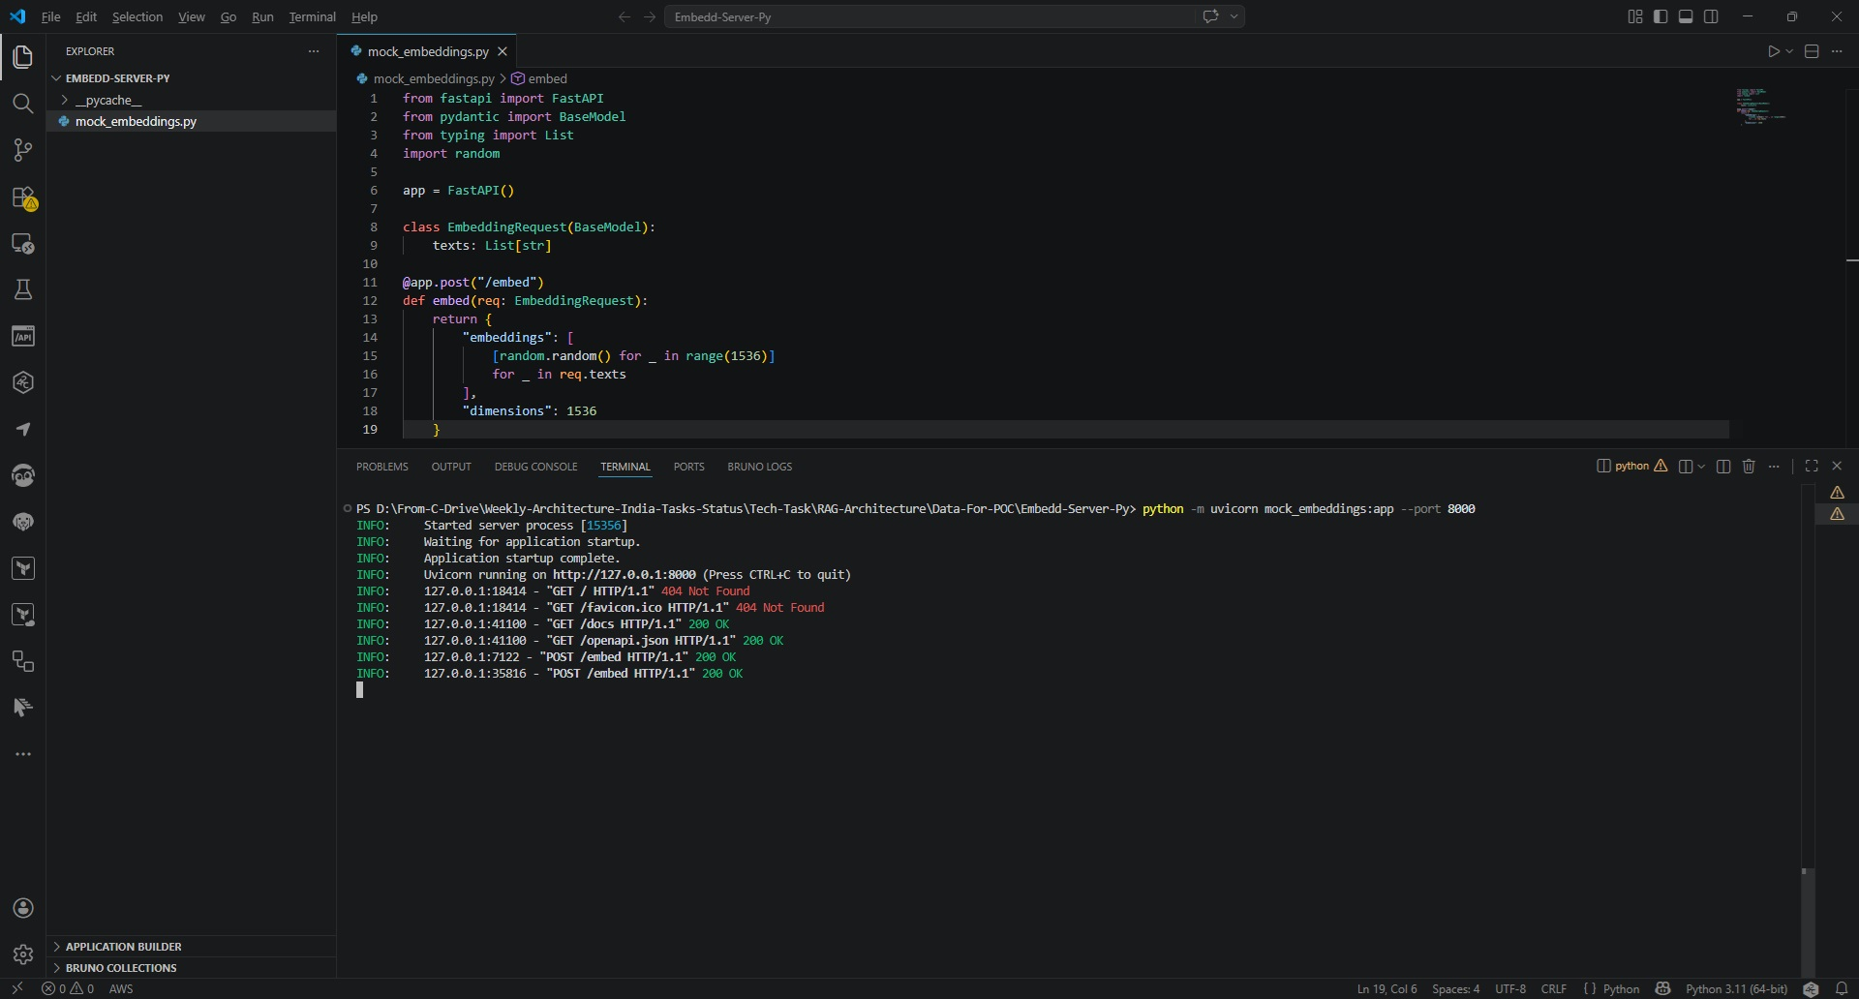
PoC– FastAPI Running
FastAPI is running

Slide 18
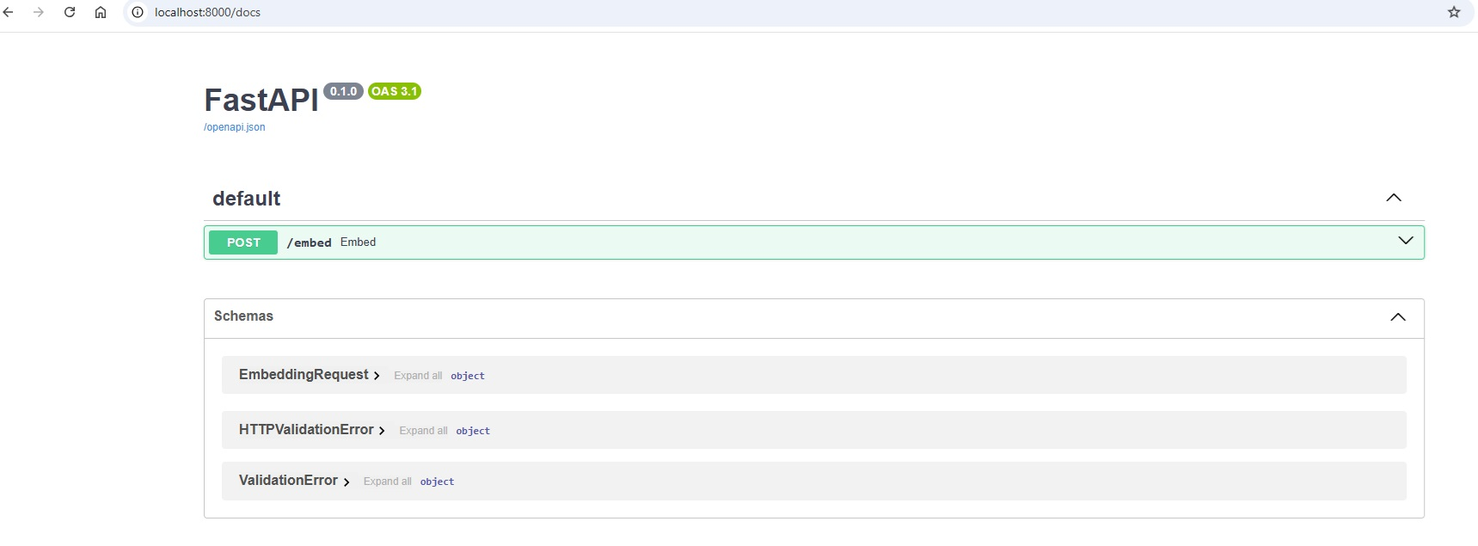
PoC – FastAPI Swagger
FastAPI Swagger

Slide 19
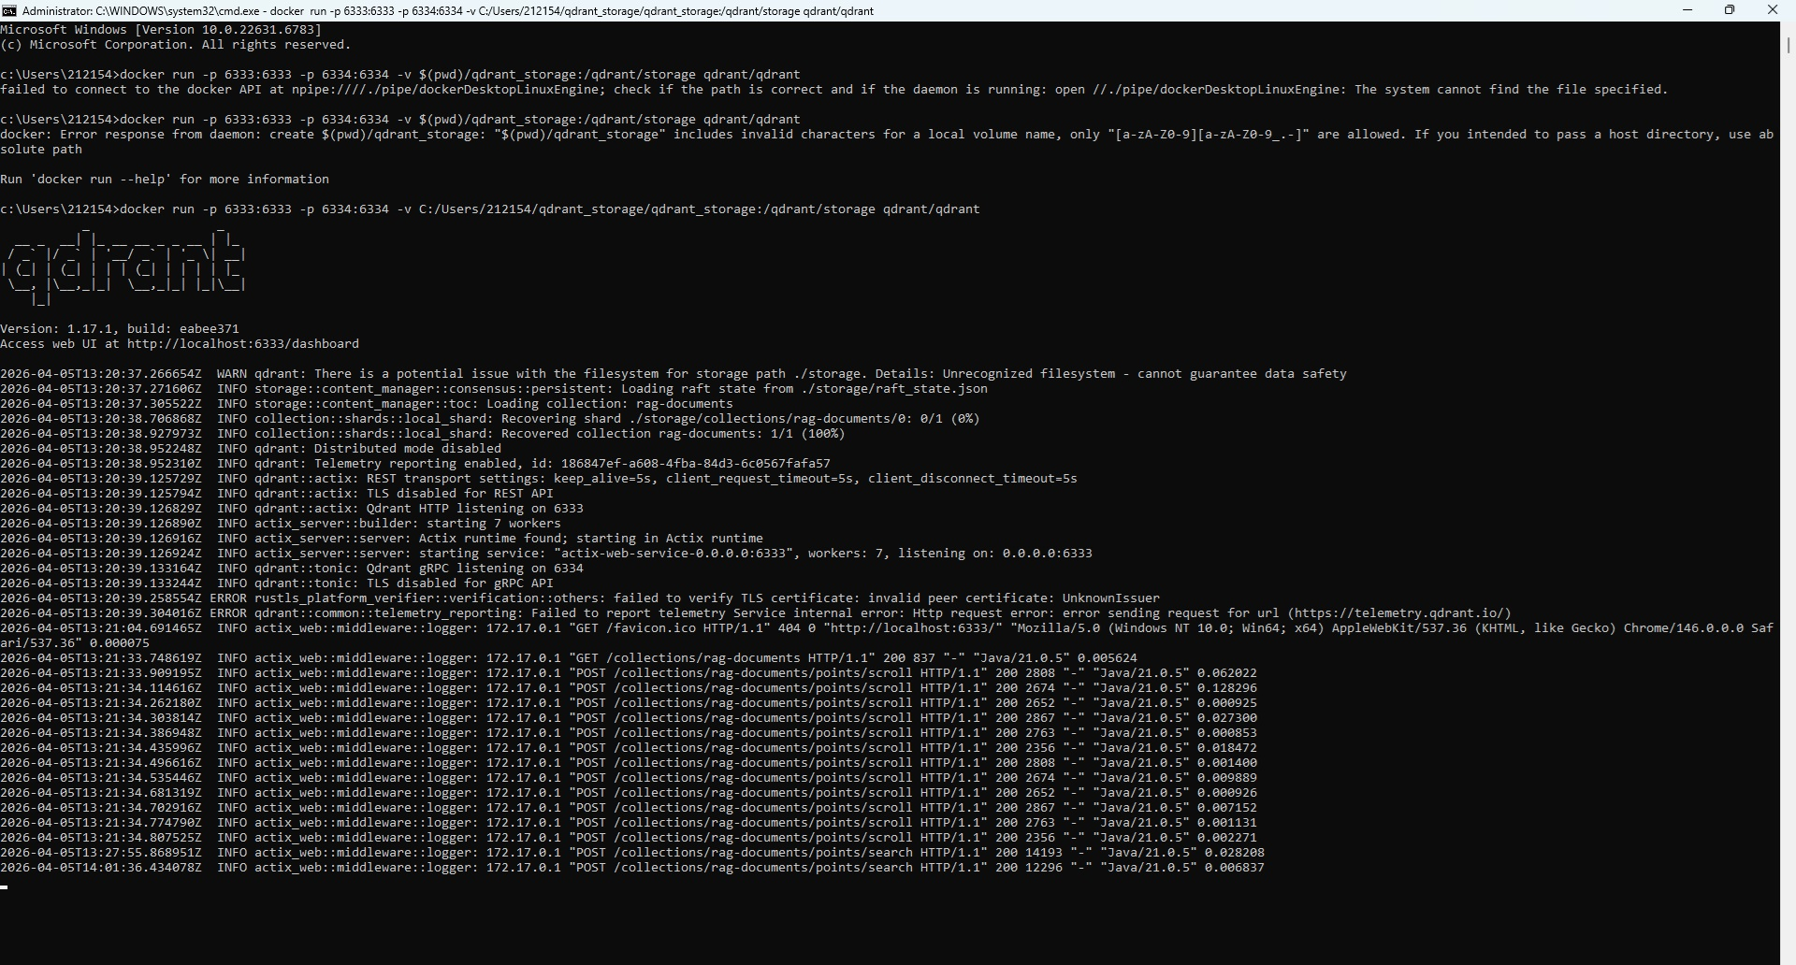
PoC– Qdrant Running
Qdrant is running

Slide 20
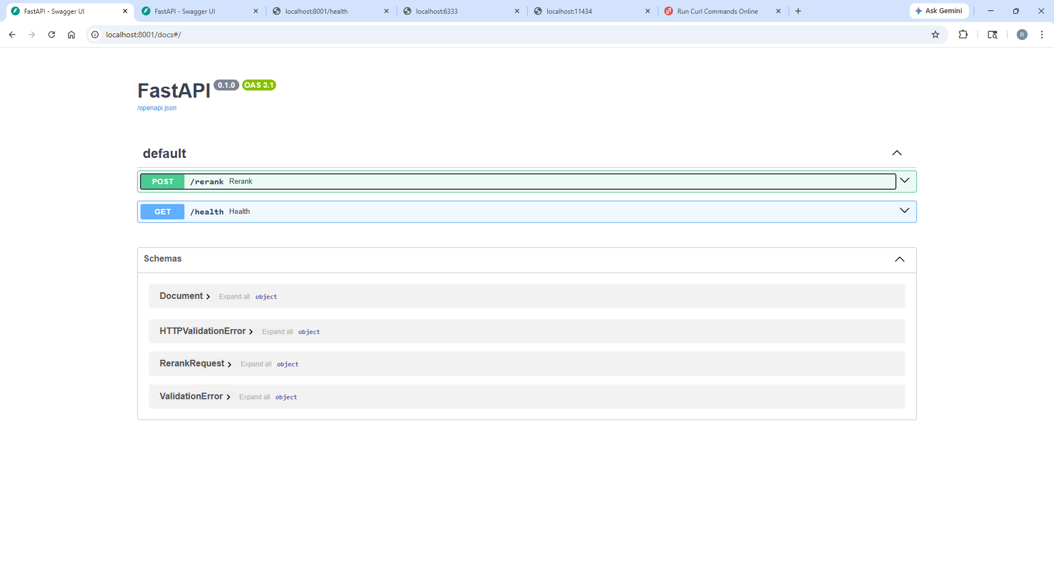
PoC – Cross Encoder Reranker
Cross Encoder for rerank (FastAPI) is running

Slide 21
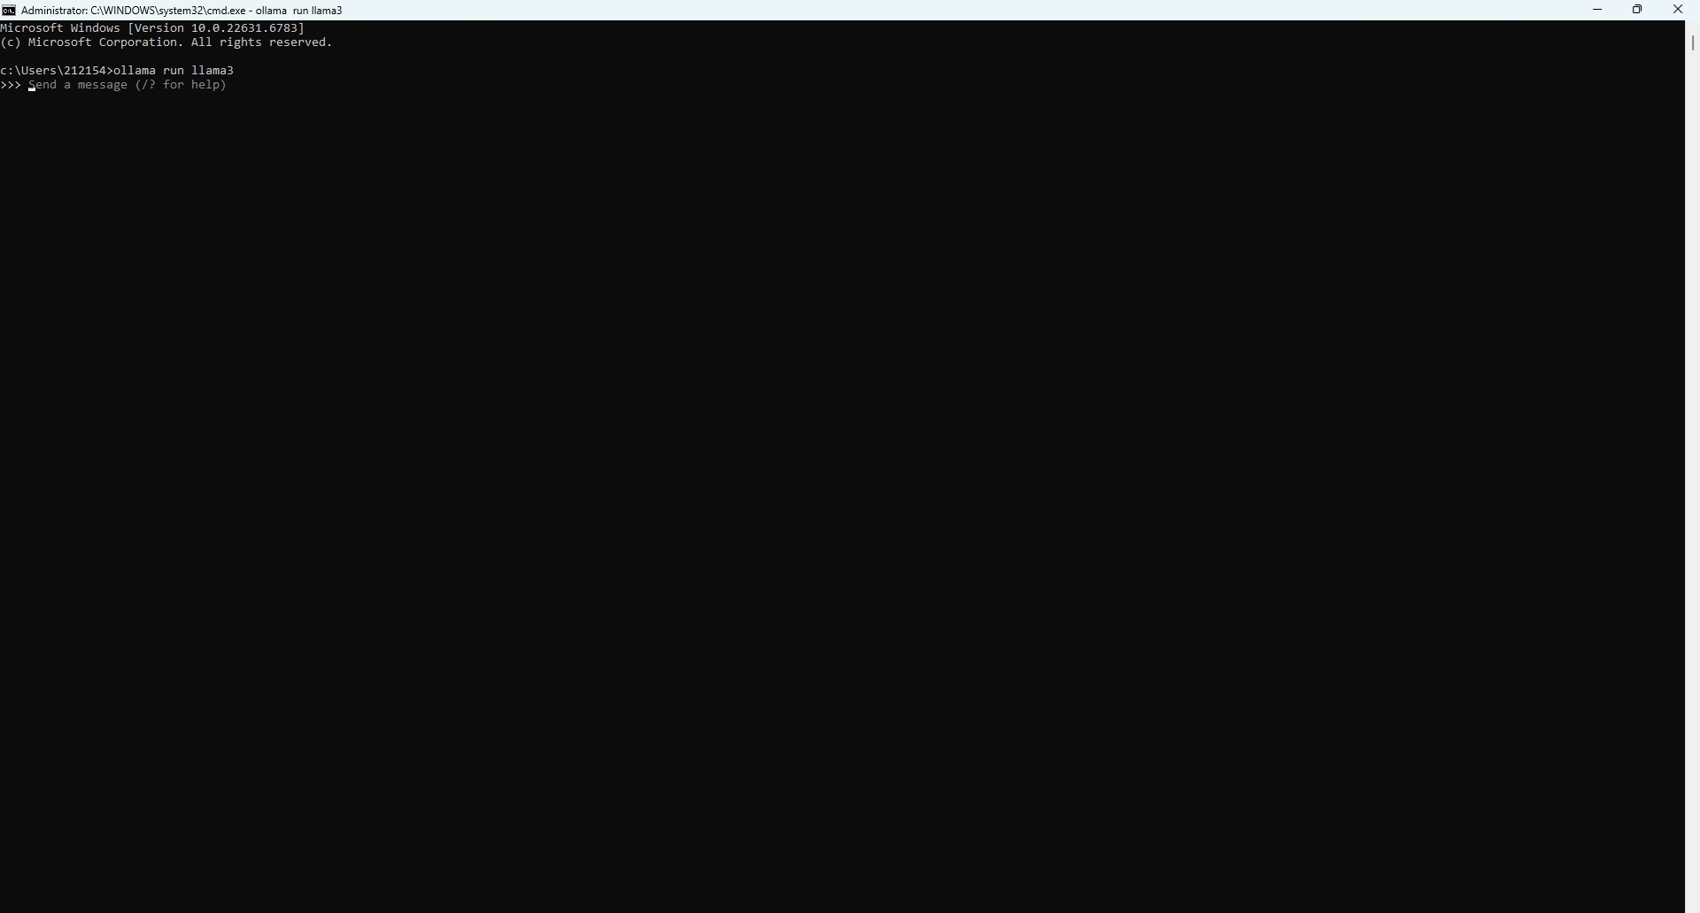
PoC – Ollama Running
Ollama is running

Slide 22
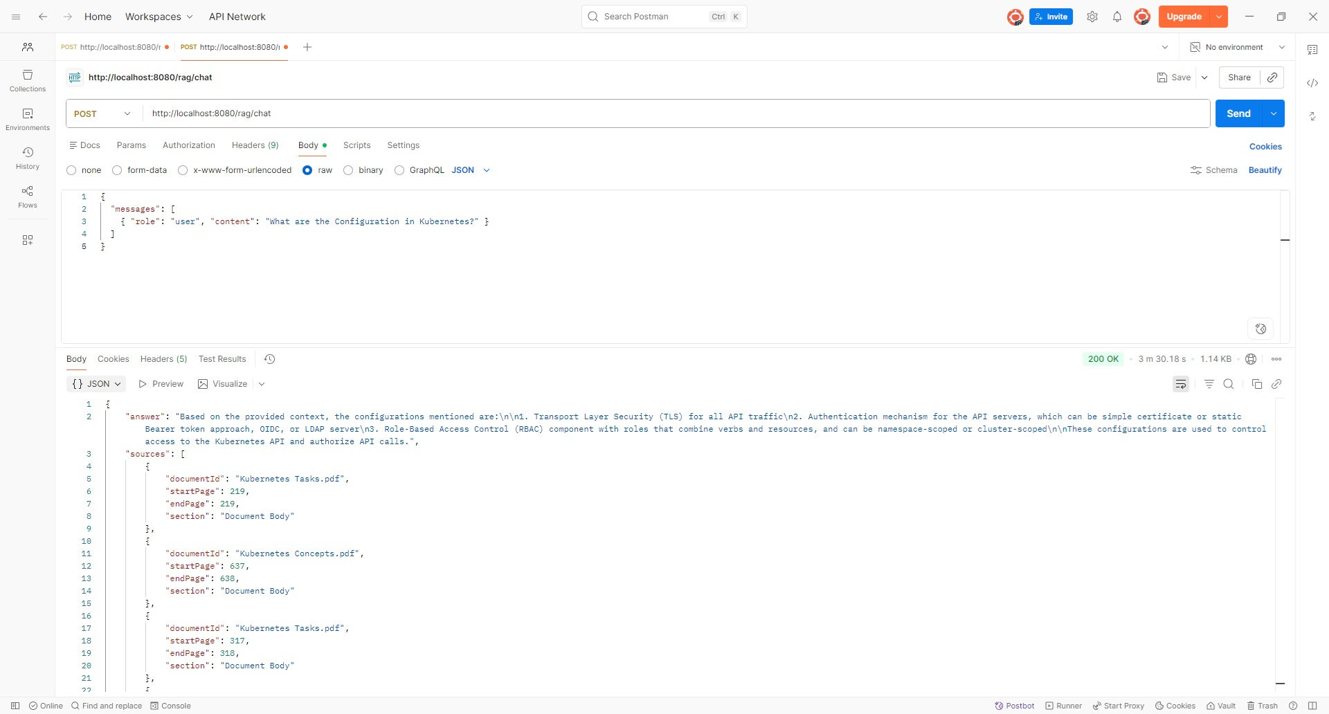
PoC – Sync call
Sync Call from Postman – API /chat

Slide 23
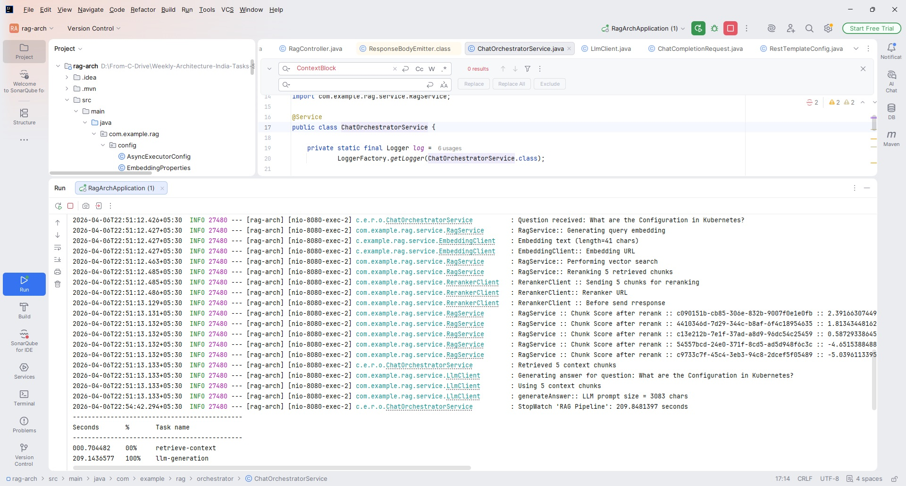
PoC - Sync call Logs
Sync Call Received Spring Boot Application – API /chat

Slide 24
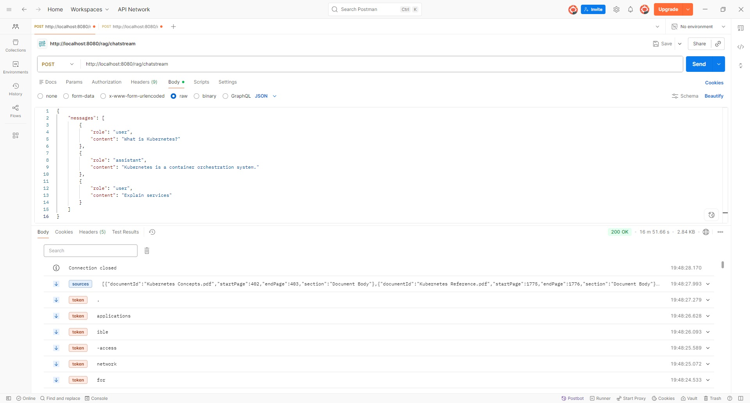
PoC – Async call
Async Call from Postman – API /chatstream

Slide 25
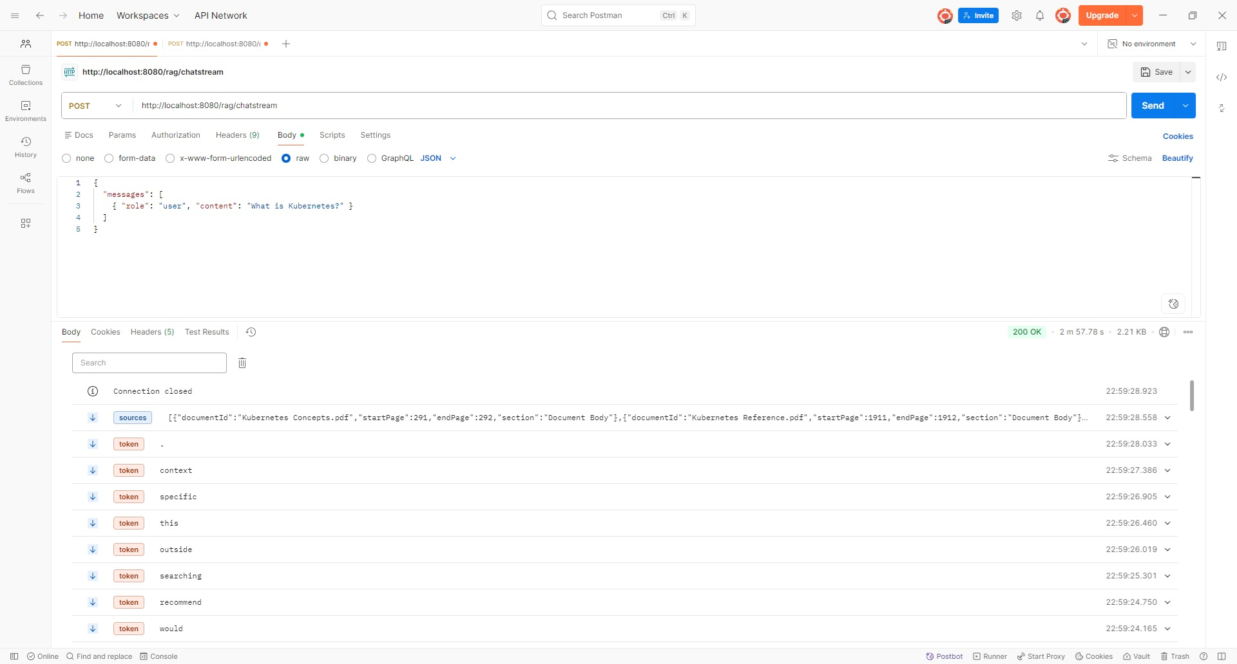
PoC – Async call Logs
Async Call Received Spring Boot Application – API /chatstream

Slide 26
Key Achievements
End-to-end RAG pipeline implemented and validated
Clear separation of concerns (ingestion, retrieval, generation)
Improved answer accuracy compared to vanilla LLM usage
Reduced hallucinations using retrieval grounding
Architecture is modular, scalable, and extensible
Supports future enhancements like multi-modal data and agents

Slide 27
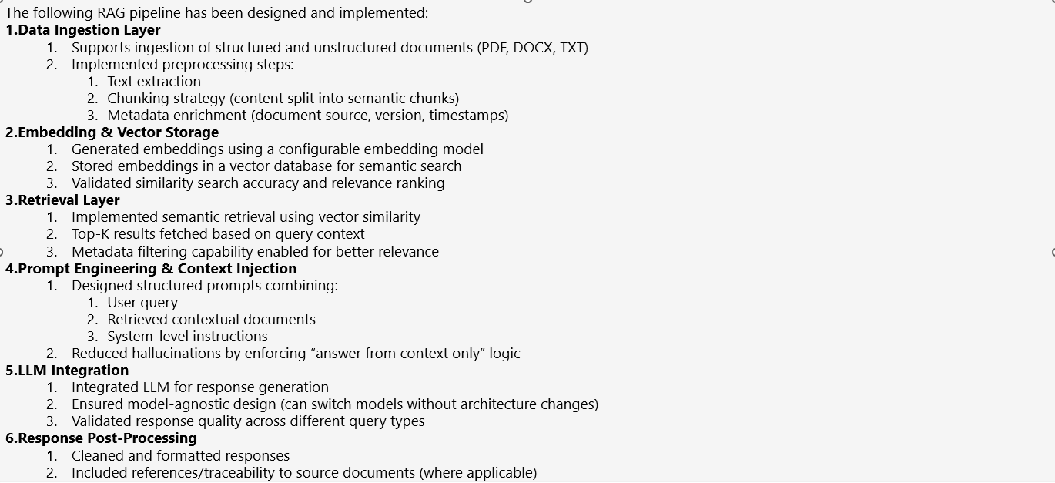
Recap

Slide 28
Thank you

