Slide 1
N
Northwind Data Analysis
Analytical insights from sales, customer, employee, and shipping data
Data Analysis Report • Northwind Traders

Slide 2
Behind the Scenes: From Query to Chart
</>
A sample of the Python + SQL pipeline used to power the “Top Customers” chart
What this code does
query = """
SELECT CustomerID,
COUNT(OrderID) AS TotalOrders
FROM Orders
WHERE OrderDate > '1996-12-31'
GROUP BY CustomerID
HAVING COUNT(OrderID) > 15;
"""
df = read_data_from_sql(conn, query)
print(df)
1. Query the database
A SQL query pulls every customer who placed more than 15 orders since the start of 1997, counting orders per CustomerID.
2. Load into pandas
read_data_from_sql() runs the query through the SQL Server connection and returns the results as a DataFrame.
3. Inspect the output
print(df) shows 5 VIP customers, from SAVEA (28 orders) down to FOLKO and HILAA (16 orders each).
OUTPUT
CustomerID TotalOrders
0 ERNSH 24
1 FOLKO 16
2 HILAA 16
3 QUICK 22
4 SAVEA 28
4. Sort & visualize
The DataFrame is then sorted by TotalOrders and passed to Seaborn to build the bar chart on the next slide.

Slide 3
Straight from SQL Server
DB
The raw T-SQL query run in SQL Server Management Studio before any Python touches the data
select * from Orders
where OrderDate = '1997-05-19';
RESULTS
OrderID | CustomerID | EmployeeID | OrderDate | ShippedDate | ShipCountry
10540 | QUICK | 3 | 1997-05-19 | 1997-06-13 | Germany
10541 | HANAR | 2 | 1997-05-19 | 1997-05-29 | Brazil
WHY THIS QUERY MATTERS
This is the exact query behind the first insight in the deck. Running it directly in SQL Server confirms the source data before it ever reaches Python: only two orders were placed on May 19, 1997 — order 10540 (Employee 3, QUICK) and order 10541 (Employee 2, HANAR). That two-row result is what the read_data_from_sql() function loads into a DataFrame and what the “Employee Orders on a Single Day” chart later visualizes.

Slide 4
Analysis Overview
Five key analytical questions extracted from the Northwind database
1
Daily order distribution across employees
2
Most loyal high-volume (VIP) customers
3
Employee footprint vs. customer density by city
4
Best-selling products
5
Employees linked to shipment delays

Slide 5
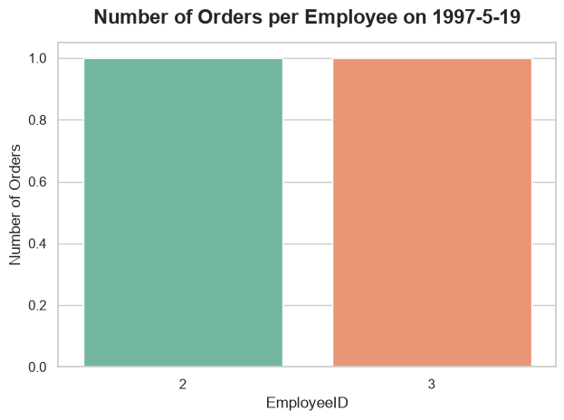
1
Employee Orders on a Single Day
ANALYTICAL QUESTION
What was the volume and distribution of orders processed by employees on May 19, 1997?
KEY INSIGHTS
The day was extremely low-volume for the company, with only two orders registered in total.
Workload was split evenly between Employee 2 and Employee 3, one order each.

Slide 6
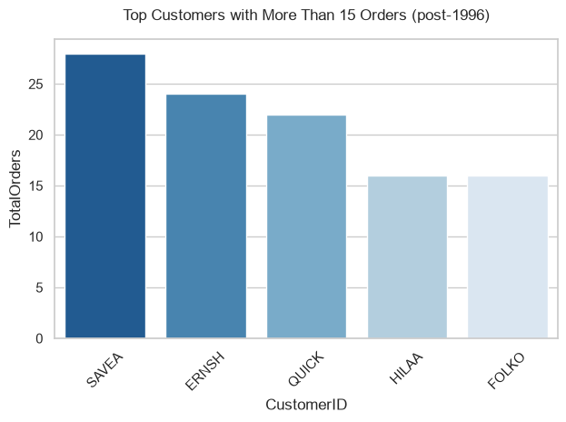
2
Top Customers (VIP)
ANALYTICAL QUESTION
Who are our most loyal, high-volume (VIP) customers who placed more than 15 orders since the start of 1997?
KEY INSIGHTS
The chart clearly highlights the top-tier customers driving the highest order volume post-1996.
RECOMMENDATION
Target these VIP clients with dedicated loyalty programs and exclusive offers to ensure long-term retention.

Slide 7
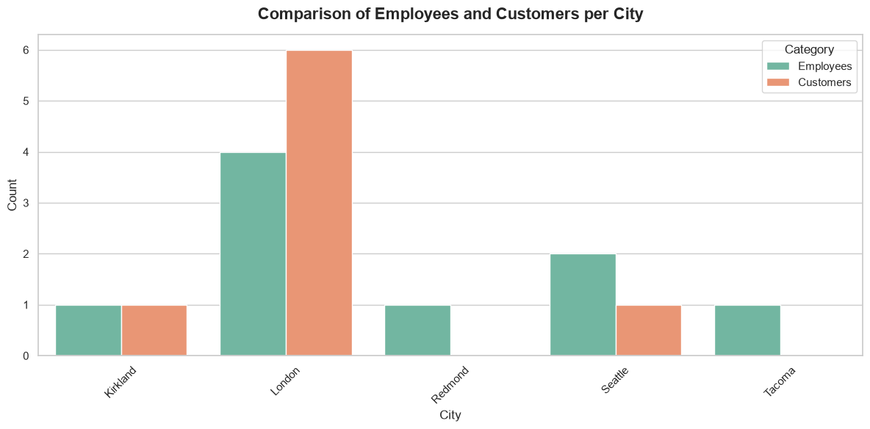
3
Employees vs. Customers by City
ANALYTICAL QUESTION
How does the geographic distribution of our employees compare to the actual density of our customers across cities?
KEY INSIGHTS
The dual-comparison plot reveals geographic gaps; some cities have a large customer base but very few (or no) local employees supporting them.
RECOMMENDATION
Management can strategically relocate staff or hire local representatives in high-density customer cities to optimize service.

Slide 8
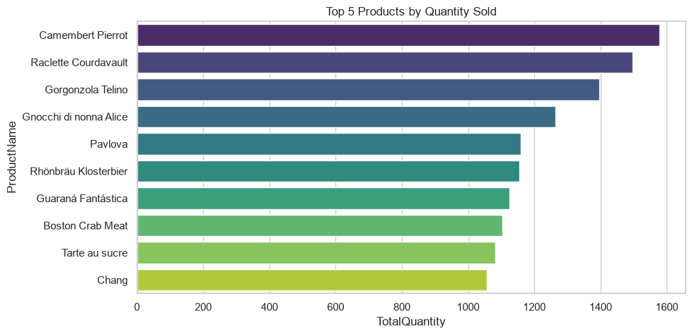
4
Best-Selling Products
ANALYTICAL QUESTION
Which products generated the highest sales volume in terms of total quantity ordered?
KEY INSIGHTS
The chart ranks our most in-demand inventory items, with the leading products showing a significant margin over the rest.
RECOMMENDATION
Inventory and procurement teams must keep consistent stock levels for these top products to prevent stockouts and maximize revenue.

Slide 9
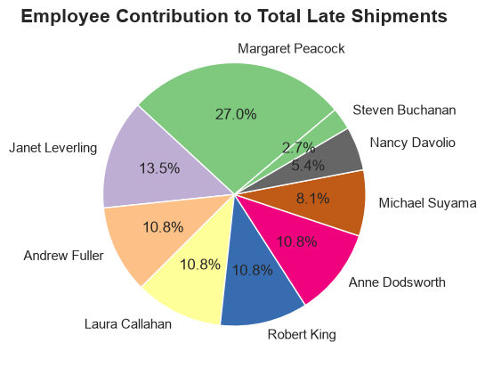
5
Employees and Late Shipments
ANALYTICAL QUESTION
Which employees recorded the highest number of late shipments, where the shipped date exceeded the required date?
KEY INSIGHTS
The chart pinpoints the team members associated with the highest shipping delays.
RECOMMENDATION
Use this insight for operational support — identifying bottlenecks in specific shipping routes or logistics workflows to help improve efficiency.

Slide 10
Summary & Recommendations
Strengthen loyalty programs for VIP customers to secure retention.
Rebalance employee locations to match customer density.
Keep stable inventory for the best-selling products.
Address the root causes of delay for the slowest-shipping employees.
Thank You

