Slide 1

INSIGHTS ON CYBERSECURITY-1
.

Slide 2


Insight on :
Cybersecurity
Cutting edge technologies
Malware and threats
Pentesting and kali linux
Next generation firewalls
VPN and proxies
Cloud computing and cloud security
Vulnerability exploits
Incident response policy
Forensic process
Certifications and resources
Content Outline

Slide 3
WHAT IS CYBERSECURITY
Cyber security is the practice of defending computers, servers, mobile devices, electronic systems, networks, and data from malicious attacks.

Slide 4
NEED FOR CYBERSECURITY
Secure Credentials
Data protection
cia for computing assets

Slide 5
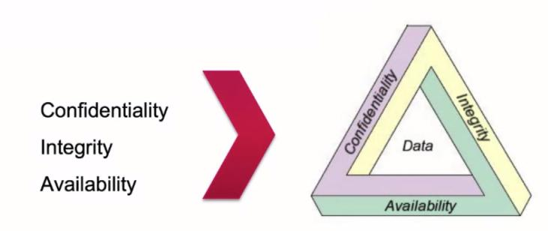
CIA TRIAD

Slide 6
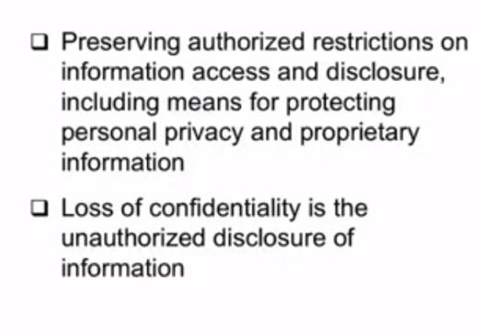
CONFIDENTIALITY:

Slide 7
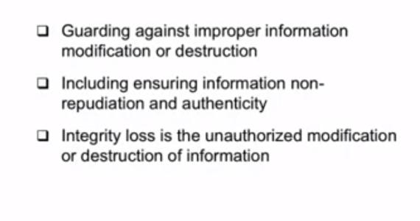
INTEGRITY:
HashGenerator - CheckSum

Slide 8
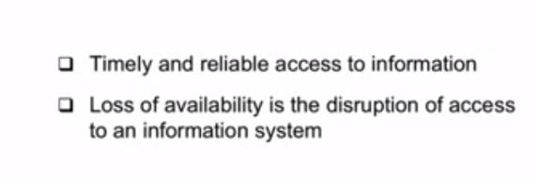
AVAILABILITY:

Slide 9
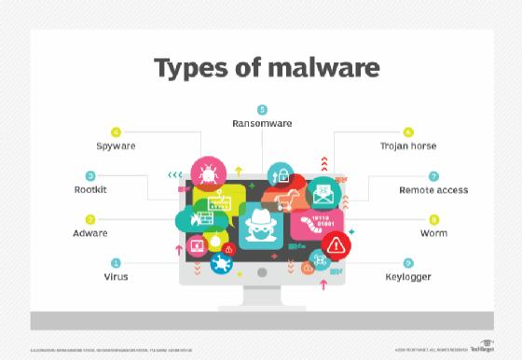
MALWARE
Malicious Software is a software that is intentionally designed to cause damage to a computational asset if the damage caused was unintentional its called a bug

Slide 10
TYPES OF MALWARE
Virus: A computer virus is a malicious piece of computer code designed to spread from device to device.
Trojans: A Trojan (or Trojan Horse) disguises itself as legitimate software with the purpose of tricking you into executing malicious software on your computer.
Worms: A worm replicates itself by infecting other computers that are on the same network. They’re designed to consume bandwidth and interrupt networks.
Ransomware: Ransomware is designed to encrypt your files and block access to them until a ransom is paid.
Keyloggers: Keyloggers keep track of your keystrokes on your keyboard and record them on a log. This information is used to gain unauthorized access to your accounts.

Slide 11
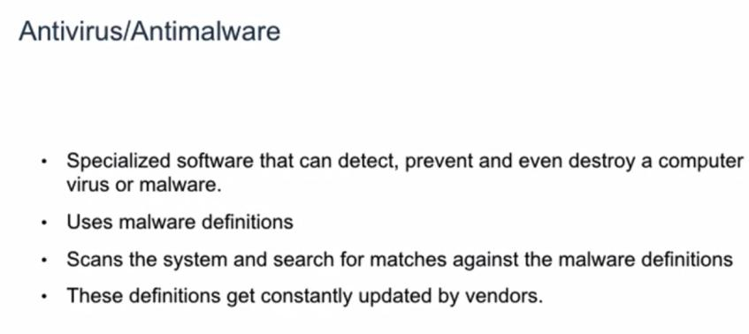

Slide 12
CRYPTOGRAPHY
Cryptography is an advanced mathematical approach to generate ciphers and encrypt the data
PlainText
CipherText
HIE
727369
Cryptographic Algorithm

Slide 13

Steganography
Steganography is the art of concealing information into transfer media such as images, audio and video files. Here we deal with image steganography
+ HIE

Slide 14
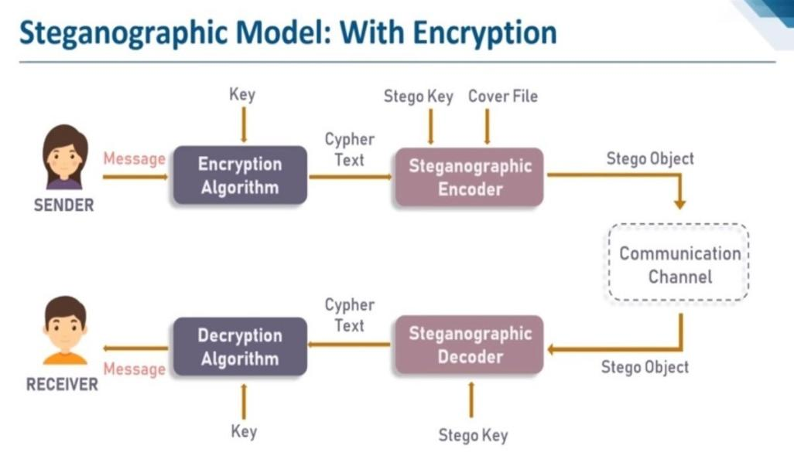

Slide 15
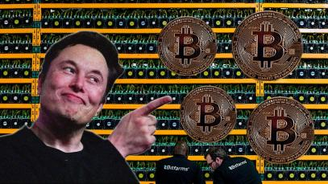
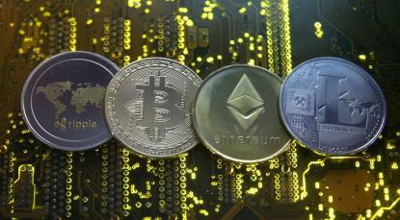
Crypto-Currency
Cryptocurrency is a type of digital currency that generally only exists electronically
Example : Bitcoin, Ethereum, etc.
Some people earn cryptocurrency through a complex process called “mining,” which requires advanced computer equipment to solve highly complicated math puzzles.

Slide 16
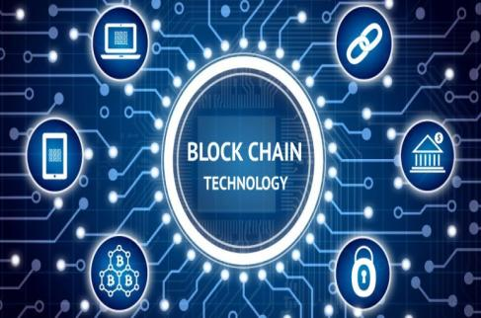
BLOCKCHAIN
Blockchain is a system of recording information in a way that makes it difficult or impossible to change, hack, or cheat the system
Blockchains store data in blocks that are then chained together.
As new data comes in it is entered into a fresh block. Once the block is filled with data it is chained onto the previous block, which makes the data chained together in chronological order

Slide 17
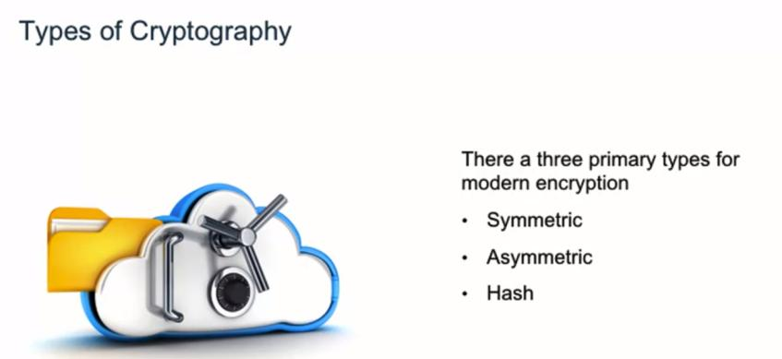

Slide 18
Symmetric Encryption : Symmetric-key algorithms are algorithms for cryptography that use the same cryptographic keys for both the encryption of plaintext and the decryption of cipher text
EX: AES, DES, TRIPLE-DES
Asymmetric Encryption : Public-key cryptography, or asymmetric cryptography, is a cryptographic system that uses pairs of keys
EX: Rivest Shamir Adleman (RSA), Digital Signature Standard (DSS), Elliptical Curve Cryptography (ECC)
Hash encryption : It is an algorithm that takes an arbitrary amount of data input—a credential—and produces a fixed-size output of enciphered text called a hash value, or just “hash.” That enciphered text can then be stored instead of the password itself, and later used to verify the use
EX: SHA1, SHA2, MD5

Slide 19
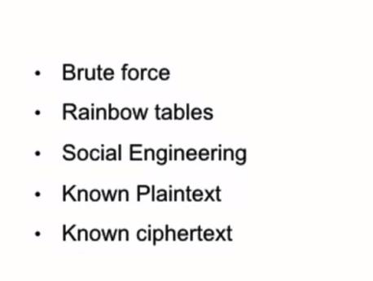
CRYPTOGRAPHIC ATTACKS:

Slide 20
Cloud computing
It is the on-demand availability of computer system resources, especially data storage and computing power, without direct active management by the user.
Types of Cloud
Public Cloud
Private Cloud
Hybrid Cloud

Slide 21
Services of Cloud
Iaas
Paas
Saas
Cloud security: Also known as cloud computing security, consists of a set of policies, controls, procedures and technologies that work together to protect cloud-based systems, data, and infrastructure.

Slide 22
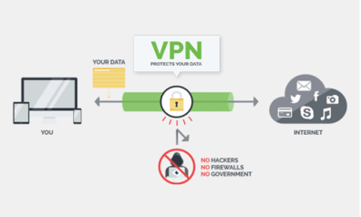
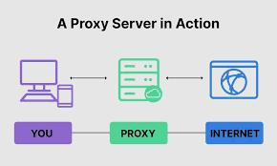
Virtual Private Networks and Proxies
A virtual private network, or VPN, is an encrypted connection over the Internet from a device to a network (secureTunnel)
A proxy server provides a gateway between users and the internet. It is a server, referred to as an “intermediary” because it goes between end-users and the web pages they visit online (gateWay)
Ex: Tunnelbear, NordVPN, ExpressVPN
Ex: SLLProxy, GatherProxy

Slide 23
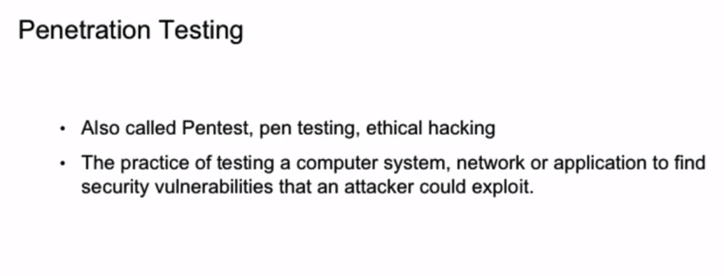

Slide 24
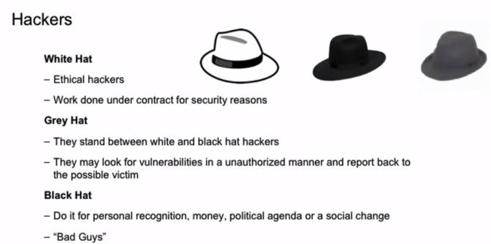
A Hacker is a threat actor who intends to penetrate into a system’s defenses either ethically or unethically with his/her own motive

Slide 25
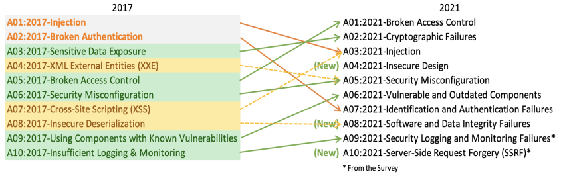
OWASP TOP 10
OPEN WEB APPLICATION SOFTWARE PROJECT

Slide 26
Firewall (Filters traffic)
A firewall is a network security device that monitors incoming and outgoing network traffic and decides whether to allow or block specific traffic based on a defined set of security rules
Types Of Firewalls
Packet filtering firewall
Circuit-level gateway
Application-level gateway (aka proxy firewall)
Stateful inspection firewall
Next-generation firewall (NGFW)

Slide 27
(IDS VS IPS)
Vulnerability Exploits
IDS
IPS
INTRUSION DETECTION SYSTEM | INTRUSION PREVENTION SYSTEM
IDS are detection and monitoring tools. | IPS is a control system
These tools do not take action on their own. | The control system accepts and rejects a packet based on the ruleset
IDS requires a human or another system to look at the results | IPS requires that the database gets regularly updated with new threat data.

Slide 28
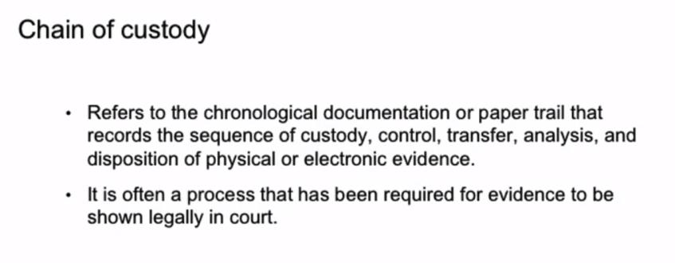

Slide 29
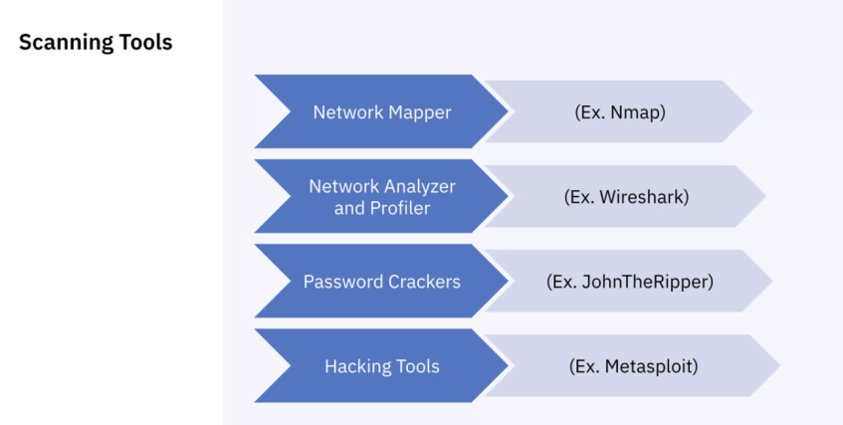

Slide 30
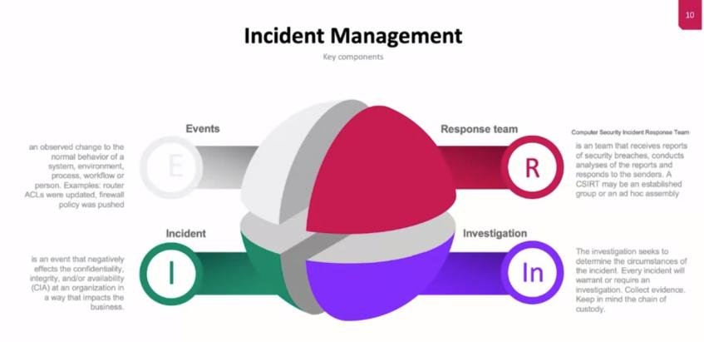

Slide 31
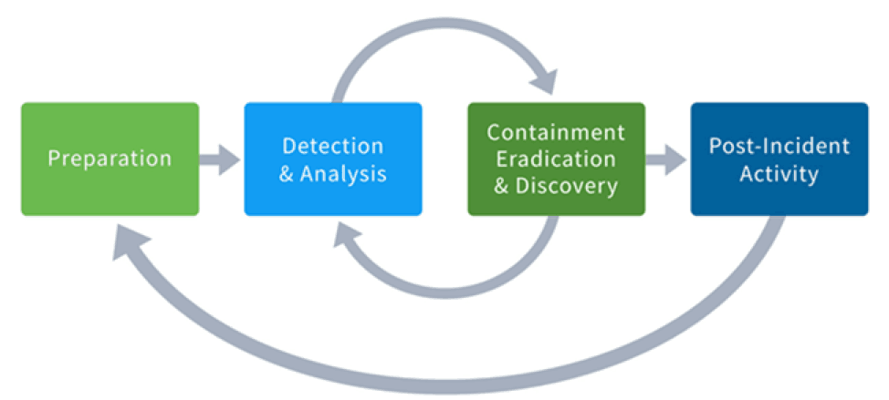
Incident management
Incident management is the process used by IT Operations teams to respond to an unplanned event or service interruption and restore the service to its operational state

Slide 32
Preparation:
Preparation is one of the most essential steps to an incident response plan because it determines how the IR team will respond to a myriad of incidents that may affect the organization.
Detection And Analysis:
During the identification phase, your IR team will need to identify threats from log alerts, IDS/IPS, firewalls, and any other suspicious activity occurring on the network. Once a threat has been identified, it should be documented and communicated per the policy established during the preparation phase
Containment:
Once a threat has been identified, the IR team should work to contain the threat to prevent further damage to other systems and the organization at large

Slide 33
Eradication:
Once the threat has been sufficiently contained, the IR team should work to implement a more permanent fix. The goal is to eliminate the entry point(s) that the threat actor used to obtain access to the network.
Recovery:
At the recovery stage, any production systems affected by a threat will be brought back online. This includes any data recovery or restoration efforts that need to take place as well.
Post-Incident Activity:
Finally, the IR team should finalize documentation from the incident investigation and remediation as well as supply a detailed report that reviews the entire incident response process. LESSONS LEARNT session has to be conducted.

Slide 34
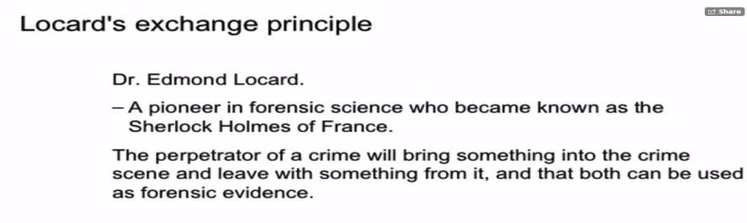
Digital forensics
Digital forensics, also known as computer and network forensics, is considered the application of science to the identification, collection, examination, and analysis of data while preserving the integrity of the information and maintaining a strict chain of custody for the data.

Slide 35
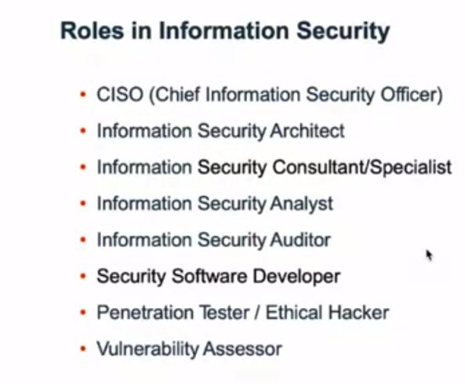

Slide 36
Courses and Certifications
IBM Cybersecurity Analyst : Coursera
Practical Ethical Hacking - The Complete Course : Udemy
Cisco Certified Network Associate(CCNA) : Cisco Systems
Advanced certifications:
CCNP
CCIE
OSCP

Slide 37
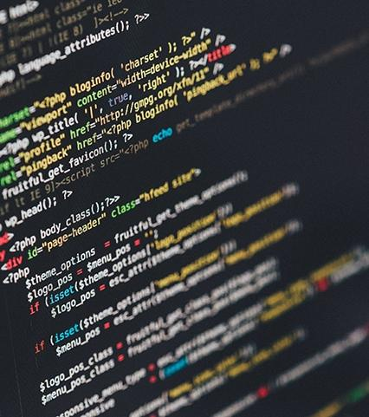


QUIZ
Kimitachi arigato

